Slide 1
Dr. Muhammad Ali-ur-Rasheed
Lecturer , Department of Physiotherapy.
Sargodha Medical College.

Slide 2
Sociological Perspective of profession

Slide 3
According to Ritzer, sociological literature about the professions takes three approaches
Structural
Processual (or process),
Power
Structural Approach :
Static characteristics that an occupation must possess to be considered a profession.
According to the classic definition of a profession includes at least four characteristics
a body of theoretical knowledge
some degree of professional autonomy
an ethic that the members enforce
and accountability to society

Slide 4
2.Process approach
The process approach focuses on either the stages and developmental periods that an occupation must pass through or activities that its members must perform to achieve recognition as a profession.

Slide 5
The social processes or developmental stages through which occupations move to attain the power and status that professions have traditionally held in society.
Central to this perspective is the recognition that an occupation can enhance its autonomy and professional status through social and political actions.
Much of the sociological literature about professions has emphasized autonomy as the sine qua non
(latin ,essential element)of a profession.
Those occupations with extensive autonomy in their work are considered “true professions”; those with less autonomy are either “semi-professions” or not professions at all.

Slide 6
3.Power approach
a profession’s ability to obtain the political and social power to define its work is its most important characteristic.
the use and abuse of power by the professions was accompanied by changes in public opinion regarding the professions
Scholars and members of the public criticized the professions for setting up economic monopolies, using political power for self interest, and focusing on professional autonomy and self-governance without consideration of the public welfare.
The requirement for licensure is one strategy for using political power to create an economic monopoly and decrease competition for members of a particular profession.

Slide 7
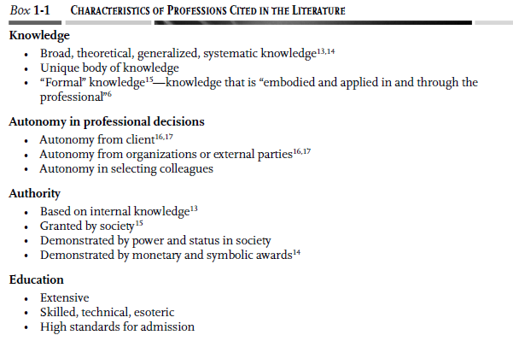

Slide 8
