Slide 1
Diabetic Retinopathy
By
Dr. Suhail Mushtaq Boobak
MBBS, DOMS, MCPS, ICO (UK), FCPS, FRCS (UK)
Associate Professor Ophthalmology
Sargodha Medical College, University of Sargodha

Slide 2
Most prevalent cause of legal blindness between the ages of 20 and 65 years.
Risk factors
1-Duration of diabetes
2-Poor metabolic control
3-Pregnancy
4-Hypertension
5-Nephropathy

Slide 3
Pathogenesis
Microangiopathy Microvascular occlusion
Leakage
1-Capillaropathy
2-Haematological changes
3-Microvascular occlusion—Results in capillary nonperfusion and retinal hypoxia
a- Arteriovenous shunts
b- Neovascularization

Slide 4
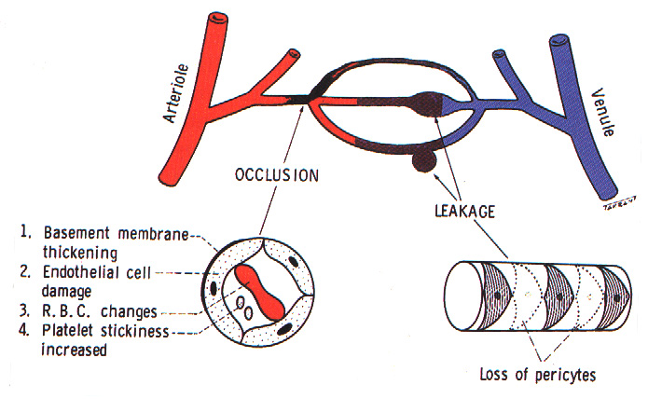
Pathogenesis of diabetic retinopathy

Slide 5
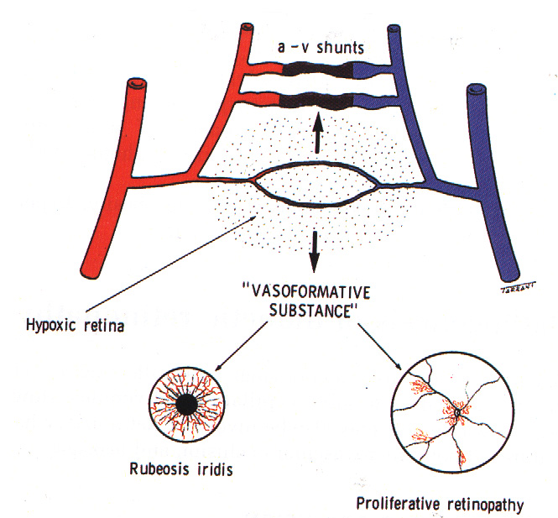
Consequences of retinal ischaemia

Slide 6
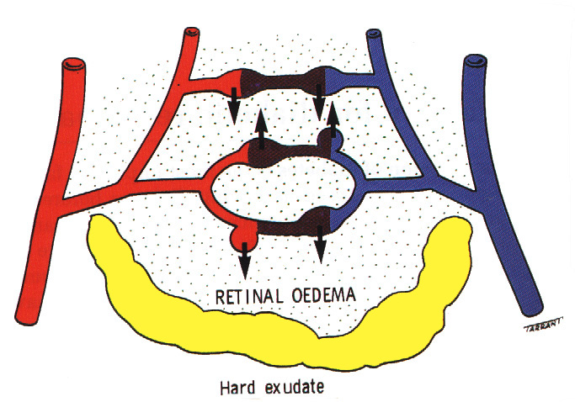
Consequences of chronic leakage

Slide 7
A-Classification
1-Background diabetic retinopathy
2-Diabetic maculopathy
3-Preproliferative diabetic retinopathy
4-Proliferative diabetic retinopathy
5-Adavaced diabetic retinopathy
B-ETDRS- Classification
a-Nonproleferative retinopathy
Mild,moderate,severe,very severe
b-Prolifrative
Without high-risk characteristics
With high-risk characteristics

Slide 8
cont.
c- Maculopathy
i-Clinically significant macular oedema(CSMO)
ii-Clinically non significant macular oedema(Non-CSMO).
d- Adavanced diabetic eye disease

Slide 9
Background DR
1-Microaneurysm-Tiny,red dots.
2-Retinal haemorrhages
a-Retinal NF layer haemorrhages
b-Intraretinal haemorrhages
3-Macular oedema-Retinal thicknening
4-Hard exudates-Waxy,yellow lesions

Slide 13
F.A
Hyperflorescence & Hypoflorescence
Treatment-
1-No treatment,reviewed annually
2-Control of DM and associated
factors

Slide 14
Diabetic maculopathy
Involvement of fovea by oedema,
hard exudates or ischaemia
1-Focal maculopathy
2-Diffuse maculopathy
3-Ishaemic maculopathy
4-Clinical significant macular oedema (CSMO)

Slide 18
Clinically Signicant Macular Oedema
Retinal oedema within500 micron of the centre of the macula
Hard exudates within 500 micron of the centre of the macula
associated with retinal thickening which may be outside the 500 micron
Retinal oedema 1 DD or larger any part of which is within 1DD of centre of the macula

Slide 21
Fluorescein angiography(F.A)
Hyperflorescence & Hypoflorescence
0ptical coherence tomography(OCT)
Treatment
1-Argon Laser photocoagulation
2-Anti- VEGF;Ranibizumab,Bevacizumab
3-Intavitreal steroid
4-Posterior sub-Tenon steroids
5- PPV

Slide 22
Preproliferative DR
1-Cotton- wool spots
small,whitish, fluffy lesions
2-Intra-retinal microvascular
abnormalities(IRMA)
Fine,irregular,red lines that
run from arteriol to venule
3-Venous & arteriol changes,blot
haemorrages

Slide 26
F.A
Hyperflorescence
Treatment
1-Laser treatment –If follow-up is
not possible
2-Max.Diabetic control & other
factors also

Slide 27
Proliferative DR
1-New vessels at disc (NVD)
2-New vessels elsewhere (NVE)
F.A
Hyperflorescence

Slide 31
Clinical assessment
1-Severity 2-Elevated new vessels
3-Fibfrosis 4-High risk factors
Treatment
1-Laser photocoagulation
2- Anti- VEGF;Ranibizumab,Bevacizumab

Slide 34
Advanced diabetic eye disease
1-Haemorrhage 2-Tractional RD
3-Rubeosis iridis
Treatment
1- Pars-plana vitrectomy
2- Retinal reattachment surgery

Slide 38
Thanks

