Slide 1
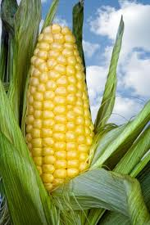

Slide 2
History and Origin
For western civilization, the story of maize began in 1492
Columbus's men discovered this new grain in Cuba
American native, it was exported to Europe than imported, as were other major grains
Maize first went to Europe

Slide 3
Within a few years, it spread throughout France
It also spread in Italy, and all of southeastern Europe and northern Africa
In 1575, it was making its way into western China
It become important in the Philippines and the East Indies

Slide 4
Crop botany.
Zea is a genus of the family Graminae (Poaceae), commonly known as the grass family.
Maize(Z. mays L.) is a tall, monecious annual grass
Overlapping sheaths and broad leaves

Slide 5
Plants have staminate spikelets in long spike
Spreading terminal panicles (tassels)
spikelets occur in 8 to 16 rows, approximately 30 long, on a thickened, almost woody axis (cob)

Slide 6
The whole structure (ear) is enclosed in numerous large foliaceous bracts
A mass of long styles (silks) protrude from the tip
Pollen is produced entirely in the staminate inflorescence
Eggs is produce entirely in the pistillate inflorescence

Slide 7
Maize is wind pollinated
Both self and cross pollination are usually possible
Shed pollen usually remains viable for 10 to 30 minutes
Can remain viable for longer durations under favorable conditions

Slide 8
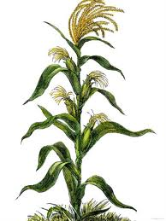
Maize.

Slide 9
Agro metrology
Maize is essentially a warm weather or kharif crop.
It is largely dependent upon the rains.
Three distinct seasons for the cultivation of maize .
Main season is kharif ; whereas its cultivation during rabi.
Higher yields have been recorded in the rabi and spring crop.

Slide 10
Higher yields are due to better water management
The lower is due to incidence of disease and pests
Mostly maize during kharif is sown with the break of monsoon
The actual dates varying from region to region

Slide 11
The late sowing of maize may extend up to late August in certain irrigated tracts of Punjab
Spring maize is sown in late January
End Rabi maize is generally sown in October to mid-November
Maize can grow from sea level to 3000 metre altitudes under diverse conditions

Slide 12
Maize does however, require considerable moisture and warmth from germination to flowering
The ideal temperature for germination is 21° C
For growth 32°C is suitable
50-75 cms of well-distributed rainfall is conducive to growth
It can be successfully grown where the night temperature does not go below 15.6ºC (60ºF)
It cannot withstand frost at any stage of its growth

Slide 13
Soil.
Requires fertile, deep and well-drained soils.
Can be grown on any type of soil, ranging from deep heavy clays to light-sandy ones.
pH of the soil should not deviate from the range 7.5 to 8.5.
At seedling stage, maize plants are highly susceptible to salinity and water-logging.

Slide 14
Provision of proper drainage is essential for the successful cultivation
Light-sandy soils greatly facilitate drainage, but have a relatively poor water-holding capacity
On very heavy soils, they have excellent water-holding capacity, relatively poor drainage.

Slide 15
Ideally suited soils for maize cultivation should have adequate water-holding capacity and good drainage
Over 85 per cent of the maize acreage is sown under rain-fed conditions during the monsoon
Alluvial soils are very suitable for growing maize crop

Slide 16
Economic Importance of Maize
Ranks 3rd after wheat and rice
Used as both as food for man and feed for animals
High yield potential than any other cereal
Sometimes referred to as “the miracle crop” or the ‘Queen of Cereals.’
In Pakistan, with the growth in demand of poultry feed the demand for maize is also going up.

Slide 17
Seedbed Preparation
Good seedbed for maize should be fine but compact
Well aerated, moist and free from weeds
It is desirable that the previous crop refuse is buried under with a mould-board plough
In due course, two or three ploughings with the wooden plough are given.

Slide 18
If tractor is used, one ploughing followed by a couple of diskings is generally adequate
No need of preparing extremely fine seedbed
The first ploughing for maize should be done with soil inverting plough
20-25 cm deep soil may become lose

Slide 19
It should be followed by two or three harrowings
Three or four intercrossing ploughings with local plough
Planking should be done with each ploughing
It is important that while preparing the field for maize, crop leveling must be done
Properly leveled field is necessary for good water management.

Slide 20
It is sown in rows,row to row 60-75 cm and plant to plant 20 to 25 cm
A population of 60-75 thousand plants per hectare for obtain the optimum yield
Sowing in rows is generally done with drill or by dropping the seed behind the plough
Practice of broadcasting, particularly under rain-fed conditions and for fodder maize is still present in several parts of the country.

Slide 21
Maize should be planted across the slope and the seed sown 3-5 cm deep
The planting depth to depend on the moisture status of the field and the type of soil
If the soil is dry and sandy, it is advisable to plant deeper

Slide 22
Normally planting is done in one of the following ways:
Planting on the side of the ridge: A method adopted in high rainfall situation
Planting in narrow furrows: A method adopted in low rainfall areas
Planting in flat bed with no earthing up: In normal conditions
Planting on flat bed and earthing up after 40-50 days of planting: In areas where is heavy storm during rainy season

Slide 23
Irrigation
Maize is susceptible both to excess water and moisture stress
Maize can withstand heavy rain, however the water should not be allowed to stand in the field any time during maize growth
Water stand even for as small period as six hours can destroy the crop
For kharif cultivation, it is essential that adequate drainage is provided

Slide 24
In regions with about 60 cm of well-distributed rainfall during the growing season, any additional irrigation is not necessary
A maize require about 460-600 ml of water during its life cycle

Slide 25
Critical stages of maize crop
Maize plants never wilt because of water shortage any time during their life cycle
Tasselling and silking stage is very crucial
At this stage water shortage for even two days can reduce maize yield by 20%
Inadequate soil moisture during flowering and post-flowering particularly during the grain-filling period markedly reduce the yield
During the grain filling period, the most susceptible stage, additional irrigation, if needed, should be applied

Slide 26
The total number of irrigations will depend on the rainfall-distribution pattern
Number of irrigations may vary from 5-10, depending upon the type of the soil and temperature.

Slide 27
Fertilizers management
Fertilizers and manure both play a critical role in maize cultivation
For obtaining high yields, the maize crop should be heavily manured .
Twenty-five to thirty cartloads of farmyard manure or compost should be ploughed into the soil before sowing
For hybrid and composite varieties of maize, 100-120 kg of nitrogen, along with 60 kg of P₂O₅ and 40 kg of K₂O per hectare, is recommended

Slide 28
Phosphorus and potash should be modified in the background of soil analysis
One-third of the nitrogen and total quantity of potash and phosphorus should be applied before sowing
Remaining nitrogen should be applied as side-dressing at the Knee-high stage and at tasselling in two equal doses

Slide 29
.
In freshly levelled fields and soils with very light texture, a soil application of 10-20 kg/ha of zinc sulphate before sowing has also given good results
Farmers planting local varieties may apply 40-60 kg of nitrogen to the soil per hectare.

Slide 30
Weeds of maize
Narrow leaved weeds:
Eleusine indica (L.) Gartn., Dactyloctinum aegyptium (L.) P. Beauv., Echinochloa crusgalli P. Beauv., Eragrostis major Host., Digitaria sanguinalis (L.) Scop., as narrow leaved
Broad leaved weeds:
weeds and Phyllanthus niruri L., Digera arvensis Frosk., Euphorbia hirta L., Boerhavia diffusa L. as broad leaved weeds.

Slide 31
Methods of weed control
Prevention - Practices that prevent the introduction, propagation, and spread of weeds. For example: destroying the weeds before they set seeds, planting weed-free seed, using clean equipment on the farm, and keeping the field margins clean to prevent weed invasion.
Cultural - Practices such as crop rotation, intercropping and mulching.
Manual - Practices whereby human energy is directly utilized to remove the weeds. This involves hand weeding using hoes or pangas, hand pulling, hand slashing and push-type weeders.

Slide 32
Controls:
Mechanical - Appropriate tillage equipment used for weed control, with animals or fossil fuel as the source of energy, e.g., drawn by donkeys, oxen or a tractor.
Chemical - The use of herbicides selected for the soil, crop, weeds and stage of crop development. For instance, after the maize seed has been planted, atrazine can be applied to kill the weeds before they emerge. Atrazine, applied as a pre-emergence herbicide, controls most annual broadleaf weeds and some annual grasses. It is only recommended for use on soil with more than 35% clay.

Slide 33
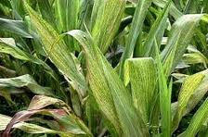

Slide 34
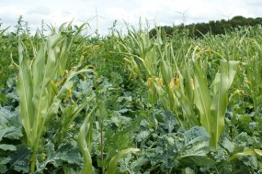

Slide 35
Insect Management
Maize stem borer is a single major insect problem which on the average will reduce the yield by about 10-30% under normal conditions. The loss may reach as high as 50%.
For protection apply 25 kg/ha of furadan 3% at sowing or with first irrigation.

Slide 36
Thrips
May damage crops that are stressed and not growing well. Infected plants may have a yellow or silvery patches on the leaves of young plants and a desiccated or wilted appearance. Look in the throat of individual maize plants for the presence of very small, brown/black insects measuring 1-2 mm in size. Control with insecticides. Check with your grain buyer as to which chemicals can be used for the particular target market.
Maize leafhopper
Are small, brownish, translucent insects with dark eyes that spring away (hop) rapidly when disturbed. More than 15 per plant can cause a disease-like condition known as Wallaby ear. Plant resistant varieties.

Slide 37
Black field earwigs
(Nala lividipes) are shiny black insects (up to 15 mm) with a pair of forceps or pincers at the rear end. The immature stages resemble adults but are wingless. They attack seeds, shoots, roots and stems at/or below ground level. Populations are regulated by soil moisture and serious damage is usually confined to soils that retain moisture well. Note: There are beneficial earwigs. These are usually larger and light brown in colour. Control earwigs with insecticidal grain bait.

Slide 38
Disease Management.
1. Bacterial Stalk Rot:
Causal organism:
Erwinia carotovora,
Symptoms
The basal internodes develop soft rot and give a water soaked appearance.
Ears and shank may also show rot.
They fail to develop further and the ears hang down.

Slide 39
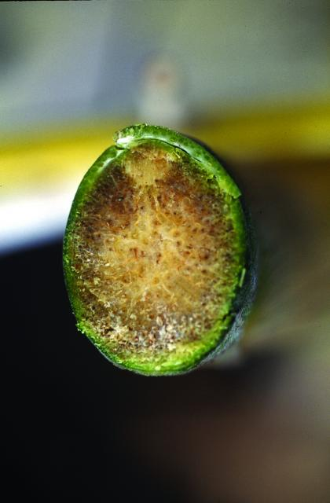
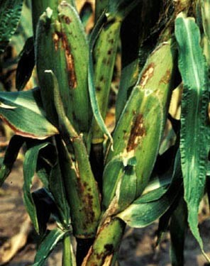

Slide 40
Control measures
Use of disease resistance varieties.
Avoid waterlogging and poor drainage.
2. Charcoal-Rot:
Causal organism:
Macrophamina phaseolina
Symptoms
The characteristic symptoms of the disease become apparent as the plants approach maturity.

Slide 41
The disease generally appears early after flowering.
Plants affected show evidence of pre-mature ripening.
The out sides of lower internodes become straw coloured.
The infected stalks may split longitudinally into a mass of fibres.
Control measures
Regular irrigations particularly during flowering time should be provided.

Slide 42
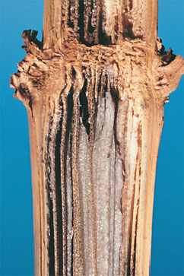

Slide 43
Use resistant varieties.
Field sanitation, crop rotation should be followed.
3. Common Rust:
Causal organism: Puccinia sorghi
Symptoms:
Circular to elongate golden brown powdery, erumpent pustules appear on both leaf surfaces.
As the crop matures brownish black pustules containing dark thick walled .

Slide 44
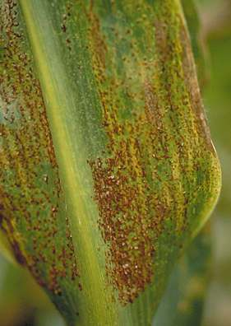
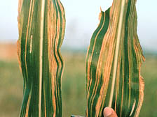

Slide 45
Control measures
Use resistant varieties.
Spray Mancozeb 2.5g/lit or Dithane M-45 spray can be taken (0.4%) as soon as first symptoms appear.
Sorghum downy mildew:
Symptoms
Malformation of tassels in infected plants.
Chlorosis, white stripes, stunting with downy fungal growth on both leaf surfaces

Slide 46
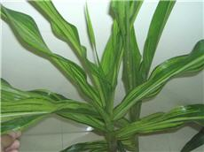

Slide 47
Control Measures
The eradication of wild hosts near maize field and rouging infected maize plants has been recommended.
Destruction of plant debris by deep ploughing and other methods.
Seed treatment with Metalaxyl at 4 g/kg and foliar spray of Mancozeb 2.5 g/l .
Use of resistant varieties

Slide 48
Harvesting
Maize crop is harvested when the husk has turned yellow
Grains are hard enough having not more than 20 per cent moisture
Appearance of the plant may be green
High yielding hybrids and composites whose grains are dry, while the stalk and leaves may be still green

Slide 49
Ears are removed from the standing crop
Harvested ears are dried in the sun before shelling
Late-sown crop, farmers prefer to harvest the whole plants and dry them, and the ears are removed later
Stalks are used as a cattle-feed and fuel
No part of the maize plant, even the cobs from which the grains have been removed, is left unused

Slide 50
Maize grown for fodder should be harvested at the milk to early-dough stage
Earlier harvested crop is likely to yield less and have a lower protein content
For silage, however, the late dough is preferred
Both power- and hand-operated low-priced maize shellers are available

Slide 51
Shellers are more efficient than hand-shelling or beating with sticks
Farmers using hybrid maize should not save their own seed for their next crop

Slide 52
Post harvesting
Ears should be dried, shelled and treated with an insecticide
Untreated seeds on ears are at times badly attacked by stored-grain pests
Germination is also reduced
Result in low yeild

Slide 53
Storage Of Maize
The maize store should be properly cleaned. Remove undesired grains, cobwebs, and any other material in the store where pests can hide
Preferably, the shelled maize can be stored in airtight containers to prevent pests from getting into the maize and destroying it.
Sort the maize before storage to remove any cobs that may be infested with weevils or moths.

Slide 54
Continued
Most of the maize that is harvested early or during the rains has a moisture content as high as 37 per cent. The farmer has to reduce by all means the moisture level to about 12 per cent before storage.
The maize should be spread on a tent on dry ground or paved, clean surface. All rotten maize cobs should removed and even those showing signs of weevil infestation.
Shelling is done by hand or power Sheller driven by electric current or tractors are available in the stat

Slide 55
Continued
After shelling, the grain can be dried for 2 to 3 days, cleaned and stored at 8 to 10 per cent moisture
Storing in airtight containers reduces damage due to insects and rodents
Ensure the maize that is still on the cob is properly dried in the sun before being stored. The cobs should be properly dried 48 hours after harvest
Diatomite can solve the problem. Diatomite is a powder with very sharp particles that pierces all insects on contact; this dehydrates the insects killing them. Unlike chemical pesticides, no insect can resist diatomite.

Slide 56
Varieties Yellow cultivars
Akbar
Nelam
Sultan
White type
Sadaf only (both for grain and fodder)
Early verity
Agaiti -72 (for spring and early maturity)

Slide 57
Yield
The yield levels depend upon the variety, the amount of the fertilizer used, the rainfall pattern, etc
Under irrigated conditions and recommended cultural practices, an average yield on 4 tonnes per hectare
Grain yield about one to 2.5 tonnes/ha is obtained
Grass yield about 60-75 t/ha

