Slide 1
Essential plant nutrients
Dr. Amjed Ali
Assistant Professor,
COA, UOS, 2020

Slide 2
Essential plant nutrients
Introduction
A total of only 17 elements are essential for the growth and full development of higher green plants according to the criteria laid down by Arnon and Stout (1939). These criteria are:
A deficiency of an essential nutrient makes it impossible for the plant to complete its life cycle.
Such deficiency is specific to the element in question and can be prevented or corrected only by supplying this element.
The element is involved directly in the nutrition of the plant.

Slide 3
Essential plant nutrients
Introduction
The essentiality of most micronutrients for higher plants was established between 1922 and 1954.
The essentiality of nickel (Ni) was established in 1987 by Brown et al., although there is no unanimity among the scientists as to whether Ni is essential or beneficial.
However, this list may not be considered as final and it is probable that more elements may prove to be essential in future.

Slide 4
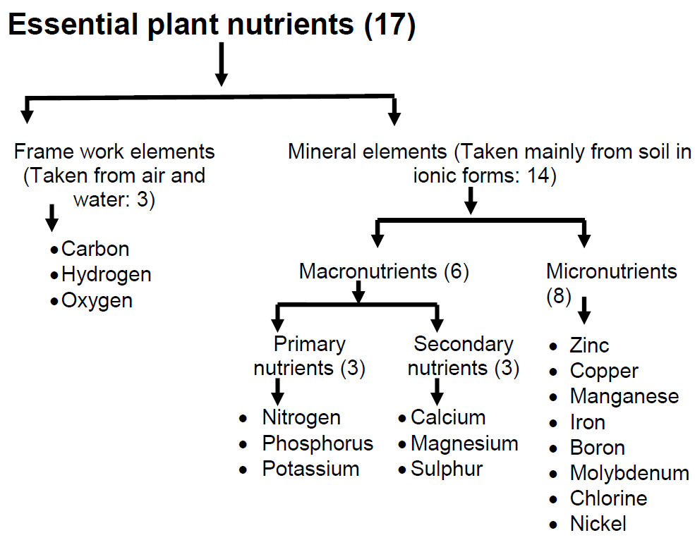
Essential plant nutrients
Classification of essential plant nutrients

Slide 5
Essential plant nutrients
Frame-work nutrient elements
Carbon (C) and oxygen (O) are obtained from the gas CO₂, and hydrogen (H) is obtained from water (H₂O).
These three elements are required in large quantities for the production of plant constituents such as cellulose or starch.
Hence, many times referred as frame-work elements.
Oxygen, carbon and hydrogen make up 95 percent of plant biomass, and the remaining 5 percent is made up by all other elements.

Slide 6
Essential plant nutrients
Mineral nutrient elements
14 elements are called mineral nutrients because they are taken up in mineral (inorganic) forms. They are traditionally divided into two groups, macronutrients and micronutrients, according to the relative amounts required.
The difference in plant concentration between macronutrients and micronutrients is enormous. The relative contents of N and molybdenum (Mo) in plants is in the ratio of 10,000:1. Plants need about 40 times more magnesium (Mg) than Fe.

Slide 7
Essential plant nutrients
Macronutrients
Macronutrients are nitrogen (N), phosphorus (P), potassium (K), calcium (Ca), magnesium (Mg), and sulphur (S).
N, P, and K are often referred to as primary nutrients and are the most common elements found in commercial fertilizers.
Ca, Mg, and S are referred to as secondary nutrients and are also found in fertilizers and soil amendments.

Slide 8
Essential plant nutrients
Micronutrients
Micronutrients include iron (Fe), manganese (Mn), zinc (Zn), boron (B), copper (Cu), chloride (Cl), molybdenum (Mo), and nickel (Ni).
Note: Cobalt (Co), sodium (Na), vanadium (V) and silicon (Si) are sometimes called as beneficial plant nutrients. They are not required by all plants but appear to benefit certain plants. Cobalt is required for nitrogen fixation in legumes. Silicon is found in plant cell walls and appears to produce tougher cells. This increases the resistance of these plants to piercing and sucking insects and decreases the spread of fungal diseases.

Slide 9
Essential plant nutrients
Typical concentrations of nutrient elements sufficient for plant growth
Element | Symbol | mg/kg | percent
Nitrogen | N | 15,000 | 1.5
Potassium | K | 10,000 | 1.0
Calcium | Ca | 5,000 | 0.5
Magnesium | Mg | 2,000 | 0.2
Phosphorus | P | 2,000 | 0.2
Sulphur | S | 1,000 | 0.1

Slide 10
Essential plant nutrients
Relative concentration of essential elements in plants
Some microelements can be toxic for plants at levels only somewhat higher than normal. In the majority of the cases this happens when the pH is low to very low.
Aluminium and manganese toxicity are the most frequent ones, in direct relation with acid soils. The concentration of different essential elements sufficient for plant growth are given in Table (Next slide).

Slide 11
Essential plant nutrients
Typical concentrations of nutrient elements sufficient for plant growth
Element | Symbol | mg/kg | percent
Chlorine | Cl | 100 | --
Iron | Fe | 100 | --
Boron | B | 20 | --
Manganese | Mn | 50 | --
Zinc | Zn | 20 | --
Copper | Cu | 6 | --
Molybdenum | Mo | 0.1 | --
Nickel | Ni | 0.1 | --

Slide 12
Essential plant nutrients
Classification of plant nutrients based on biochemical behaviour and physiological functions
Mengel and Kirkby (1987) have divided essential plant nutrients into four groups.
Group I includes C, H, O, N and S, which are major constituents of the organic plant materials (carbohydrates, proteins, fats, etc.).
Group II includes P and B, which are involved in biochemical reactions such as esterification.(mainly the reaction between alcohols and carboxylic acids to make esters. It also looks briefly at making esters from the reactions between acyl chlorides (acid chlorides) and alcohols, and between acid anhydrides and alcohols)

Slide 13
Group III includes K, Ca, Mg, Mn and Cl. These elements are present in the free ionic state or are adsorbed to indiffusible organic anions (e.g. absorption of Ca²⁺ by the carboxylic group of pectins).
Group IV includes Fe, Cu, Zn and Mo. These elements are predominantly presented as chelates in the plant. (Chelation describes a particular way that ions and molecules bind metal ions).

Slide 14
Essential plant nutrients
Classification of essential plant nutrients on the basis of biochemical and physiological functions in plants
Group | Nutrients | Form in which taken up by plants | Biochemical/physiological functions
I | C | CO₂, HCO₃⁻ | Major constituents of organic material, essential elements of atomic groups which are involved in enzymatic process, etc.
 | H | H₂O
 | O | O₂
 | N | NH₄⁺, NO₃⁻, N₂ (in fixation)
 | S | SO₄⁻², SO₂ (gaseous absorption in leaves
II | P | H₂PO₄⁻¹, HPO₄⁻² | Esterification with native plant alcohol. Phosphate esters are involved in energy transfer.
 | B | B(OH)₃

Slide 15
Essential plant nutrients
Classification of essential plant nutrients on the basis of biochemical and physiological functions in plants
Group | Nutrients | Form in which taken up by plants | Biochemical/physiological functions
III | K | K⁺ | Nonspecific functions, involved in establishing osmotic potential. Ca is a component of plant structural parts.
 | Mg | Mg⁺²
 | Ca | Ca⁺²
 | Mn | Mn⁺²
 | Cl | Cl⁻¹
IV | Fe | Fe⁺² | Present predominantly in a chelated form in prosthetic group, enable electron transport by valency change
 | Cu | Cu⁺²

