Slide 1
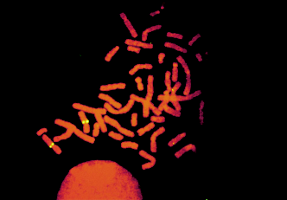
The Chromosomal Basis of Inheritance

Slide 2
Chromosomal Behavior
Mendelian inheritance has its physical basis in the behavior of chromosomes
The behavior of chromosomes during meiosis was said to account for Mendel’s laws of segregation and independent assortment
Several researchers proposed in the early 1900s that genes are located on chromosomes

Slide 3
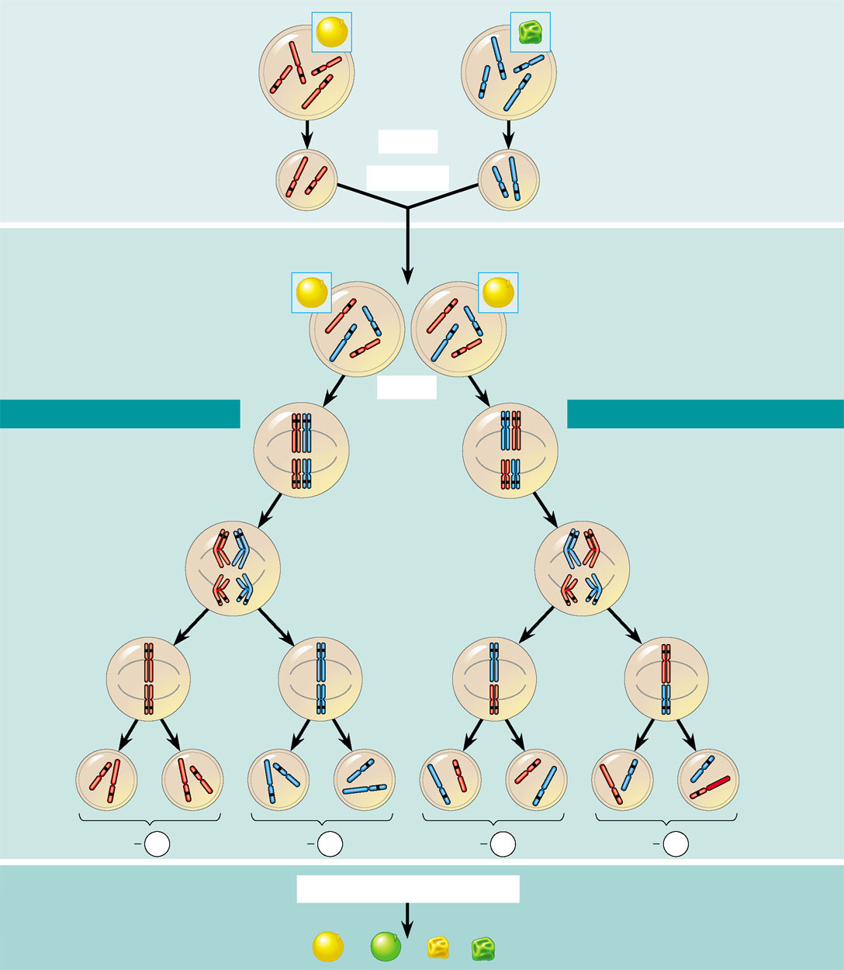
Chromosome Theory Of Inheritance
Mendelian genes have specific loci on chromosomes
Chromosomes undergo disjunction and independent assortment
P Generation
Yellow-round
seeds (YYRR)
Green-wrinkled
seeds (yyrr)
Starting with two true-breeding pea plants,
we follow two genes through the F₁ and F₂
generations. The two genes specify seed
color (allele Y for yellow and allele y for
green) and seed shape (allele R for round
and allele r for wrinkled). These two genes are
on different chromosomes. (Peas have seven
chromosome pairs, but only two pairs are
illustrated here.)
y
Y
r
Y
R
R
y
r
Meiosis
Y
Fertilization
y
r
Gametes
R
All F₁ plants produce
yellow-round seeds (YyRr)
F₁ Generation
R
y
R
y
r
r
Y
Meiosis
Y
LAW OF SEGREGATION
R
r
r
R
LAW OF INDEPENDENT ASSORTMENT
Two equally
probable
arrangements
of chromosomes
at metaphase I
Y
y
Y
y
1
1
Alleles at both loci segregate
in anaphase I, yielding four
types of daughter cells
depending on the chromosome
arrangement at metaphase I.
Compare the arrangement of
the R and r alleles in the cells on the left and right
The R and r alleles segregate
at anaphase I, yielding
two types of daughter
cells for this locus.
r
R
r
R
Anaphase I
Y
y
Y
y
2
R
r
r
R
Each gamete
gets one long
chromosome
with either the
R or r allele.
Metaphase II
2
Y
y
Each gamete gets
a long and a short
chromosome in
one of four allele
combinations.
y
y
Y
Y
Y
Y
Y
Y
y
y
Gametes
R
R
r
r
r
r
R
R
1
4
1
4
1
4
1
4
YR
yr
yr
yR
F₂ Generation
Fertilization among the F₁ plants
Fertilization results
in the 9:3:3:1
phenotypic ratio in
the F₂ generation.
3
3
Fertilization
recombines the
R and r alleles
at random.
9
: 3
: 3
: 1

Slide 4
Morgan’s Experimental Evidence
Thomas Hunt Morgan provided convincing evidence that chromosomes are the location of Mendel’s heritable factors
Morgan worked with fruit flies
Because they breed at a high rate
A new generation can be bred every two weeks
They have only four pairs of chromosomes

Slide 5
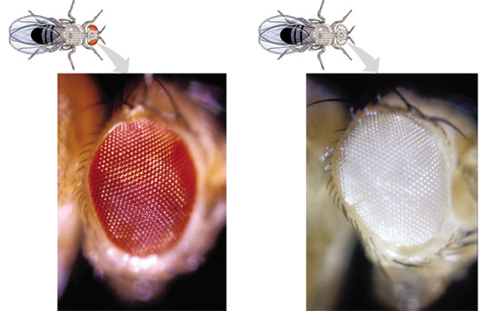
Morgan’s Experimental Evidence
Morgan first observed and noted wild type (normal), phenotypes that were common in the fly populations
Traits alternative to the wild type are called mutant phenotypes

Slide 6
Correlating the Behavior of a Gene’s Alleles with a Chromosome Pair
In one experiment Morgan mated male flies with white eyes (mutant) with female flies with red eyes (wild type)
The F1 generation all had red eyes
The F2 generation showed the 3:1 red:white eye ratio, but only males had white eyes
Morgan determined that the white-eye mutant allele must be located on the X chromosome

Slide 7
Sex Linkage
Sex in humans (and other organisms) is determined by genes located on a pair of chromosomes called the sex chromosomes
All other chromosomes are called autosomes.
Even though the sex chromosomes pair during synapsis, they are not homologous. The larger chromosome is called the X and the smaller is the Y.
In humans, XX is female and XY is male.

Slide 8
XY
XX
Parents
Parental Gametes
X
Y
X
X
X
Y
F₁ Offspring:
X
XX | XY
XX | XY
X

Slide 9
Sex-linked Traits
Other traits, besides sex, are controlled by genes on the sex chromosomes.
Traits controlled by the X are X-linked.
Traits controlled by the Y are Y-linked.
Since most sex-linked traits are controlled by the X, its assumed X-linkage
X-linked traits are an exception to Mendel’s laws because females have 2 alleles for each X-linked trait, but males have only 1.
In humans, hemophilia is caused by a recessive allele on the X chromosome.

Slide 10
Parents
X^{H}Y
X^{H}X^{h}
Parental Gametes
X^{H}
Y
X^{H}
X^{h}
X^{H}
Y
F₁ Offspring:
X^{H}
X^{H}X^{H} | X^{H}Y
X^{H}X^{h} | X^{h}Y
X^{h}

Slide 11
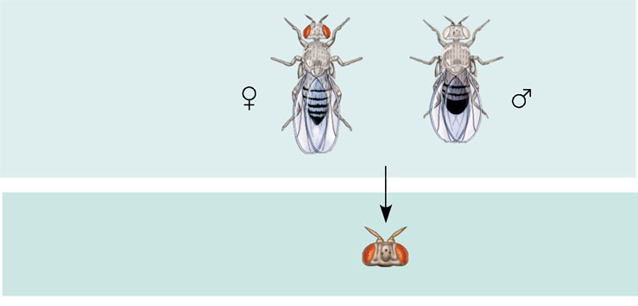
Morgan’s Experimental Evidence
EXPERIMENT
Morgan mated a wild-type (red-eyed) female
with a mutant white-eyed male. The F₁ offspring all had red eyes.
P
Generation
X
F₁
Generation
Morgan then bred an F₁ red-eyed female to an F₁ red-eyed male to
produce the F₂ generation.
RESULTS
The F₂ generation showed a typical Mendelian
3:1 ratio of red eyes to white eyes. However, no females displayed the
white-eye trait; they all had red eyes. Half the males had white eyes,
and half had red eyes.
F₂
Generation

Slide 12
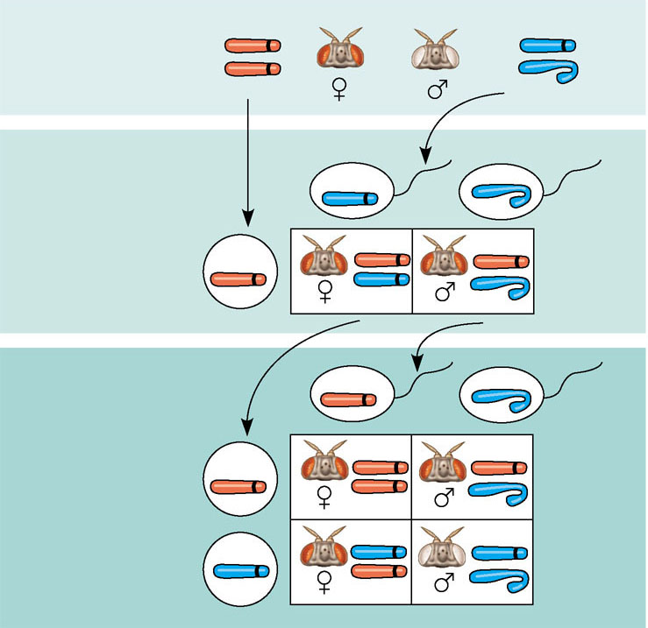
CONCLUSION
Since all F₁ offspring had red eyes, the mutant
white-eye trait (w) must be recessive to the wild-type red-eye trait (w⁺).
Since the recessive trait—white eyes—was expressed only in males in
the F₂ generation, Morgan hypothesized that the eye-color gene is
located on the X chromosome and that there is no corresponding locus
on the Y chromosome, as diagrammed here.
X
W⁺
X
W
P
Generation
X
X
Y
W⁺
Ova
(eggs)
W
Sperm
F₁
Generation
W⁺
W⁺
W⁺
W
Ova
(eggs)
W⁺
F₂
Generation
Sperm
W⁺
W⁺
W⁺
W⁺
W
W
W
W⁺

Slide 13
Morgan’s discovery
Transmission of the X chromosome in fruit flies correlates with inheritance of the eye-color trait
First solid evidence indicating that a specific gene is associated with a specific chromosome

Slide 14
Linked genes
Linked genes tend to be inherited together because they are located near each other on the same chromosome
Each chromosome has hundreds or thousands of genes
Morgan did other experiments with fruit flies to see how linkage affects the inheritance of two different characters

Slide 15
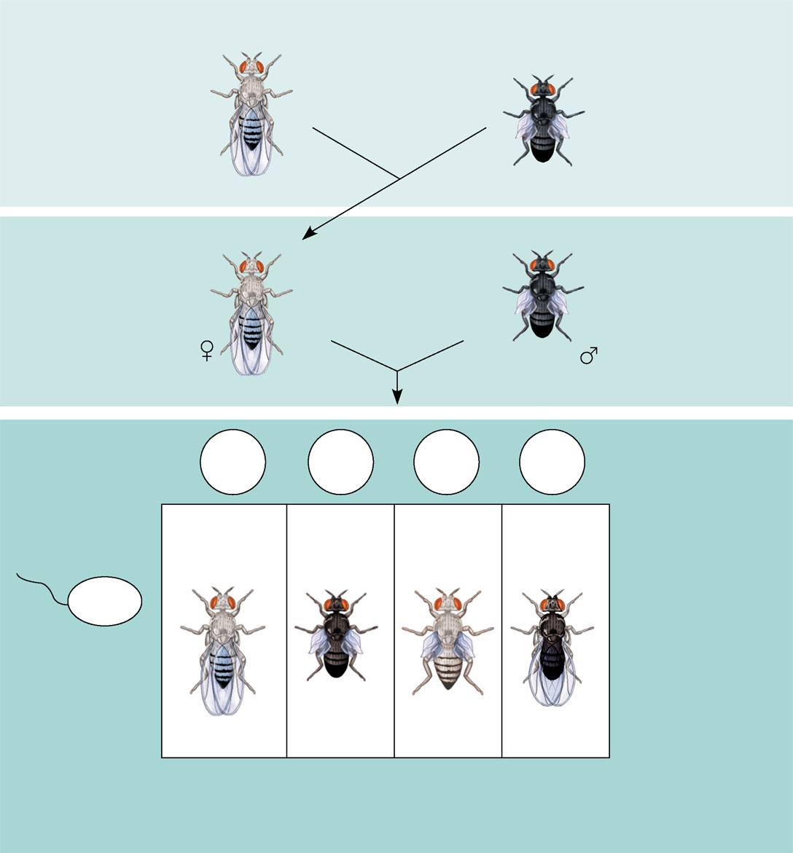
Morgan’s Dihybrid Cross
P Generation
(homozygous)
Double mutant
(black body,
vestigial wings)
EXPERIMENT
Morgan first mated true-breeding
wild-type flies with black, vestigial-winged flies to produce
heterozygous F₁ dihybrids, all of which are wild-type in
appearance. He then mated wild-type F₁ dihybrid females with black, vestigial-winged males, producing 2,300 F₂ offspring, which he “scored” (classified according to
phenotype).
Wild type
(gray body,
normal wings)
Double mutant
(black body,
vestigial wings)
x
b⁺ b⁺ vg⁺ vg⁺
b b vg vg
F₁ dihybrid
(wild type)
(gray body,
normal wings)
Double mutant
(black body,
vestigial wings)
TESTCROSS
Double mutant
(black body,
vestigial wings)
x
CONCLUSION
b b vg vg
If these two genes were on
different chromosomes, the alleles from the F₁ dihybrid
would sort into gametes independently, and we would
expect to see equal numbers of the four types of offspring.
If these two genes were on the same chromosome,
we would expect each allele combination, B⁺ vg⁺ and b vg,
to stay together as gametes formed. In this case, only
offspring with parental phenotypes would be produced.
Since most offspring had a parental phenotype, Morgan
concluded that the genes for body color and wing size
are located on the same chromosome. However, the
production of a small number of offspring with
nonparental phenotypes indicated that some mechanism
occasionally breaks the linkage between genes on the
same chromosome.
b⁺ b vg⁺ vg
RESULTS
b⁺vg⁺
b vg
b⁺ vg
b vg⁺
965
Wild type
(gray-normal)
944
Black-
vestigial
206
Gray-
vestigial
185
Black-
normal
b vg
Sperm
b⁺ b vg⁺ vg
b b vg vg
b⁺ b vg vg
b b vg⁺ vg
Parental-type
offspring
Recombinant (nonparental-type)
offspring

Slide 16
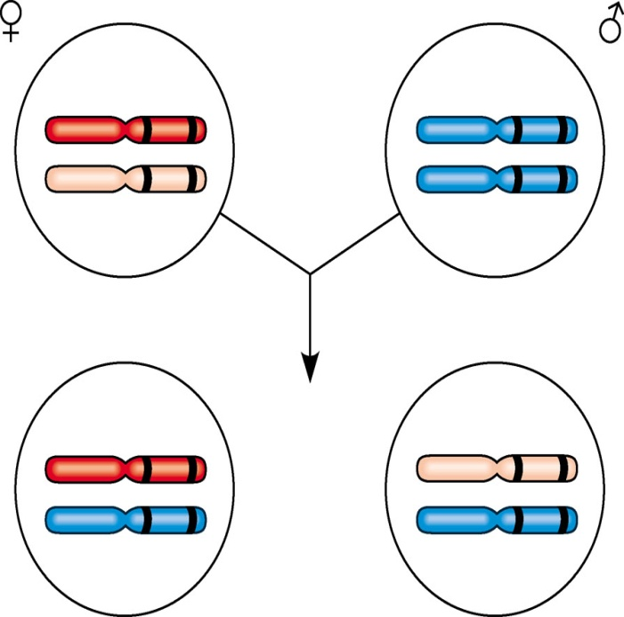
Morgan’s Conclusion
Genes that are close together on the same chromosome are linked and do not assort independently
Unlinked genes are either on separate chromosomes of are far apart on the same chromosome and assort independently
b⁺ vg⁺
b vg
X
Parents
in testcross
b vg
b vg
Most
offspring
b⁺ vg⁺
b vg
or
b vg
b vg

Slide 17
Unlinked genes
Located on different chromosomes assort independently:
B b
Y y
B
Y
B
y
b
Y
b
y
25%
25%
25%
25%

Slide 18
Linked genes
Located on the same chromosome often do NOT assort independently:
Parental type
B b
N n
Parental type
B
N
B
n
b
N
b
n
47%
5%
5%
43%
Recombinant types

Slide 19
Genetic Recombination and Linkage
Recombinant offspring are those that show new combinations of the parental traits
Morgan discovered that genes can be linked but due to the appearance of recombinant phenotypes, the linkage appeared incomplete
Morgan proposed that some process must occasionally break the physical connection between genes on the same chromosome
Crossing over of homologous chromosomes was the mechanism

Slide 20
Recombinant Types
Produced when a crossover occurs between the 2 genes being studied:
a
A
A
a
A
a
A
a
B
b
B
b
B
b
B
b
Recombinant types
Non recombinant types

Slide 21
Genetic Maps
Because crossovers occur along the length of a chromosome at random, the farther apart 2 genes are, the larger the chance a crossover will occur between them, and the higher the frequency of recombinant types.
Therefore, the frequency of recombinant types can be used to construct genetic maps:

Slide 22
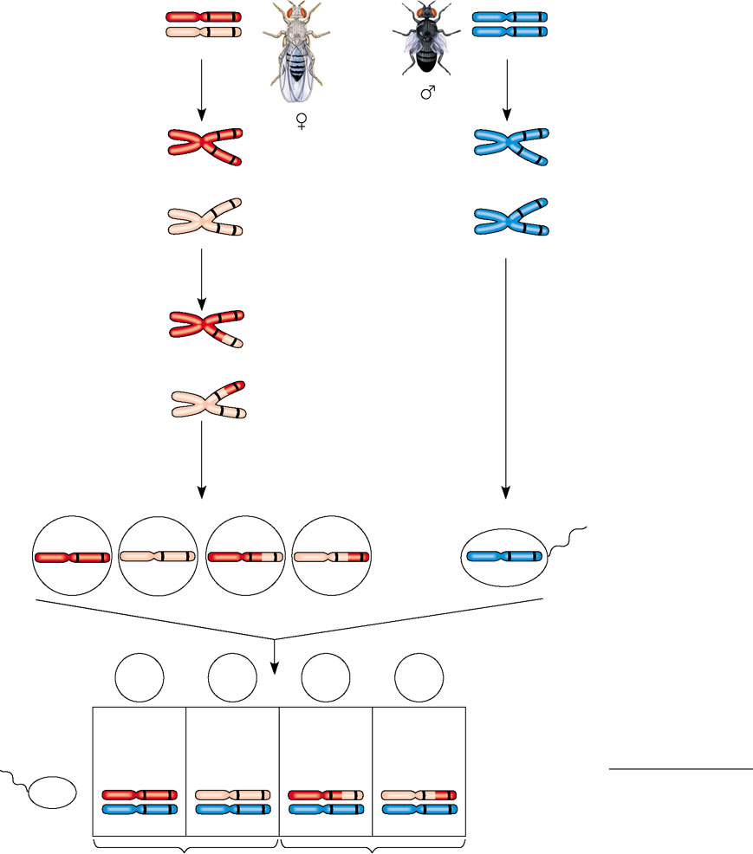
Linked genes
Exhibit recombination frequencies less than 50%
Testcross
parents
Gray body,
normal wings
(F₁ dihybrid)
b⁺
vg⁺
b vg
Black body, vestigial wings (double mutant)
b
vg
×
b vg
Replication of
chromosomes
Replication of
chromosomes
vg
vg
b⁺
b
b⁺
b
vg⁺
vg
b
vg
b
vg
Meiosis I: Crossing
over between b and vg
loci produces new allele
combinations.
b
vg
b vg
Meiosis II: Segregation
of chromatids produces
recombinant gametes
with the new allele
combinations.
Meiosis I and II:
Even if crossing over
occurs, no new allele
combinations are
produced.
Recombinant
chromosome
Gametes
Ova
Sperm
b⁺vg⁺
b vg
b⁺ vg
b vg⁺
b vg
Testcross
offspring
b⁺ vg⁺
b vg
b⁺ vg
b vg⁺
Ova
Sperm
965
Wild type
(gray-normal)
944
Black-
vestigial
206
Gray-
vestigial
185
Black-
normal
b⁺ vg⁺
b vg⁺
b⁺ vg⁺
b vg⁺
Recombination
frequency
=
391 recombinants
×
100 = 17%
b vg
2,300 total offspring
b vg
b vg
b vg
b vg
Parental-type offspring
Recombinant offspring

Slide 23
Linkage Mapping: Using Recombination Data
A genetic map
Is an ordered list of the genetic loci along a particular chromosome
Can be developed using recombination frequencies
A linkage map
Is the actual map of a chromosome based on recombination frequencies

Slide 24
Map Units
The farther apart genes are on a chromosome the more likely they are to be separated during crossing over
2 genes on the same chromosome can be located so far apart that the frequency of recombinant types reaches 50%
Same as for genes located on different chromosomes.
These genes will assort independently, even though they are on the same chromosome.

Slide 25
Genetic Maps Units
One map unit is defined as the distance between 2 genes that will produce 1% recombinant types.
What is the distance in map units between the 2 gene loci Morgan studied:
b+b vg+vg | b+b vgvg | bb vg+vg | bb vgvg
47% | 5% | 5% | 43%
b+b vgvg + bb vg+vg = 10% = 10 map units

Slide 26
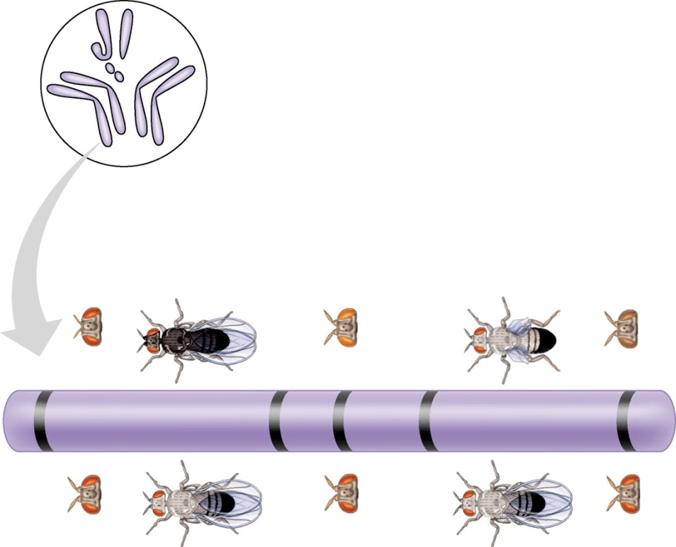
Genetic Mapping
Many fruit fly genes were mapped initially using recombination frequencies
I
Y
X
IV
II
III
Mutant phenotypes
Short
aristae
Black
body
Cinnabar
eyes
Vestigial
wings
Brown
eyes
0
48.5
57.5
67.0
104.5
Long aristae
(appendages
on head)
Gray
body
Red
eyes
Normal
wings
Red
eyes
Figure 15.8
Wild-type phenotypes

Slide 27
Abnormal Chromosome Number or Structure
Alterations of chromosome number or structure cause some genetic disorders
Large-scale chromosomal alterations often lead to spontaneous abortions (miscarriages) or cause a variety of developmental disorders

Slide 28
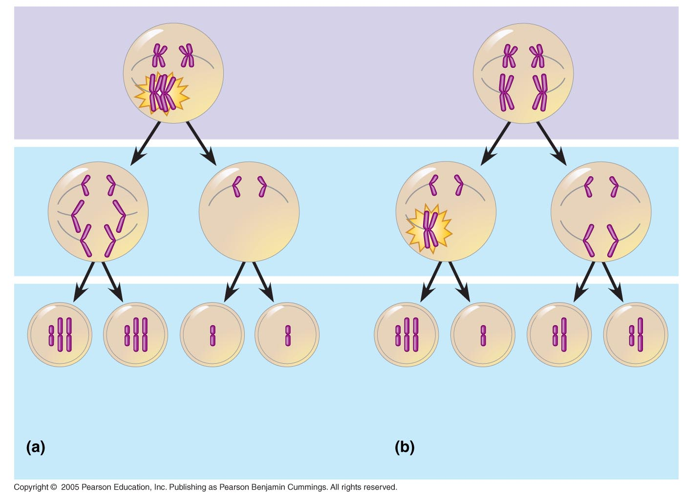
Abnormal Chromosome Number
In nondisjunction, pairs of homologous chromosomes do not separate normally during meiosis
As a result, one gamete receives two of the same type of chromosome, and another gamete receives no copy
Meiosis I
Nondisjunction
Meiosis II
Nondisjunction
Gametes
n + 1
n + 1
n – 1
n – 1
n + 1
n – 1
n
n
Number of chromosomes
Nondisjunction of homologous
chromosomes in meiosis I
Nondisjunction of sister
chromatids in meiosis I

Slide 29
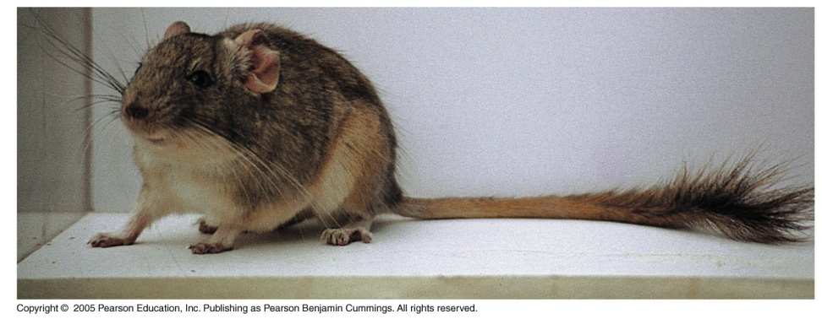
Aneuploidy
Aneuploidy results from the fertilization of gametes in which nondisjunction occurred
Offspring with this condition have an abnormal number of a particular chromosome
A trisomic zygote has three copies of a particular chromosome
A monosomic zygote has only one copy of a particular chromosome
Polyploidy is a condition in which an organism has more than two complete sets of chromosomes

Slide 30
Aneuploidy
Some types of aneuploidy appear to upset the genetic balance less than others, resulting in individuals surviving to birth and beyond
These surviving individuals have a set of symptoms, or syndrome, characteristic of the type of aneuploidy

Slide 31
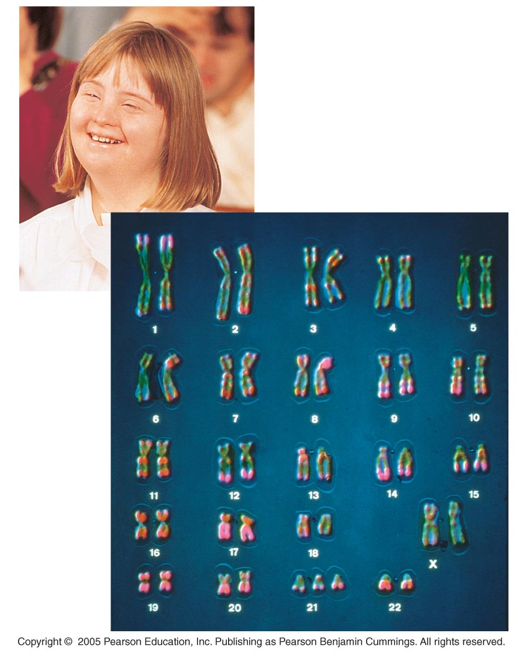
Down Syndrome
Down syndrome is an aneuploid condition that results from three copies of chromosome 21
It affects about one out of every 700 children born in the United States
The frequency of Down syndrome increases with the age of the mother, a correlation that has not been explained

Slide 32
Aneuploidy of Sex Chromosomes
Nondisjunction of sex chromosomes produces a variety of aneuploid conditions
Klinefelter syndrome is the result of an extra chromosome in a male, producing XXY individuals
These individuals have male sex organs, but have abnormally small testes and are sterile.
Although the extra X is inactivated, some breast enlargement and other female characteristics are common.
Monosomy X, called Turner syndrome, produces X0 females, who are sterile; it is the only known viable monosomy in humans

Slide 33
Alterations of Chromosome Structure
Breakage of a chromosome can lead to four types of changes in chromosome structure:
Deletion removes a chromosomal segment
Duplication repeats a segment
Inversion reverses a segment within a chromosome
Translocation moves a segment from one chromosome to another

Slide 34
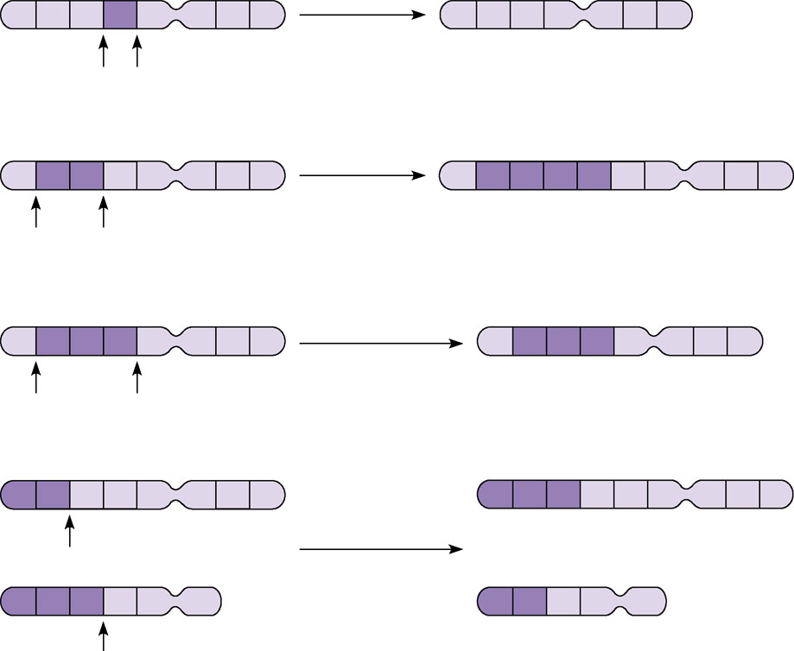
Alterations of chromosome structure
(a) A deletion removes a chromosomal
segment.
A
B
C
D
E
F
G
H
Deletion
A
B
C
E
F
G
H
A
B
C
D
E
F
G
H
Duplication
A
B
C
B
C
D
E
F
G
H
(b) A duplication repeats a segment.
A
B
C
D
E
F
G
H
Inversion
A
D
C
B
E
F
G
H
(c) An inversion reverses a segment within
a chromosome.
(d) A translocation moves a segment from one chromosome to another,
nonhomologous one. In a reciprocal
translocation, the most common type,
nonhomologous chromosomes exchange
fragments. Nonreciprocal translocations
also occur, in which a chromosome
transfers a fragment without receiving a
fragment in return.
A
B
C
D
E
F
G
H
M
N
O
C
D
E
F
G
H
Reciprocal
translocation
M
N
O
P
Q
R
A
B
P
Q
R
Figure 15.14a–d

Slide 35
Alterations of Chromosome Structure
One syndrome, cri du chat (“cry of the cat”), results from a specific deletion in chromosome 5
A child born with this syndrome is mentally retarded and has a catlike cry; individuals usually die in infancy or early childhood
Certain cancers, including chronic myelogenous leukemia (CML), are caused by translocations of chromosomes
Normal chromosome 9
Reciprocal
translocation
Translocated chromosome 9
Philadelphia
chromosome
Normal chromosome 22
Translocated chromosome 22

