Slide 1
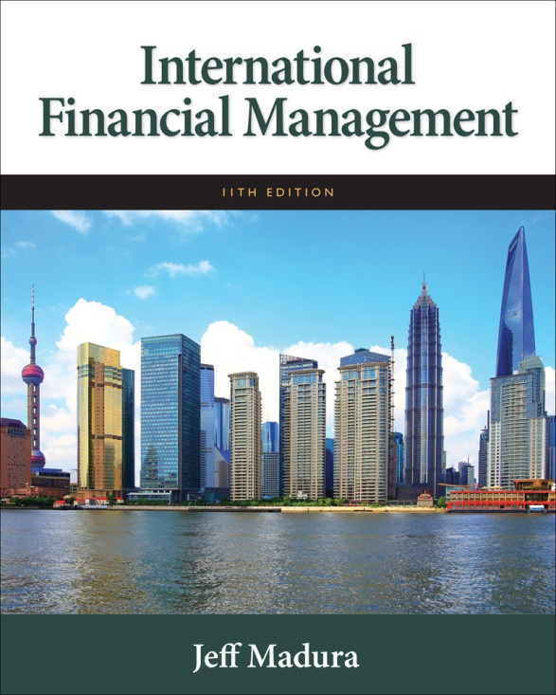

Slide 2
7
International Arbitrage And Interest Rate Parity
Chapter Objectives
Explain the conditions that will result in various forms of international arbitrage and the realignments that will occur in response
Explain the concept of interest rate parity
Explain the variation in forward rate premiums across maturities and over time
2

Slide 3
International Arbitrage
Defined as capitalizing on a discrepancy in quoted prices by making a riskless profit.
Arbitrage will cause prices to realign.
Three forms of arbitrage:
Locational arbitrage
Triangular arbitrage
Covered interest arbitrage

Slide 4
Locational Arbitrage
Defined as the process of buying a currency at the location where it is priced cheap and immediately selling it at another location where it is priced higher. (See Exhibit 7.1)
Gains from locational arbitrage are based on the amount of money used and the size of the discrepancy. (See Exhibit 7.2)
Realignment due to locational arbitrage drives prices to adjust in different locations so as to eliminate discrepancies.

Slide 5
Exhibit 7.1 Currency Quotes for Locational Arbitrage Example
5

Slide 6
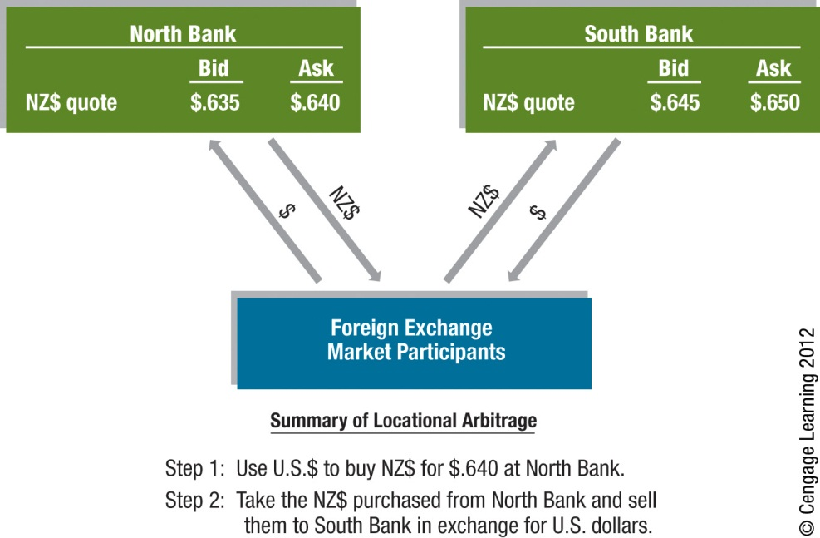
Exhibit 7.2 Locational Arbitrage
6

Slide 7
Triangular Arbitrage
Defined as currency transactions in the spot market to capitalize on discrepancies in the cross exchange rates between two currencies. (See Exhibits 7.3, 7.4, & 7.5)
Accounting for the Bid/Ask Spread: Transaction costs (bid/ask spread) can reduce or even eliminate the gains from triangular arbitrage.
Realignment due to triangular arbitrage forces exchange rates back into equilibrium. (See Exhibit 7.6)

Slide 8
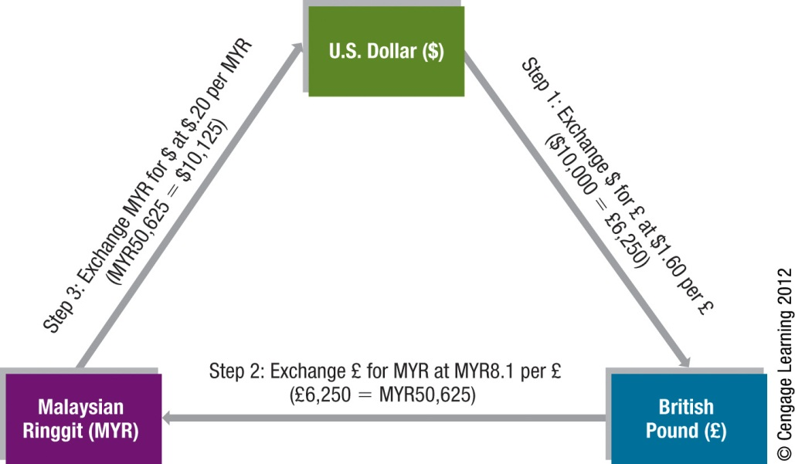
Exhibit 7.3 Example of Triangular Arbitrage
8

Slide 9
Exhibit 7.4 Currency Quotes for a Triangular Arbitrage Example
9

Slide 10
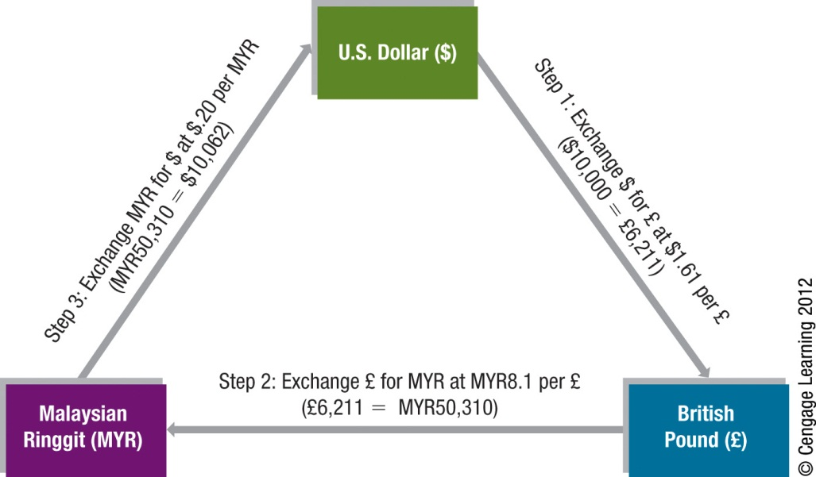
Exhibit 7.5 Example of Triangular Arbitrage Accounting for Bid/Ask Spreads
10

Slide 11
Exhibit 7.6 Impact of Triangular Arbitrage
11

Slide 12
Covered Interest Arbitrage
Defined as the process of capitalizing on the interest rate differential between two countries while covering your exchange rate risk with a forward contract.
Consists of two parts: (See Exhibit 7.7)
Interest arbitrage: the process of capitalizing on the difference between interest rates between two countries.
Covered: hedging the position against interest rate risk.
Realignment due to covered interest arbitrage causes market realignment.
Timing of realignment may require several transactions before realignment is completed.

Slide 13
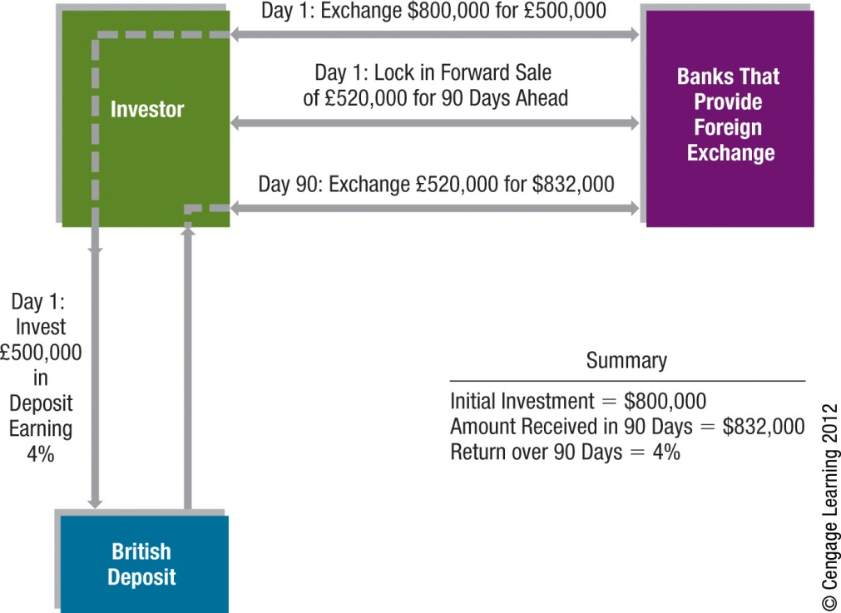
Exhibit 7.7 Example of Covered Interest Arbitrage
13

Slide 14
Comparison of Arbitrage Effects
The threat of locational arbitrage ensures that quoted exchange rates are similar across banks in different locations.
The threat of triangular arbitrage ensures that cross exchange rates are properly set.
The threat of covered interest arbitrage ensures that forward exchange rates are properly set. Any discrepancy will trigger arbitrage, which should eliminate the discrepancy.
Thus, arbitrage tends to allow for a more orderly foreign exchange market.

Slide 15
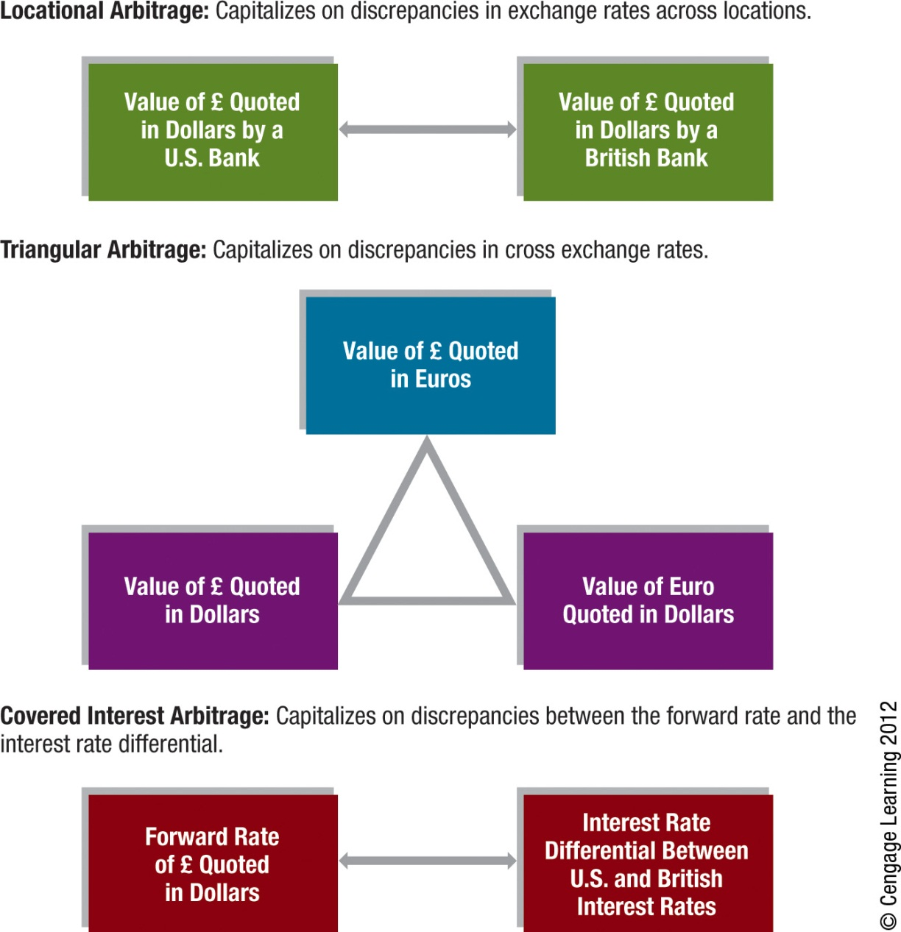
Exhibit 7.8 Comparing Arbitrage Strategies
15

Slide 16
Interest Rate Parity
In equilibrium, the forward rate differs from the spot rate by a sufficient amount to offset the interest rate differential between two currencies.

Slide 17
Determining the Forward Premium
The relationship between the forward premium (or discount) and the interest rate differential according to IRP is simplified in an approximated form:

Slide 18
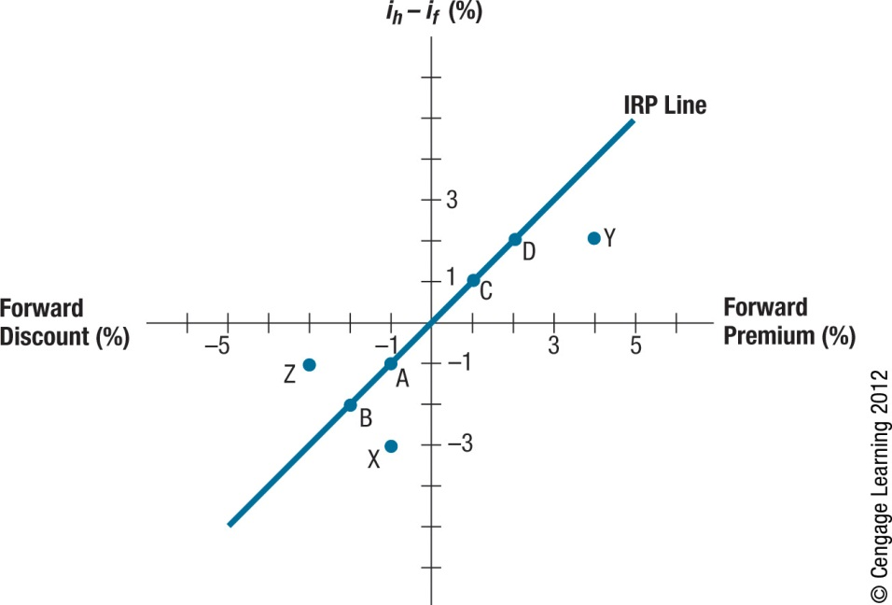
Exhibit 7.9 Comparing Arbitrage Strategies
18

Slide 19
Interpreting Exhibit 7.9 Illustration of Interest Rate Parity
Points representing a discount: points A and B
Points representing a premium: points C and D
Points representing IRP: points A, B, C, D
Points below the IRP line: points X and Y
Investors can engage in covered interest arbitrage and earn a higher return by investing in foreign currency after considering foreign interest rate and forward premium or discount.
Points above the IRP line: point Z
U.S. investors would achieve a lower return on a foreign investment than on a domestic one.
19
Notes:
19

Slide 20
Interpreting Exhibit 7.9 Illustration of Interest Rate Parity (Cont.)
How to Test Whether Interest Rate Parity Exists
The location of the points provides an indication of whether covered interest arbitrage is worthwhile.
For points to the right of the IRP line, investors in the home country should consider using covered interest arbitrage, since a return higher than the home interest rate (i_{h}) is achievable.
Of course, as investors and firms take advantage of such opportunities, the point will tend to move toward the IRP line.
Covered interest arbitrage should continue until the interest rate parity relationship holds.
20
Notes:
20

Slide 21
More on Interest Rate Parity
Interpretation of Interest Rate Parity
Interest rate parity does not imply that investors from different countries will earn the same returns.
Does Interest Rate Parity Hold?
Compare the forward rate (or discount) with interest rate quotations occurring at the same time. Due to limitations in access to data, it is difficult to obtain quotations that reflect the same point in time.
21
Notes:
21

Slide 22
Considerations When Assessing Interest Rate Parity
Transaction costs
The actual point reflecting the interest rate differential and forward rate premium must be farther from the IRP line to make covered interest arbitrage worthwhile. (See Exhibit 7.10)
Political risk
A crisis in the foreign country could cause its government to restrict any exchange of the local currency for other currencies.
Differential tax laws
Covered interest arbitrage might be feasible when considering before-tax returns but not necessarily when considering after-tax returns.

Slide 23
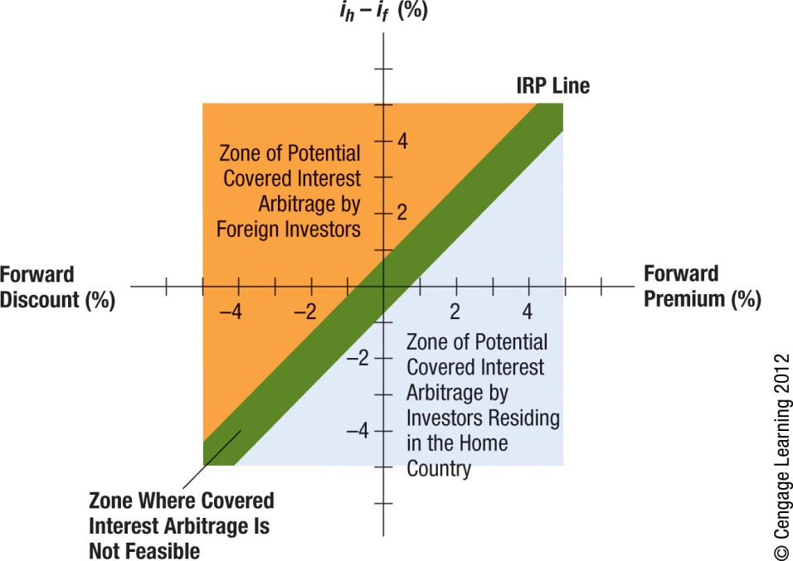
Exhibit 7.10 Potential for Covered Interest Arbitrage When Considering Transaction Costs
23

Slide 24
Variation in Forward Premiums
Forward Premiums across Maturities
The annualized interest rate differential between two countries can vary among debt maturities, and so will the annualized forward premiums.(See Exhibit 7.11)
Changes in Forward Premiums over Time
Exhibit 7.12 illustrates the relationship between interest rate differentials and the forward premium over time, when interest rate parity holds. The forward premium must adjust to existing interest rate conditions if interest rate parity holds.
Explaining Changes in the Forward Rate
The forward rate is indirectly affected by all the factors that can affect the spot rate (S) over time, including inflation differentials, interest rate differentials, etc. The change in the forward rate can also be due to a change in the premium.

Slide 25
Exhibit 7.11 Quoted Interest Rates for Various Times to Maturity
25

Slide 26
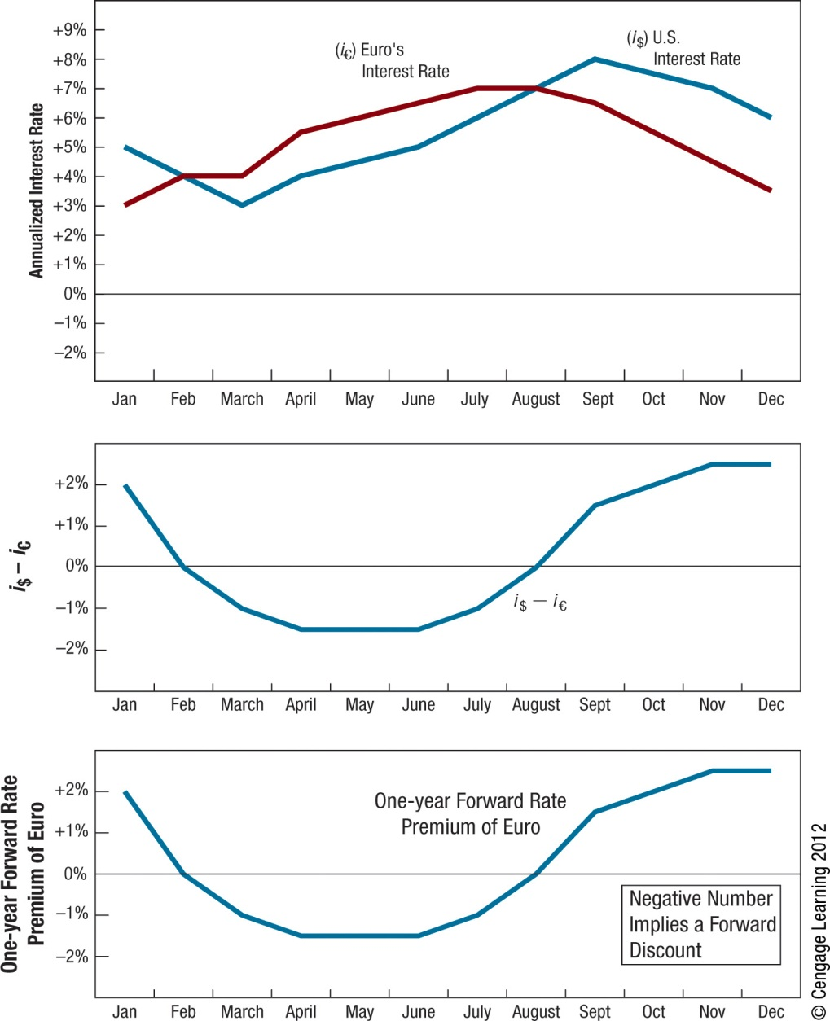
Exhibit 7.12 Relationship between the Interest Rate Differential and the Forward Premium
26

Slide 27
SUMMARY
Locational arbitrage may occur if foreign exchange quotations differ among banks. The act of locational arbitrage should force the foreign exchange quotations of banks to become realigned, and locational arbitrage will no longer be possible.
Triangular arbitrage is related to cross exchange rates. A cross exchange rate between two currencies is determined by the values of these two currencies with respect to a third currency. If the actual cross exchange rate of these two currencies differs from the rate that should exist, triangular arbitrage is possible. The act of triangular arbitrage should force cross exchange rates to become realigned, at which time triangular arbitrage will no longer be possible.

Slide 28
SUMMARY (Cont.)
Covered interest arbitrage is based on the relationship between the forward rate premium and the interest rate differential. The size of the premium or discount exhibited by the forward rate of a currency should be about the same as the differential between the interest rates of the two countries of concern. In general terms, the forward rate of the foreign currency will contain a discount (premium) if its interest rate is higher (lower) than the U.S. interest rate.
If the forward premium deviates substantially from the interest rate differential, covered interest arbitrage is possible. In this type of arbitrage, a foreign short term investment in a foreign currency is covered by a forward sale of that foreign currency in the future. In this manner, the investor is not exposed to fluctuation in the foreign currency’s value.

Slide 29
SUMMARY (Cont.)
Interest rate parity (IRP) is a theory that states that the size of the forward premium (or discount) should be equal to the interest rate differential between the two countries of concern. When IRP exists, covered interest arbitrage is not feasible because any interest rate advantage in the foreign country will be offset by the discount on the forward rate. Thus, the act of covered interest arbitrage would generate a return that is no higher than what would be generated by a domestic investment.

Slide 30
SUMMARY (Cont.)
Because the forward premium of a currency from a U.S. perspective is influenced by the interest rate of that currency and the U.S. interest rate and because those interest rates change over time, the forward premium changes over time. Thus the forward premium may be large and positive in one period when the interest rate of that currency is relatively low, but it could become negative (reflecting a discount) if that interest rate rises above the U.S. interest rate.

