Slide 1
Calvin Cycle
Has Three Stages: Carboxylation, Reduction, and Regeneration

Slide 2
Calvin Cycle
In the Calvin cycle, CO2 and water from the environment are enzymatically combined with a five-carbon acceptor molecule to generate two molecules of a three-carbon intermediate. This intermediate (3-phosphoglycerate) is reduced to carbohydrate by use of the ATP and NADPH generated photochemically. The cycle is completed by regeneration of the five-carbon acceptor (ribulose-1,5-bisphosphate, abbreviated RuBP).

Slide 3
Dark Reactions

Slide 4
Triose Phosphates Are Formed in the Reduction Step of the Calvin Cycle
It is first phosphorylated via 3-phosphoglycerate kinase to 1,3-bisphosphoglycerate through use of the ATP generated in the light reactions
Then it is reduced to glyceraldehyde-3-phosphate through use of the NADPH generated by the light reactions. The chloroplast enzyme NADP:glyceraldehyde-3-phosphate dehydrogenase catalyzes this step

Slide 5
Operation of the Calvin Cycle Requires the Regeneration of Ribulose-1,5-Bisphosphate
One molecule of glyceraldehyde-3-phosphate is converted via triose phosphate isomerase to dihydroxyacetone-3-phosphate in an isomerization reaction
Dihydroxyacetone-3-phosphate then undergoes aldol condensation with a second molecule of glyceraldehyde-3-phosphate, a reaction catalyzed by aldolase to give fructose-1,6-bisphosphate
Fructose-1,6-bisphosphate occupies a key position in the cycle and is hydrolyzed to fructose-6-phosphate , which then reacts with the enzyme transketolase

Slide 6
A two-carbon unit (C-1 and C-2 of fructose-6-phosphate) is transferred via transketolase to a third molecule of glyceraldehyde-3-phosphate to give xylulose-5-phosphate (from C-2 of the fructose and the glyceraldehyde-3-phosphate) and erythrose-4-phosphate (from C-3 to C-6 of the fructose)
Erythrose-4-phosphate then combines via aldolase with a fourth molecule of triose phosphate (dihydroxyacetone-3-phosphate) to yield the seven-carbon sugar sedoheptulose-1,7-bisphosphate

Slide 7
This seven-carbon bisphosphate is then hydrolyzed by way of a specific phosphatase to give sedoheptulose-7-phosphate
Sedoheptulose-7-phosphate and glyceraldehyde-3-phosphate produces ribose-5-phosphate (from C-3 to C-7 of sedoheptulose) and xylulose-5-phosphate (from C-2 of the sedoheptulose and the glyceraldehyde-3-phosphate) The two molecules of xylulose-5-phosphate are converted to two molecules of ribulose-5-phosphate sugars by a ribulose-5-phosphate epimerase.
The third molecule of ribulose-5-phosphate is formed from ribose-5-phosphate by ribose-5-phosphate isomerase

Slide 8
Finally, ribulose-5-phosphate kinase catalyzes the phosphorylation of ribulose-5-phosphate with ATP, thus regenerating the three needed molecules of the initial CO2 acceptor, ribulose-1,5-bisphosphate

Slide 9
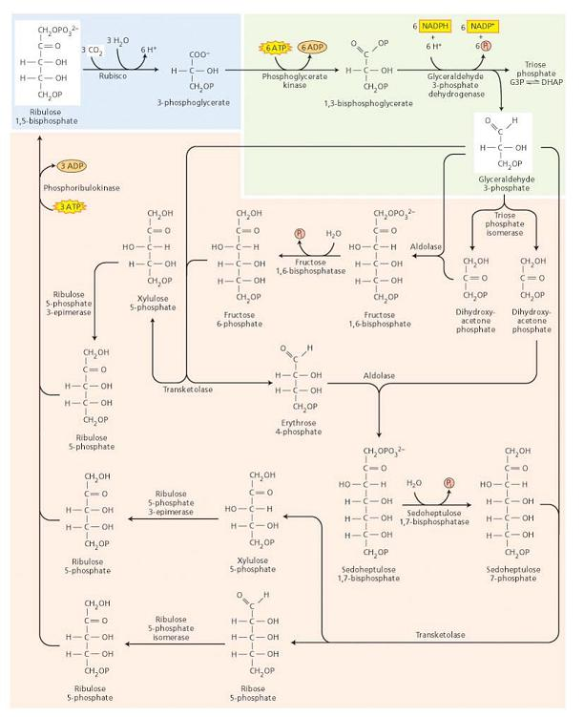

Slide 10
1. Ribulose-1,5-bisphosphate carboxylase/oxygenase | 6 Ribulose-1,5-bisphosphate + 6 CO2 + 6 H2O → 12 (3-phosphoglycerate) + 12 H+
2. 3-Phosphoglycerate kinase | 12 (3-Phosphoglycerate) + 12 ATP → 12 (1,3-bisphosphoglycerate) + 12 ADP
3. NADP:glyceraldehyde-3-phosphate dehydrogenase | 12 (1,3-Bisphosphoglycerate) + 12 NADPH + 12 H+ → 12 glyceraldehye-3-phosphate + 12 NADP+ + 12 Pi
4. Triose phosphate isomerase | 5 Glyceraldehyde-3-phosphate → 5 dihydroxyacetone-3-phosphate
5. Aldolase | 3 Glyceraldehyde-3-phosphate + 3 dihydroxyacetone- 3-phosphate → 3 fructose-1,6-bisphosphate
6. Fructose-1,6-bisphosphatase | 3 Fructose-1,6-bisphosphate + 3 H2O → 3 fructose- 6-phosphate + 3 Pi
7. Transketolase | 2 Fructose-6-phosphate + 2 glyceraldehyde-3-phosphate → 2 erythrose-4-phosphate + 2 xylulose-5-phosphate
8. Aldolase 2 Erythrose-4-phosphate + 2 dihydroxyacetone-3-phosphate → 2 sedoheptulose-1,7-bisphosphate | 2 Erythrose-4-phosphate + 2 dihydroxyacetone-3-phosphate → 2 sedoheptulose-1,7-bisphosphate
9. Sedoheptulose-1,7,bisphosphatase | 2 Sedoheptulose-1,7-bisphosphate + 2 H2O → 2 sedoheptulose-7-phosphate + 2 Pi
10. Transketolase | 2 Sedoheptulose-7-phosphate + 2 glyceraldehyde-3-phosphate → 2 ribose-5-phosphate + 2 xylulose-5-phosphate
11a. Ribulose-5-phosphate epimerase | 4 Xylulose-5-phosphate → 4 ribulose-5-phosphate
11b. Ribose-5-phosphate isomerase | 2 Ribose-5-phosphate → 2 ribulose-5-phosphate
12. Ribulose-5-phosphate kinase | 6 Ribulose-5-phosphate + 6 ATP → 6 ribulose-1,5-bisphosphate +6 ADP + 6 H+

