Slide 1
Topic: t-test

Slide 2
Hypothesis Testing of population mean ( when σ is unknown)
Suppose a population has mean µ which is unknown and standard deviation σ which is also unknown. A small sample of size n<30 is selected from the population and sample mean $\overline{X}$and sample standard deviation ‘s’ is calculated. So the testing procedure used for this kind of information is called t-test for testing a specified value of µ i.e. $μ_{0}.$
The test procedure for t-test is given below
Procedure:
1. Formulating Hypothesis: We frame the null and alternative hypothesis. Three different forms of null and alternative hypothesis are possible which are:
$H_{0}: μ=μ_{0} and H_{1}: μ≠μ_{0}$
$H_{0}: μ≤μ_{0} and H_{1}: μ>μ_{0}$
$H_{0}: μ≥μ_{0} and H_{1}: μ<μ_{0}$
2. Level of significance α is decided that can be 1%, 5% and 10%

Slide 3
3. Test Statistics $t=\frac{\overline{X}−μ_{0}}{s/\sqrt{n}}$
where, $\overline{X}=\frac{\sum{X}}{n} and s=\sqrt{\frac{\sum{{(x−\overline{x})}^{2}}}{n−1}}$
4. Critical Region
It depends upon alternative hypothesis
If $H_{1}: μ≠μ_{0}$ than $\left|t_{cal}\right|≥t_{α/{2(v)}}$ or ($t_{cal}>t_{α(v)}$ and ${−t}_{cal}<−t_{α(v)}$)
If $H_{1}: μ>μ_{0}$ than $t_{cal}>t_{α(v)}$
If $H_{1}: μ<μ_{0}$ than $t_{cal}<−t_{α(v)}$
Where
v = n-1 which is the degree of freedom for t-test
5. Calculation
Put all the information test statistics and get the results
6. Conclusion
If the calculated value of t falls in the critical region than we say that our null hypothesis is rejected under and the provided information and conclude that the selected value is not the correct estimate about population mean.

Slide 4
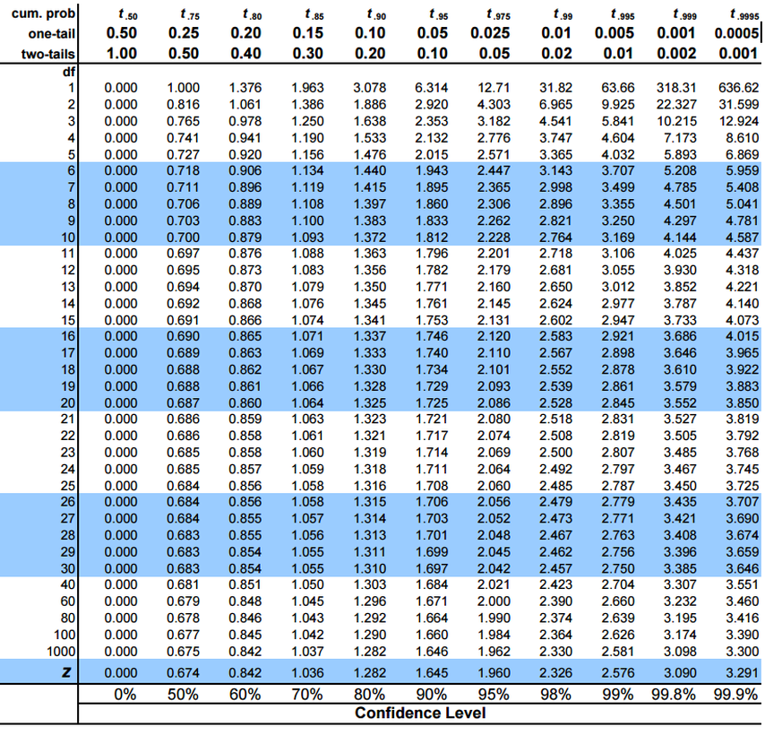

Slide 5
Question 1
A random sample of 8 cigarettes of a certain brand has an average nicotine content of 4.2 milligrams and standard deviation of 1.4 milligram. Is this in line with manufacturer’s claim that the average nicotine content does not exceed 3.5 milligrams. Use 1% level of significance?
Solution
Null hypothesis: $H_{0}: μ≤3.5$ Alternative hypothesis: $H_{1}: μ>3.5$
Level of significance: α = 0.01
Test statistics: t$=\frac{\overline{X}−μ_{0}}{s/\sqrt{n}}$
Critical region: ${\text{tcal}\text{ >} t}_{α(v)}$
1.414>2.998
from t-table, we have $t_{0.01(8−1)}=2.998$
v = 8-1 = 7

Slide 6
Calculation: Here $n=8, \overline{X}=4.2, μ_{0}=3.5 and s=1.4$
$t=\frac{4.2−3.5}{1.4/\sqrt{8}}=\frac{0.7}{1.4}\sqrt{8}=1.414$
6. Conclusion: Since the calculated value of t = 1.414 does not falls in the critical region. So under the provided information our null hypothesis is not rejected and we conclude that the average nicotine content does not exceed 3.5.

Slide 7
Practice Questions:
Q 1. A manufacturing company making automobile tires claims that the average life of its product is 35000 miles. A random sample of 16 tires was selected and it was found that the mean life was 34000 miles with a standard deviation 2000 miles. Test hypothesis $H_{0}: μ=35000$against the alternative $H_{1}: μ<35000$ at α = 0.05
Q 2. A sample of 12 jars of butter was taken from a lot, each jar being labeled 8 ounces weight. The individual weights in ounces are 8.2, 8.0, 7.6, 7.6, 7.7, 7.5, 7.3, 7.4, 7.5, 8.0, 7.4 and 7.5. Test whether these values are consistent with a population mean of 8 ounce. Use α = 0.05
Q 3. A random sample of 10 from a population gave $\overline{X}=20$ and sum of squares of deviation from mean is 144 test $H_{0}: μ=19.5$against the alternative $H_{1}: μ>19.5$ at α = 0.05

