Slide 1
Variance and Standard Deviation

Slide 2
Variance:
The variance of a set of observation is defined as the mean of the squares of deviation of all the observations from their mean.
Variance is another absolute measure of dispersion.
The variance is also denoted by Var (X).

Slide 3

Formulas : (for ungrouped data) $σ2$ = $\frac{{Ʃx}^{2}}{N}−\left(\frac{{Ʃx}_{i}}{N}\right)$ ² Population S² = $\frac{{Ʃx}^{2}}{n}−\left(\frac{{Ʃx}_{i}}{n}\right)$ ² Sample (for grouped data) s² = $\frac{{Ʃfx}^{2}}{n}−\left(\frac{{Ʃfx}_{i}}{n}\right)$² Sample Coefficients of variation = = $\frac{S}{\overline{X}}$ $×$100

Slide 4
Standard Deviation:
Standard Deviation (S.D) is the most commonly used measure of dispersion . It is a measure of spread of data about the mean.
Standard Deviation is a number that measures how far away each number in a set of data is from their mean.
Standard Deviation is the square root of the variance.

Slide 5
Formulas : (for ungrouped data) $σ$ = $\sqrt{\frac{{Ʃx}^{2}}{N}−\left(\frac{{Ʃx}_{i}}{N}\right)}$² Population S = $\sqrt{\frac{{Ʃx}^{2}}{n}−\left(\frac{{Ʃx}_{i}}{n}\right)}$² Sample (for grouped data) s = $\sqrt{\frac{{Ʃfx}^{2}}{n}−\left(\frac{{Ʃfx}_{i}}{n}\right)}$² Sample Coefficients of variation = $\frac{S}{\overline{X}}$

Slide 6
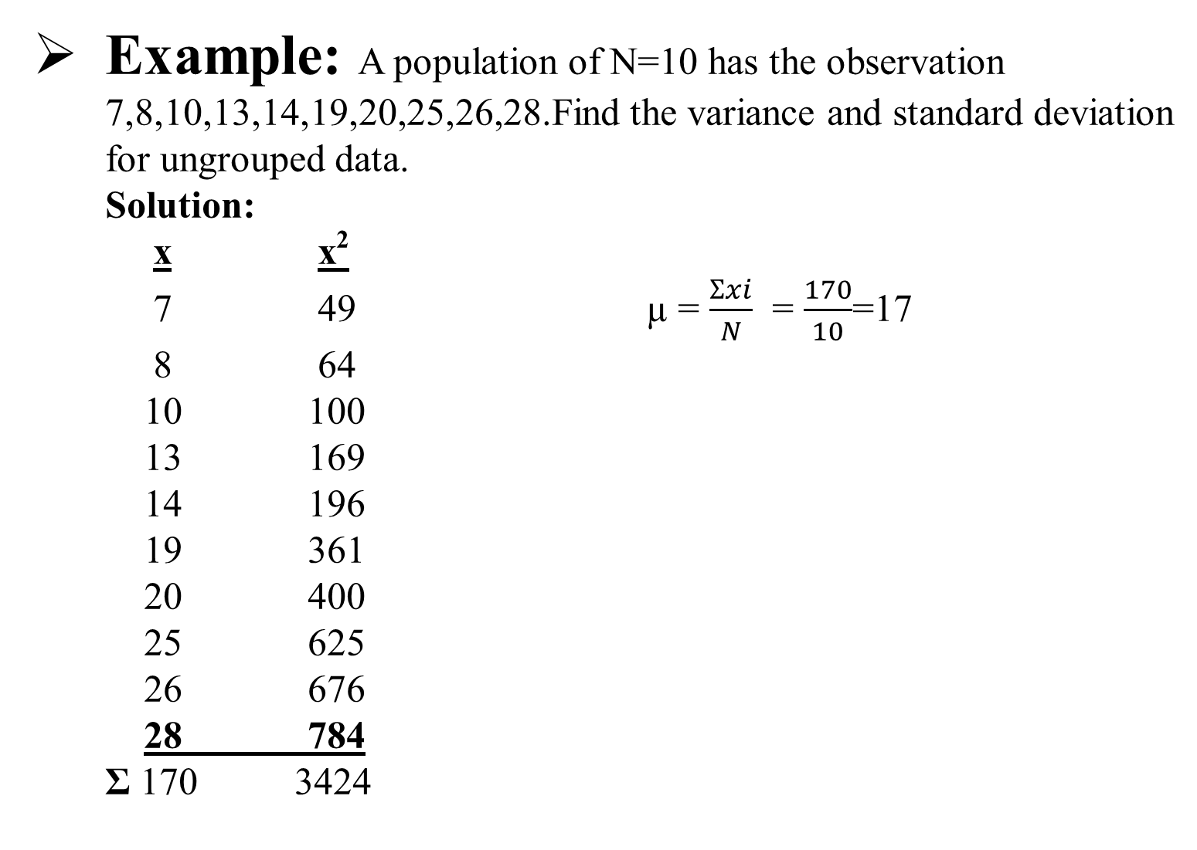
Example: A population of N=10 has the observation 7,8,10,13,14,19,20,25,26,28.Find the variance and standard deviation for ungrouped data. Solution: x x² 7 49 µ = $\frac{Ʃxi}{N}$ = $\frac{170}{10}$=17 8 64 10 100 13 169 14 196 19 361 20 400 25 625 26 676 28 784 Ʃ 170 3424

Slide 7

$σ2$ = $\frac{{Ʃx}^{2}}{N}−\left(\frac{{Ʃx}_{i}}{N}\right)$ ² $σ2$ = $\frac{3424}{10}−\left(\frac{170}{10}\right)$ ² $σ2$ = 342.4 – 289 $σ2$ = 53.4 $σ$ = $\sqrt{\frac{{Ʃx}^{2}}{N}−\left(\frac{{Ʃx}_{i}}{N}\right)}$² $σ$ = $\sqrt{53.4}$ $σ$ = 7.31

Slide 8
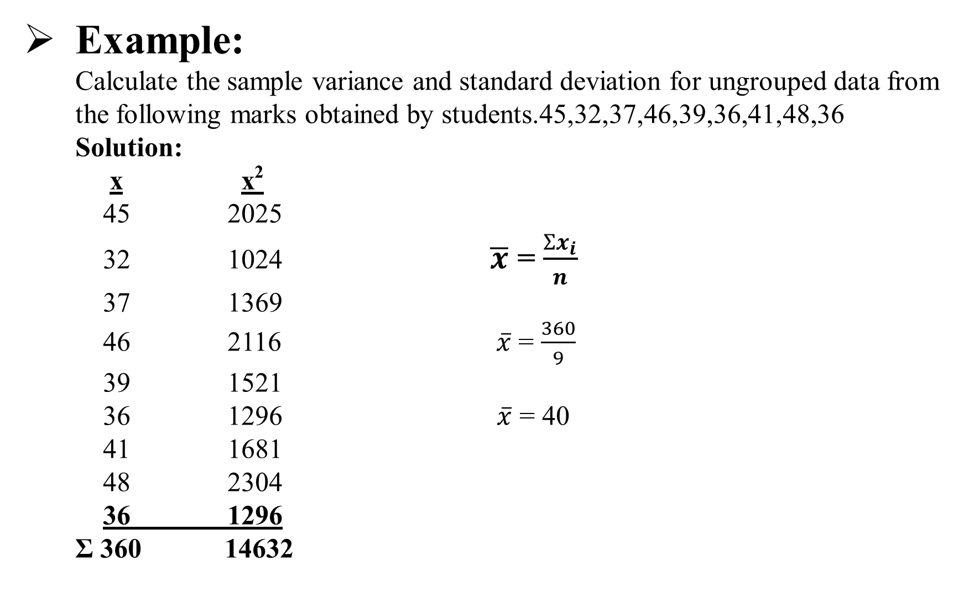
Example: Calculate the sample variance and standard deviation for ungrouped data from the following marks obtained by students.45,32,37,46,39,36,41,48,36 Solution: x x² 45 2025 32 1024 $\overline{x}$ = $\frac{{Ʃx}_{i}}{n}$ 37 1369 46 2116 $\overline{x}$ = $\frac{360}{9}$ 39 1521 36 1296 $\overline{x}$ = 40 41 1681 48 2304 36 1296 Ʃ 360 14632

Slide 9

S² = $\frac{{Ʃx}^{2}}{n}−\left(\frac{{Ʃx}_{i}}{n}\right)$ ² S² = $\frac{14632}{9}−\left(\frac{360}{9}\right)$ ² S² = 1625.78 – 1600 S² = 25.78 S = $\sqrt{\frac{{Ʃx}^{2}}{n}−\left(\frac{{Ʃx}_{i}}{n}\right)}$² S = $\sqrt{25.78}$ S = 5.08

Slide 10
Example: Calculate the variance and standard deviation from the given data. Weights Frequency 65-84 9 85-104 10 105-124 17 125-144 10 145-164 5 165-184 4 185-204 5

Slide 11
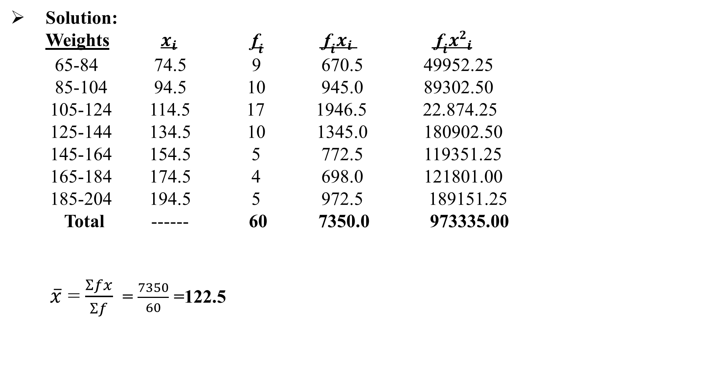
Solution: Weights $x_{i}$ ${\text{f}}_{i}$ ${\text{f}}_{i}x_{i}$ ${\text{f}}_{i}{x2}_{i}$ 65-84 74.5 9 670.5 49952.25 85-104 94.5 10 945.0 89302.50 105-124 114.5 17 1946.5 22.874.25 125-144 134.5 10 1345.0 180902.50 145-164 154.5 5 772.5 119351.25 165-184 174.5 4 698.0 121801.00 185-204 194.5 5 972.5 189151.25 Total ------ 60 7350.0 973335.00 $\overline{x}$ = $\frac{Ʃfx}{Ʃf}$ = $\frac{7350}{60}$ =122.5

Slide 12

s² = $\frac{{Ʃfx}^{2}}{n}−\left(\frac{{Ʃfx}_{i}}{n}\right)$² s² = $\frac{973335}{60}−\left(\frac{7350}{60}\right)$² s² = 16222.25-15006.25 s² = 1216 s = $\sqrt{\frac{{Ʃfx}^{2}}{n}−\left(\frac{{Ʃfx}_{i}}{n}\right)}$² s = $\sqrt{1216}$ s = 34.87

Slide 13
Example: Compute the Coefficients of variation for the given data. Prices in rupees: 8,13,18,23,30 Life in hours: 130,150,180,250,345 Solution: Prices in rupees(X) Life in hours(Y) X X² Y Y² 8 64 130 16900 13 169 150 22500 18 324 180 32400 23 529 250 62500 30 900 345 119025 Total 92 1986 1055 253325

Slide 14

Prices in rupees(X) Life in hours(Y)
$\overline{X}$ = $\frac{{Ʃx}_{i}}{n}$ $\overline{Y}$ = $\frac{{Ʃx}_{i}}{n}$ $\overline{X}$ = $\frac{92}{5}$ =18.4 $\overline{Y}$ = $\frac{1055}{5}$ = 211
S _{X}= $\sqrt{\frac{{Ʃx}^{2}}{n}−\left(\frac{{Ʃx}_{i}}{n}\right)}$² S_{Y} = $\sqrt{\frac{{Ʃx}^{2}}{n}−\left(\frac{{Ʃx}_{i}}{n}\right)}$²
S_{X}= $\sqrt{\frac{1986}{5}−\left(\frac{92}{5}\right)}$² S_{Y} = $\sqrt{\frac{253325}{5}−\left(\frac{1055}{5}\right)}$²
S_{X}= $\sqrt{397.2−338.56}$ S_{Y} = $\sqrt{50665−44521}$

Slide 15

S_{X}= $\sqrt{58.44}$ S_{Y} = $\sqrt{6144}$ = 7.66 = 78.38 C.V = $\frac{S}{\overline{X}}$ $×$100 C.V = $\frac{S}{\overline{Y}}$ $×$100 C.V = $\frac{7.66}{\overline{18.4}}$ $×$100 C.V = $\frac{78.38}{211}$ $×$100 C.V = 41.63% C.V = 37.15%

Slide 16
Assignment : Question 01: Find the Variance and Standard deviation of the following data. Weekly Income No.workers 35-39 15 40-44 13 45-49 17 50-54 29 55-59 11 60-64 10 65-69 5

Slide 17
Question 02: Find the Variance and Standard deviation. Weights Frequency/ No. of students 20-24 5 25-29 8 30-34 13 35-39 22 40-44 15 45-49 10 50-54 8

Slide 18
Question:03 Calculate the population variance and standard deviation. Rs.60,80,90,96,120,150,200,360,480,520,1060,1200,1450,2500,7200. Question:04 Calculate the sample variance and standard deviation. 14,42,53,27,53,78,38,52,92,29

