Slide 1
Sunflower
Fourth most important vegetable.
9 million tonnes production and a cultivated acreage over 22 million hectares.
Russian Federation, Ukraine, and Argentina (totalize more than 50% of sunflower world acreage).
Family Compositae (Asteraceae).
The basic chromosome number is n = 17.
Helianthus including 14 annual and 36 perennial species from North America
Genus includes diploid, tetraploid and hexaploid species.
Helianthus include
H. tuberosus is grown for production of edible tubers, and several other species grown as ornamentals.

Slide 2
Origin and domestication
Domesticated in North American by Native American Indians for its edible seeds (Heiser et al. 1969).
the drastic increase of oil percentage in sunflower in the Former Soviet Union from 1920 to 1960 (Gundaev 1971)
the development of a cytoplasmic male sterility system (Leclercq 1969) combined with fertility restoration by nuclear genes (Kinman 1970) that enabled the commercial production of hybrid seed.
the development of short-stemmed high yielding hybrid cultivars with high oil content well adapted to mechanised cropping.

Slide 3
Table 1. Infrageneric classification of annual Helianthus species (n=17)
Sectionª | Species
Helianthus Agrestes Porteri | H. annuus L. H. anomalus S.F. Blake H. argophyllus Torr.& A. Gray H. bolanderi A. Gray H. debilis Nutt. subsp. debilis subsp. cucumerifolius (Torr. & A. Gray) Heiser subsp. silvestris Heiser subsp. tardiflorus Heiser subsp. vestitus (E. Watson) Heiser H. deserticola Heiser H. exilis A. Gray H. neglectus Heiser H. niveus (Benth.) Brandegee subsp. canescens (A. Gray) Heiser subsp. niveus subsp. tephrodes (A. Gray) Heiser H. paradoxus Heiser H. petiolaris Nutt. subsp. fallax Heiser subsp. petiolaris H. praecox Engelm. & A. Gray subsp. hirtus (Heiser) Heiser subsp. praecox subsp. runyonii (Heiser) Heiser H. agrestis Pollard H. porteri (A. Gray) Pruski

Slide 4
Classification of varietal groups
There are three major groups of varieties of cultivated sunflower (H. annuus):
those used for the extracted seed oil (oilseed types),
those for the direct consumption of the seeds (confectionery types),
and those used as ornamentals.

Slide 5
Varietal groups
Hybrid varieties are nowadays predominant for all three groups.
By far, the major portion of sunflower production is devoted to oil extraction (Miller and Fick 1997).
Sunflower oil as a healthful vegetable oil and it is considered a premium oil for salad, cooking, and margarine production.
The seeds of confectionery sunflower varieties are used as snack food as well as for feeding birds and small animals.
The oilseed varieties have small black seeds with low hull content and very high oil content (about 50%).
Confectionery sunflower varieties have larger seeds, which are usually black with white stripes, with lower oil content (about 30%) and a higher hull percentage.

Slide 6
Varietal classification
Oilseed sunflower varieties are divided into three groups according to their oleic acid content.
Linoleic, mid-oleic, and high oleic. Linoleic (traditional) varieties have linoleic acid content between 45 and 75%.
The seed oil of mid- and high-oleic varieties has an oleic acid content of 55–75% and 85–90%.

Slide 7
Table 2 Infrageneric classification of perennial Helianthus species
Sectionª | Series | Species | Chromosome number (n)
Ciliares | Ciliares | H. arizonensis R.C. Jacks. 17 H. ciliaris DC. H. laciniatus A. Gray | 17 34,51
Ciliares | Pumili | H. cusickii A. Gray H. gracilentus A. Gray H. pumilus Nutt. | 17
Atrorubens | Coronasolis | H. californicus DC. 51 H. decapetalus L. 17,34 H. divaricatus L. 17 H. eggertii Small 51 H. giganteus L. 17 H. grosseserratus M. Martens 17 H. hirsutus Raf. 34 H. maximiliani Schrad. 17 H. mollis Lam. 17 H. nuttallii Torr. & A. Gray subsp. nuttallii 17 subsp. parishii (A. Gray) Heiser 17 subsp. rydbergii (Britton) R. Long 17 H. resinosus Small 51 H. salicifolius A. Dietr. 17 H. schweinitzii Torr. & A. Gray 51 H. strumosus L. 34,51 H. tuberosus L. 51 | 51 17,34 17 51 17 17 34 17 17 17 17 17 51 17 51 34,51 51

Slide 8
Table 2 Infrageneric classification of perennial Helianthus species
Sectionª | Series | Species | Chromosome number (n)
Atrorubens | Microcephali | H. glaucophyllus D.M. Sm. H. laevigatus Torr. & A. Gray H. microcephalus Torr. & A. Gray H. smithii Heiser | 17 34 17 17,34
Atrorubens | Atrorubentes | H. atrorubens L. H. occidentalis Riddell subsp. occidentalis subsp. plantagineus (Torr. & A. Gray) Heiser H. pauciflorus Nutt. subsp. pauciflorus 51 subsp. subrhomboideus (Rydb.)O. Spring & E.E. Schill. | 17 17 17 51 51

Slide 9
Cytoplasmic Male Sterility
Cytoplasmic male sterility (CMS) is a maternally inherited trait preventing plants from producing normal pollen.
CMS is used as a tool to generate F1
hybrid seed.
CMS is classified as autoplasmic or alloplasmic.
A type of stable alloplasmic male sterility named PET1 was reported by Leclercq (1969).
Identification of dominant fertility restoration genes
All cultivated sunflower hybrids are currently based on the CMS source derived by Leclercq (1969)
A total of 70 CMS sources were identified.
34 Fertility restoration sources in wild Helianthus species

Slide 10
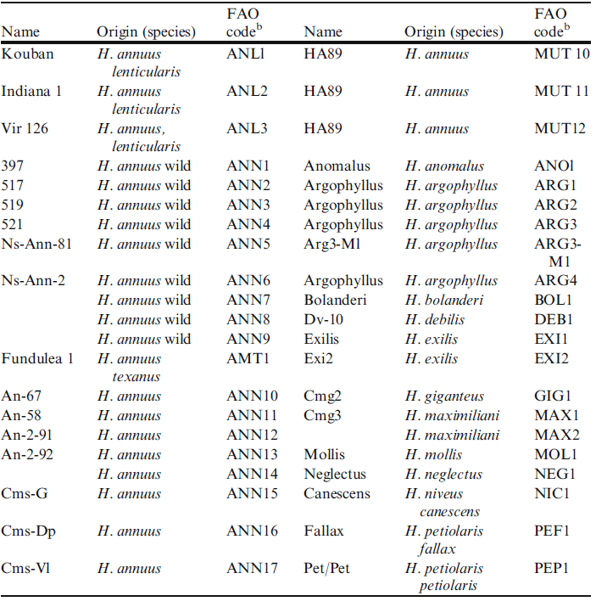
Table 3 Sources of cytoplasmic male sterility in Sunflowerª

Slide 11
Disease and Insect Resistance
Diseases and insects are limiting factors of production in the majority of sunflower producing countries.
The most serious diseases of sunflower are caused by fungi.
European sunflower moth (Homoeosoma nebulellum, Lepidoptera) causes significant yield reduction.

Slide 12
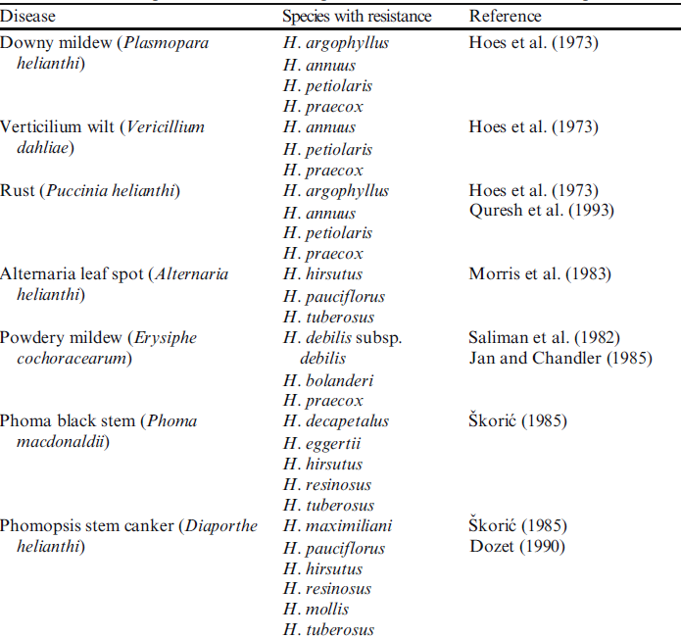
Table 4. Reported resistance to important diseases in wild sunflower species

Slide 13
Development of High Oil Germplasm in the Former USSR
Scientific sunflower breeding started in 1910–1912 at Krasnodar by the academician V.S. Pustovoit,).
The local varieties cultivated in Russia in 1913 contained only 30–33% of oil in dry seeds.
This percentage increased up to 43% in 1935, 46% in 1953 and 51% i n 1958
The use of Pustovoit’s ‘‘Method of Reserves’’, a method of individual selection with progeny testing and controlled pollination (Pustovoit 1967), together with the use of accurate laboratory techniques for oil content analysis.
Spectacular increase of oil content of the achenes did not caused any decline in the seed yield of the varieties released.
The open pollinated Russian cultivar ‘‘Peredovik’’, with high oil content, introduced during the 1960s in the western countries.

Slide 14
Utilization of the Inbred-Hybrid Method
First commercial sunflower hybrids were produced in Canada during the 1950s with a high degree of self-incompatibility.
Nuclear male sterility was first reported in the former USSR (Kuptok 1935) and later in France (Leclercq 1966) and Canada (Putt and Heiser 1966).
Nuclear male sterility was used to produce hybrid seed in France and Romania during 1970s.
The identification of a close linkage between genes for male sterility and anthocyanin pigmentation (Leclercq 1966) facilitated the identification and removal of the male fertile plants prior to flowering.
The first stable source of cytoplasmic male sterility was discovered by Leclercq in 1968 from an interspecific cross involving H. petiolaris and H. annuus (Leclercq 1969).
Subsequent identification of genes for fertility restoration in wild species (Kinman 1970) and in certain obsolete sunflower cultivar (Vraˆ nceanu and Stoenescu 1971).

Slide 15
Development of New Types of Oil
Sunflower breeders have been tremendously successful in developing mutants with new types of oil in the last 30 years.
The high oleic acid mutant identified in Russia in the seventies (Soldatov 1976) with mid oleic acid content (55–75%) and high oleic acid content (>85%).
Nusun variety had 85% oleic acid of the total oilseed sunflower

