Slide 1
Noun and it’s types:
Words are divided according to the purpose they are used for.The different kinds of words are called parts of speech.
Noun:
Word comes from Latin word “Nomes” meaning “Name”.
Used to name a person,a place,a thing,a quality,an action or Abstract idea.
Can function as the subject of a verb,or the Object of a verb,the Object,of preposition,or an oppositive.
For example:Aslam, car,garden,book etc.

Slide 2
Errors we committ in noun:
Politics are a dirty game.
The jury are deciding the case.
She bought four dozens eggs.
I have a hundred rupees note.
The father with his sons have come here.
There news are true.
He has nine braces of birds.

Slide 3
Exercise:
Are You able to recognize noun from the following:
Aslam is a tall boy.
Ali saw a bird on the branch of tree.
This news is true.
The boy and girl were holding hands as they crossed the bridge on the way to town.
I love watching my cat play with the pink yarn.
It is raining! Everyone, grab your umbrella and rain hat and watch out for the puddles!

Slide 4
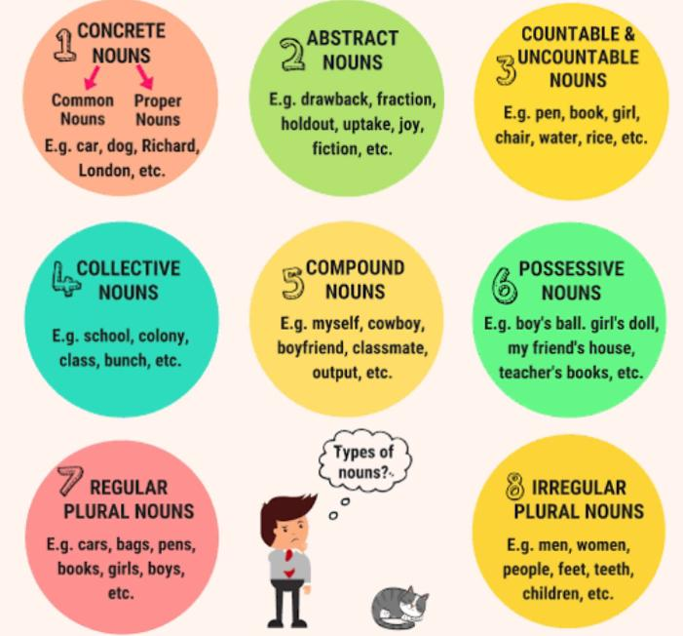
Types of noun:
Different types of noun:
Proper noun Common noun
Collective noun
Material noun
Abstarct noun
Countable noun
Uncountable noun

Slide 5
Common Noun Vs Proper Noun:
Proper Noun is the name of particular person,place or thing like saleem,faisalabad,The Holy Quran etc.
Common Noun is a noun which is used for every person,place or thing of same class or kind like pen, boy,book,city etc
Proper means one’s own while common Noun is shared by all.

Slide 6
Exercise:
Murree is the Switzerland of Pakistan.
Fish live in water.
I saw animals in the zoo.
The police are running after the thief.

Slide 7
Common Noun Vs Proper Noun
I ordered a new computer online.
I ordered the laptop from Amazon.
We are going to play baseball in the park.
We’re going to play baseball in Prospect Park
We’re going shopping in the city.
Atlanta is one of my favorite places to visit.

Slide 8
Collective Noun:
“A noun which is the name of a group or collection of similar persons or things considered as one complete whole”.
For example:
Crowd,Army,class,Team,Nation etc

Slide 9
Examples:
Our class took a field trip to the natural history museum.
The herd of bison ran across the prairie, leaving a massive dust cloud in its wake.
We waited anxiously for the jury to come to a verdict.
Basketball team includes three players who are over six feet tall.

Slide 10
Material Noun:
“A Noun is the name of material or matter or substance out of which things are made”.
For example:
Gold,silver,milk,iron,water etc.

Slide 11
Examples:
Cotton dresses are very cheap and comfortable.
My mom purchased a gold ring for me.
I drink milk in the silver.
My father has a shop for Diamonds.
Calcium is a good mineral for health.
plastic is made of many molecules of ethylene.

Slide 12
Abstract Noun:
“An noun is the name of a quality,action,or state”.
It can not be measured by any instrument.
For example:
Goodness,hate,boyhood,death,poverty etc.

Slide 13
Examples:
We have to get at the truth of the matter.
Mary isn’t the type of person who gossips.
Leople lost Faith in banks.
He will Defeat them.
I was delighted at the news of her Success.
They Laughed at my idea.
Alex had a fear that he would fall down.
She tried to restrain her Anger.

Slide 14
Countable And Uncountable Nouns:
Nouns are used for persons,places,and things which can be counted.
For example:
Megan took a lot of photographs when she went to the Grand Canyon.
Your Book is on the kitchen Table.
How many Candles are on that birthday cake?
You have several Paintings to study in art appreciation class.

Slide 15
Uncountable Nouns are used for things and places Which can not be counted.
For example:
There is no more water in the pond.
Please help yourself to some Cheese.
I need to find information about Pulitzer Prize winners.
You seem to have a high level of intelligence.

Slide 16
Important points:
Proper Noun always begins with capital letter.
When a collective Noun refers to the numbers of group individually,it takes a plural verb like:
“The jury were divided In their opinions”.
Sometimes abstract noun is used as proper noun when it is personified like:
“ O Death! Where are you?”

Slide 17
Numbers of Nouns:
Common nouns have two numbers:
The singular number: A noun that refers to one person,place or thing is said to be in singular number like man, table,car, apple etc.
The plural number:A noun that refers to more than one person,place or thing is said to be In the pLural number like men, cats, trees etc.
Ways of Forming plurals:
By adding ‘s’ or ‘es‘.
By adding ‘en‘ or ‘ne‘.

Slide 18
Gender Of Noun:
Gender means kind or sort,it expresses
the sex of living beings.
Masculine gender:A gender which is used for male sex. Like: boy,man,etc.
Feminine gender:A gender which is used for female sex. Like: girl,woman etc.

Slide 19
Common gender:A noun which is used for both male and female. Like:patent,friend,thief,enemy cousin etc.
Neuter Gender:A noun that is used for lifeless objects. Like: book,pen,garden etc.

Slide 20
Compound Noun:
A noun that is made with two or more word.
Each compound noun acts as a single unit and can be modified by adjectives and other nouns.
Like: toothpaste, haircut, or bedroom.

Slide 21
Examples:
Bluebird is a type of bird.
Greenhouse is a place where we grow plants.
lots of Fire-flies come at night in the summer season.
We Played football today for two hours.

Slide 22
Possessive Noun:
A noun that possesses something—i.e., it has something.
In most cases, a possessive noun is formed by adding an apostrophe +s to the noun, or if the noun is plural and already ends in s, only an apostrophe needs to be added.
Apostrophe is used only with living beings.it is never used with names of lifeless objects.

Slide 23
Examples:
Notre Dame's tower
Yellowstone National Park's hours
Middle class's income
T- shirt’s logo
Attorney General’s job
Real estate’s decline
Full moon's brightness

