Slide 1
Brown Leaf spot of Rice
Dr. Salman Ahmad
March 27, 2020

Slide 2
Description:
Common*(present in all rice growing areas) disease of rice, caused by a fungus that infects coleoptiles*(protective sheath that cover leaf), leaves, panicle, glumes (outer husk surrounding the grain). It can occur at all stages but more severe from tillering to maturity stages.

Slide 3
History and Importance:
It causes high yield losses (up to 90%). It appeared in epidemic form in India and caused complete crop failure that was regarded Great Bengal Famine 1943.

Slide 4
Etiology:
Causal organism: Bipolaris oryzae

Slide 5
Symptoms:
In early stage small dark brown spots*(necrotic area with defined margin) on leaves, coleoptiles etc.
With the passage of time oval shaped brown lesions (wound) with grayish centers are found on leaves, coleoptiles.
Dark brown to black spots on glumes and panicles.
Infected grains become discolored and are known as “Pecky Rice”

Slide 6
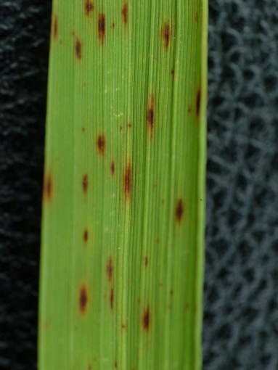
Brown Leaf spot of Rice

Slide 7
Disease cycle:
Fungus can survive in seed up to 4 years. Sowing of infected seeds give rise to infected seedlings from where fungal spores spread through air or wind and infect other plants.
Other sources for survival of fungal spores are weeds and plant debris.

Slide 8
Epidemiology:
Pathogen is the most active at high relative humidity (86-100%) and temperature (16-36°C). Leaf wetness between 8-24 hours favors the disease. Poorly drained and nutrient deficient soils are the hot spot for pathogen multiplication.

Slide 9
Management:
Pre-sowing hot water treatment of seed at 53-54°C for 10-12 minutes.
Seed treatment with fungicides i.e. Captan, Thiram, Mancozeb.
At tillering and booting stage spray with Mancozeb and Tricyclazole.
Apply calcium silicate before sowing.

