Slide 1
Phrases and its types
Instructor: Attiqa Riaz

Slide 2
Phrase
A phrase consists of two or more words adding meaning to a clause or a sentence.
They do not have a subject and finite verb (except verb and infinitive phrase)
Function of a phrase depends upon the word used in it
By itself, a phrase does not give a complete thought
E.g.: I saw a joker in the street

Slide 3
Finite v/s Non-finite verb

Slide 4
Types of phrase:
Noun phrase
Prepositional phrase
Adjective phrase
Adverb phrase
Verb phrase
Infinitive phrase
Gerund phrase
Participle phrase
Absolute phrase

Slide 5
Noun phrase
A phrase having a noun and other words that compliment and signifies the noun
Noun phrase (NP) = N + modifier
The modifier can be after or before a noun
NP can work as a subject or object of the clause/ sentence
Noun or a pronoun constitute as head in the noun phrase
Head is the most important part of a noun phrase

Slide 6
Noun phrase
sentence
Noun phrase (NP)
Determiner
Pre-modifier
Verb phrase (VP)
Pre-determiner
Head
Post-modifier

Slide 7
Noun phrase
Pre-determiners = all, both, half, one-third, double, twice, ten times
Determiners =
Article: a, an, the
Possessive forms: my, your, Rida’s, our, his, her, it, their etc
Demonstrative= this, that, these, those
Pre-modifier = adjectives, adverbs
Head = noun
Post-modifier = prepositional phrase (PP), Verb phrase (VP) etc

Slide 8
Example:
All the women in the camp gave vent to cries of horror
He is wearing a nice red shirt
She gave the little girl a toffee
The boy with brown hair was crying
He imagined good old days
A man on the roof was shouting
The little child was crying for milk

Slide 9
Prepositional phrase
A prepositional phrase consists of preposition and a modifier
PP = P + modifier
It can act both as an adverb or adjective
It starts with a preposition and mostly ends with a noun or a pronoun
Whatever prepositional phrase ends with is called object of preposition

Slide 10
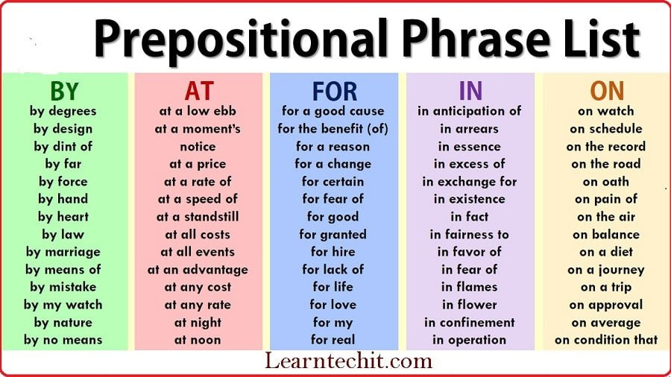
Prepositional phrase

Slide 11
Examples:
A new railroad is under construction
By the way, how are you?
The crew is on the move
A man on the roof was shouting
The boy with the brown hair was crying
He is thinking for the better future
It is up to us to find a way out.

Slide 12
Adjective phrase
An Adjective phrase consists of adjective and modifier.
It modifies a noun or a pronoun
It functions as an adjective as gives information about noun/ pronoun
The main part of it is “Adjective” the head of this phrase

Slide 13
Example:
The boy was extremely sad
The girl who is so beautiful is from London
Deniz is a nice, beautiful, intelligent girl
The boy with brown hair was crying
He gave me a glass full of water
A boy from China won the medal

Slide 14
Adverb phrase
An adverb phrase is a prepositional phrase working as an adverb that modifies a verb, an adjective or an adverb
It functions as an adverb in the sentence
It consists of adverb and modifier
Adv.P = Adv + modifer

Slide 15
Example:
He always behaves in a good manner
They were shouting in a loud voice
She always drives with care.
He sat in a corner of the room.
He returned in a short while.
The gorilla laughed at him

Slide 16
Verb phrase
A verb phrase consists of auxiliaries (helping verb) and main verb
The main verb always acts as head
It can also refer to the predicate of the sentence
VP= Aux + V

Slide 17
Example:
She is witnessing two fights
Sana is eating an apple
You should study for exams in order to get good marks
He is always in a hurry
She might have changed
I should have gone to school today

Slide 18
Infinitive phrase
An infinitive phrase consists of infinitive and modifiers
Infinitive consists of to + verb
It can function as adjective, noun, adverb
Examples
We started to look at the beautiful painting
I have a job to do
He likes to do his work

Slide 19
Gerund phrase
Gerund consists of verb + -ing form
A gerund phrase consists of gerund and modifier
It acts as a noun in the sentence
Examples:
I like reading good books
Swimming the mile is my favorite event
She has started thinking about the problem

Slide 20
Participle phrase
A participle phrase consists of either present participle or past participle with other modifiers
Present participle: verb + -ing
Past participle: verb + -ed
It is separated by commas
It always acts as an adjective

Slide 21
Examples
Brimming with confidence, Jack gave the answer
The kids, making noise, need food
We saw a car, damaged in the accident
My friends used headlamps, walking at night

Slide 22
Absolute phrase
An absolute phrase is a group of words that modifies an independent clause as a whole.
An absolute may precede, follow, or interrupt the main clause
It is made up of a noun and its modifiers
It may include participle or participle phrase
It is also called nominative phrase

Slide 23
Example
Their car having been repaired, the Smiths, continued their road trip
He looks sad, his face expressing worry
John is painting a wall, his shirt dirty with paint

Slide 24
End!
…

