Slide 1
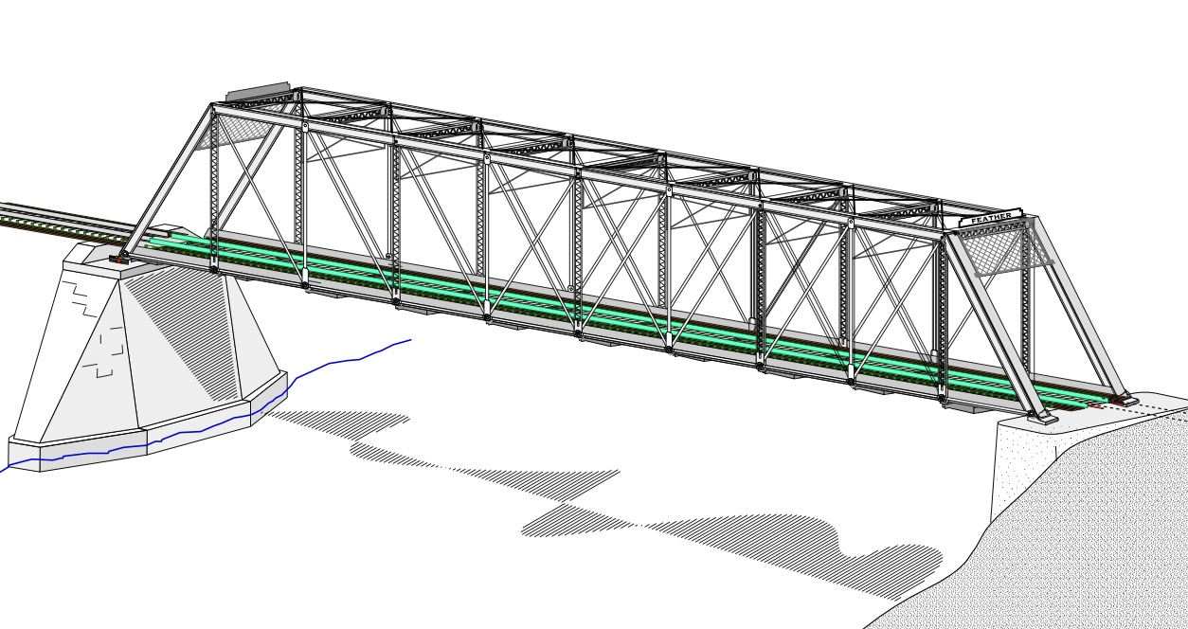
COLLEGE OF ENGINEERING AND TECHNOLOGY UNIVERSITY OF SARGODHA STEEL STRUCTURES (CT-313) (B.S TECHNOLOGY)
LECTURE-43, 44 & 45
FLEXURAL MEMBERS………….
Engineer Aqeel Ahmed
Lecturer, Civil Engineering Department
CET, UOS, Sargodha

Slide 2
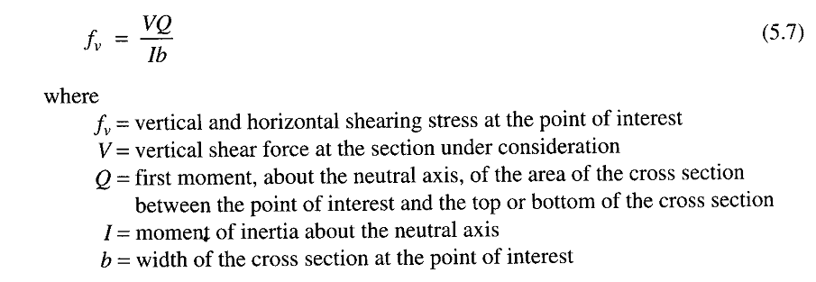
SHEAR STRENGTH
Before covering the AISC provisions for shear strength, we will first review some basic concepts from mechanics of material.
Consider the simple beam of figure-5.17, at a distance x from left and at neutral axis the state of cross-section, the state of stress is as shown in figure-5.17d.
Because this element is located at neutral axis, it is not subjected to flexural stress. From elementary mechanics of materials, the shear stress is given by:

Slide 3
SHEAR STRENGTH
Before covering the AISC provisions for shear strength, we will first review some basic concepts from mechanics of material.
Consider the simple beam of figure-5.17, at a distance x from left and at neutral axis the state of cross-section, the state of stress is as shown in figure-5.17d.
Because this element is located at neutral axis, it is not subjected to flexural stress. From elementary mechanics of materials, the shear stress is given by:

Slide 4
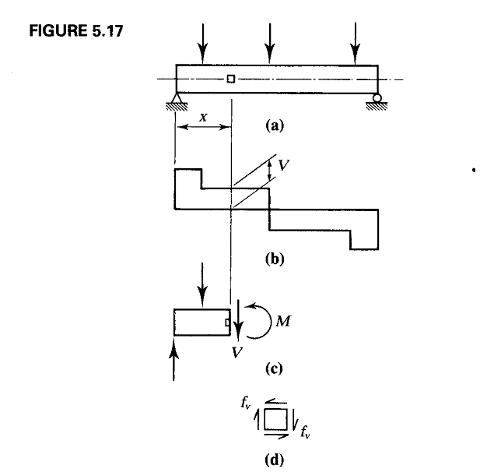

Slide 5
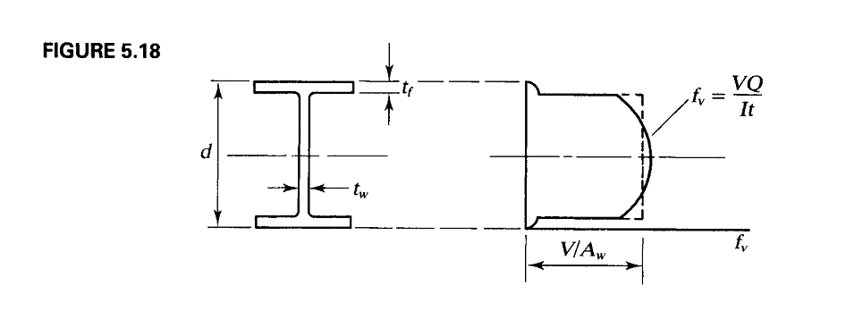
SHEAR STRENGTH……..
Figure 5.18 shows the shearing stress distribution for a W-shape

Slide 6
SHEAR STRENGTH……..

Slide 7
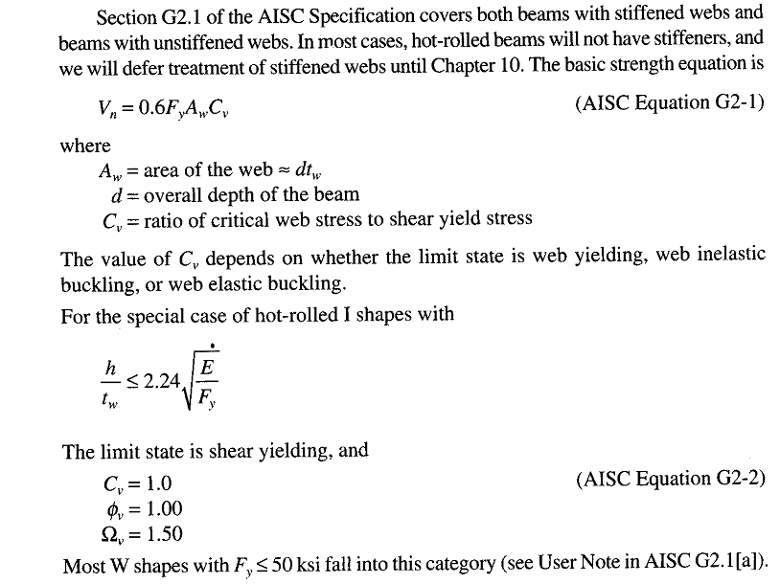
SHEAR STRENGTH……..

Slide 8
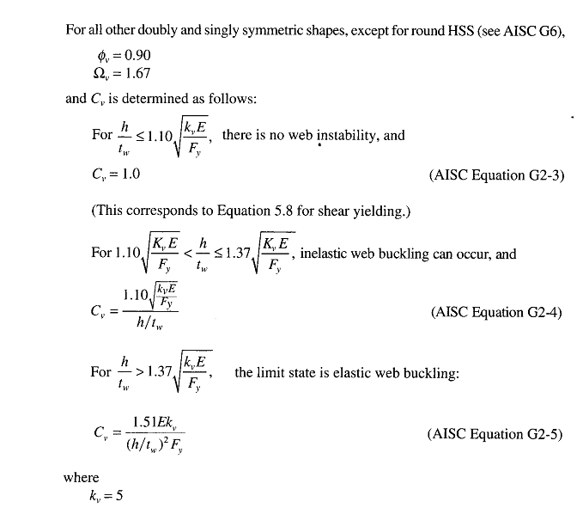
SHEAR STRENGTH……..

Slide 9
DEFLECTION
In addition to being safe, a structure must be serviceable.
A serviceable structure is one that performs satisfactorily, not causing any discomfort or perceptions of unsafety for the occupants for the occupants or users of structure.
For a beam, being serviceable usually means that the deformations, primarily the vertical sag or deflection must be limited.
Excessive deflection is usually an indication of a very flexible beam, which can lead to problems with vibrations.
The deflection itself can cause problems if elements attached to the beam can be damaged by small distortions.
In addition, users of the structure may view large deflections negatively and wrongly assume that the structure is unsafe.

Slide 10
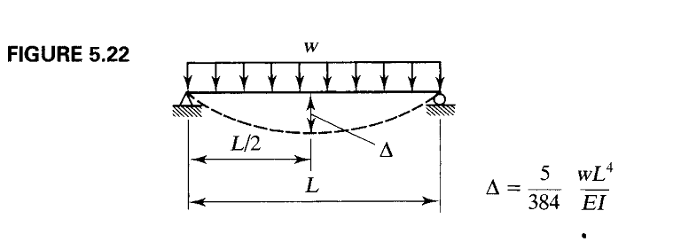
DEFLECTION………
For the common case of a simply supported, uniformly loaded beam such as that in figure-5.22, the maximum vertical deflection is:-
Deflection formulas for a variety of beams and loading conditions can be found in Part-3, “Design of flexural members” of the manual.
For more unusual situations, standard analytical methods such as the method of virtual work may be used.

Slide 11
DEFLECTION………
Deflection is a serviceability limit state, not one of the strength, so deflections should always be computed with service loads.
The appropriate limit for the maximum deflection depends on the function of the beam and likelihood of damage resulting from the deflection.
The AISC specification furnishes little guidance other than a statement in chapter L, “Design for Serviceability”, that the deflections should not be excessive.
Appropriate limits for deflection can be usually found from the governing building code, expressed as a fraction of span length L, such as L/360. sometimes a numerical limit such as 1 inch is appropriate.
The limits given in the International Building code (IBC, 2003) are typical. Table 5.4 shows some of the deflection limits given by that code.
The limits shown in table 5.4 for deflection due to dead load plus live load do not apply to steel beams because the dead load deflection is usually compensated for by some means such as cambering.

Slide 12
DEFLECTION………
Camber is a curvature in the opposite direction of the dead load deflection curve and can be accomplished by bending the beam with or without heating.
When the dead load is applied to the beam, the curvature is removed and the beam becomes level.
Therefore, only the live load deflection is of concern in the completed structure.
Dead load deflection can also be accounted for by pouring a variable depth slab with a level top surface, the variable depth being a consequence of the deflection of the beam (this is referred to as ponding of concrete).

Slide 13
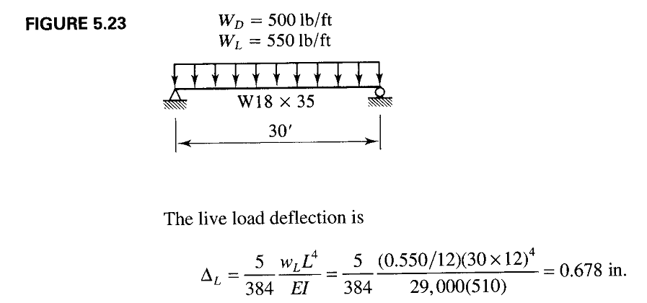

Slide 14
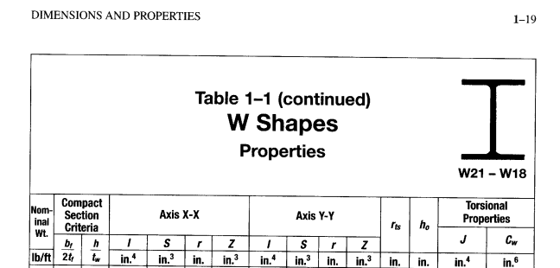

Slide 15
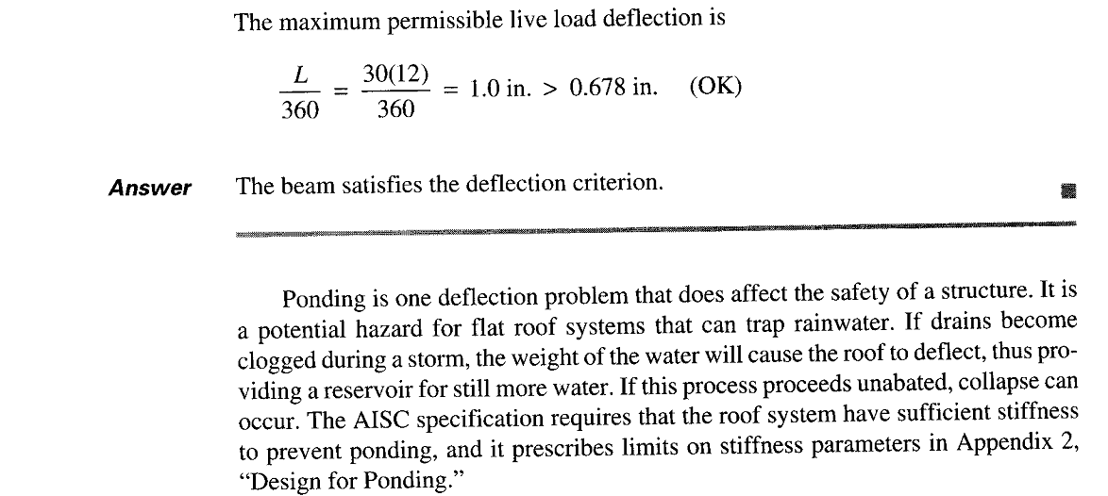

Slide 16
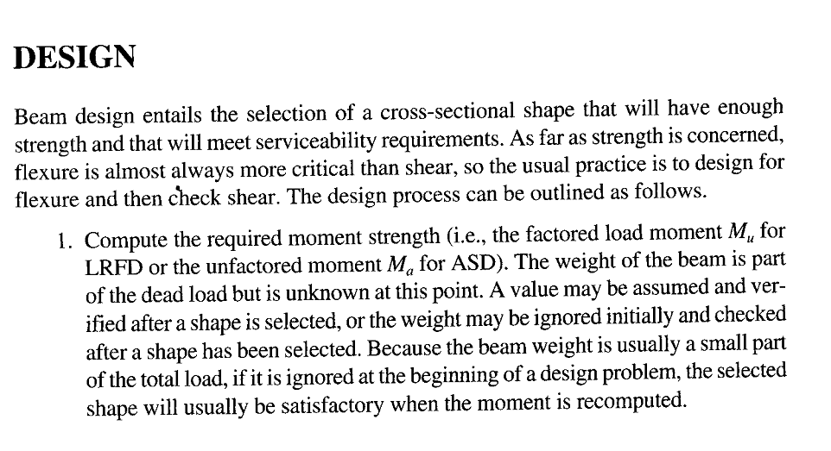

Slide 17
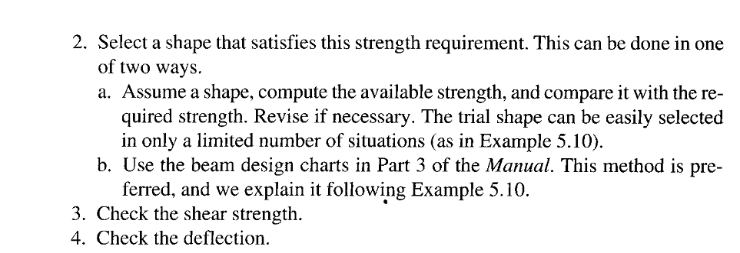

Slide 18
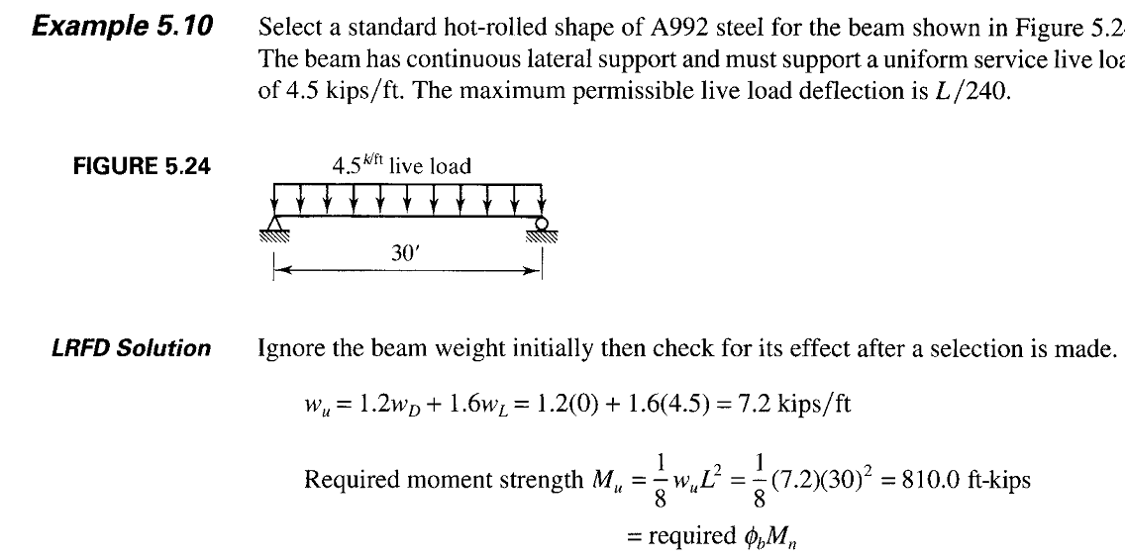

Slide 19
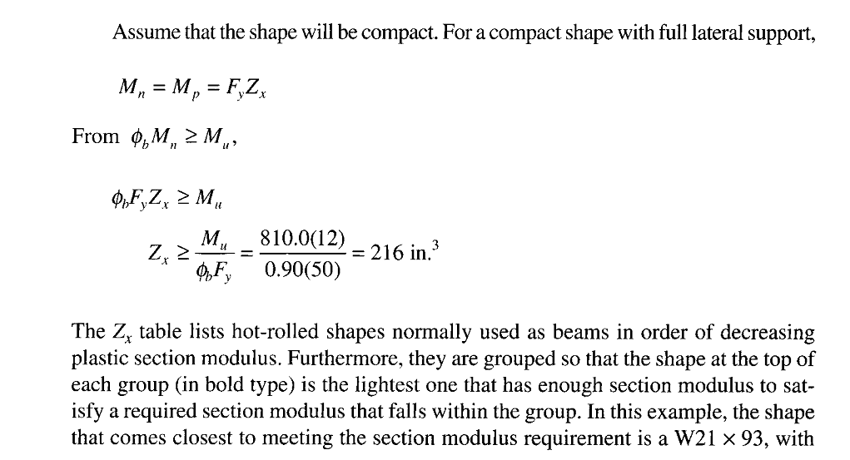

Slide 20
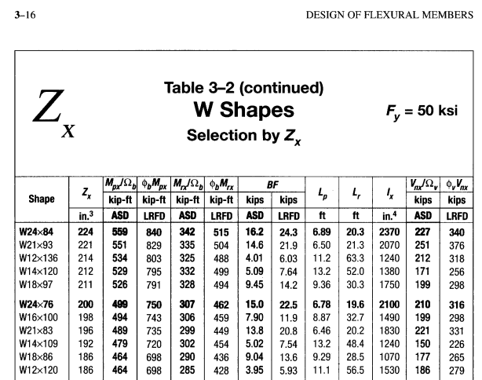

Slide 21
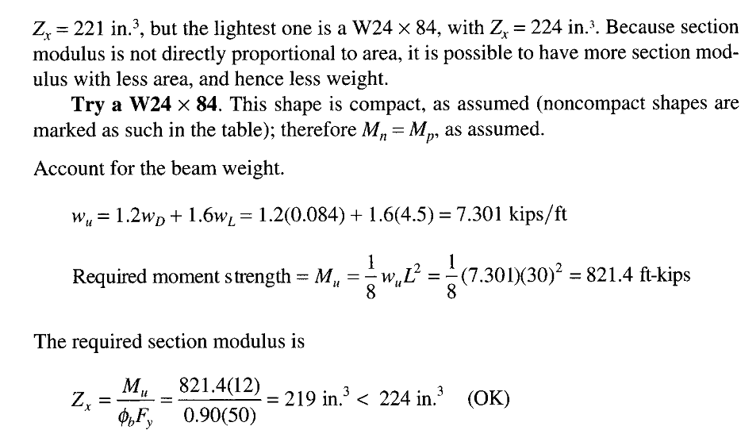

Slide 22
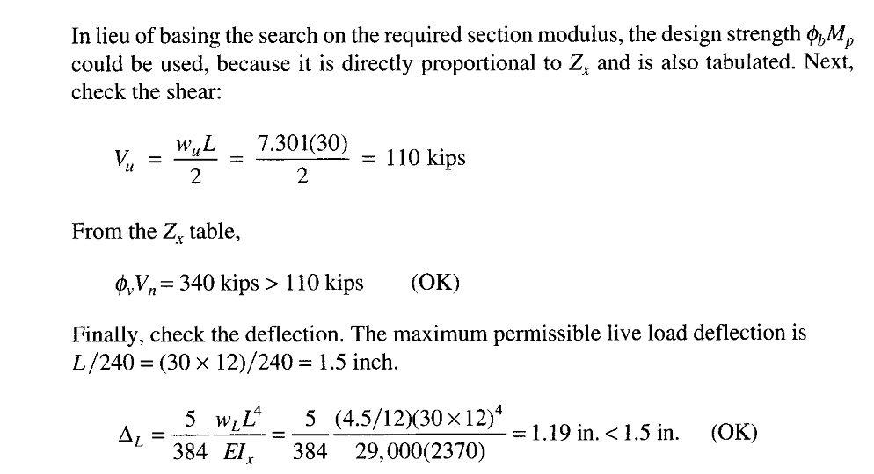

Slide 23
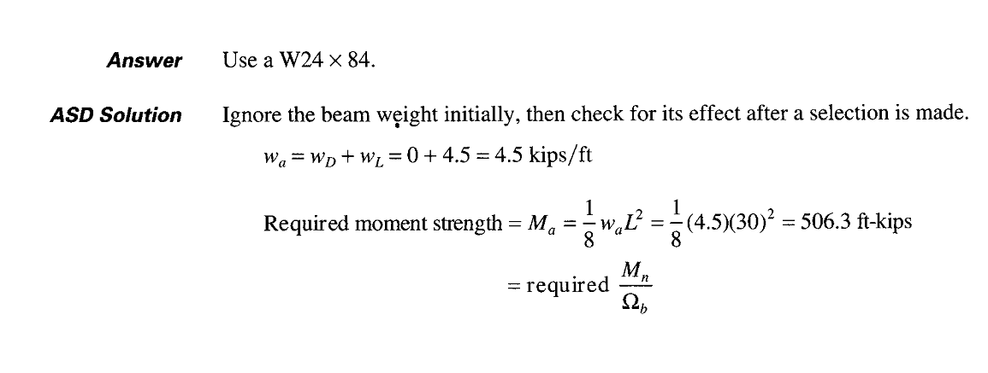

Slide 24
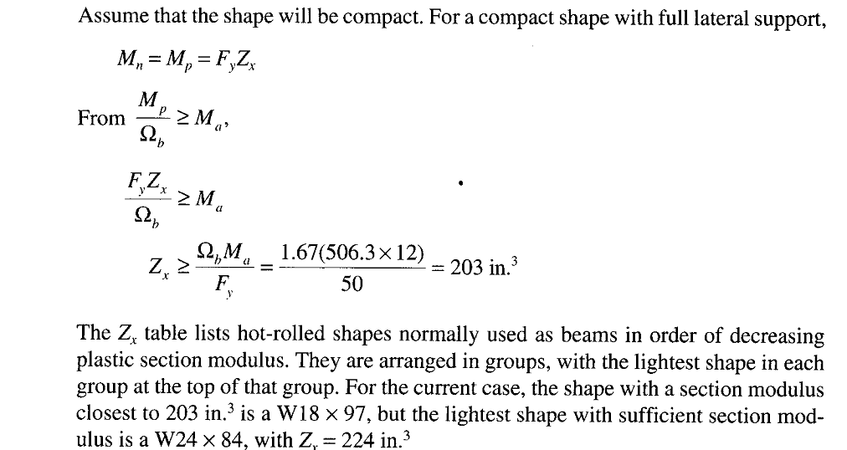

Slide 25
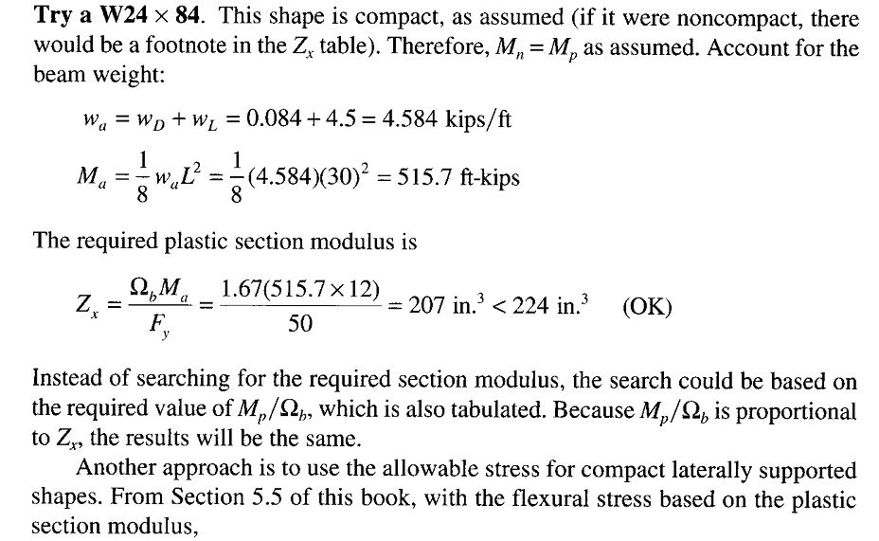

Slide 26
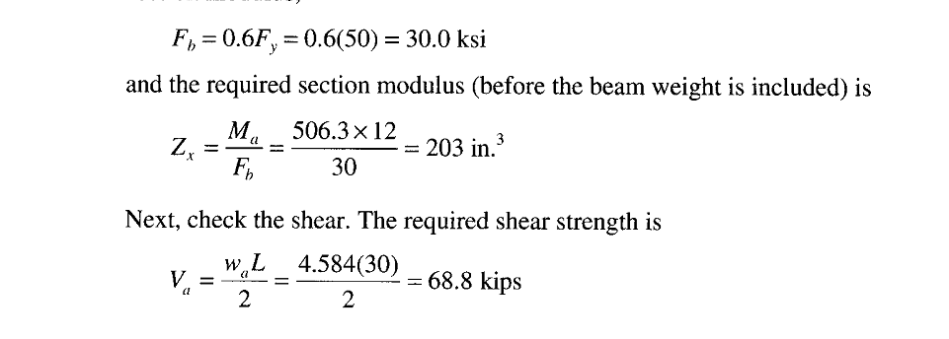

Slide 27
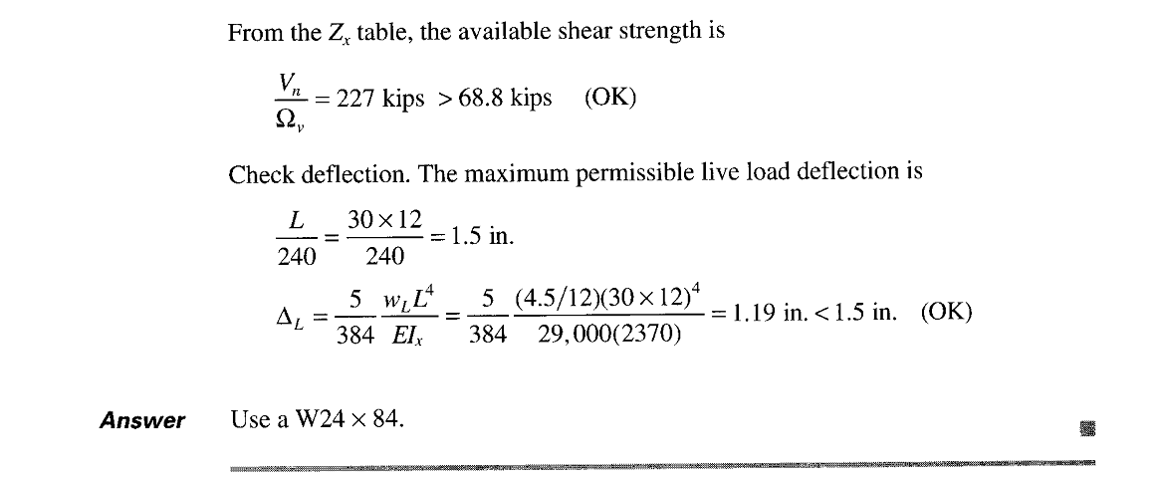

Slide 28
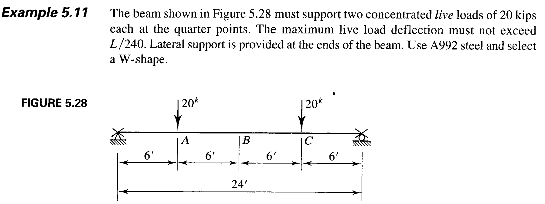

Slide 29
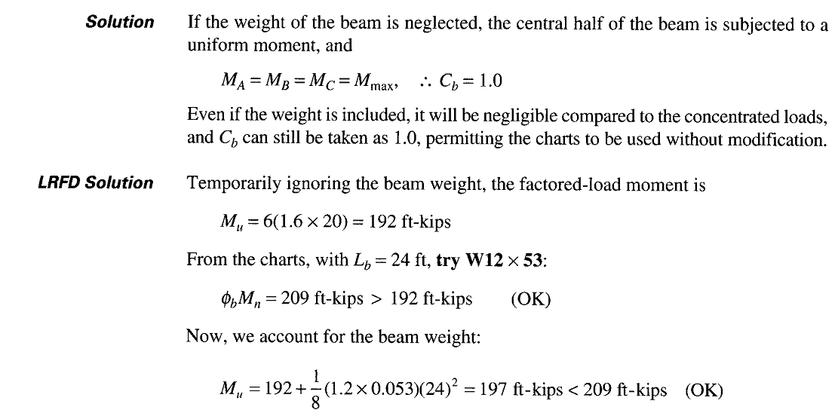

Slide 30
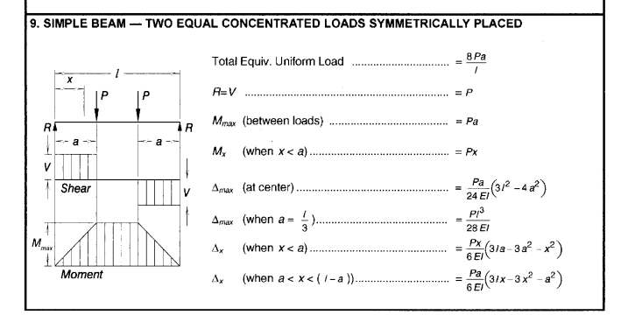

Slide 31
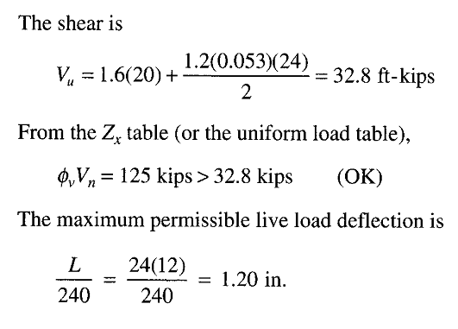

Slide 32
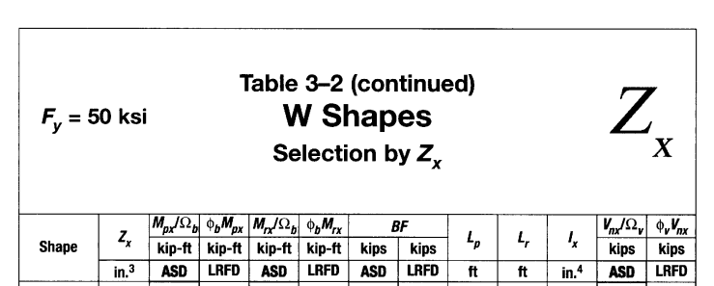

Slide 33
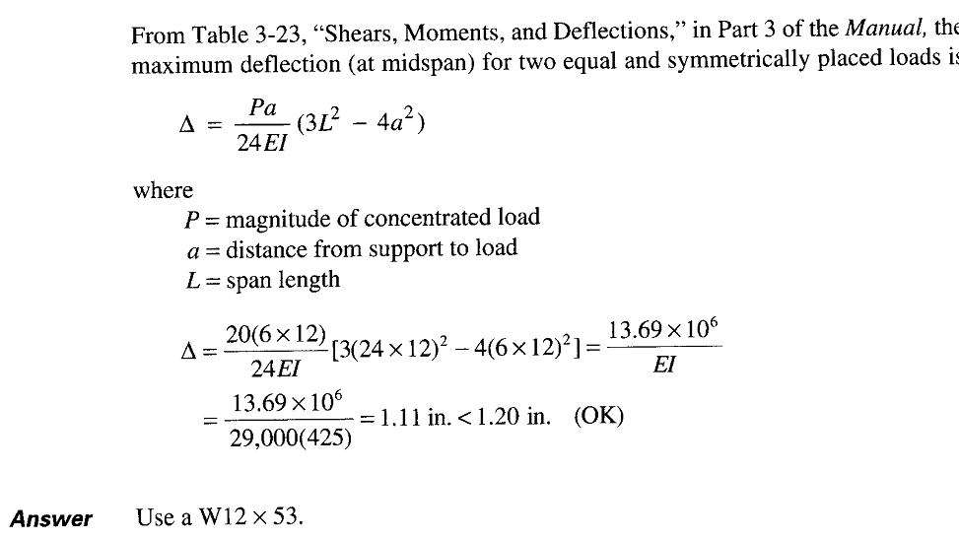

Slide 34
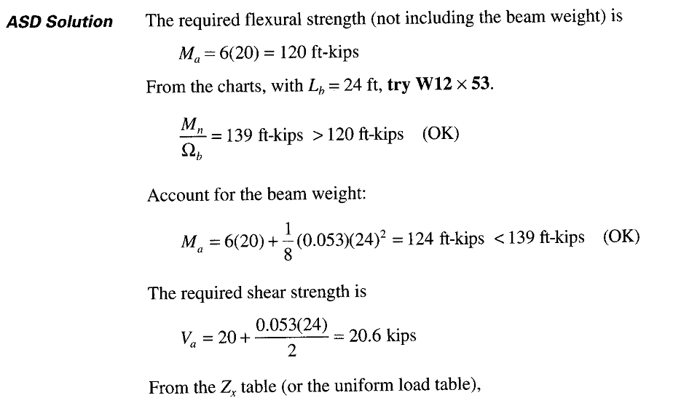

Slide 37
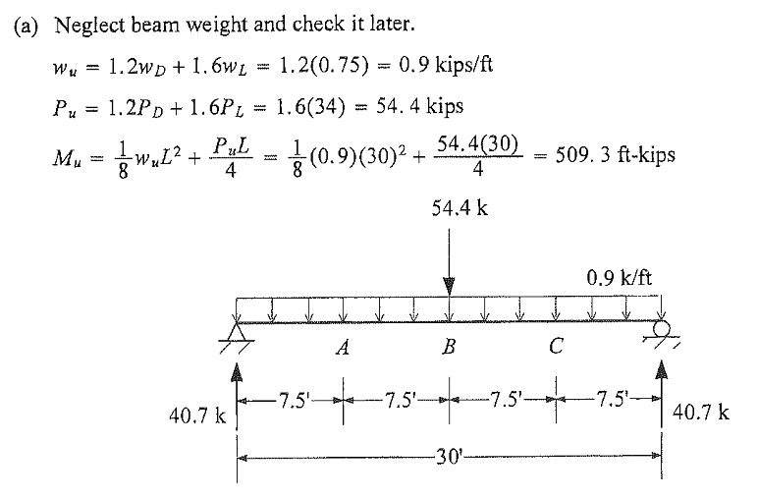

Slide 38
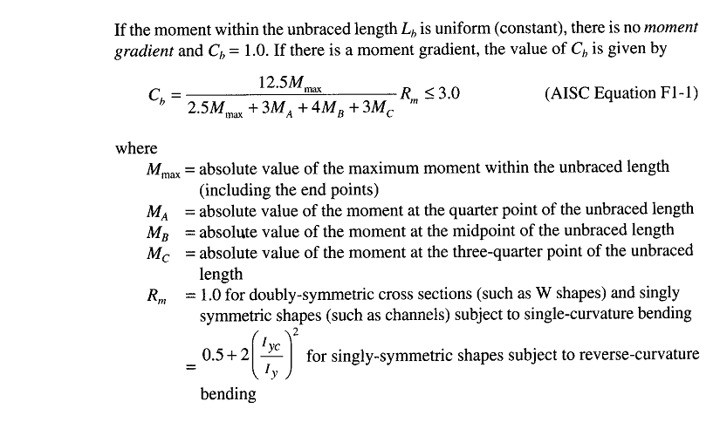

Slide 39
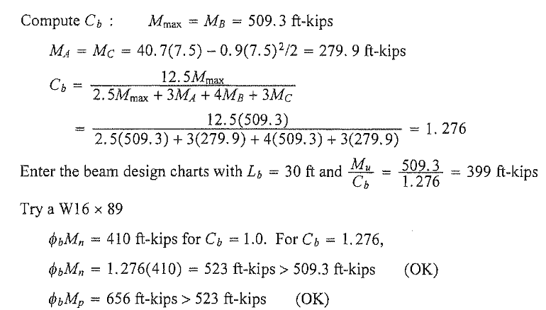

Slide 40
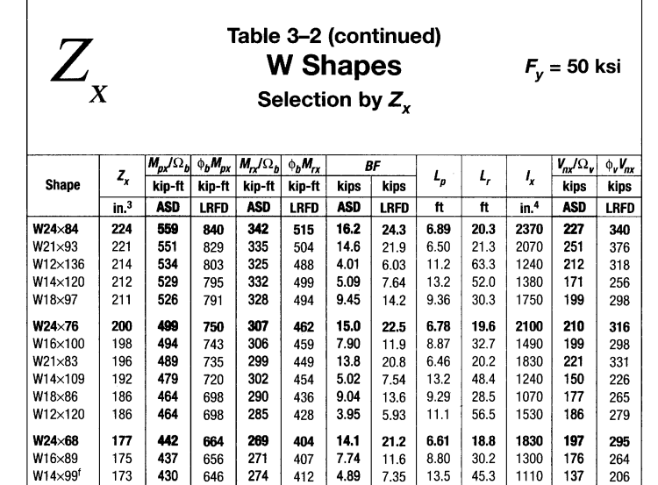

Slide 41
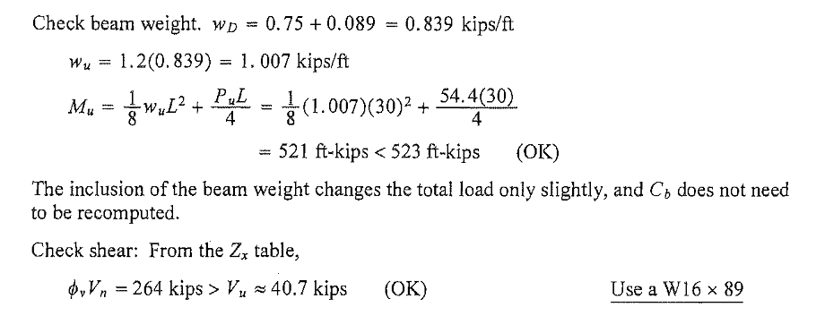

Slide 42
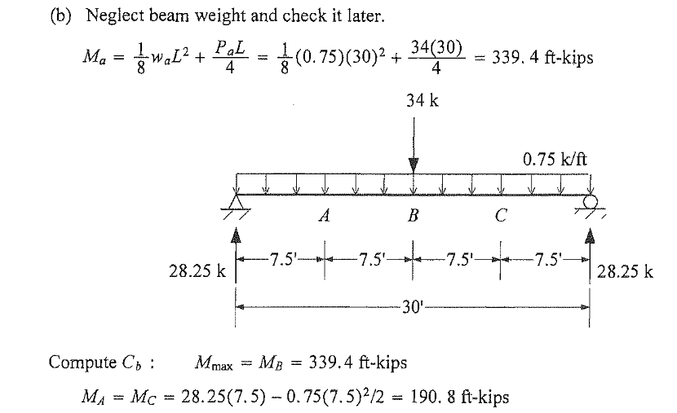

Slide 43
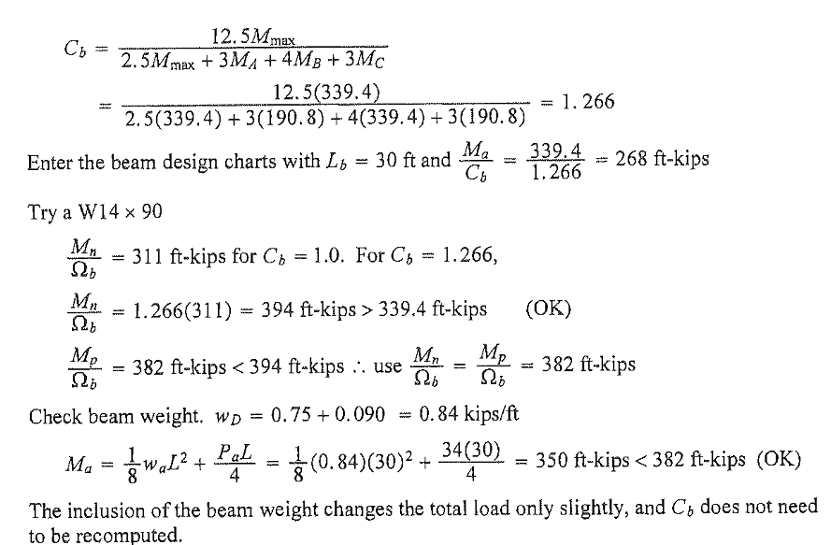

Slide 44
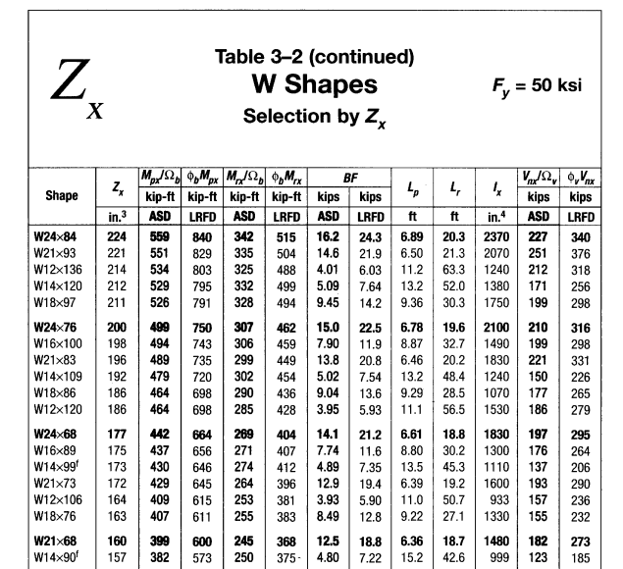

Slide 45
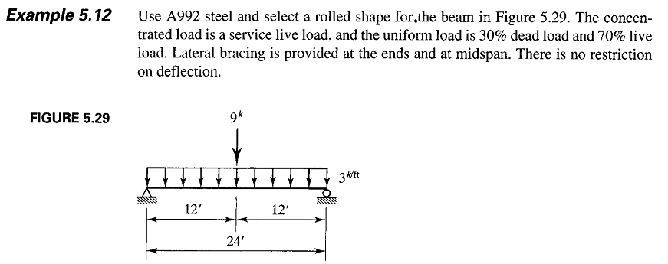

Slide 47
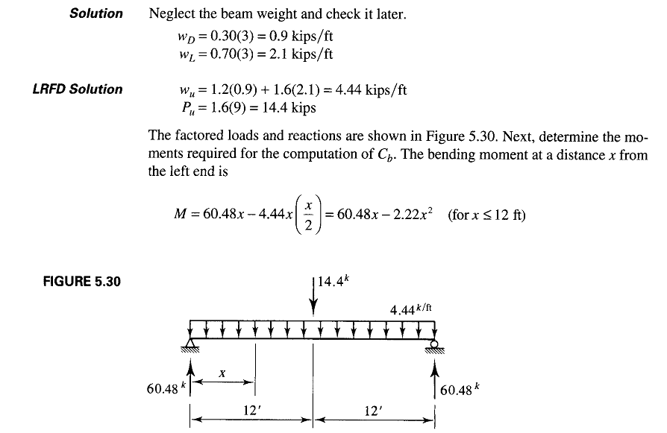

Slide 48
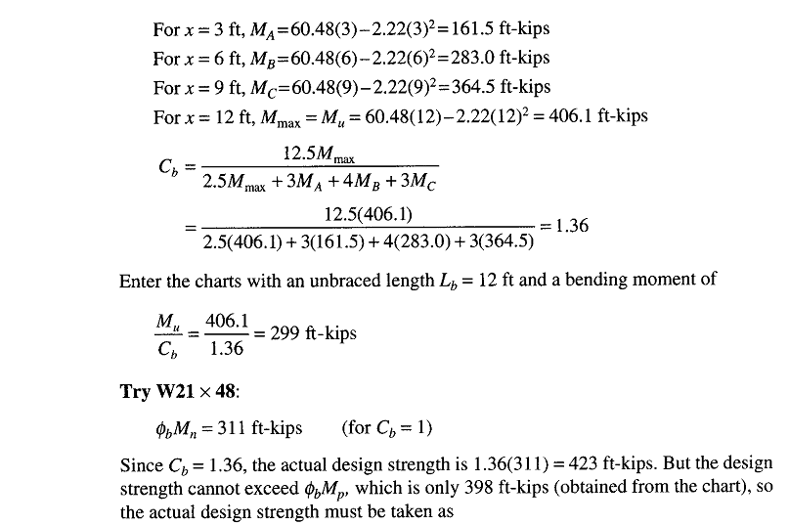

Slide 49
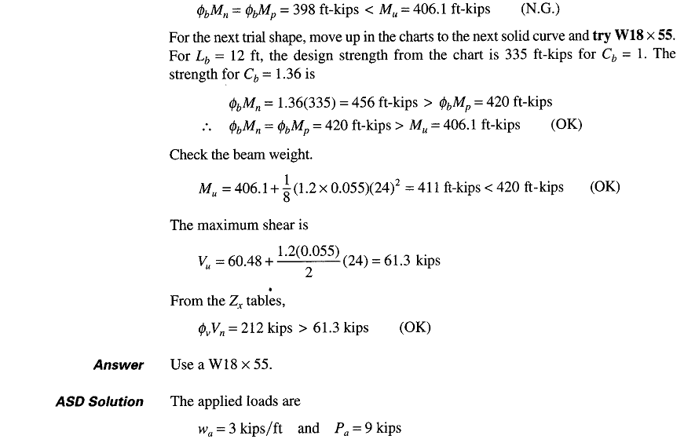

Slide 50
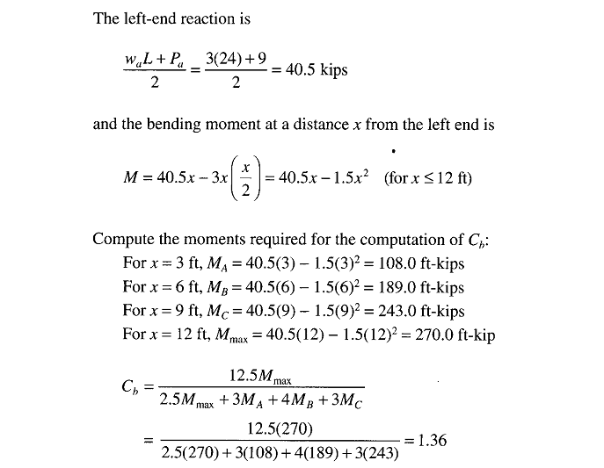

Slide 51
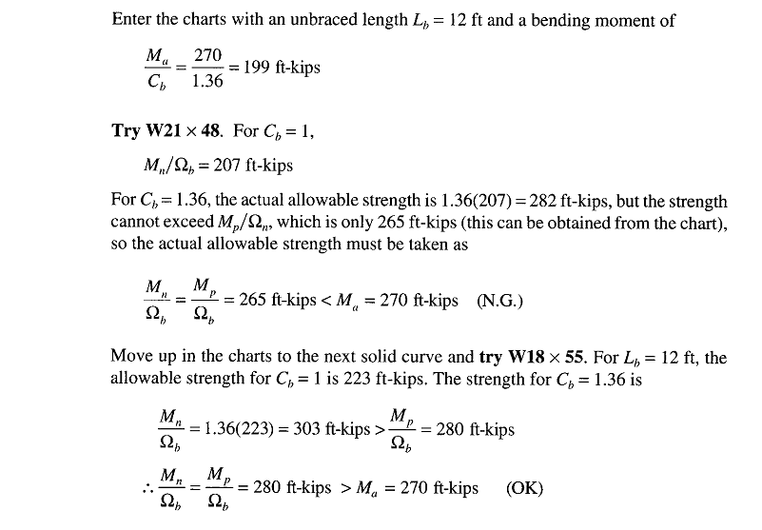

Slide 52
