Slide 1
Ent-502 3(2-1)
Insect Physiology
Sound production in insects

Slide 2
Sound
Sound is produced by vibrations, travel through any medium and can be heard through ears
Both living & non-living objects produce sound but only living objects use it for communication
Communication is the exchange of information b/w individuals

Slide 3
Sound production in insects
In insects, sound is a very effective communication tool.
It can be made to vary in frequency, amplitude and periodicity.
Acoustic communication is rapid source of information transfer as speed of air is 331m/sec
Insects use acoustic signals for both inter and intra-specific communication

Slide 4
Humans can hear the sound within the range of 20-20,000 Hz.
Some insects can produce ultrasonic sounds, not hearable for humans
E.g. Some grasshoppers and moths produce sounds of 80,000 Hz.
These high-pitch sounds are studied by an electronic device called “Audio transducer”
It converts inaudible high frequency sounds into audible low frequency sounds

Slide 5
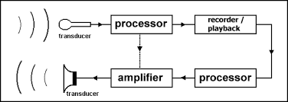
Audio transducer

Slide 6
Purpose of sound production
1. Recognition of kin or nest-mates
2. Locating or identifying a member of the opposite sex
3. Facilitation of courtship and mating
4. Giving directions for location of food or other resources
5. Establishing and maintaining a territory
6. Warning of danger; setting off an alarm
7. Advertising one's presence or location
8. Expressing threat or submission
9. Deception / mimicry

Slide 7
Mechanism of sound production in insects
By tapping part of body against external object
By friction of one part of body against another
By vibration of wings or thoracic wall
By vibration of special membrane through muscular action
By emission of air

Slide 8
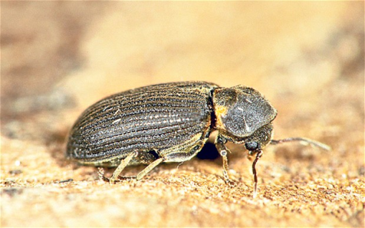
1-By tapping part of body against external object
Tapping the head against wall of burrow as a sexual call by male e.g.,Death-watch beetle and allied Anobiidae
Male plecoptera and Psocopteran (less Death-watch)rap the end of abdomen against substrate.
Pupae of Hesperidae and Lycaenidae knock the body against wall of their cells or substrate as defensive sound.
Soldiers of termites hammering their heads against the nest-structure as warning signal

Slide 9
By friction of one part of body against another
Stridulation:
Sound production by rubbing one part of body against another part
e.g. field cricket, mole cricket, tree cricket, Bess beetle, rhinoceros beetle, longhorn beetle
Stridulatory organs are present on insects body parts including wings, legs, antennae, mouthparts and segmental joints

Slide 10
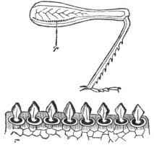
Stridulation in Acrididae

Slide 11
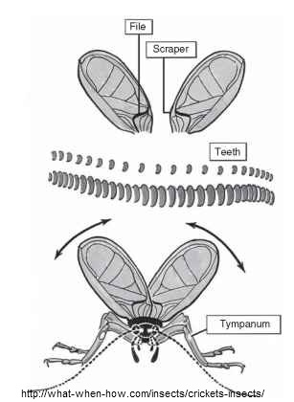
Stridulation in crickets-Tettigonidae and Gryllidae
Row of teeth on tegminal vein Cu2 (the file) is scraped by opposite tegmen.

Slide 12
Stridulation in Gryllacrididae
2nd and 3rd abdominal segments are rubbed by posterior femora
Stridulation in Hymenoptera
File on the first gastral tergum is scraped by the posterior edge of preceding tergum
Rhinoceros beetle
rubbing of a specialised region along the margin of the apex of the elytron

Slide 13
3-By vibration of wings or thoracic wall
Humming or buzzing sound during flight
In bees,
Food source 300-800 Hz
Normal flight 200Hz
Drosophila courtship song by wing vibration

Slide 15
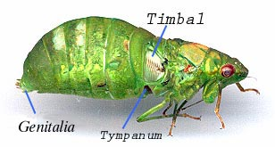
4-By vibration of special membrane through muscular action
Timbal mechanism:
Sound is produced by the contraction & relaxation of timbal
Timbal is an area of thin cuticle, surrounded by a rigid frame
The tymbal (or timbal) is the corrugated exoskeletal structure used to produce sounds in insects
Some cicadas produce sounds louder than 106 dB (SPL), among the loudest of all insect-produced sounds.

Slide 16
E.g. Cicada, Members of Homoptera and Hemiptera, some Lepidopterous adults specially of Arctiidae family

Slide 17
Sound production in Cicada
b, From above showing tymbals (drums), natural size;
a, Body of male Cicada from below, showing cover-plates of sound-producing organs
c, Section showing muscles which vibrate tymbals (magnified);
e, Thrown into vibration (as when cicada is singing), more highly magnified.
d, A tymbal at rest;
d
e

Slide 18
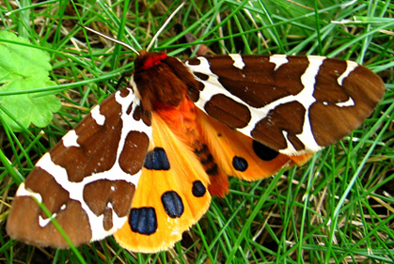
Sound production in Tiger moth
The tymbals of a tiger moth are specialized regions on the metathoracic episterna, (normally corrugated )
sound is produced when the entire tymbal surface is buckled by muscular contraction and then released, producing a series of extremely rapid "clicks" as the corrugations flex back into place
These sounds are used as warning signal to bats and as mating signals.
sounds are used by some moths to "jam" the sonar of moth-eating bats.

Slide 19
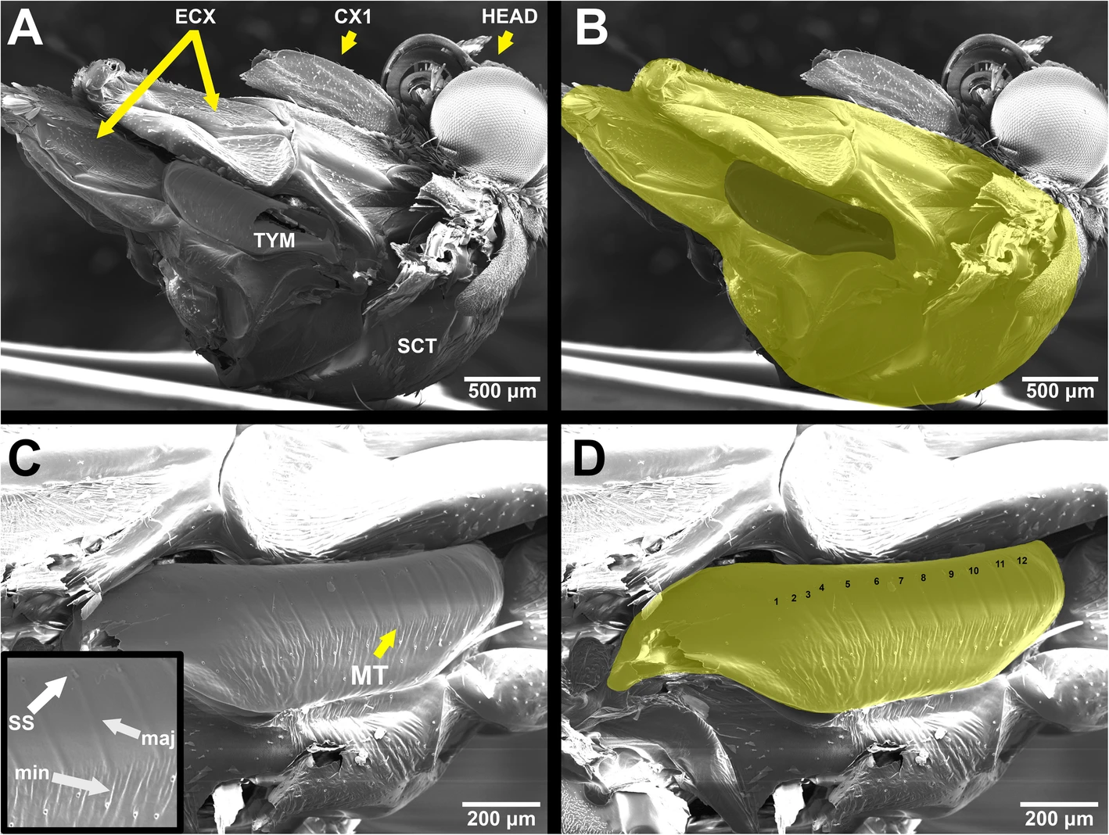
TYM: tymbal
Microtymbals (MT),
Tymbal
a Thorax with tymbal; ECX: eucoxae of meso- and metathorax, CX1: coxa of prothorax, TYM: tymbal, SCT: scutum
Dowdy, N.J., Conner, W.E. Characteristics of tiger moth (Erebidae: Arctiinae) anti-bat sounds can be predicted from tymbal morphology. Front Zool 16, 45 (2019). https://doi.org/10.1186/s12983-019-0345-6
Notes:
Scanning electron micrographs of Cisthene martini. a Thorax with tymbal; ECX: eucoxae of meso- and metathorax, CX1: coxa of prothorax, TYM: tymbal, SCT: scutum, HEAD: head. b Projected surface areas of the thorax (THSA) and tymbal (TYSA) highlighted in lighter and darker yellow regions, respectively. c Magnified image of tymbal; inset: further magnified view of microtymbals (MT), ss: scale sockets, maj: major grooves, min: minor grooves. d Magnified image of tymbal highlighted in yellow with microtymbals numbered in order from anterior to posterior. Scale bars in each image. a–d are oriented with the dorsal side towards the bottom and the ventral side towards the top. a, b are oriented with the anterior side towards the right and the posterior towards the left. c, d are oriented with the posterior towards the right and the anterior towards the left

Slide 20
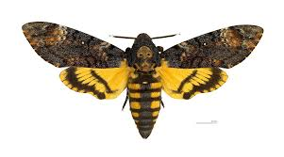
5-By emission of air
Emission of air from pharynx near the base of proboscis
E.g, death’s head hawkmoth (Acherontia atropos)

