Slide 1
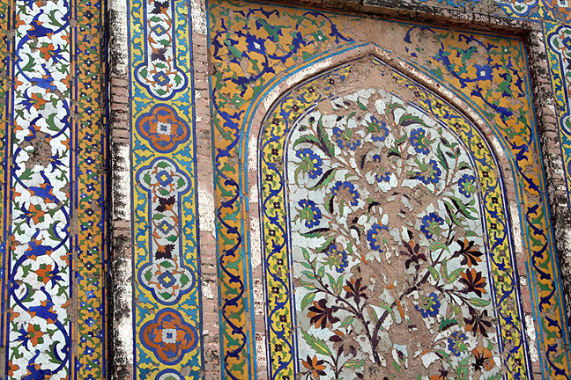
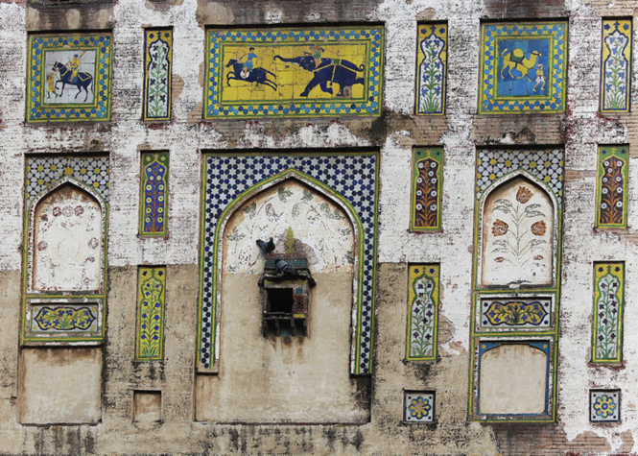
Histroric Mounments
Lahore Fort A Glorious Heritage of Mughal Emperors
The Picture Wall features mosaics depicting a myriad of scenes.

Slide 2
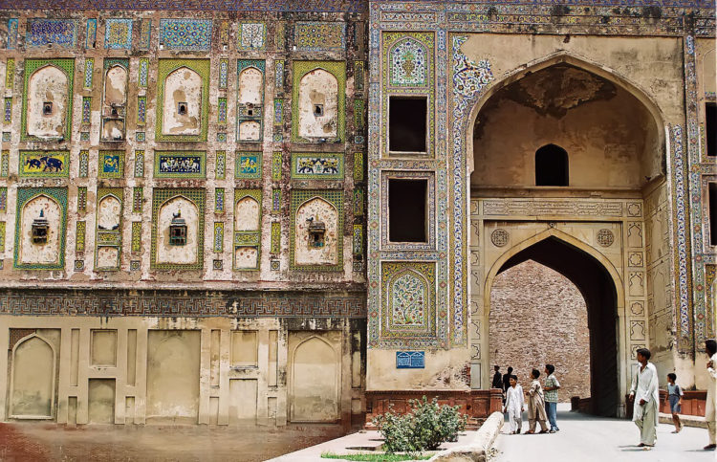
The fort’s massive Picture Wall dates from the Jahangir period.

Slide 3
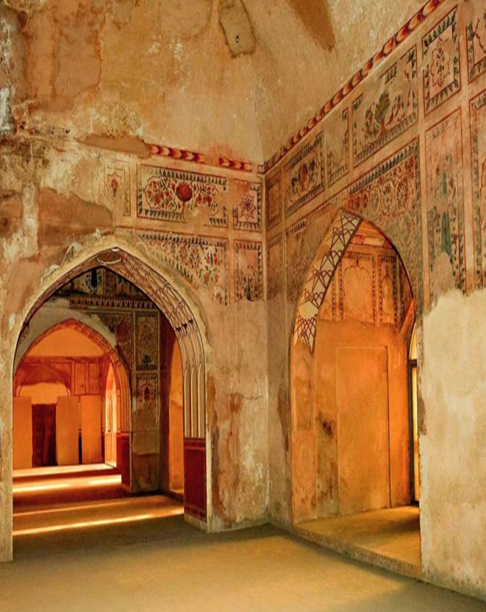

Slide 4
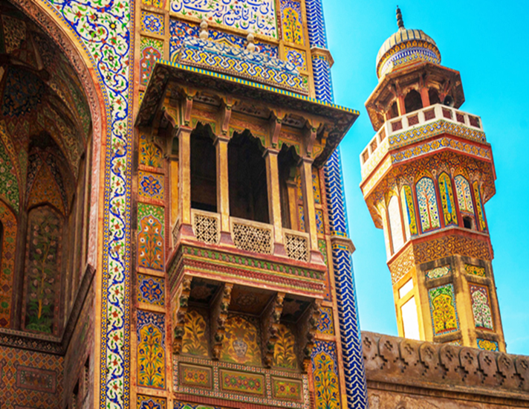
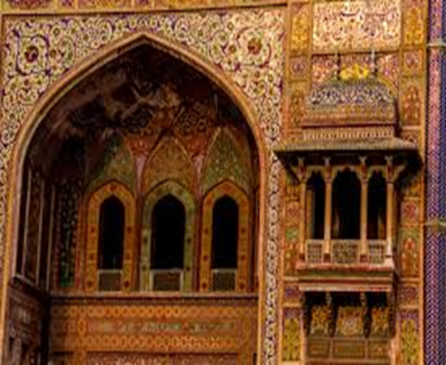
The Wazir Khan Mosque
The Wazir Khan Mosque ) in Lahore, Pakistan, is famous for its extensive faience tile and Calligraphy work. It has been described as ' a mole on the cheek of Lahore'.
It was built in seven years, starting around 1634-1635 AD, during the reign of the Mughal Emperor Shah Jahan. It was built by Shaikh-u-din Ansari.

Slide 5
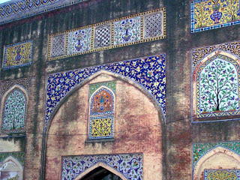
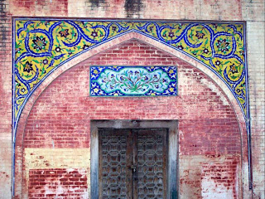
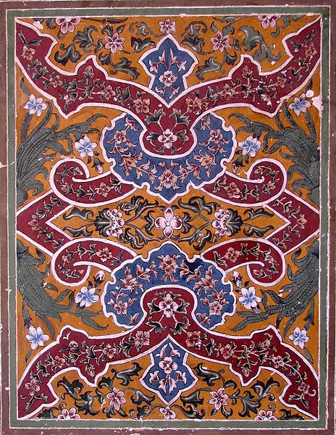

Slide 6
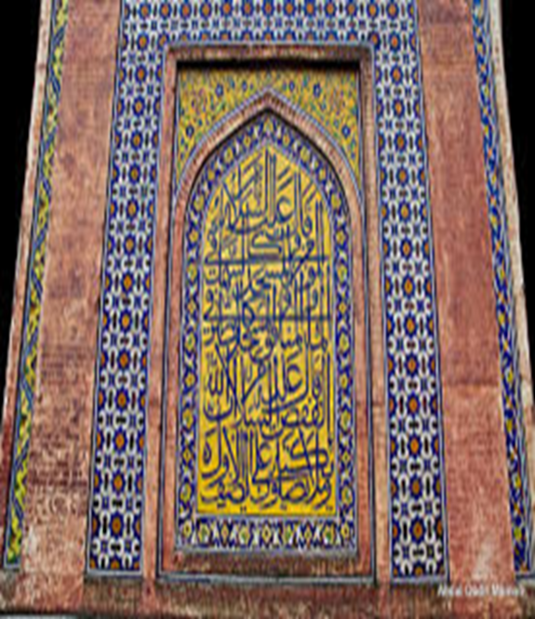

Slide 7
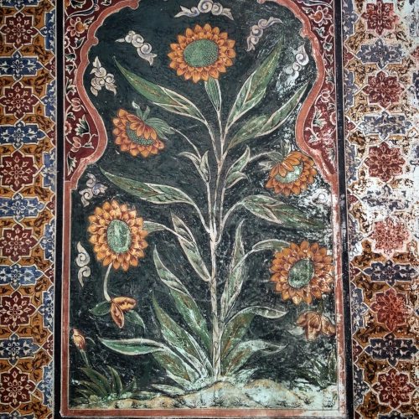
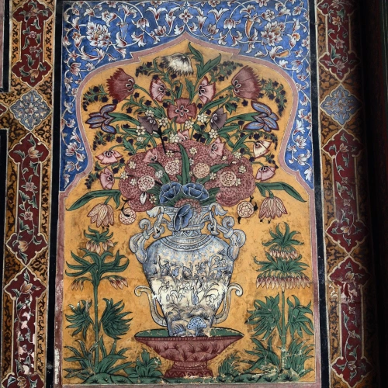

Slide 8
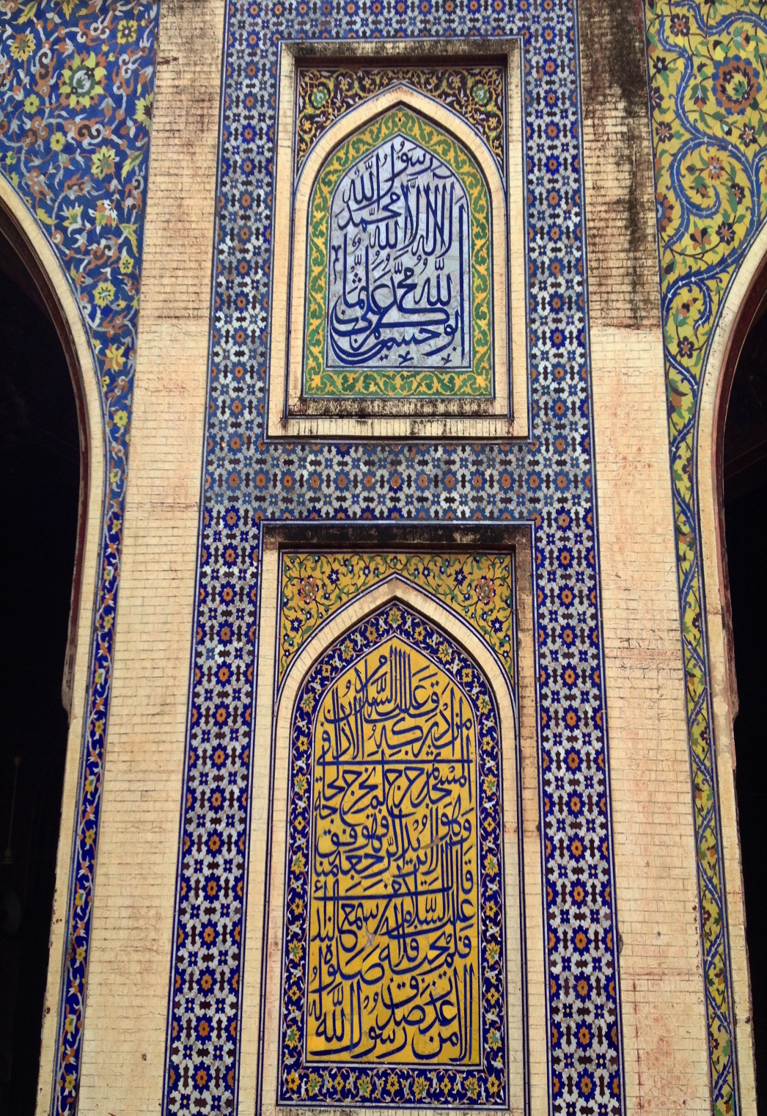
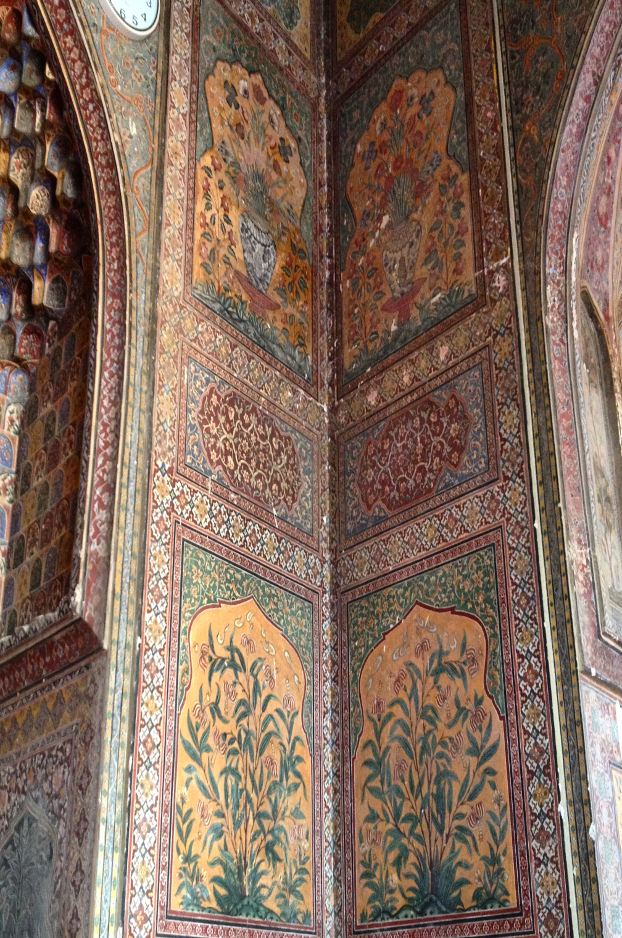

Slide 9
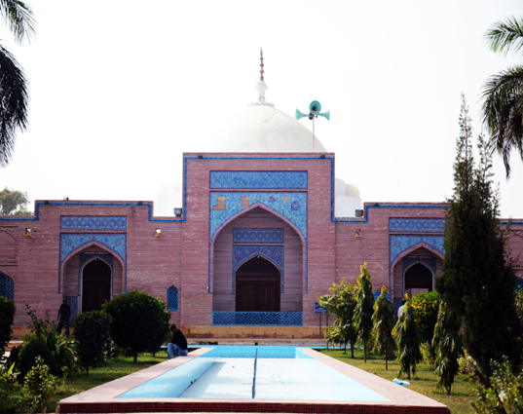
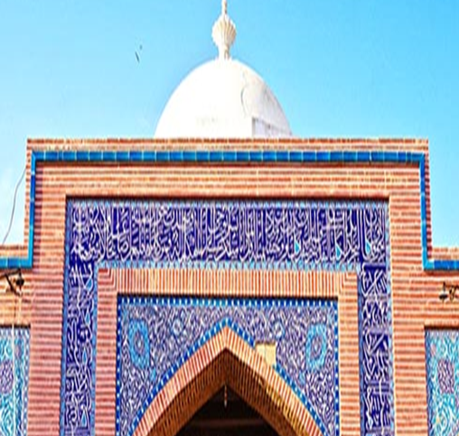
THATTA SHAH JAHAN MOSQUE
Shah Jahan Mosque was built by Shah Jahan in 1647-49. This structure has 101 domes and is designed in such a way that imam's voice can reach every corner of this building without the help of any loudspeaker or other device.

Slide 10
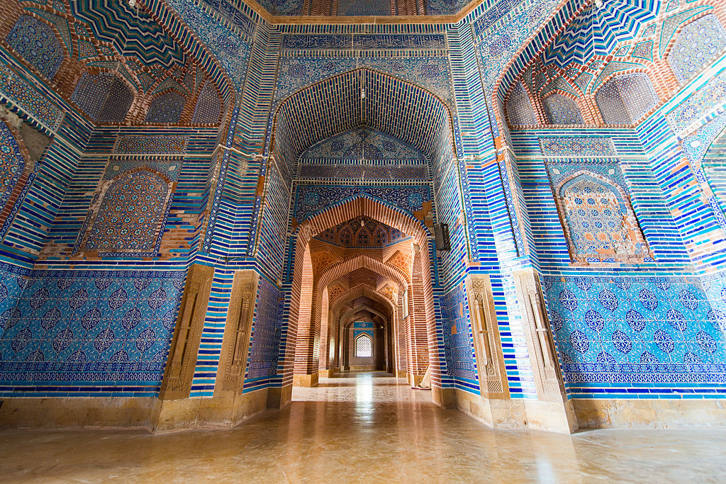

Slide 12
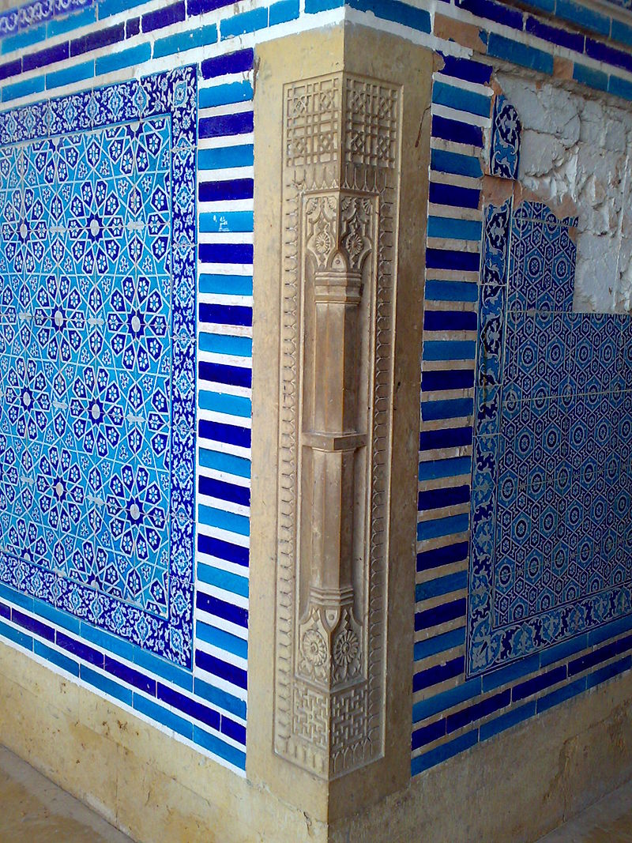

Slide 13
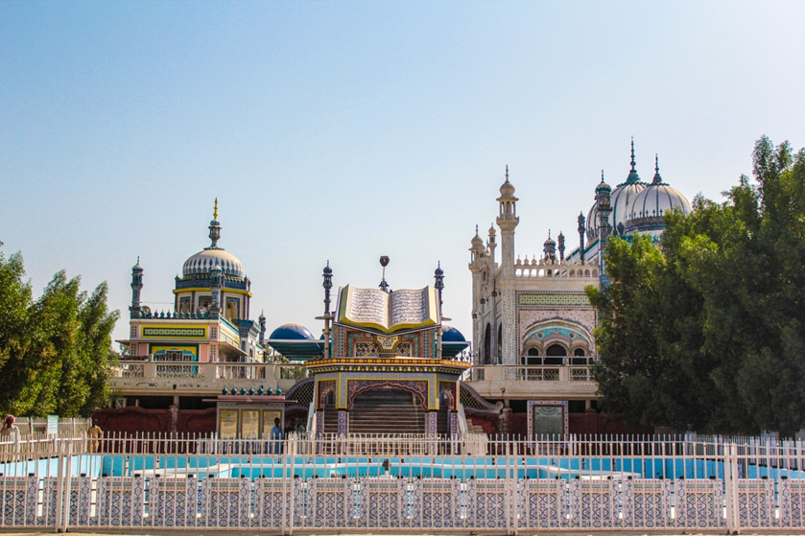
Bhong Mosque
Bhong Mosque is located in the village of Bhong, Sadiqabad Tehsil, Rahim Yar Khan District, Southern Punjab Pakistan.
It was designed and constructed over a period of nearly 50 years (1932–1982) and won the Aga Khan Award for Architecture in 1986.

Slide 14
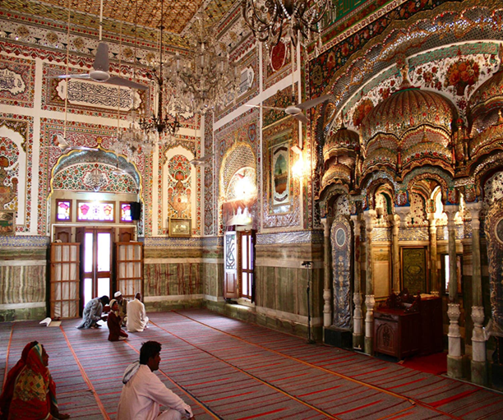

Slide 15
