Slide 1
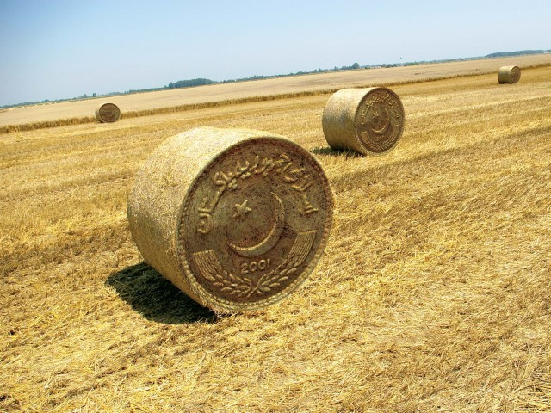
Salient Features of Pakistan’s Agriculture
Dr. AMJED ALI , COA, UOS

Slide 2
Agriculture Overview
Contribution to GDP = 20.9%
Labour force employed = 43.5%
Share of agriculture in total exports = 57.3%
Contribution of Different Sectors in GDP (%) 2017-18
Source: Economic Survey of Pakistan 2017-18

Slide 3
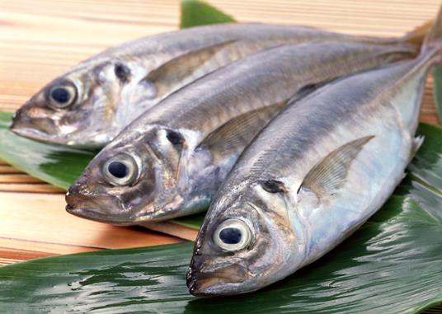
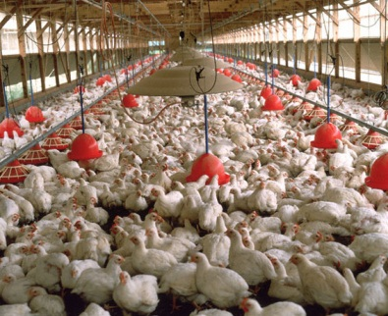
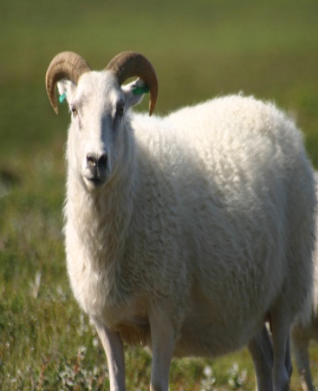
Share of Agro-based Products in Export Earnings
Pakistan Bureau of Statistics

Slide 4
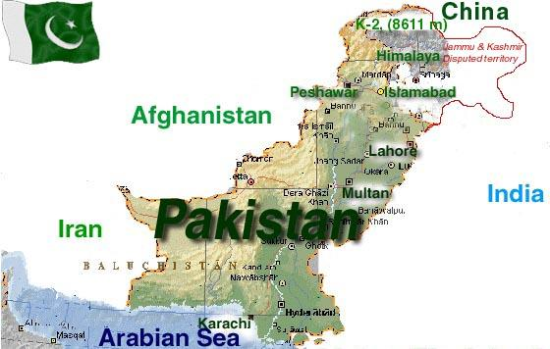

Slide 5
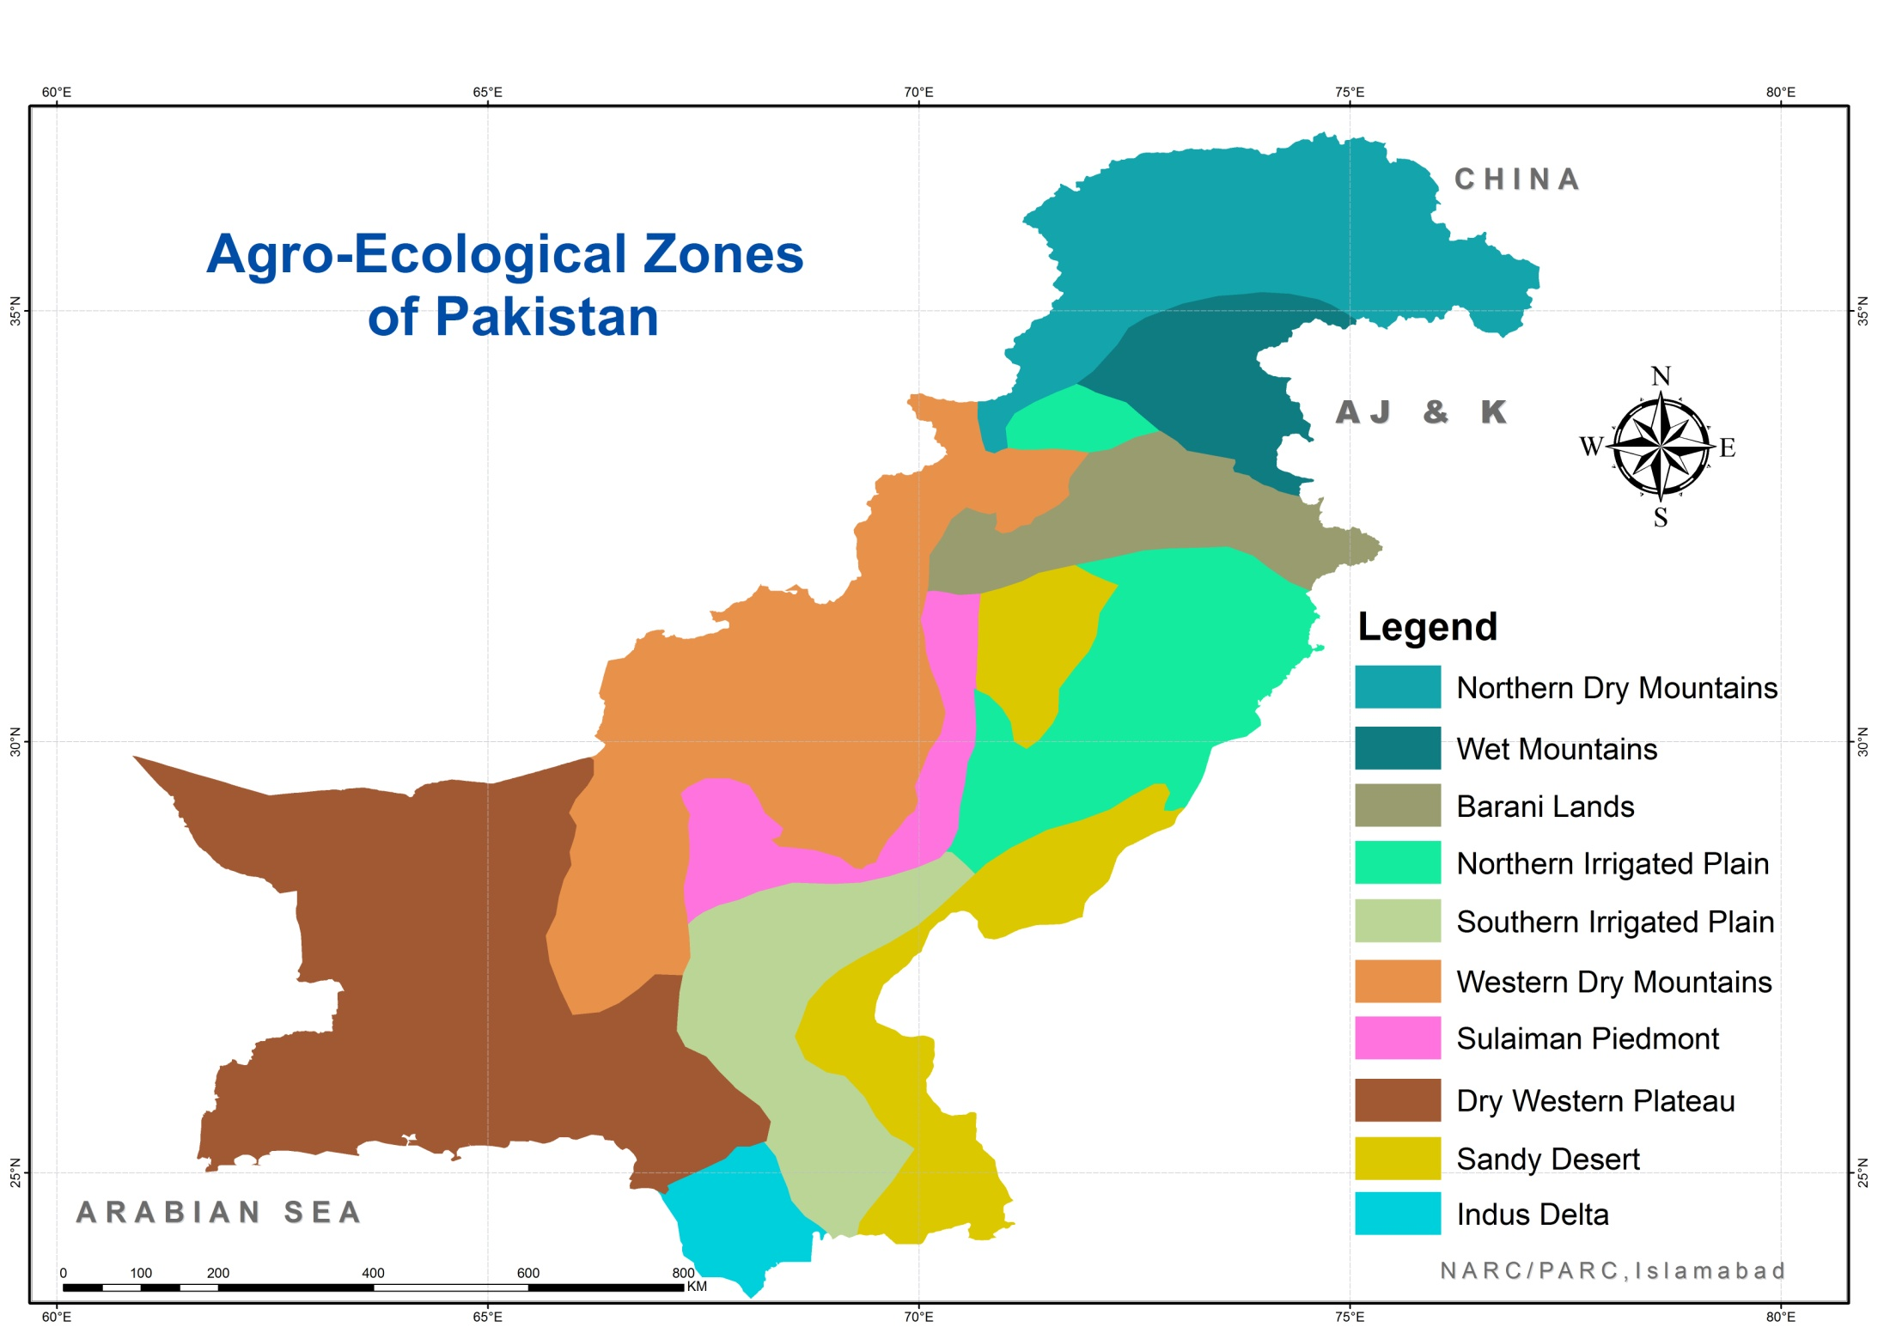

Slide 6
Agro Ecological Zones:
Zone | Climate | Soils and land use
1. Indus Delta (lands along sea) | Arid tropical marine | Clayey soils ; rice, sugar cane, banana, and pulses are the main crops
2. Southern Irrigated plain (Punjab + Upper Sindh) | Arid sub-tropical | Calcareous silty, sandy loams and loams; cotton, wheat, mustard, sugarcane and berseem are the major crops.

Slide 7
Agro Ecological Zones:
Zone | Climate | Soils and land use
3. Sandy deserts (Cholistan etc.) | Typical arid; | Moderately calcareous sandy soils; mainly used for grazing.
4. Northern Irrigated plain (upper Punjab) | Semiarid | Eastern part consists of calcareous silt loams, and southern part mainly calcareous loams; wheat and millet are the main crops.

Slide 8
Agro Ecological Zones:
5. Barani (rainfall land) | Semiarid | Sandy soil; wheat, gram, millet, pulses
6. Wet Mountains (Northern areas) | Semiarid; humid | Slightly to non-calcareous silt loams and silty calys; maize, wheat, olive and natural coniferous forests.

Slide 9
7. Northern Dry Mountains | Undifferentiated, very cold, snow fall common | Soils deep clayey in valleys and shallow on slopes, non-calcareous to acidic; main land use in grazing.
8. Western dry Mountains | Arid to semiarid: | Mostly bare sloping rocks, in valleys loamy soils; main land use is grazing and wheat with flood water, fruit include apple, peaches, plum, apricot and grapes.

Slide 10
9.Dry western Plateau | Arid tropical; | Soils in plains deep and calcareous silt loams; xerophytic vegetation, mainly grazing, vegetable and wheat with spring or kareze water at places.
10. Sulaiman Piedmont | Arid & hot, subtropical | Loams on gently sloping areas while clayey away, strongly calcareous; torrent watered and millet are main crops.

Slide 11
Overview
Total Area 79.61 M. hac
Cultivated Area 22.00 M. hac
Irrigated 17 Million Hectare
Barani (rainfed) 5 M. hac
Source: Pakistan Economic Survey, 2017-18

Slide 12
Status of Agriculture
Sr.# | Commodity | Ranking
1 | Chickpea | 3rd
2 | Cotton | 4th
3 | Livestock population | 4th
4 | Mango | 5th
5 | Sugarcane | 5th
6 | Milk | 5th
7 | Date | 6th
8 | Kinnow | 6th
9 | Apricot | 6th
10 | Wheat | 8th
11 | Onion | 8th
12 | Rice | 13th

Slide 13
Threats
Glaciers
Depletion
Climate
Change
Water
Pollution
Threats
Water
Sharing
Issues
Siltation
In
Mega dams
Increasing
Water
Deficit

Slide 14
Water Resources
Rainfall, Glacier, Ground water
Average Rain Fall
Pakistan is one of the world’s most arid countries – over 75% of it receives rainfall less than 250 mm annually and 20% of it less than 125 mm.
The population and economy are heavily dependent on an annual influx into Indus River System of about 154.88 MAF of water mostly derived from snow and glacier melt.

Slide 15
WATER AVAILABILITY IN PAKISTAN
Surface Water 154.88 MAF
Ground Water: 55 MAF
Total Quantity Available 59 MAF

Slide 16
A High Risk Water Environment
Pakistan’s dependence on single river system is highly vulnerable and has little flexibility as compared to most of the countries enjoyed by virtue of multiple river basins and diversity of water resources. If the water/sediment/salt system of the Indus Basin goes badly wrong, that’s it – and unfortunately we are very close to it.

Slide 17
No Additional Water
There is no additional water to be injected into the system.
Pakistan uses more than 90% of water for irrigation. Non-agricultural water uses are going to increase manifold in future.

Slide 18
DECLINING PER CAPITA AVAILABILITY OF WATER IN PAKISTAN

Slide 19
Points for Urgent Attention
Climate Change
Indus Waters Treaty
Transboundary pollution
Pakistan should demand minimum environmental flows for eastern rivers to protect biodiversity.
Pakistan needs both software and hardware solutions for future water management.

Slide 21
Investment Opportunities

Slide 22
Investment Opportunities
Aquaculture Value Chain Development
Olive & Grapes Value Chain
Farm Mechanization
Inclusive Value Chain for Horticulture
Seed Enterprise (Vegetable Seed Production)
Livestock Breeding Farms
Dairy Products
Meat Production & Value Addition
Veterinary Vaccine & Pharmaceutical Production

