Slide 1
Fruit & Vegetable Processing Technology-FST 303
Dr. SARFRAZ HUSSAIN
Professor
Institute of Food Science & Nutrition

Slide 2
Flow sheet of canning
Receiving:
Canning manger deals with the purchase of fresh fruits and vegetables and makes agreement with formers/growers and ensures fresh fruits and vegetables reach in factory in two hours.
He is also responsible for verities of F&V suitable for canning, there maturity at harvest and free of diseases, optimum quality

Slide 3
Flow sheet of canning
Sorting and Grading: After receiving F&V are sorted and graded on the basis of quality factors as suitable variety for canning, proper maturity, optimum size, color, flavor, taste and proper maturity for processing

Slide 4
Flow sheet of canning
Washing: washing is often practiced on the basis of availability of water after sorting and then washing and vice versa.

Slide 5
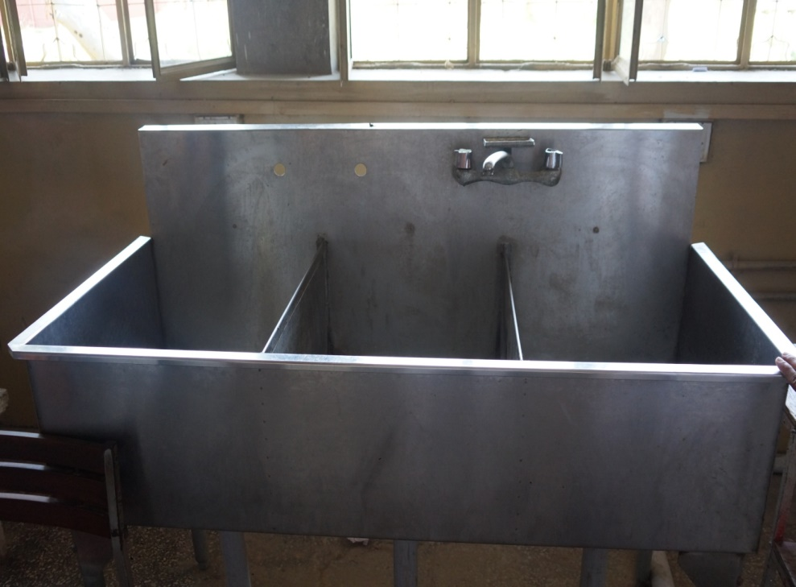
Rotary washer
Manual Tub Washer

Slide 6
Flow sheet of canning
Peeling:
All F&V have an outer protective covering which is mostly inedible hard fiber which remains undigested through passing our GI tract. This inedible fiber is removed by following methods
Abrasive peeler/mechenical peeler :
It is a batch type peeler handling 15 to 20 KG at once.it contains abrasion known as carborandum (mixture of carbon + silicon).it contains a lower round revolving disk with un even surface which helps in tumbling of vegetables up and down. The round drum also have rough coating which help in peeling. The peel is removed by application of water through pipe at the top. The peeling losses are very high (15-20 %). Its efficiency depends on the operator. It is only used for hard vegetables like tinda, turnip, carrot, patatoes.

Slide 7
Flow sheet of canning
2. Chemical peeler
In this method NaOH(sodium hydro oxide) 5-10% at boiling temperature for 5-10 min retention time used.
This chemical is very costly and to maintain its proper concentration is difficult.
It is dangerous to human skin and have cutting action.
It can be neutralized with the help of phenolphthlene indecator which show pink color on the excess of NaOH and can be neutralized with citric acid solution.
It needs excessive water to make vegetables free of sodiumhydro oxide.
It is not used oftenly in pakistan due high cost and danger to human health.

Slide 8
Flow sheet of canning
Cutting/slicing/dicing:
The F&V are cut into different shapes suitable for canning normal cutters are used for this purpose.
The size of the cuts is kept to penitrate heat and to kill micro organisms and inactivate enzymes (catalse and peroxidaze).

Slide 9
Flow sheet of canning
Blanching:
It can be defined as application of heat through boiling water or steam.
Catalse in 5 min while peroxidaze inactivates in 8 min.
Among additional benefits of blanching color of the vegetables is fixed and the gasses in plant tissue are expelled resulting in reduction in volume which helps in ease in filling tin cans.
The copper metal treqtment in blanching water fixes the green color of vegetable and green leafy vegetables through forming a stable bond.
Other wise on heating or boiling the color of green leafy vegetables turns light to unatractive olive green color.

Slide 10
Objectives Of Blanching
Blanching is an old and well-established practice in the food industry.
Early technological improvements focused on increasing product quality.
Later process efficiency in terms of product throughput, energy efficiency, and waste effluent reduction has been the main concern.
Targeting the right enzyme indicator would reduce blanching time and tackle all these priorities,

Slide 11
Objectives of blanching.....
Implementation of this requires modification of existing equipment to allow either faster product conveying or shorter pieces of equipment.
Furthermore, food processors and their customers have been using long-established guidelines that suggest the use of catalase or peroxidase as indicators.
There is still room for improvement of an apparently simple technology.

Slide 12
Objectives of blanching.....
Improving product quality (increasing retention of nutrients and other freshlike quality attributes),
Reducing energy consumption, and reducing waste production.

Slide 13
Flow sheet of canning
Filling:
The blanched and trained vegetables are filled in tin cans and due 2 to 3 % boiling salt solution is added in the vegetables and passed through the exhaust box to raise its temprature above 85 ⁰C the temprature is checked with the help of thermometer by insert it in the center of the tin can.

Slide 14
Flow sheet of canning
Exhausting
The tin cans filled with vegetables and brine are passed through a steam belt in an enclosed chamber to raise the temperature and expel the air and gasses and also raise the volume.
Advantages of exhausting:
Heating of tin cans in steam causes creation of vaccuum in tin cans after immediate sealing, processing and cooling.
The vaccuum releases the head space air which may help in breathing of micro organisms.
Vacuums results in reduction chemical spoilage.
If proper exhausting is not done at 85 ⁰ C the cans may show buldging and spoilage.

Slide 15
Flow sheet of canning
Sealing:
Sealing is done with the help of double seaming machine which makes the cannery end air tight by making five layers in the seam.
Seam becomes air tight with the help of a rubber lining coated on inside wedge on the lid.

Slide 16
Flow sheet of canning
Processing:
Processing means putting the sealed tin can in the retort to cook at 121 ⁰C and a correspondent pressure of 15 psi for at least required time recommended to kill the bacteria and make the can free of micro organisms.

Slide 17
1-Canning of spinach
Washing of spinach
Cutting/slicing of spinach
Water blanching: 3-5 min with addition of Sodium bicarbonate + sodium chloride to fix green color
Filling in tin cans: 450g blanched, drained spinach, 4.8 - 5.9g table salt in 2,5 No. Can and fill with boiling water
Exhaust at 76⁰ C for 7-8 min & seal immediately

Slide 18
1- Canning of Spinach Conti...
Process for 40 min at 121⁰C and 15 PSI and cool at 43⁰ C
Dissolve 2-3g bleaching powder in cooling water per liter to get 2-3ppm active chlorine to avoid post processing contamination through sniffing of cooling water during cooling.
Incubate at room temperature for one week or until buldging is seen.
Discard buldged cans and wipe and labell.
Secondary packing and marketting.

Slide 19
2-Canning of mango slices
Selection of mango for slices canning grafted mango chaunsa
Washing of mangoes
Peeling by hand & making 6 slices
Dipping of slices in 4% sugar (199g sugar in 3.8 liter water) solution to avoid blackening of slices
Filling 520g mango slices in 401 x 411 No. Can with 50% sugar solution (1.8939lier water with 1.0192 kg sugar) and boil fill syrup in cans,
Exhaust for 7-9 min at 212⁰F and seal,

Slide 20
2-Canning of mango slices
Acidity 0.25%, pH4.2
Exhaalcium chloride optional depending on maturity induces of mango & slices
Processing at 100⁰C for 7 minutes
Cooling at 43⁰C
Incubation for one week or until buldging is seen
Discard buldged cans wipe & label
Marketting

Slide 21
3-Canning of Tinda
Washing and peeling in abrassive peeler,
Cutting in slices as desired
Blanching in water for 4-6 min in water
Filling 350 -440g blanched drained tinda in 2.5 No. Can
Exhaust at 76⁰ C for 7 minutes

Slide 22
3 – Canning of tinda
Seal immediately
Process for 20 min at 121⁰C nd 15PSI
Cool at 43⁰C
Incubate for on weekor until buldging is seen
Wipe and label
Marketting

Slide 23
canning of whole Tomatoes in juice
Washing and peeling in boiling water for 30-45 sec or steam for 30 sec & cool under chilled water to remove peel by hand
Fill to the ¼ inch top head space
Add 2-3% sugar for balancing taste,
Acidification with citric acid 0.1-0.2%
Addition of 0.035 to 0.1% CaCl₂

Slide 24
Canning of whole Tomatoes (peeled & cored) in juice
Add 0.5% table salt to improve taste
Fill with hot boiling tomato juice to the top of can
Exhaust at 140-160⁰F for 7-8 min
Seal immediately & process at 212⁰ F for 40-45 min
Cool to 100⁰F
Drain weight not less than 540g.

Slide 25
Retorting in progress

Slide 26
Autoclave or Retort

Slide 27
Retort operation
Open the retort
Open the steam valve to make the retort warm
Open the drain valve to drain condenste.
Load the cans to keep them warm,
Make full load capacity quickly or by lowering the basket

Slide 28
Retort operation....
Close the retort tight.
Close the drain valve, over flow valve, exhaust valve, and steam to full.
Check the temperature and presure guage to attain 121⁰C and correspondant 15PSI pressure,
Note the come up time and start the stop watch for count of time.
Do not allow to fluctuate temperature & pressure,
Or record on a recorder & allow to elapse the processing time as required.

