Slide 1
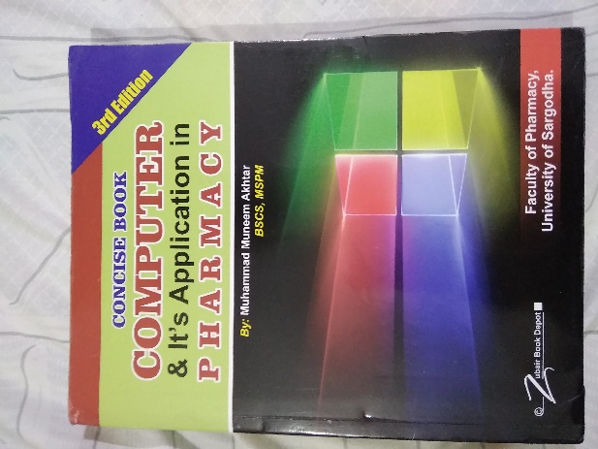
Computer Number System
13
Recommended For
Pharmacy Student !
Part
Pharm-D (Doctor of Pharmacy),
DPT (Doctor of Physiotherapy) &
Pharmacy Technician.
Muhammad Munim Akhtar

Slide 2
Welcome to
Computer & its Application in Pharmacy with Munim Akhtar
Free online quality educational tutorials about Computer in Pharmacy

Slide 4
Number Systems

Slide 5
Introduction
Number systems are simply ways to count things.
There is no symbol for “10” – or for the base of any system. We count 1,2,3,4,5,6,7,8,9, and then put a 0 in the first column and add a new left column, starting at 1 again. Then we count 1-9 in the first column again.
A number can be represented differently in different systems.
For example,
The numbers 2A₁₆, 52_{8,} 42₁₀.

Slide 6
Introduction
We are all familiar with the decimal number system (Base 10). Some other number systems that called positional number system are:
Binary → Base 2
Octal → Base 8
Hexadecimal → Base 16

Slide 7
The Decimal System

Slide 8
Binary Numbering Scale
Base 2 Number | Base 10 Equivalent | Power | Positional Value
000 | 0 | 2⁰ | 1
001 | 1 | 2¹ | 2
010 | 2 | 2² | 4
011 | 3 | 2³ | 8
100 | 4 | 2⁴ | 16
101 | 5 | 2⁵ | 32
110 | 6 | 2⁶ | 64
111 | 7 | 2⁷ | 128

Slide 9
Binary Number System
Also called the “Base 2 system”
The binary number system is used to model the series of electrical signals computers use to represent information
0 represents the no voltage or an off state
1 represents the presence of voltage or an
on state

Slide 10
Common Number Systems
System | Base | Symbols | Used by humans? | Used in computers?
Decimal | 10 | 0, 1, … 9 | Yes | No
Binary | 2 | 0, 1 | No | Yes
Octal | 8 | 0, 1, … 7 | No | No
Hexa- decimal | 16 | 0, 1, … 9, A, B, … F | No | No

Slide 11
Quantities/Counting (1 of 3)
Decimal | Binary | Octal | Hexa- decimal
0 | 0 | 0 | 0
1 | 1 | 1 | 1
2 | 10 | 2 | 2
3 | 11 | 3 | 3
4 | 100 | 4 | 4
5 | 101 | 5 | 5
6 | 110 | 6 | 6
7 | 111 | 7 | 7

Slide 12
Quantities/Counting (2 of 3)
Decimal | Binary | Octal | Hexa- decimal
8 | 1000 | 10 | 8
9 | 1001 | 11 | 9
10 | 1010 | 12 | A
11 | 1011 | 13 | B
12 | 1100 | 14 | C
13 | 1101 | 15 | D
14 | 1110 | 16 | E
15 | 1111 | 17 | F

Slide 13
Quantities/Counting (3 of 3)
Decimal | Binary | Octal | Hexa- decimal
16 | 10000 | 20 | 10
17 | 10001 | 21 | 11
18 | 10010 | 22 | 12
19 | 10011 | 23 | 13
20 | 10100 | 24 | 14
21 | 10101 | 25 | 15
22 | 10110 | 26 | 16
23 | 10111 | 27 | 17
Etc.

Slide 14
Conversion Among Bases
The possibilities:
Decimal
Octal
Binary
Hexadecimal

Slide 15
Decimal to Binary Conversion
The easiest way to convert a decimal number to its binary equivalent is to use the Division method (Algorithm)
This method repeatedly divides a decimal number by 2 and records the quotient and remainder

Slide 16
Quick Example
Decimal no Binary no. Octal no Hexadecimal no
25₁₀ =11001₂ =31₈ =19₁₆
Base

Slide 17
Decimal to Decimal (just for fun)
Decimal
Octal
Binary
Hexadecimal
Next slide…

Slide 18
Weight
125₁₀ => 5 x 10⁰ = 5 2 x 10¹ = 20 1 x 10² = 100 125
Base

Slide 19
Binary to Decimal
Decimal
Octal
Binary
Hexadecimal

Slide 20
Binary to Decimal Conversion
The easiest method for converting a binary number to its decimal equivalent is to use the Multiplication Algorithm
Multiply the binary digits by increasing powers of two, starting from the right
Then, to find the decimal number equivalent, sum those products

Slide 21
Significant digits

Slide 22
Binary to Decimal
Technique
Multiply each bit by 2^{n}, where n is the “weight” of the bit
The weight is the position of the bit, starting from 0 on the right
Add the results

Slide 23
Example
Bit “0”
101011₂ => 1 x 2⁰ = 1 1 x 2¹ = 2 0 x 2² = 0 1 x 2³ = 8 0 x 2⁴ = 0 1 x 2⁵ = 32
43₁₀

Slide 24
Octal to Decimal
Decimal
Octal
Binary
Hexadecimal

Slide 25
Octal Number System
Also known as the Base 8 System
Uses digits 0 - 7
Readily converts to binary
Groups of three (binary) digits can be used to represent each octal digit
Also uses multiplication and division algorithms for conversion to and from base 10

Slide 26
Octal to Decimal
Technique
Multiply each bit by 8^{n}, where n is the “weight” of the bit
The weight is the position of the bit, starting from 0 on the right
Add the results

Slide 27
Example
Weight
724₈ => 4 x 8⁰ = 4 2 x 8¹ = 16 7 x 8² = 448 468₁₀
Base
Base

Slide 28
Hexadecimal to Decimal
Decimal
Octal
Binary
Hexadecimal

Slide 29
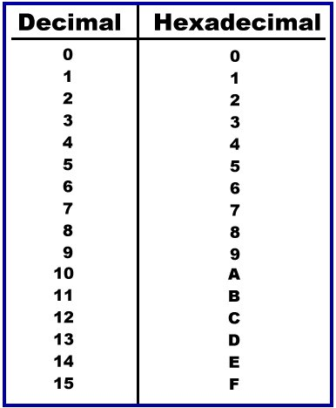
Hexadecimal Number System
Base 16 system
Uses digits 0-9 & letters A,B,C,D,E,F
Groups of four bits represent each base 16 digit

Slide 30
Hexadecimal to Decimal
Technique
Multiply each bit by 16^{n}, where n is the “weight” of the bit
The weight is the position of the bit, starting from 0 on the right
Add the results

Slide 31
Example
Weight
ABC₁₆ => C x 16⁰ = 12 x 1 = 12 B x 16¹ = 11 x 16 = 176 A x 16² = 10 x 256 = 2560
2748₁₀
Base
Base

Slide 32
Decimal to Binary
Decimal
Octal
Binary
Hexadecimal

Slide 33
Decimal to Binary
Technique
Divide by two, keep track of the remainder
First remainder is bit 0 (LSB, least-significant bit)
Second remainder is bit 1
Etc.

Slide 34
Example
125₁₀ = ?₂
2 125 62 1
2 31 0
2 15 1
2 7 1
2 3 1
2 1 1
125₁₀ = 1111101₂

Slide 35
Octal to Binary
Decimal
Octal
Binary
Hexadecimal

Slide 36
Octal to Binary
Technique
Convert each octal digit to a 3-bit equivalent binary representation

Slide 37
Example
705₈ = ?₂
7 0 5
111 000 101
705₈ = 111000101₂

Slide 38
Hexadecimal to Binary
Decimal
Octal
Binary
Hexadecimal

Slide 39
Hexadecimal to Binary
Technique
Convert each hexadecimal digit to a 4-bit equivalent binary representation

Slide 40
Example
10AF₁₆ = ?₂
1 0 A F
0001 0000 1010 1111
10AF₁₆ = 0001000010101111₂

Slide 41
Decimal to Octal
Decimal
Octal
Binary
Hexadecimal

Slide 42
Decimal to Octal
Technique
Divide by 8
Keep track of the remainder

Slide 43
Example
1234₁₀ = ?₈
8 1234
154-2
8
19-2
8
2-3
8
1234₁₀ = 2322₈

Slide 44
Decimal to Hexadecimal
Decimal
Octal
Binary
Hexadecimal

Slide 45
Decimal to Hexadecimal
Technique
Divide by 16
Keep track of the remainder

Slide 46
Example
1234₁₀ = ?₁₆
16 1234
77-2
Base
16
4-13 = D
16
Base
1234₁₀ = 4D2₁₆
Base

Slide 47
Binary to Octal
Decimal
Octal
Binary
Hexadecimal

Slide 48
Binary to Octal
Technique
Group bits in threes, starting on right
Convert to octal digits

Slide 49
Example
1011010111₂ = ?₈
Base
1 011 010 111
1 3 2 7
1011010111₂ = 1327₈

Slide 50
Binary to Hexadecimal
Decimal
Octal
Binary
Hexadecimal

Slide 51
Binary to Hexadecimal
Technique
Group bits in fours, starting on right
Convert to hexadecimal digits

Slide 52
Multiplication Algorithm

Slide 53
Example
1010111011₂ = ?₁₆
Base
Base
10 1011 1011
B B
Base
Base
1010111011₂ = 2BB₁₆

Slide 54
Octal to Hexadecimal
Decimal
Octal
Binary
Hexadecimal

Slide 55
Octal to Hexadecimal
Technique
Use binary as an intermediary

Slide 56
Example
1076₈ = ?₁₆
1 0 7 6
001 000 111 110
Base
2 3 E
Base
1076₈ = 23E₁₆

Slide 57
Hexadecimal to Octal
Decimal
Octal
Binary
Hexadecimal

Slide 58
Hexadecimal to Octal
Technique
Use binary as an intermediary

Slide 59
Example
1F0C₁₆ = ?₈
1 F 0 C
0001 1111 0000 1100
Base
1 7 4 1 4
Base
Base
1F0C₁₆ = 17414₈

Slide 60
Exercise – Convert ...
Decimal | Binary | Octal | Hexa- decimal
33
 | 1110101
 |  | 703
 |  |  | 1AF
Don’t use a calculator!
Skip answer
Answer

Slide 61
Exercise – Convert …
Answer
Decimal | Binary | Octal | Hexa- decimal
33 | 100001 | 41 | 21
117 | 1110101 | 165 | 75
451 | 111000011 | 703 | 1C3
431 | 110101111 | 657 | 1AF

Slide 62
Binary Addition (1 of 2)
Two bit values
A | B | A + B
0 | 0 | 0
0 | 1 | 1
1 | 0 | 1
1 | 1 | 10
“two”

Slide 63
Binary Addition (2 of 2)
Two n-bit values
Add individual bits
Propagate carries
E.g.,
1
1
10101 21 1001 + 25 101110 46

Slide 64
Multiplication (1 of 3)
Decimal multiplication (just for fun)
35 x105 175 00x 35xx 3675

Slide 65
Binary Multiplication (2 of 3)
Binary, multiplication two bit values
A | B | A × B
0 | 0 | 0
0 | 1 | 0
1 | 0 | 0
1 | 1 | 1

Slide 66
Multiplication (3 of 3)
Binary, Multiplication two bit values
As with decimal values
E.g.,
1110 x 1011 1110 1110 0000 1110 10011010

Slide 67
Example of Multiplication …
Q = Ans.
=
=
=

Slide 68
?

