Slide 2
ANTIMALARIAL DRUGS AND DENGUE FEVER
BY HAFIZA SARA AFZAL

Slide 7
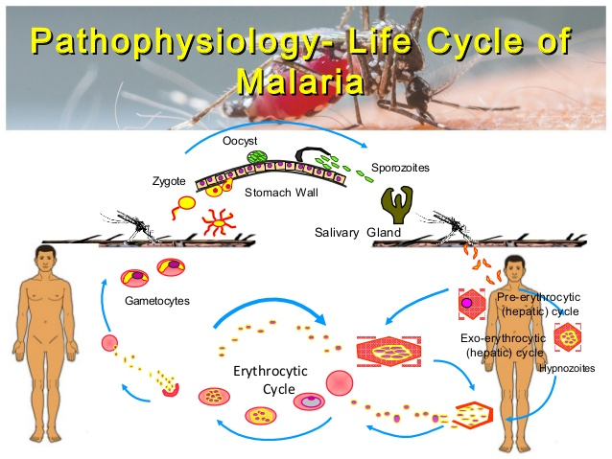

Slide 10
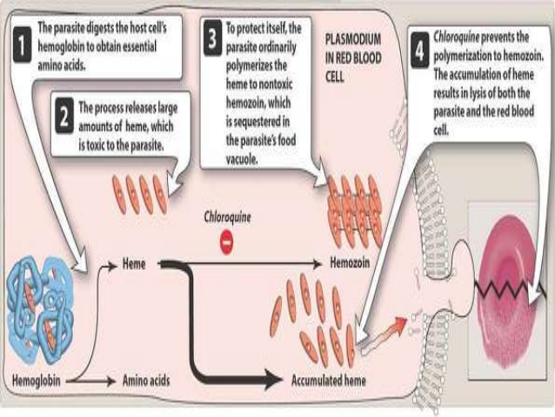

Slide 13
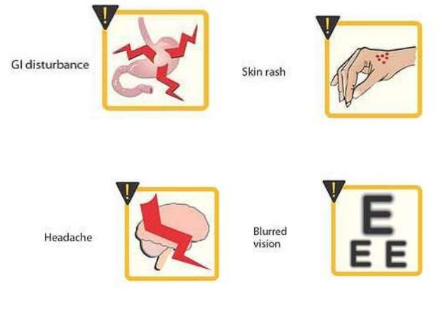

Slide 19
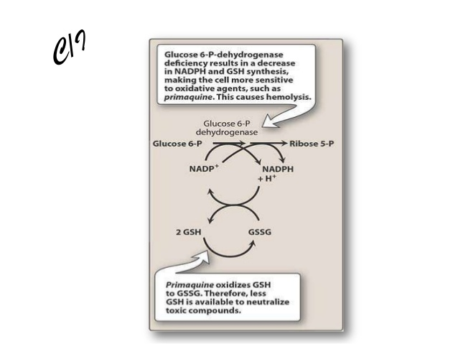

Slide 39
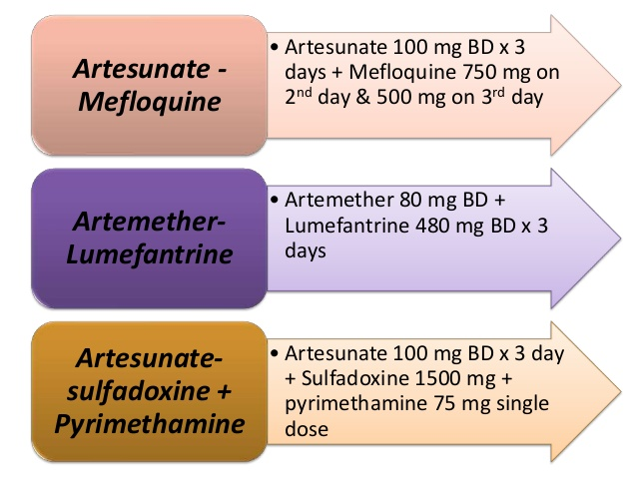

Slide 58
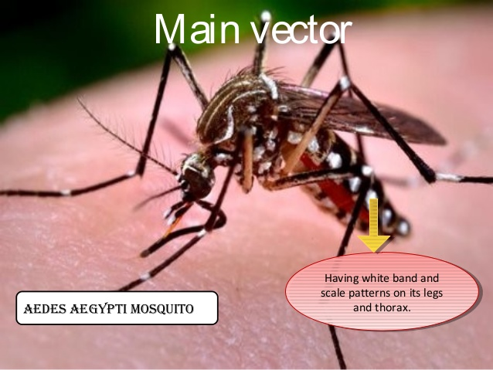

Slide 59
