Slide 1
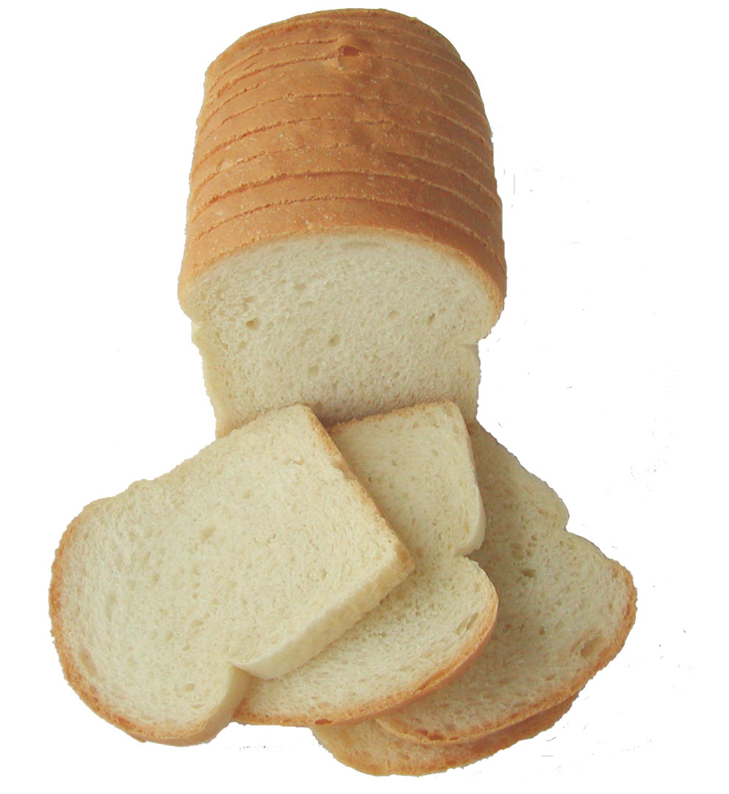
QUALITY CONTROL IN BAKING INDUTRSY
Quality Control
Covers the activities which help to keep the production running smoothly and efficiently
Objective
Ensure that the finished products are within the predetermined specifications

Slide 2
QUALITY CONTROL IN BAKING INDUTRSY
How to ensure Quality control
Testing of raw material
Testing of Finished Product

Slide 3
Testing of raw material
Most important raw material is flour
Tests of wheat flour include
Moisture
Ash
Protein
Gluten
Water absorption

Slide 4
Testing of finished product
1. External characteristics
2. Internal characteristics
External characteristics
Volume:-
Important consideration in consumers acceptance and depends upon ingredients and processing conditions

Slide 5
Volume…….
Excessive volume will have
Open grain
Weak texture
Low loaf volume will have
Rough grain
Honey comb texture
So volume should be neither too large not too small

Slide 6
Color Of Crust
Color of crust is called Bloom
Ideal color is appetizing golden brown.
Crust color is due to
Caramilization
Millard reaction
Color depends upon
Amount of sugar
Temperature of baking

Slide 7
Crust color……………..
Undesirable crust color includes
Dark
Reddish brown
Greyish
Pale straw coplo

Slide 8
Evenness of bake
Means loaf has been made with uniformity of bake from all sides
Factors effecting the evenness of bake include
Proofing
Controlled oven conditions
Distance between the pans in oven
Symmetry of form
It’s the shape of bread or symmetry of loaf

Slide 9
Internal characteristics of Bread
Crumb Structure
Most important internal character
Crumb structure is Broadly divided into
Grain
Texture
Grain
Cell structure of loaf is called as grain

Slide 10
Grain
Grain might be
Fine grain
Coarse grain
Fine grain
Crumb structure where
Cells are small and uniform
Cells are round
Cell walls are thin

Slide 11
Grain………….
Coarse grain
In case of course grain bread
Cells are large
Cell walls are thick
Cells are irregular

Slide 12
Crumb Texture
Texture is the feel of the surface of interior of loaf when cut and sliced
Texture could be classified as
Velvety
Silky
Soft
Elastic

Slide 13
Texture………….
Inferior texture may be
Rough
Hard
Crumbly
Lumpy
Texture is determined by pressing the fingers and rubbing them across the cut surface of loaf

Slide 14
Crumb Color
Color of the crumb should be bright without any dark patches
Coarse grain will appear
Darker in color
Fine grain slice will appear
White in color

Slide 15
Bread Aroma
Aroma is judged by carefully smelling
Aroma may be
Wheaty
Sweet
Rancid
Moldy
Sour
Ideal loaf will have wheaty aroma

Slide 16
Bread Taste
Aroma is judged by carefully smelling, whereas taste is judged by eating and both are closely related character
Taste may be
Wheaty
Sweet
Rancid
Moldy
Sour

Slide 17
Properly Baked Bread

