Slide 1
Chapter 6
Storage

Slide 2
Storage
Storage holds data, instructions, and information for future use.
For example, all types of users store digital photos; appointments, schedules, and contact/address information; correspondence, such as letters, e-mail messages; tax records; and Web pages.

Slide 3
Storage
A storage medium (media is the plural), also called secondary storage, is the physical material on which a computer keeps data, instructions, and information.
Examples of storage media are hard disks, solid state drives, memory cards, USB flash drives, ExpressCard modules, optical discs, smart cards, magnetic stripe cards, and microfilm.

Slide 4
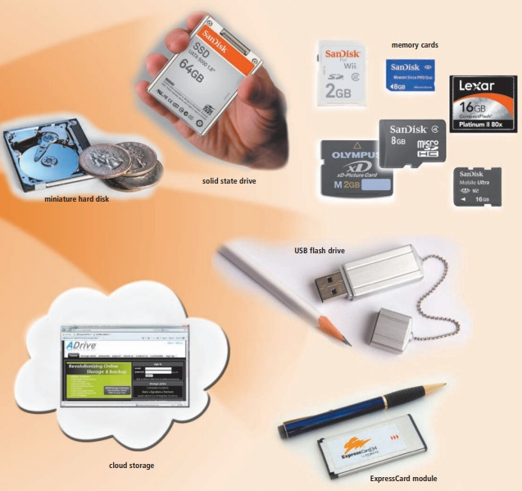
Storage Devices

Slide 5
capacity
Capacity is the number of bytes (characters) a storage medium can hold.
For example, a reasonably priced USB flash drive can store up to 4 GB of data (approximately four billion bytes) and a typical hard disk has 320 GB (approximately 320 billion bytes) of storage capacity.

Slide 6
Writing / Reading Process
A storage device is the computer hardware that records and/or retrieves items to and from storage media.
Writing is the process of transferring data, instructions, and information from memory to a storage medium.
Reading is the process of transferring these items from a storage medium into memory.
When storage devices write data on storage media, they are creating output. Similarly, when storage devices read from storage media, they function as a source of input.

Slide 7
Access Time
The speed of storage devices is defined by access time.
Access time measures the amount of time it takes a storage device to locate an item on a storage medium.
The access time of storage devices is slow, compared with the access time of memory.
Memory (chips) accesses items in billionths of a second (nanoseconds).
Storage devices, by contrast, access items in thousandths of a second (milliseconds) or millionths of a second (microseconds).

Slide 8
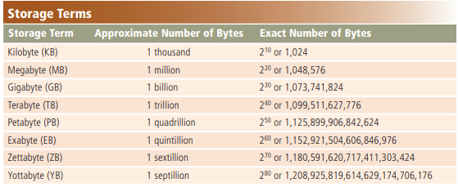
Storage Terms

Slide 9
Hard disk
A hard disk is a storage device that contains one or more inflexible, circular platters that use magnetic particles to store data, instructions, and information.
Current personal computer hard disks have storage capacities from 160 GB to 2 TB and more.
Home users store documents, spreadsheets, presentations, databases, e-mail messages, Web pages, digital photos, music, videos, and software on hard disks.

Slide 10
Hard disk
Traditionally, hard disks stored data using longitudinal recording, which aligned the magnetic particles horizontally around the surface of the disk.
With perpendicular recording, by contrast, hard disks align the magnetic particles vertically, or perpendicular to the disk’s surface, making much greater storage capacities possible.
Experts estimate that hard disks using perpendicular recording provide storage capacities about 10 times greater than disks that use longitudinal recording.

Slide 11
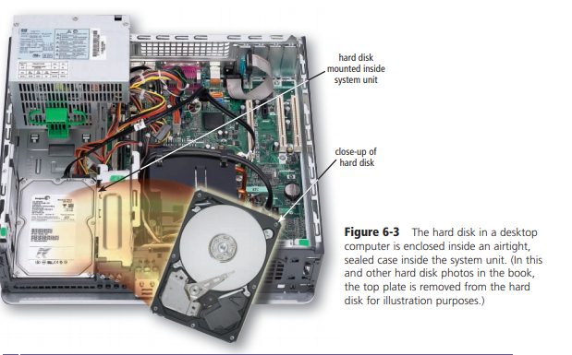
Hard disk

Slide 12
Characteristics of a Hard Disk
Characteristics of a hard disk include capacity, platters, read/write heads, cylinders, sectors and tracks, revolutions per minute, transfer rate, and access time. Figure 6-4 shows sample characteristics of a 1 TB hard disk.

Slide 13
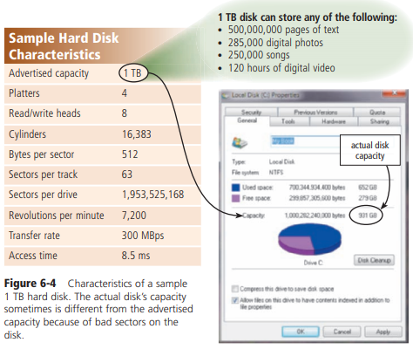
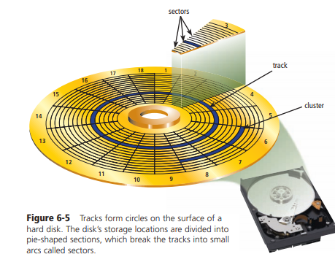
Hard Disk

Slide 14
Hard Disk
The capacity of a hard disk is determined from whether it uses longitudinal or perpendicular recording, the number of platters it contains, and the composition of the magnetic coating on the platters.
A platter is made of aluminum, glass, or ceramic and is coated with an alloy material that allows items to be recorded magnetically on its surface.
The coating usually is three millionths of an inch thick.

Slide 15
Hard Disk
Magnetic disks store data and instructions in tracks and sectors (Figure 6-5).
A track is a narrow recording band that forms a full circle on the surface of the disk.
The disk’s storage locations consist of pie-shaped sections, which break the tracks into small arcs called sectors. On a hard disk, a sector typically stores up to 512 bytes of data

Slide 16
Hard Disk
On desktop computers, platters most often have a size of approximately 3.5 inches in diameter.
On notebook computers, mobile devices, and some servers, the diameter is 2.5 inches or less.
A typical hard disk has multiple platters stacked on top of one another.
Each platter has two read/ write heads, one for each side.
The hard disk has arms that move the read/write heads to the proper location on the platter.
The distance between the read/write head and the platter is about two millionths of one inch.

Slide 17
Hard Disk

Slide 18
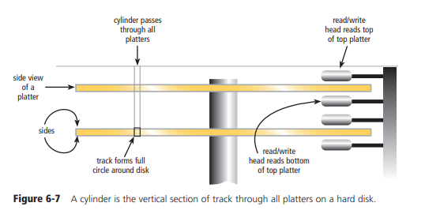
Hard Disk

Slide 19
Hard Disk
The close clearance leaves no room for any type of contamination.
Dirt, hair, dust, smoke, and other particles could cause the hard disk to have a head crash.
A head crash occurs when a read/write head touches the surface of a platter, usually resulting in a loss of data or sometimes loss of the entire disk.
Thus, it is crucial that you back up your hard disk regularly.
A backup is a duplicate of a file, program, or disk placed on a separate storage medium that you can use in case the original is lost, damaged, or destroyed.
Access time for today’s hard disks ranges from approximately 3 to 12 ms (milliseconds).

Slide 20
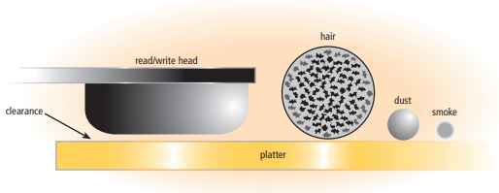
Hard Disk

Slide 21
RAID
Some personal computer manufacturers provide a hard disk configuration that connects multiple smaller disks into a single unit that acts like a single large hard disk.
A group of two or more integrated hard disks is called a RAID (redundant array of independent disks).
RAID is an ideal storage solution for users who must have the data available when they attempt to access it.

Slide 22
NAS (network attached storage)
A network attached storage (NAS) device is a server connected to a network with the sole purpose of providing storage.
Any user or device connected to the network can access files on the NAS device.
These devices often use a RAID configuration.

Slide 23
External and Removable Hard Disks
An external hard disk, shown in the left picture in Figure 6-9, is a separate freestanding hard disk that connects with a cable to a USB port or FireWire port on the system unit or communicates wirelessly.
As with the internal hard disk, the entire hard disk is enclosed in an airtight, sealed case. External hard disks have storage capacities of up to 4 TB and more.

Slide 24
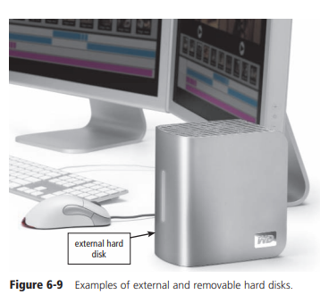
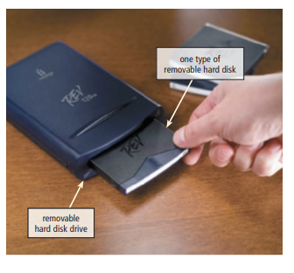
External and Removable Hard Disk

Slide 25
Removable hard disk
A removable hard disk is a hard disk that you insert and remove from a drive. A removable hard disk drive, shown in the right picture in Figure 6-9, reads from and writes on the removable hard disk. Removable hard disks have storage capacities up to 1 TB or more.

Slide 26
External removable hard disk \ internal hard disk
External and removable hard disks offer the following advantages over internal hard disks (fixed disks):
Transport a large number of files
Back up important files or an entire internal hard disk (several external hard disk models allow you to back up simply by pushing a button on the disk)
Easily store large audio and video files
Secure your data; for example, at the end of a work session, remove the hard disk and lock it up, leaving no data in the computer
Add storage space to a notebook computer, including netbooks and Tablet PCs
Add storage space to a desktop computer without having to open the system unit or connect to a network

Slide 27
Miniature Hard Disks
Both internal and external hard disks are available in miniature sizes.
These tiny hard disks have form factors of 1.8 inch, 1 inch, and 0.85 inch.
Devices such as portable media players, digital cameras, and smart phones often have internal miniature hard disks, which provide greater storage capacities than flash memory.
External hard disks that are smaller in size and capacity, which also contain miniature hard disks, are sometimes called a pocket hard drive because they enable mobile users easily to transport photos and other files from one computer to another (Figure 6-11).
Miniature hard disks have storage capacities that range from 4 GB to 250 GB.

Slide 28
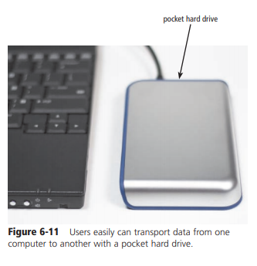
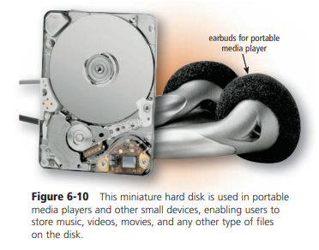
Miniature Hard Disk

Slide 29
Hard Disk Controllers
A disk controller consists of a special-purpose chip and electronic circuits that control the transfer of data, instructions, and information from a disk to and from the system bus and other components in the computer.
That is, it controls the interface between the hard disk and the system bus

Slide 30
Types of hard disk interfaces
Four other types of hard disk interfaces for use in personal computers are SATA, EIDE, SCSI, and SAS.
SATA (Serial Advanced Technology Attachment) uses serial signals to transfer data, instructions, and information.
The primary advantage of SATA interfaces is their cables are thinner, longer, more flexible, and less susceptible to interference than cables used by hard disks that use parallel signals.
SATA interfaces also support connections to optical disc drives.
External disks use the eSATA (external SATA) interface, which is much faster than USB and FireWire.

Slide 31
EIDE
EIDE (Enhanced Integrated Drive Electronics) is a hard disk interface that uses parallel signals to transfer data, instructions, and information. EIDE interfaces can support up to four hard disks at 137 GB per disk.
EIDE interfaces also provide connections for optical disc drives and tape drives

Slide 32
SCSI
SCSI interfaces, which also use parallel signals, can support up to eight or fifteen peripheral devices.
Supported devices include hard disks, optical disc drives, tape drives, printers, scanners, network cards, and much more.
Some computers have a built-in SCSI interface, while others use an adapter card to add a SCSI interface.

Slide 33
SAS
SAS (serial-attached SCSI) is a newer type of SCSI that uses serial signals to transfer data, instructions, and information.
Advantages of SAS over parallel SCSI include thinner, longer cables; reduced interference; less expensive; support for many more connected devices at once; and faster speeds.
In addition to hard disks, SAS interfaces support connections to optical disc drives, printers, scanners, digital cameras, and other devices. Experts predict that SAS eventually will replace parallel SCSI.

Slide 34
Flash Memory Storage
Flash memory is a type of nonvolatile memory that can be erased electronically and rewritten.
Flash memory chips are a type of solid state media, which means they consist entirely of electronic components, such as integrated circuits, and contain no moving parts.
The lack of moving parts makes flash memory storage more durable and shock resistant than other types of media such as magnetic hard disks or optical discs.
Types of flash memory storage include solid state drives, memory cards, USB flash drives, and ExpressCard modules.

Slide 35
Solid state drive
A solid state drive (SSD) is a storage device that typically uses flash memory to store data, instructions, and information (Figure 6-12).
With available sizes of 3.5 inches, 2.5 inches, and 1.8 inches, SSDs are used in all types of computers including servers, desktop computers, and mobile computers and devices such as portable media players and digital video cameras.
Storage capacities of current SSDs range from 16 GB to 256 GB and more.

Slide 36
SSD
SSDs have several advantages over magnetic hard disks.
Access times of SSDs are about 0.1 ms, which is more than 80 times faster than a hard disk.
Transfer rates of SSDs are faster than comparable hard disks.
SSDs generate less heat and consume less power than hard disks.
Manufacturers claim that SSDs will last more than 50 years, which is much greater than the 3 to 5 year hard disk stated lifespan.

Slide 37
SSD
The disadvantages of SSDs are they currently have a higher failure rate than hard disks, and their cost is much higher per gigabyte.
As the price of SSDs drops, experts estimate that increasingly more users will purchase computers and devices that use this media.

Slide 38
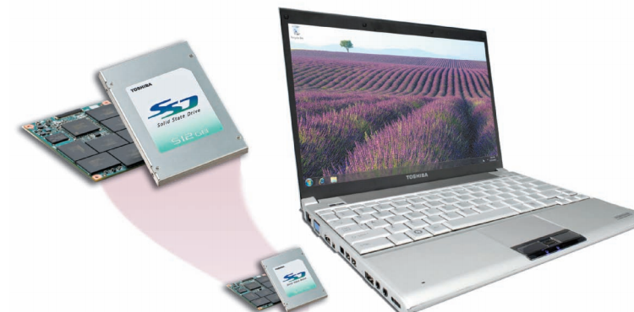
SSD

Slide 39
Memory Cards
Memory cards enable mobile users easily to transport digital photos, music, or files to and from mobile devices and computers or other devices.
As mentioned in Chapter 4, a memory card is a removable flash memory device, usually no bigger than 1.5 inches in height or width, that you insert and remove from a slot in a computer, mobile device, or card reader/writer (Figure 6-13).
Common types of memory cards include CompactFlash (CF), Secure Digital (SD), Secure Digital High Capacity (SDHC), microSD, microSDHC, xD Picture Card, Memory Stick, and Memory Stick Micro (M2).

Slide 40
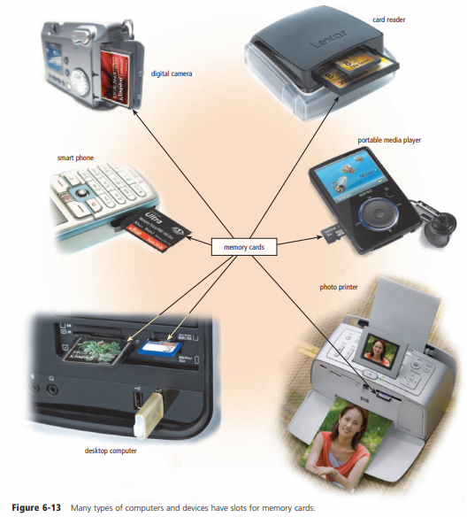
Memory Cards

Slide 41
Memory Cards
To view, edit, or print images and information stored on memory cards, you transfer the contents to your desktop computer or other device.
Some printers have slots to read flash memory cards. If your computer or printer does not have a built-in slot,
you can purchase a card reader/writer, which is a device that reads and writes data, instructions, and information stored on memory cards. Card reader/writers usually connect to the USB port or FireWire port on the system unit.
The type of card you have will determine the type of card reader/writer needed.

Slide 42
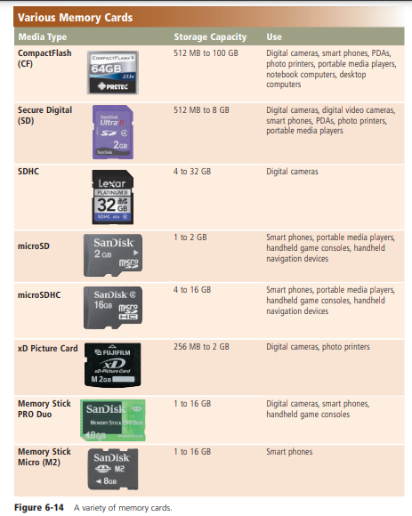
Memory Cards

Slide 43
USB Flash Drives
A USB flash drive, sometimes called a thumb drive, is a flash memory storage device that plugs in a USB port on a computer or mobile device (Figure 6-15).
USB flash drives are convenient for mobile users because they are small and lightweight enough to be transported on a keychain or in a pocket.
Current USB flash drives have storage capacities ranging from 512 MB to 64 GB, with the latter being extremely expensive

Slide 44
USB Flash Drives

Slide 45
Express Card Modules
An Express Card module is a removable device, about 75 mm long and 34 mm wide or L-shaped with a width of 54 mm, that fits in an Express Card slot (Figure 6-16).
Express Card modules can be used to add memory, storage, communications, multimedia, and security capabilities to a computer.
Express Card modules commonly are used in notebook computers.

Slide 46
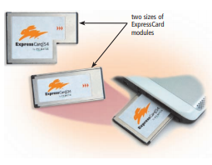
Express Card Modules

Slide 47
Cloud Storage
Some users choose cloud storage instead of storing data locally on a hard disk or other media. Cloud storage is an Internet service that provides hard disk storage to computer users (Figure 6-17).
Types of services offered by cloud storage providers vary. Figure 6-18 identifies a variety of cloud storage providers.

Slide 48
cloud storage
Users subscribe to a cloud storage service for a variety of reasons:
To access files on the Internet from any computer or device that has Internet access
To allow others to access their files on the Internet so that others can listen to an audio file, watch a video clip, or view a photo — instead of e-mailing the file to them
To view time-critical data and images immediately while away from the main office or location; for example, doctors can view X-ray images from another hospital, home, or office
To store offsite backups of data
To provide data center functions, relieving enterprises of this task

Slide 49
Optical Discs
An optical disc is a type of optical storage media that consists of a flat, round, portable disc made of metal, plastic, and lacquer.
These discs usually are 4.75 inches in diameter and less than one-twentieth of an inch thick.
Optical discs primarily store software, data, digital photos, movies, and music.
Some optical disc formats are read only, meaning users cannot write (save) on the media.
Others are read/write, which allows users to save on the disc just as they save on a hard disk

Slide 50
CDs
A CD-ROM, or compact disc read-only memory, is a type of optical disc that users can read but not write (record) or erase — hence, the name read-only.
A standard CD-ROM is called a single-session disc because manufacturers write all items on the disc at one time.
A typical CD-ROM holds from 650 MB to 1 GB of data, instructions, and information

Slide 51
CD-Rs and CD-RWs
Many personal computers today include either a CD-R or CD-RW drive, or a combination drive that includes CD-R or CD-RW capabilities, as a standard feature.
Unlike standard CD-ROM drives, users record, or write, their own data on a disc with a CD-R or CD-RW drive.
The process of writing on an optical disc is called burning.

Slide 52
CD-R
A CD-R (compact disc-recordable) is a multisession optical disc on which users can write, but not erase, their own items such as text, graphics, and audio.
Multisession means you can write on part of the disc at one time and another part at a later time.
Each part of a CD-R can be written on only one time, and the disc’s contents cannot be erased.

Slide 53
CD-RW
A CD-RW (compact disc-rewritable) is an erasable multisession disc you can write on multiple times.
To write on a CD-RW disc, you must have CD-RW software and a CD-RW drive.
A popular use of CD-RW and CD-R discs is to create audio CDs. For example, users can record their own music and save it on a CD, purchase and download songs from the Web, or rearrange tracks on a purchased music CD.
The process of copying audio and/or video data from a purchased disc and saving it on digital media is called ripping.

Slide 54
Archive Discs and Picture CDs
Many people use archive discs or Picture CDs to preserve their photos.
When you post and share photos online on a photo sharing community, you can choose to save your collection of online photos on an archive disc, which stores photos in the jpg file format (Figure 6-23).
The cost of archive discs is determined by the number of photos being stored.
One service, for example, charges $9.99 for the first hundred pictures.

Slide 55
Archive Discs and Picture CDs
A Kodak Picture CD stores digital versions of film using a jpg file format. Many photo centers offer Picture CD service for consumers when they drop off film to be developed.
The additional cost for a Picture CD is about $3 per roll of film.

Slide 56
DVDs and Blu-ray Discs
Although the size and shape of a CD and DVD are similar, a DVD stores data, instructions, and information in a slightly different manner and thus achieves a higher storage capacity.
DVD quality also far surpasses that of CDs because images are stored at higher resolution.

Slide 57
DVDs and Blu-ray Discs
A DVD-ROM (digital versatile disc-read-only memory or digital video disc-read-only memory) is a high-capacity optical disc on which users can read but not write or erase.
Manufacturers write the contents of DVD-ROMs and distribute them to consumers. DVD-ROMs store movies, music, huge databases, and complex software.

Slide 58
Blu-ray Disc
. A Blu-ray Disc (BD) has storage capacities of 100 GB, with expectations of exceeding 200 GB in the future.
Blu-ray Disc drives and players are backward compatible with DVD and CD formats.
Another high density format, called HD VMD (Versatile Multilayer Disc) potentially will contain up to 20 layers, each with a capacity of 5 GB.
Current HD VMDs have capacities of 40 GB and more.

Slide 59
UMD
The UMD(Universal Media Disc), which has a diameter of about 2.4 inches, can store up to 1.8 GB of games, movies, or music.
Similarly, the mini Blu-ray Disc, which is used primarily in digital video recorders, stores approximately 7.5 GB.

Slide 60
Recordable and Rewritable DVDs
Many types of recordable and rewritable DVD formats are available.
DVD-R, DVD+R and BD-R allow users to write on the disc once and read (play) it many times.
DVD-RW, DVD+RW, and DVD+RAM are three competing rewritable DVD formats.
Similarly, BD-RE is a high-capacity rewritable DVD format.
To write on these discs, you must have a compatible drive or recorder.
Rewritable DVD drives usually can read a variety of DVD and CD media.
Before investing in equipment, check to be sure it is compatible with the media on which you intend to record.

Slide 61
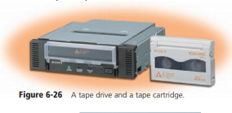
Other Types of Storage
Tape
One of the first storage media used with mainframe computers was tape.
Tape is a magnetically coated ribbon of plastic capable of storing large amounts of data and information at a low cost.
Tape no longer is used as a primary method of storage.
Instead, business users utilize tape most often for long-term storage and backup.

Slide 62
Magnetic Stripe Cards and Smart Cards
A magnetic stripe card is a credit card, entertainment card, bank card, or other similar card, with a stripe that contains information identifying you and the card.
Information stored in the stripe includes your name, account number, and the card's expiration date.
A magnetic stripe card reader reads information stored on the stripe.

Slide 63
Microfilm and Microfiche
Microfilm and microfiche store microscopic images of documents on roll or sheet film.
Microfilm is a 100- to 215-foot roll of film. Microfiche is a small sheet of film, usually about 4 3 6 inches.
A computer output microfilm recorder is the device that records the images on the film.
The stored images are so small that you can read them only with a microfilm or microfiche reader.

