Slide 3
Non-Parametric Friedman Test Introduced By Milton Friedman

Slide 4
Friedman Test Outline
Introduction and Definition
History
Uses
Assumptions
Procedure
Numerical
Surprise

Slide 5
Friedman test
The Friedman test is a non parametric statistical procedure for comparing more than two samples that are related or dependent
The parametric equivalent to this test is the repeated measures analysis of variance(ANOVA)

Slide 6
Assumption:
One group that is measured on three or more different occasions.
Group is random sample from the population.
Sample do not need to be normally distributed.

Slide 7
Procedure:
Hypothesis Testing
Level Of Significance
Test Statistic
Critical Region
Decision
Conclusion

Slide 8
Procedure:
Hypothesis Testing:
Ho:M1=M2=………=Mk
HI: At least one equality violate
Level Of Significance:
𝛼=0.05
𝛼 = 0.01 𝛼 = 0.10

Slide 9
Test Statistic:
Assign ranks to the original data.
In Friedman test the observation in each block are RANKED separately from smallest to largest.
Obtain sum of ranks Rj in each column.

Slide 10
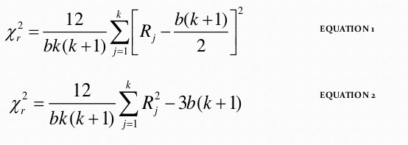
Friedman Test Statistic:

Slide 11
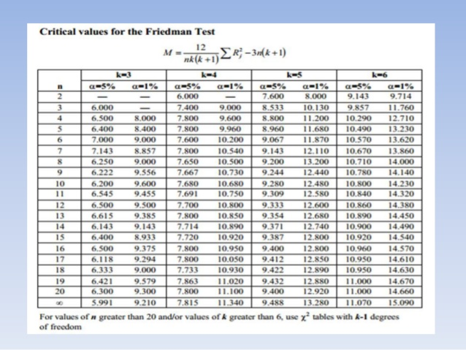

Slide 12

Decision:
Xr² $≥$X²(𝛼,k-1)
then REJECT Ho

