Slide 1
Physiotherapist as Administrator

Slide 2
Administration
Administration is the skilled process of planning, directing, organizing, and managing
human, technical, environmental, and financial resources
effectively and efficiently.
Administration includes the management, by individual physical therapists, of resources for patient/client management and for organizational operations

Slide 3
Management is the process by which an organization meets its goals.
Managers are responsible for selecting the procedures to be used and for evaluating the effectiveness and efficiency of these procedures in meeting the stated goals.
The arrangement of the management system depends on the size and complexity of the organization and the number of management levels.

Slide 4
Billing….
Current procedural terminology,AMA.1966

Slide 6
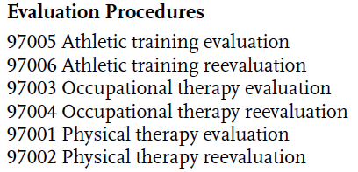

Slide 7
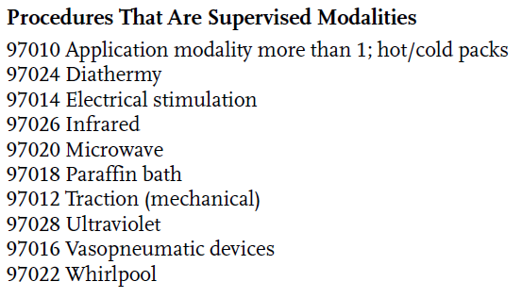

Slide 9
Direction and Supervision of Support Personnel
According to the Guide, “Direction and supervision are essential to the provision of high-quality physical therapy.”
which tasks should be delegated and
the extent of supervising support personnel:
● The education and experience of the person supervised
● The type of organization in which the work is performed
● The applicable state law
● The task to be performed

Slide 10
LEVELS OF SUPERVISION
APTA
General (presence, telecommunication)
Direct
Direct personal

Slide 11
FIRST-LINE MANAGEMENT
First-line managers in physical therapy may be assigned direct patient care tasks in addition to financial, operations, human resource, and information responsibilities.
Their duties include
budgeting;
hiring,
firing, and evaluating staff members; and ensuring that the organization meets accreditation, certification, and other legal requirements.

Slide 12
Budgeting is the process of making decisions about revenue and expenses to ensure that funds are available to meet the goals of the organization.

Slide 13
MIDLEVEL MANAGERS AND CHIEF EXECUTIVE OFFICERS
Less to do with day to day pt stuff.
Interaction with other organization.
Negotiate e 3rd party
Organizations goal setting
Marketing organization.

Slide 14
MPH,MBA?
PTs who hold these higher level management positions often have graduate degrees in
health care or business administration or have been trained through corporate staff development programs.
They may find themselves far removed from
the practice of physical therapy.
Private practice…

Slide 15
Principle . code states that
“[a] physical therapist shall maintain and promote high standards for physical therapy practice, education, and research”
but does not refer to the administrative or consultant roles…

Slide 16
The principles of the code that most directly relate to the role of the administrator..
Principle 3“A physical therapist shall comply with laws and regulations governing physical therapy and shall strive to effect changes that benefit patients/clients.”
Principle #5: Physical therapists shall fulfill their legal and professional obligations

Slide 17
Principle #7:
Physical therapists shall promote organizational behaviors and business practices that benefit patients/clients and society

Slide 18
In the APTA’s Guide for Professional Conduct (GPC), Section 4.2 explicitly addresses direction and supervision, stating that the supervising PT “has primary responsibility for the physical therapy services rendered” (GPC 4.2A).
This section also prohibits a PT from delegating “to a less qualified person any activity that requires the professional skill, knowledge, and judgment of the physical therapist” (GPC 4.2B).

