Slide 1
Endocrinology
Dr. Faryal Mazhar

Slide 2
Outline
Acromegaly
Addison’s Disease
Cushing syndrome (Hypercortisolism)
Hypothyroidism
Hyperthyroidism
Thyroid Cancer
Somogyi effect/Dawn phenomenon
Miscellaneous Endocrinology topics

Slide 3
Acromegaly
Excess production of growth hormone from a GH-secreting adenoma in the pituitary. Presents with enlargement of the head (hat size), feet (shoe size), nose, and jaw. There is intense sweating from enlargement of sweat glands.
Joint abnormalities: arise from unusual growth of articular cartilage.
Amenorrhea, cardiomegaly/HTN, Colonic polyps.
Diabetes common as GH acts as anti-insulin.

Slide 4
Acromegaly (continued)
Best initial test: Insulin-like growth factor (IGF): longer half-life.
Suppression of GH by giving glucose excludes acromegaly.
MRI will show lesion in pituitary.

Slide 5
Complications of Acromegaly
Carpal Tunnel Syndrome
Sleep Apnea
Pseudogout
Bad Billy Crystal movies

Slide 6
Treatment of Acromegaly
Surgical resection with transphenoidal removal cures 70% of cases.
Cabergoline or bromocriptine: dopamine agonists inhibit GH release.
Octreotide: somatostain has some effect in preventing GH release.
Pegvisomant: GH receptor antagonist.

Slide 7
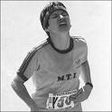
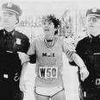
Clinical Case
A long distance marathon runner complains of amenorrhea. UPT negative. LH and FSH low and Prolactin level normal.
Treatment: Run less! This is acquired deficiency of GnRH.

Slide 8
Clinical Case
25 y.o. male complains of weakness, impotence. Childhood hx of ALL and chemotherapy and intracranial irradiation. Labs show normal TSH. Free T4 low and cortisol low. LH/FSH normal. Most likely diagnosis?
Radiation induced hypopituitarism.

Slide 9
Clinical Case
Diabetic patient with difficult to control diabetes.
Recently: frequent hypoglycemia. As a result, all anti-diabetic medications have been slowly stopped.
Most likely diagnosis?
Addison’s disease: Adrenal cortical insufficiency.

Slide 10
Addison’s Disease
Adrenal insufficiency.
Fatigue, anorexia, weight loss, weakness with hypotension.
Thin patient with hyperpigmented skin.
Labs: Hyperkalemia with mild metabolic acidosis from inability to excrete H+ or K+ because of loss of aldosterone.
Hyponatremia.
May have hypoglycemia and neutropenia.
Diagnosis:
Cosyntropin (synthetic ACTH) stimulation test: measure cortisol before and after. No rise in cortisol level if adrenal insufficiency.
CT scan of adrenal gland.

Slide 11
Adrenal insufficiency causes
Autoimmune: may be associated with Vitiligo, Type I diabetes, hypothyroidism.
Bilateral adrenal hemorrhage: patient on anticoagulation develops shock.
Infection/sepsis.
TB: CT shows calcification of adrenal gland.
Patient on chronic steroid went for surgery, went into shock (should have received stress dose of steroid).

Slide 12
Addison’s Disease treatment
Steroid replacement:
Prednisone
Fludricortisone

Slide 13
Cushing Syndrome
Hypercortisolism
Central obesity
Muscle wasting
Proximal muscle weakness (difficulty getting up from chair, going up stairs)
Easy bruisability
Moon facies
Buffalo hump
Weight gain
Hirsutism, hyperglycemia
Screening: 24 hour urine free Cortisol

Slide 14
Dexamethasone Suppression Test
A normal result: decrease in cortisol levels upon administration of low-dose dexamethasone.
Results indicative of Cushing's Disease (Pituitary adenoma causing increased ACTH production) involve no change in cortisol on low-dose dexamethasone, but inhibition of cortisol on high-dose dexamethasone.
If the cortisol levels are unchanged by low- and high-dose dexamethasone then other causes of Cushing's Syndrome must be considered with further work-up needed.

Slide 15
Dexamethasone (continued)
ACTH | Cortisol | Interpretation
Undetectable or low | Not suppressed by low or high doses. | Adrenal Cushing syndrome. Adrenal mass requires surgery.
Normal to elevated | Not suppressed by low or high doses. | Ectopic ACTH. Chest/Abdominal CT. Mostly small cell lung carcinoma. Surgery or Ketoconazole if not a surgical candidate.
Normal to elevated | Not suppressed by low, suppressed by high dose. | Pituitary MRI to confirm Pituitary Cushing syndrome (Cushing’s Disease)

Slide 16
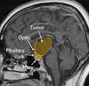
Clinical Case
10 year old complains of headaches, visual disturbance, poor sexual development. Has increased prolactin.
CT head shows dense suprasellar calcification.
Most likely diagnosis:
Craniopharyngioma
Treatment: surgery!
Brain MRI:

Slide 17
Hypothyroidism
S/Sx: cold intolerance, constipation, weakness, weight gain, amenorrhea, infertility, galactorrhea, depression.
Exam: bradycardia, delayed relaxation of DTR’s, non-pitting edema (due to deposition of glycosaminoglycans in interstitial space), dry skin, loss of hair, periorbital edema.
Investigation: Increased TSH, decreased free T4.
Treatment: Levothyroxine; in young patient start 50 micro grams per day.

Slide 18
Elderly and CAD patients
In Elderly patient > 60 and patient with CAD start 25 micro gram and increase 12.5 mcgm every 2-3 weeks by monitoring TSH. Start low and go slow!
These patients are at risk of ischemia, MI.
Start low and go slow.

Slide 19
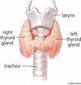
Clinical Case
A 26 year old patient with hypothyroidism initially presented with TSH of 30 and was started on synthroid 50 mcg/day. After six weeks, TSH level is 20. What to do?
Increase synthroid to 100 mcg/day.

Slide 20
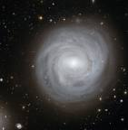
Emergency Situation
70 year old male brought to emergency room found in snow. Patient is comatose, hypothermic, and bradycardic.
Skin dry with loss of hair.
Eyes puffy (periorbital edema).
Most likely diagnosis?
Myxedema coma (not hypothermia)
Treatment: IV Hydrocortisone, IV Levothyroxine.

Slide 21
Clinical Scenarios:Hypothyroid
Pregnant
Postmenopausal symptoms
Increase Synthroid by 30% and check TSH after 4 weeks.
Check TSH after 12 weeks of starting estrogen therapy.

Slide 22
Surgery
Elective
Emergency
If pre-op workup showed hypothyroidism: postpone surgery until patient is euthyroid.
Start IV Levothyroxine!

Slide 23
Hyperthyroidism
Weight loss, increased appetite, tremor, palpitation, diarrhea, A. fib.
Lab: increased free T4 and decreased TSH.
Causes: Graves disease, toxic adenoma, thyroiditis, factitious Thyrotoxicosis.

Slide 24
Graves disease
Can have Ophthalmopathy and Pretibial myxedema due to deposition of glycosaminoglycans and lymphocytic infiltration.
Autoimmune disorder: antibodies form and bind to TSH receptor and stimulate the gland.

Slide 25
Treatment of Graves
Prefer Radioactive iodine
Drug of choice in Pregnancy: Propylthiouracil (Methimazole if not tolerated). Breast feeding allowed on those two meds.
Measure TSH receptor antibody level in 2nd or 3rd trimester (level >5 fold normal associated with neonatal Thyroxicosis).
Patients on Propylthiouracil may develop which condition?
Agranulocytosis

Slide 26
Clinical Case Scenario
Young female complains of insomnia, weight loss, palpitation, tremor. On exam: thyroid gland not enlarged.
TSH: 0.2 and T4 low at 3 (5-12), Radioactive iodine uptake low at 2% (normal is 5-30%).
What is the most likely answer?
A) Graves disease
B) Toxic adenoma
C) Thyroiditis
D) Factitious T3 toxicosis
E) Facticious T4 toxicosis

Slide 27
Clinical Case (continued)
In Graves: radioactive iodine uptake is DIFFUSELY increased.
In Toxic adenoma: uptake is FOCALLY increased.
In Thyroiditis: Decreased Radioactive uptake and gland large and tender.
Factitious: Decreased Radioactive uptake and small non-tender atrophic gland.
Factitious T4 toxicosis: T4 would be high (in this case T4 is low).

Slide 28
Clinical Case
Pregnant patient comes to ER complaining of fever/diarrhea/delirium/tachycardia/A-fib
Most likely diagnosis:
Thyroid Storm
Treatment:
Propylthiouracil
Hydrocortisone
Propranolol
Iodine

Slide 29
Subacute Thyroiditis
A patient with a recent history of URI comes with symptoms of Thyrotoxicosis.
Painful enlargement of thyroid (large, tender).
Confirmatory test: Radioactive Iodine uptake (low)
Treatment is symptomatic: Aspirin and Propranolol

Slide 30
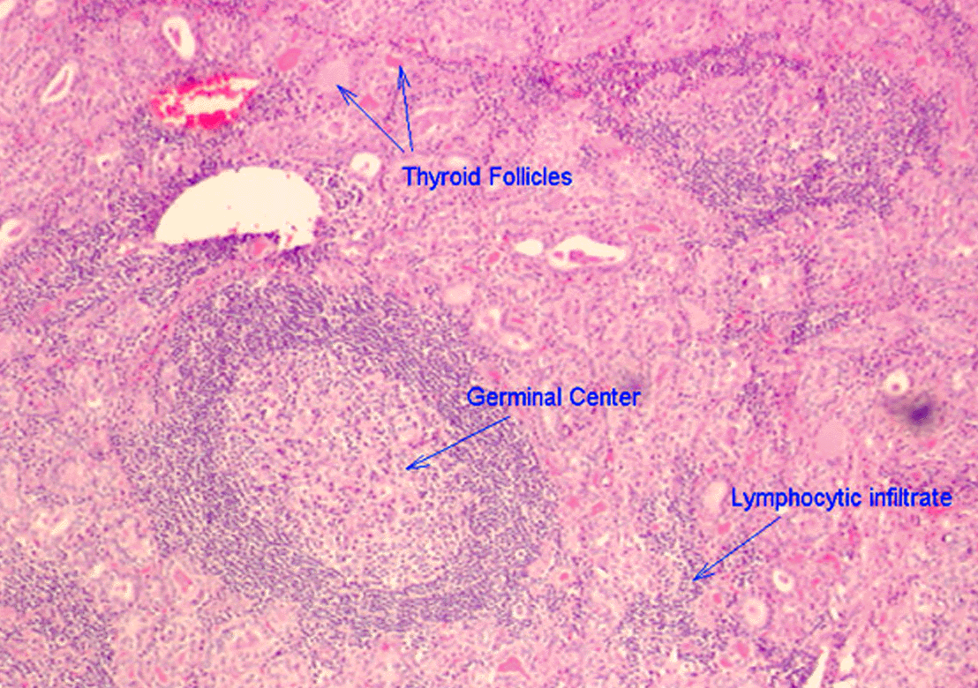
Chronic Lymphocytic Thyroiditis
Autoimmune destruction of thyroid gland (Hashimoto’s)
Gland large and non-tender
Transient thyroid toxicosis then HYPOTHYROID

Slide 31
Post partum Thyroiditis
Symptoms of transient Thyrotoxicosis
Hyperthyroid > Euthyroid
Large, non-tender thyroid
RAIU low
Tx: symptomatic with Beta Blocker

Slide 32
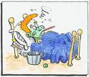
Sick Euthyroid Syndrome
Patient with pneumonia intubated with sepsis on vasopressors.
TFT’s: low T4, free T4 and TSH

Slide 33
Thyroid Binding Globulins
High in pregnancy.
Labs: Increased T4, normal free T4 and TSH.
Also high with Oral Contraceptives

Slide 34
Asymptomatic nodule, TSH wnl
Fine needle aspiration!
Benign | Malignant | Non-diagnostic
Observe | Surgery | Ultrasound Guided Biopsy

Slide 35
Low TSH, subclinical hypothyroid
Radioactive iodine scan!
Hot nodule: If Free T4 or Free T3 normal: observation. If high: treat!
Cold nodule: Biopsy!

Slide 36
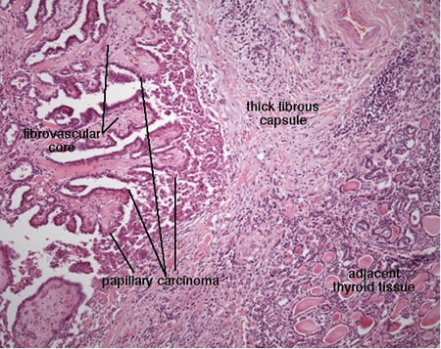
Thyroid Cancer
Diagnosis: FNAC
Papillary: most common
Follicular cells resemble normal thyroid cells and may present as hyperthyroidism due to increased T4 secretion.
Anaplastic: most aggressive.

Slide 37
Medullary Thyroid Cancer
May present as flushing and diarrhea.
Increased calcitonin level.
Association with MEN Type 2 (along with Pheochromocytoma and Hyperparathyroid).
Screen family members with serum calcitonin level.

Slide 38
Diabetes
Time of Fingerstick: | Represents:
7 am | Night NPH
11 am | AM Regular insulin
4 pm | AM NPH
10 pm | Evening/dinner time regular insulin

Slide 39
Somogyi effect
Post hypoglycemic hyperglycemia
7 am finger stick with high blood sugar
3 am with low blood sugar
To avoid this: Give NPH at bed time instead of dinner time and at lower dose.

Slide 40
Dawn phenomenon
Between 5 am to 8 am insulin resistance increases.
Possibly secondary to growth hormone.
7 am AND 3 am finger stick with HIGH blood sugar.
To avoid: increase NPH dose at dinner time.

Slide 41
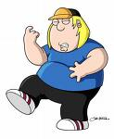
Thank you for your attention!

