Slide 1
Endomembrane system
Definition
The endomembrane system is compsed of different membranes that are suspended in the cytoplasm within a eukaryotic cell.These membranes divide the cell into functional and strutural compartments or organelles.

Slide 2
ENDOMEMBRANE SYSTEM

Slide 3
Tasks of Endomembrane system
Synthesis of proteins and their transport into membranes and organelles or out of the cell.
Metabolism and movement of lipids.
Detoxification of poisons

Slide 4
The membranes of this system are related either through direct physical continuity or by transfer of membrane segments as tiny vesicles
Vesicles: sacs made of membrane

Slide 5
Endomembrane System Includes:
Nuclear envelope
Endoplasmic reticulum
Golgi Apparatus
Lysosomes
Various kinds of vacuoles
Peroxisomes
Vesicles

Slide 6
Endoplasmic Reticulum: biosynthetic factory
Endoplasmic means within the cytoplasm and Reticulum is a Latin word for little net.
It is a network of membrane connected to nuclear envelope and extends throughout cell.
It accounts for 50% membranes in eukaryotic cell.

Slide 7
It consists of a network of membraneous tubules and sacs called cisternae.
It is derived from Latin word cisternae meaning;a reservoir for a liquid.
Endoplasmic reticulum is called Membrane factory.

Slide 8
Distinct regions of ER
Smooth ER
Doesn’t contain ribosome
Rough ER
Contain ribosome that make it look rough

Slide 9
Smooth ER
Without ribosomes
Functions :-
Factory processing operations like:
Many metabolic processes
Synthesis and hydrolysis
Enzymes of smooth ER help in:
Synthesize lipids,oils,phopholipids
Steroids and sex hormones
Hydrolysis of glycogen into glucose
Detoxify drugs and poisons, e.g;alcohol and barbiturates.

Slide 10
Rough ER
Has ribosomes on the outer surface of the membrane.
Functions
Produce proteins for export out of cell
Protein secreting cells
Packaged into transport vesicles for export

Slide 11
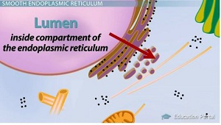
Bio-medical importance
Rough endoplasmic reticulum:
These membranes enclose a Lumen.
In this lumen newly synthesized proteins are modified.
Presence of ribosomes indicates biosynthesis of proteins.

Slide 12
The synthesized proteins are either incorporated into the membranes or into the organelles.
Special proteins are present that are called CHAPERONES.
These proteins play a role in proper folding of newly synthesized proteins.
Protein glycosylation also ocuurs in ER i.e.carbohydrates are attached to the newly synthesized proteins.

Slide 13
Endoplasmic reticulum:Membrane factory
Synthesize membrane phospholipids
Build new membrane as ER membrane expands,bud off and transfer to other parts of cell that need membranes.
Synthesize membrane proteins

Slide 14
Golgi Apparatus
Also called as shipping and receiving center.
Consists of flattened membranous sacs called cisternae.
The golgi apparatus functions as a factory in which proteins received from ER are further processed and sorted for transport to their eventual destination:lysosomes,plasma membrane,or secretion.

Slide 15
Structure
Flattened membranous sacs=cisternae
2 sides=2 functions
Cis face receives material by fusing with vesicles=receiving
Trans face buds off vesicles that travel to other sites=shipping(transport)

Slide 17
Golgi processing
During path from cis to trans,products from ER are modified into final to form tags.sorts and packages materials into transport vesicles.
Golgi=UPS headquarters
Transport vesicles=UPS trucks delivering packages that have been tagged with their own barcodes.

Slide 18
Functions of Golgi apparatus
Finishes,sorts and ships cell products
“shipping and receiving department”
Center of manufacturing,warehousing
Extensive in cells specialized for secretion

Slide 19
Transport of Proteins through golgi apparatus
Golgi Body,Proteins transport;

Slide 20
Lysosomes
called Digestive Compartments
These are membranous sac of hydrolytic enzymes that an animal cell uses to digest macromolecules
carry out intra-cellular digestion in a variety of circumstances
made by ER going to golgi:
Hydrolytic enzymes:-works in acidic environment
Lysosomal membrane/enzymes

Slide 21
lysosomes
Lysosomes biology

Slide 22
Hydrolytic enzymes:
lysosomes use their hydrolytic enzymes to recycle the cell’s own organic material by process called Autophagy
Lysosomal enzymes:
dismantle the enclosed material and the organic monomers are return to cytosol for reuse.

Slide 23
Functions
A little “stomach” for the cell
Lyso=breaking things apart,some=body
It is also called the “clean up crew” of the cell

Slide 24
In addition to degrading molecules taken up by endocytosis,lysosomes digest material derived from two other routes:
Phagocytosis
Autophagy

Slide 25
Phagocytosis:
Greek word called “phagein”,to eat and “kytos”,vessel
Autophagy:
a damaged organelle or small amount of cytosol becomes surrounded by a double membrane

Slide 26
Vacuoles:Diverse maintainance compartments
Plants cells are unique because they have a lysosome-like organelle called the vacuole. The large central vacuole stores water and wastes, isolates hazardous materials, and has enzymes that can break down macromolecules and cellular components, like those of a lysosome
. Vacuoles can be large organelles occupying between 30% and 90% of a cell by volume.

Slide 27
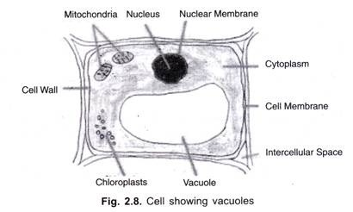
Plant cells each have a large central vacuole that occupies most of the area of the cell. The central vacuole plays a key role in regulating the cell’s concentration of water in changing environmental conditions. Have you ever noticed that if you forget to water a plant for a few days, it wilts? That’s because as the water concentration in the soil becomes lower than the water concentration in the plant, water moves out of the central vacuoles and cytoplasm.
The central vacuole also supports the expansion of the cell. When the central vacuole holds more water, the cell gets larger without having to invest a lot of energy in synthesizing new cytoplasm

Slide 28
Food vacuoles:
formed by phagocytosis
Contractile vacuoles:(freshwater protists)
vacuoles that pumps out of the cell,thereby,maintaining a suitable environment of ions and molecules inside the cell.
Central vacuoles:
large vacuoles in mature plants
cell sap,the solution inside the central vacuole that differs in composition from the cytosol.

Slide 29
Functions of Vacuoles
Vacuoles appear to have three main functions:
contribute to the rigidity of the plant using water to develop hydrostatic pressure
Store nutrient and non-nutrient chemicals
Break down complex molecules

Slide 30
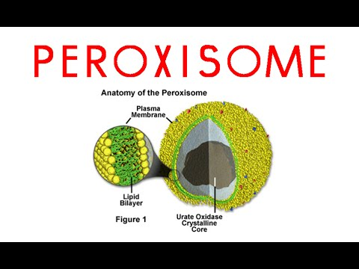
Peroxisomes
Peroxisome is a different organelle with its own unique properties and role in the cell. It houses enzymes involved in oxidation reactions, which produce hydrogen peroxide as a by-product. The enzymes break down fatty acids and amino acids, and they also detoxify some substances that enter the body.
For example, alcohol is detoxified by peroxisomes found in liver cells.
Importantly, peroxisomes—unlike lysosomes—are not part of the endomembrane system. That means they don't receive vesicles from the Golgi apparatus.

Slide 31
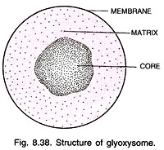
Glyoxysomes
Specialized peroxisomes that are found in the fat-storing tissues of plant seeds.
These organelles contain enzymes that initiate the conversion of fatty acids to sugar.

Slide 32
Energy budget for Glucose molecule

Slide 33
Energy budget
ATP production per molecule of glucose:
Glycolysis : 2 ATP
Krebs Cycle: 2 ATP
Electron Transport Chain:
2 NADH from Glycolysis :6 (4) ATP
2 NADH from Oxidation of Pyruvate: 6 ATP
6 NADH from Krebs Cycle :18 ATP
2 FADH₂ from Krebs Cycle: 4 ATP
Total ATP production: 36 - 38 molecules

Slide 34
Energy budget
ATP molecules produced during aerobic respiration ;

