Slide 1
Preparation of Different Types of Test in Mathematics BS Education-V Teaching Mathematics (EDU-511)
Department of Education University of Sargodha

Slide 2
Preparation of Different Types of Test in Mathematics
Usama Nisar BEUF18M019
Teaching of Mathematics (EDU-511)
BS Education (semester 5)
Department of education
University of Sargodha,40100 Sargodha, PAKISTAN
23 October 2020

Slide 3
Mathematics:
Mathematics is the science that deals with the logic of shape, quantity and arrangement.
Testing: Testing is a procedure to verify that the end product is same as requirements.

Slide 4
Types of test
Basically there are four types of test that are performed to check the performance of pupils
Placement tests
Diagnostic tests
Formative tests
Summative tests

Slide 5
Placement tests
Placement tests are used to “place” students into a course, course level, or academic program.
For example, an assessment may be used to determine whether a student is ready for Algebra I or a higher-level algebra course.

Slide 6
Diagnostic test
Diagnostic tesr is used to describe our process of getting to know our pupils. This process includes questions about the person's mood and behavior to better understand what symptoms might be most difficult for the person.
For example
Analysis of student work (e.g., classroom assignments, work samples, tests)
Observation and anecdotal notes.

Slide 7
formative test
In that collecting data before and/or during instruction only becomes a formative test if the data are used to plan or modify instruction. Formative evaluation is comprised of two areas for assessment, the learning unit and student behavior.
For example
Nnplanned quizzes or anonymous voting.
Short comparative assessments to see how pupils are performing against their peers.
One-minute papers on a specific subject matter.
Lesson exit tickets to summarize what pupils have learnt
Class discussion

Slide 8
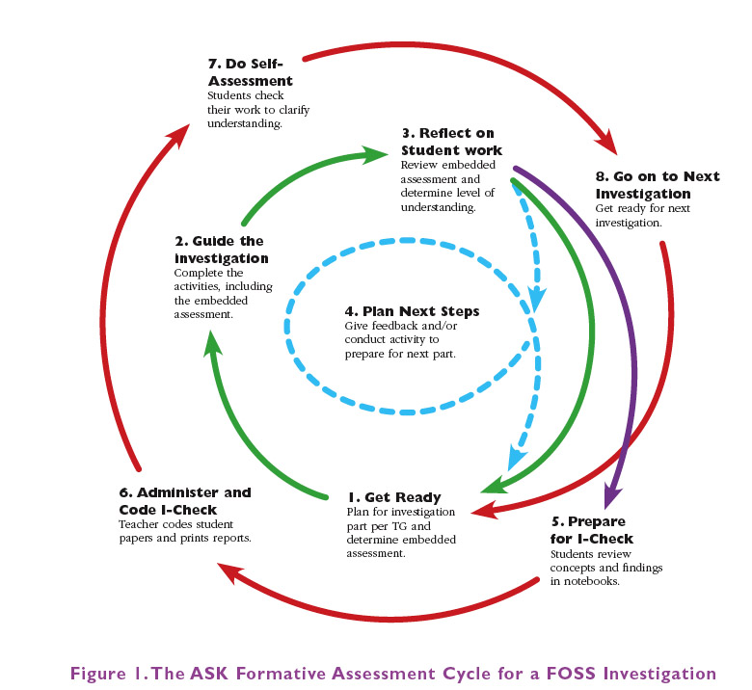

Slide 9
Summative test
Summative tests are designed to determine whether or not a module's learning objectives have been achieved. This strategy is also an essential part of the e-learning process, as it can help you determine whether or not the learner is ready to move onto the next section.
For example
Instructor-created exams
Standardized tests( that demonstrate school accountability are used for pupil admissions.)
Final essays
End-of-term or midterm exams.

Slide 10
Any Question?

Slide 11
MCQs
1. Which teat is performed to place a student in a particular coarse or program
a) diagnostic b ) placement c) formative dl summative
2. Testing is a process/procedure to verify that the end product is same as________.
a) Requirement b) philosophy c) both a and b d) note of tehse
2.Observation and ancedotel notes are example of
a) placement b) diagnostic c) formative d) summative
3. unplanned quizzes or anonymous voting comes in
a) placement b) diagnostic c) formative d) summative
4.. tests are designed to determine whether or not a module's learning objectives have been achieved.
a) summative b) formative c) diagnostic d) placement
5. is the science that deals with the logic of shape, quantity and arrangement.
a) physics b) chemistry c) mathematics d) anatomy

Slide 12
Key
Placement
Requirements
Diagnostic
Formative
Summative
Mathematics

Slide 14
Thank you

