Slide 1
Subject: Engineering Probability and Statistics
Class: BS 4th
Lecture: 5th week
Topic: Exponential Distribution

Slide 2
Memory Lessness Property of Exponential Distribution
Davit says
“I have memories but only a fool stores his past in his future’’.
Definition
The exponential distribution is memoryless because the past has no bearing on its future behavior. Every instant is like the beginning of a new random period, which has the same distribution regardless of how much time has already elapsed.
Exponential distribution is one and only one continuous probability distribution that possess the unique property of memory lessness.

Slide 3
Theorem Statement
The equation states that the probability having an arrival during the next ‘y’ seconds is independent of when the last arrival. Then prove that
$$P\left(X≤{x+y}/{X>x)=P(X}≤y\right)$$
Proof
As from conditional probability L.H.S
$$P\left(X≤{x+y}/{X>x}\right)=\frac{P(X≤x+y and X>x)}{P(X>x)}$$
It can be written as
$$=\frac{P(x≤X≤x+y)}{P(X>x)}$$
From interval approach of CDF i.e.
$$P\left(a≤X≤b\right)=F\left(b\right)−F(a)$$
So
$$=\frac{P\left(X≤x+y\right)−P(X≤x)}{P(X>x)}$$

Slide 4
From the CDF
$$F\left(x+y\right)=P\left(X≤x+y\right)=1−e^{−λ(x+y)}$$
So
$$=\frac{(1−e^{−λ\left(x+y\right)})−(1−e^{−λx})}{e^{−λx}}$$
$$=\frac{1−e^{−λ\left(x+y\right)}−1+e^{−λx}}{e^{−λx}}$$
$$=\frac{e^{−λx}e^{−λy}}{e^{−λx}}+\frac{e^{−λx}}{e^{−λx}}$$
$$=−e^{−λy}+1$$
$$=1−e^{−λy}$$
That is nothing but P(X ≤ y) so hence proved that
$$P\left(X≤{x+y}/{X>x)=P(X}≤y\right)$$

Slide 5
About the theorem
If x is a time we need to wait before a certain event occur, the above property says that probability of the event happens during a time interval of length ‘y’ is independent of how much has already elapsed ‘x’ without the event happening.
Example
Let says that there has been no arrival during last 10 seconds. The probability of having an arrival with next 2 seconds is independent of how long there has been no arrival so far, i.e.
$$P(T≤{10+2}/{T>10)=P(T≤2)}$$
So according to the property of memorylessness if we find the $P(T≤2)$ then it will be equal to $P(T≤{10+2}/{T>10})$.
Now from the CDF of exponential distribution
$$P\left(T≤2\right)=1−e^{−2λ}$$

Slide 6
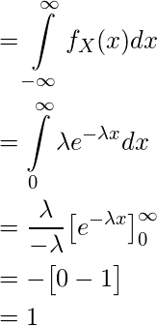
Other Properties of Exponential Distribution
Legitimate Property
The pdf of exponential distribution is complete pdf that can be shown as follows:

Slide 7
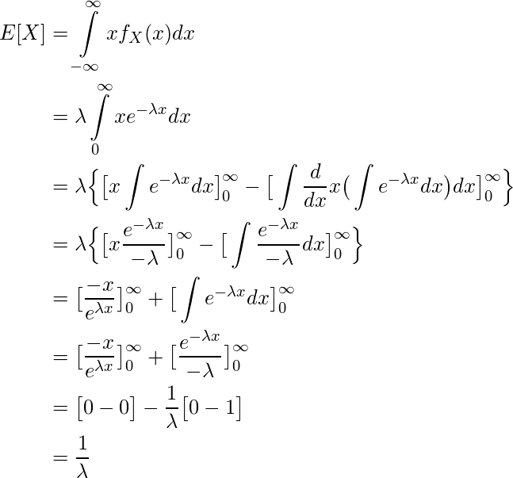
1. Mean

Slide 8
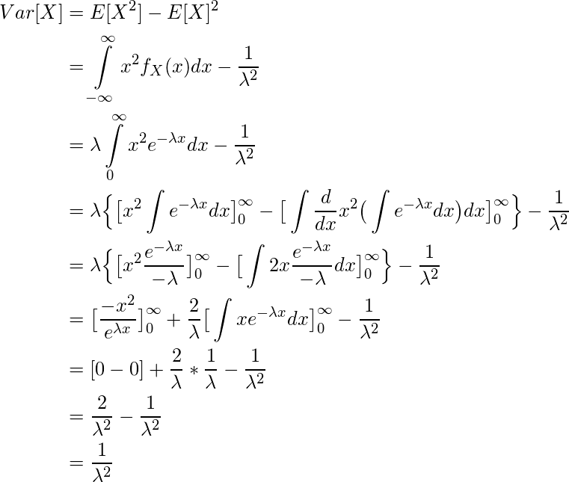
2. Variance

Slide 9
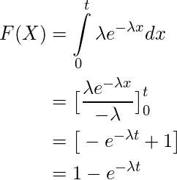
4. Cumulative Distribution Function
As we know, the cumulative density function is nothing but the sum of probability of all events upto a certain value of (x = t) In the Exponential distribution, the cumulative density function is given by F(X)

Slide 10
Task
1. Find the mgf of exponential distribution. And also derive the skewness and kurtosis.
2. Prove that
$$P(X≥{x+y}/{X≥x)=P(X≥y)}$$

Slide 11
https://www.youtube.com/watch?v=3kxnPEDecIA
https://www.youtube.com/watch?v=ONyexuJkcdE
Find all the properties of exponential distribution in the following link.
https://tutorialspoint.dev/computer-science/engineering-mathematics/probability-distributions-part-2-exponential-distribution
https://www.youtube.com/watch?v=N8O6zd6vTZ8

