Slide 1
CARCINOMA OF OVARY
CASE PRESENTATION

Slide 2
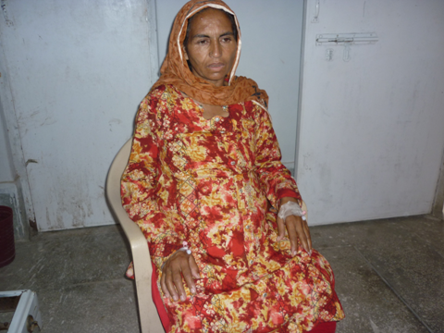

Slide 3
PT PROFILE
malika w/o abdul rasheed
age 45yrs
married 26 yrs
parity 10
address babo mohala
sargodha

Slide 4
HISTORY
presenting complaints
mass abdomen 1yrs
pain abdomen 1yrs
p/v spotting off &on
wt loss & breathlessness

Slide 5
GENERAL PHYSICAL EX
Well oriented
Pulse 100/min
B.P 120/80
Temp n
Paller +
Lymph nodes not enlarged
Thyroid not enlarged
Varicose vein +
Pedal oedema +

Slide 6
systemic ex normal
abdominal ex
huge cystic mass occupying
the whole abdomen
vaginal ex
v/v healthy uterine size could
not be assessed

Slide 7
INVESTIGATION
Blood group B+
Hb 11gm/Dl
BSL n
RFT, LFT ,Coagulation profile n
ECG ,X RAY chest normal
Ca 125 227 iu/l ( < 35 iu/l)

Slide 8
Uss
A/v ut edometrium thin
27.5 + 21.6 cm large complex mass
cystic internal septa & loculation in
the whole of abdomen

Slide 9
Ct scan (post oral &i/v contrast enhanced scan )
Huge cystic mass occupying whole abdomen &pelvis (33 27 20 cm) having internal septas & solid component . No fat or calcification . Mass is closely abutting the antrolateral wall of abdomen . aorta & ivc is
Posterior to the mass. Gut loops displaced laterally .liver ,spleen, pancreas, gall bladder kidney s normal. No lymph nodes enlarged . ut seen separately. no ascities
Notes:
Ct scan (post oral &i/v contrast enhanced scan )

Slide 10
PLAN
EXPLORATORY LAPAROTOMY
PERITONEAL WASHING
TOTAL ABDOMINAL HYSTRECTOMY
BILATERAL SALPINGO OPHRECTOMY
OMENTECTOMY

Slide 11
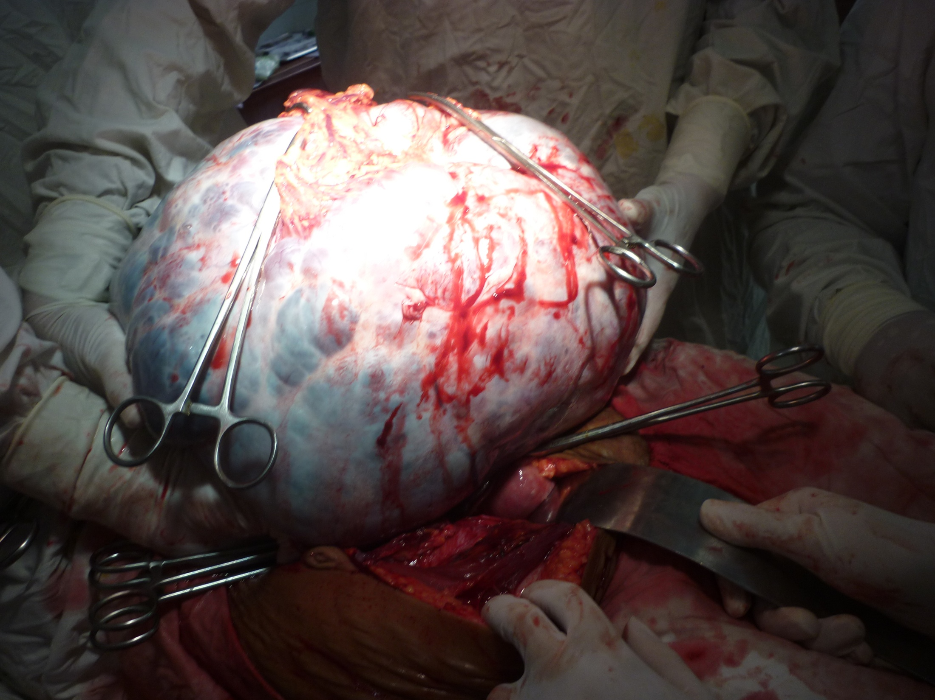

Slide 12
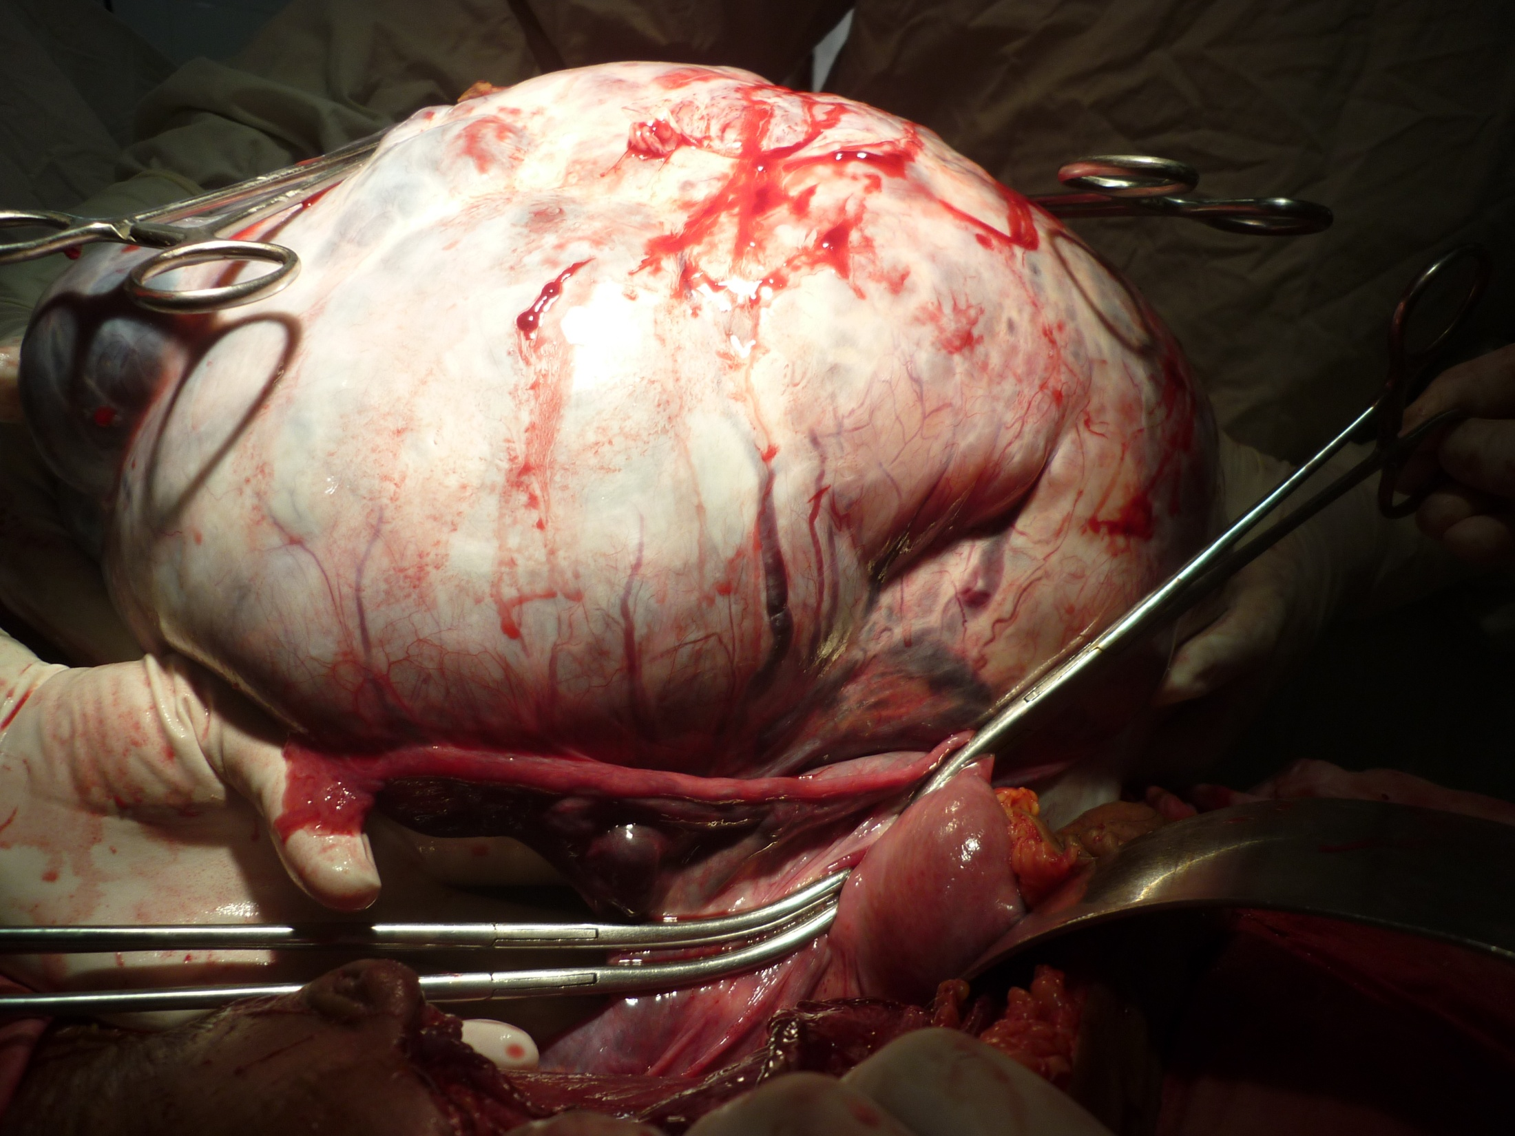

Slide 13
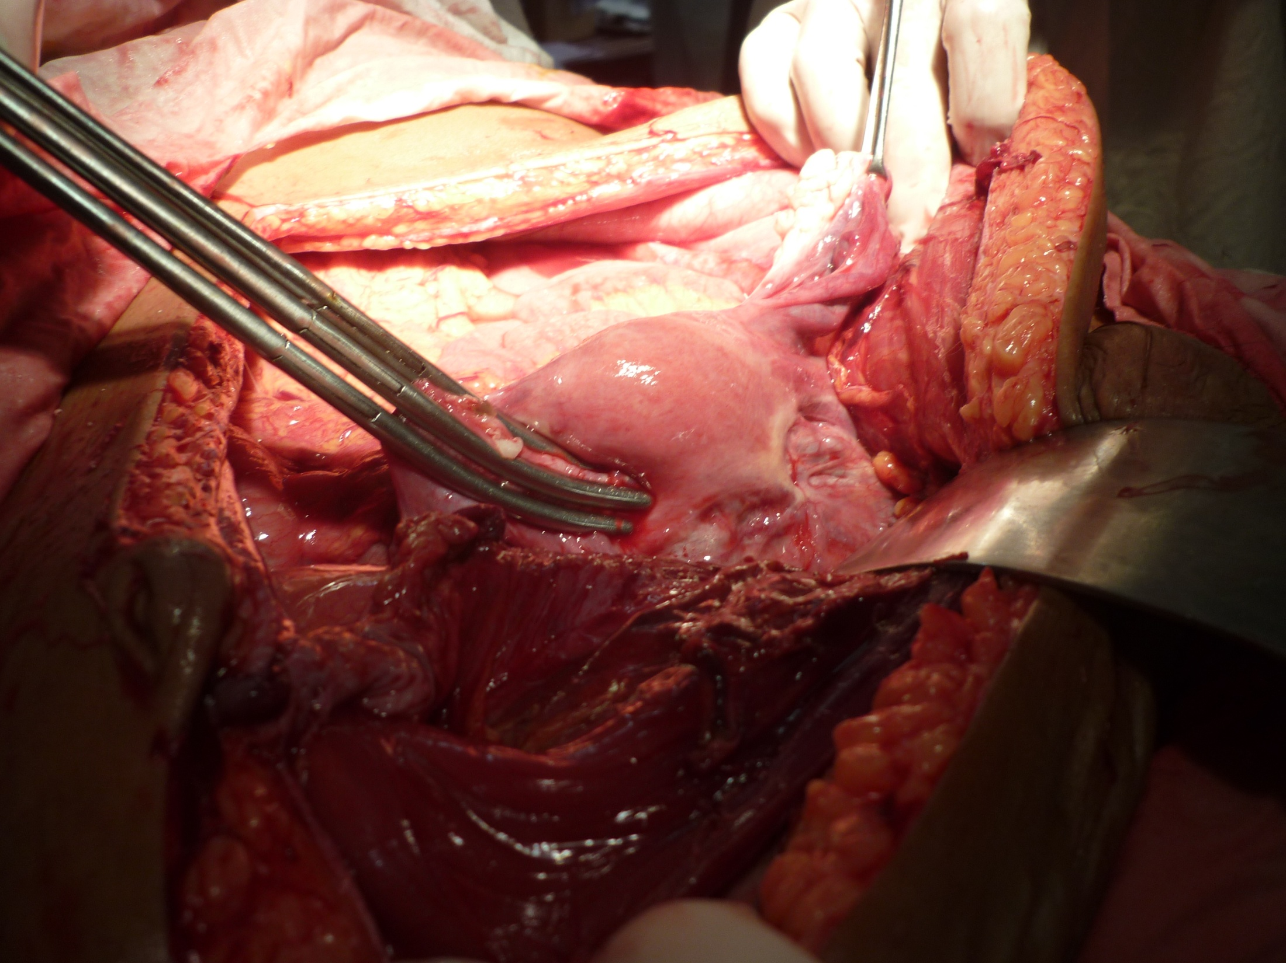

Slide 14
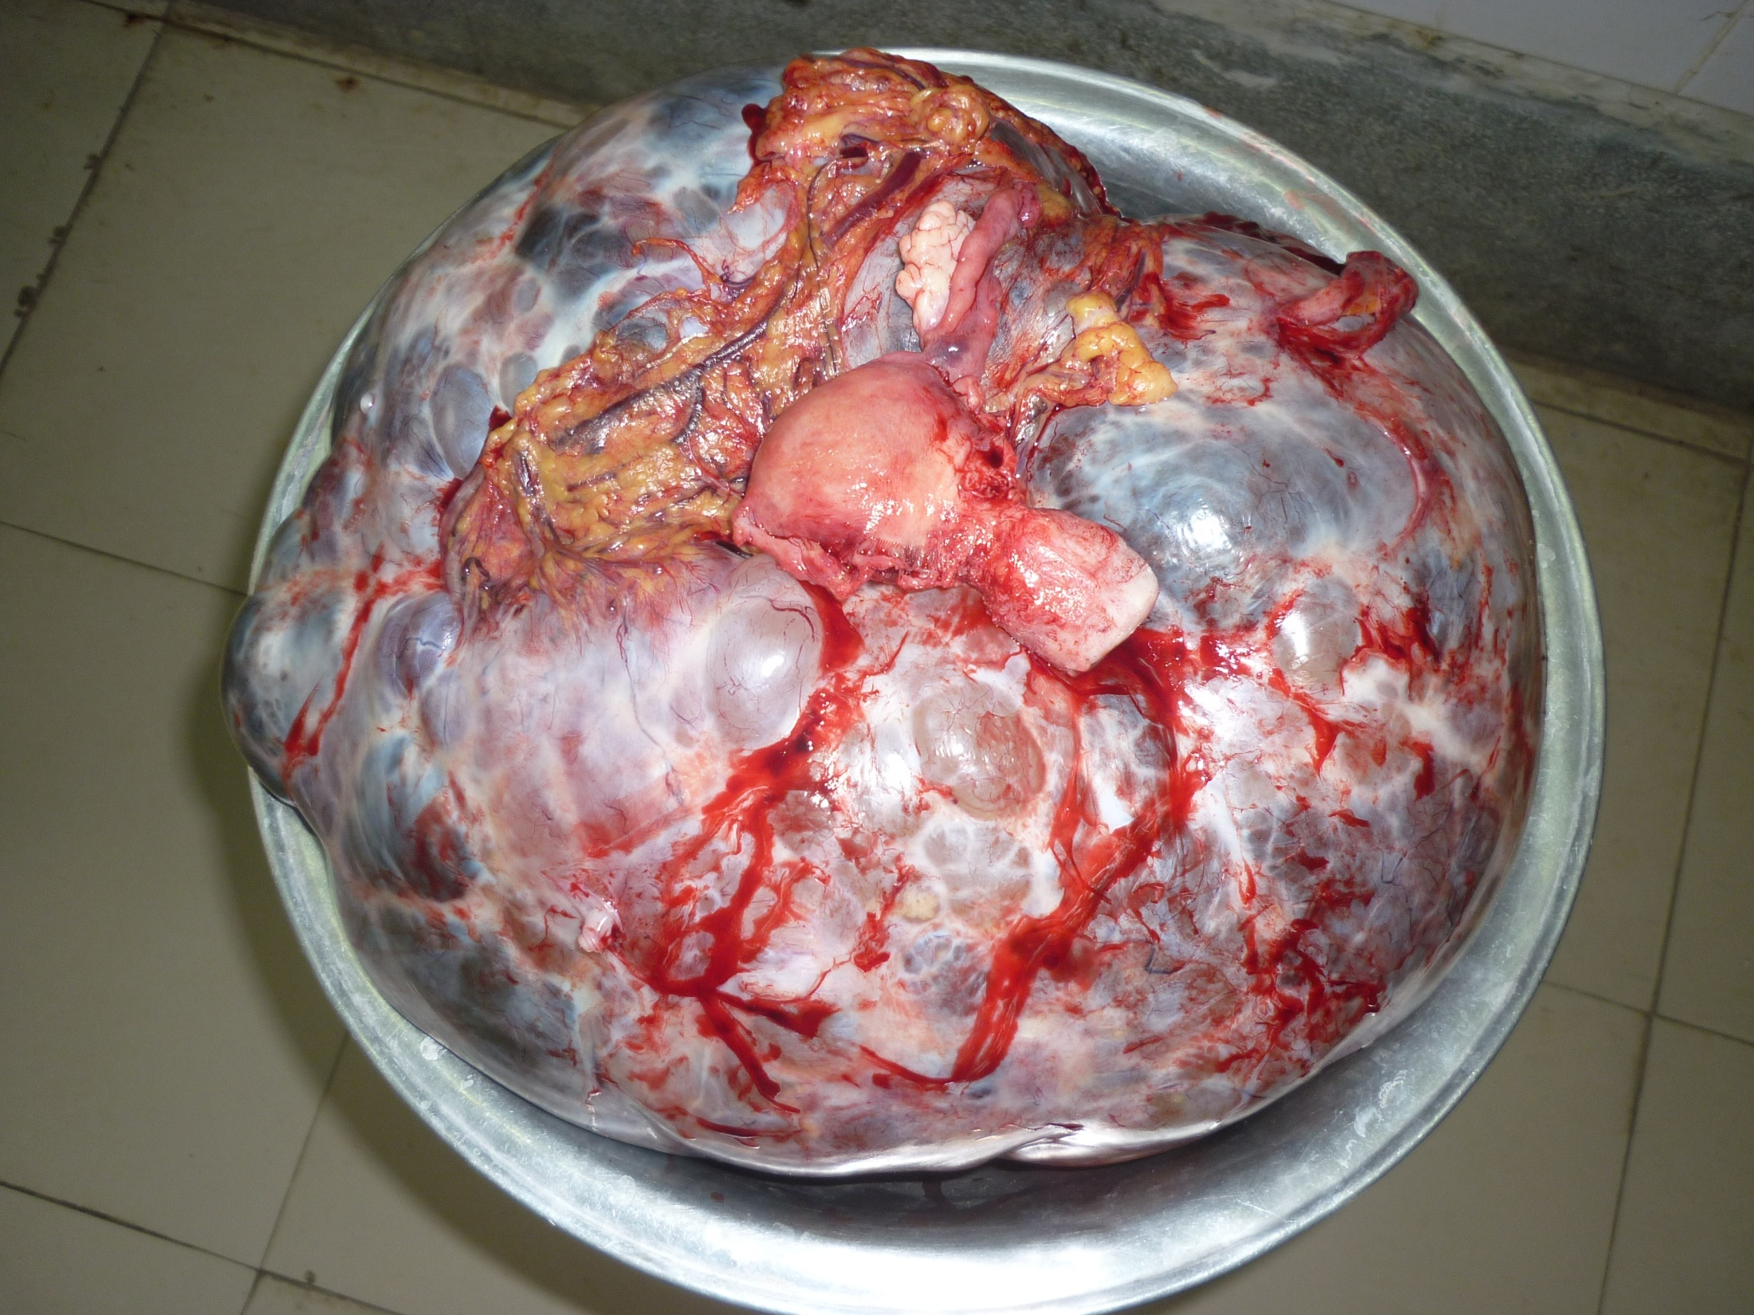
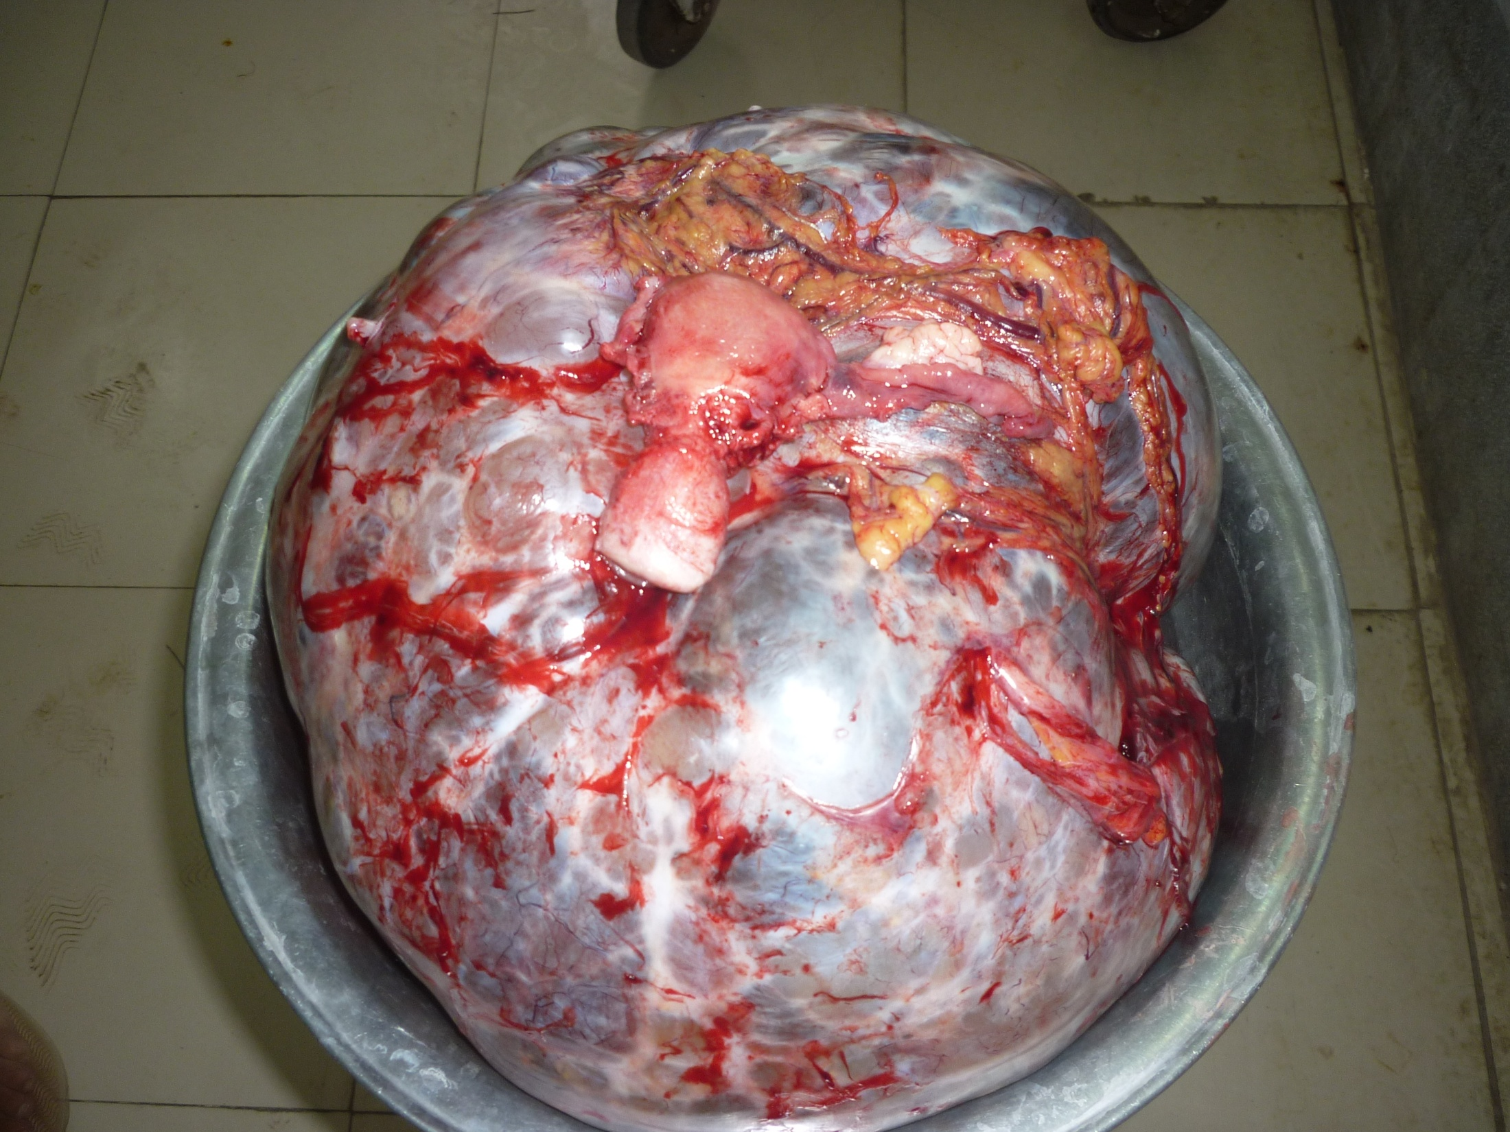
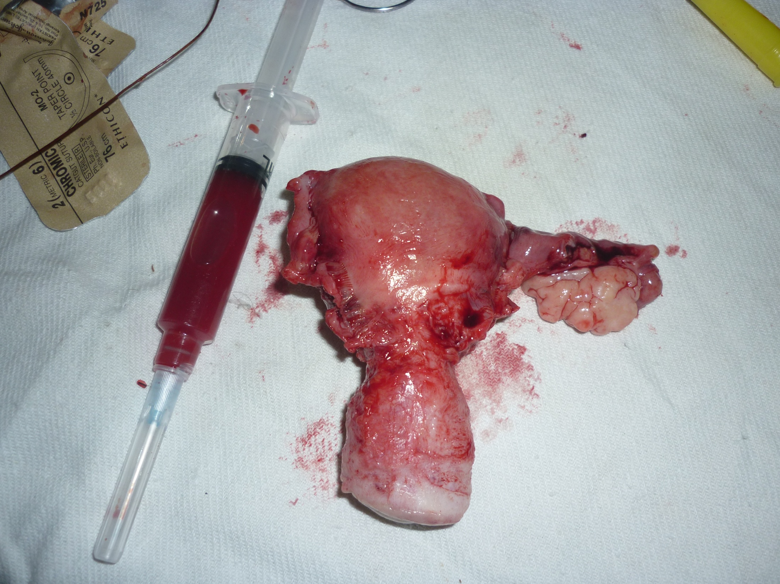

Slide 15
SURGICAL STAGING
STAGE 1 a

Slide 17
HISTOPATHOLOGY
PAPILLARY MUCINOUS ADENOCARCINOMA
PERITONEAL WASHING
NO MALIGNANT CELLS

Slide 19
CARCINOMA OF OVARY
25 %
10% malignant
epithelial
non epithelial
90% are epithelial in origin

Slide 20
CLASSIFICATION
Epithelial tumours
serous
mucinous
endometroid tumours
clear cell tumours
brenner tumours
Sex cord stromal tumours
granuloma cell tumours
androblastoma
Germ cell tumours
dysgerminoma
endodermal sinus tumours
Lipid cell tumours

Slide 21
EPIDEMIOLOGY
long number of years of ovulation
age 50-70yrs
family history
infertility treament
pelvic radiation

Slide 22
CLINICAL FEATURE
late presentation
pain
abdominal swelling
abnormal uterine blee ding
wt loss
pressure effects

Slide 23
GENERAL PHYSICAL EX
pale cachexic
lymph nodes enlarged
breast for primary & secondary
legs varicosity dvt oedema

Slide 24
EXAMINATION
ABDOMINAL distended with acities or
mass , advanced disease
growth may be hard ,irregular tender
PELVIC EX defines the mass
PER RECTAL EX posterior extension

Slide 25
INVESTIGATION
Haematological Tests
Uss
semisolid & semicystic mass with
thick septa &papillary growth & bilateral lesion
Acites
CT Scan
Tumour Marker (CA 125 ,< 35 IU )

Slide 30
SPREAD
DIRECT
LYMPHATIC
BLOOD

Slide 31
SCREENING FOR CANCER
Bimanual Pelvic Ex
Uss
Tumour Markers
CT Scan

Slide 32
5 YRS SURVIVAL RATE
STAGE
1 60-70%
2 40-50%
3 18%
4 5 %

