Slide 1
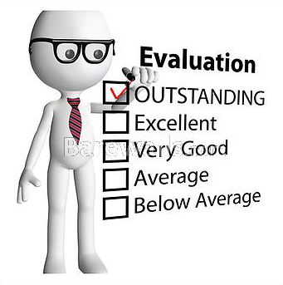
CONCEPTS OF EVALUATION

Slide 2
DEFINITION
•
Evaluation is a process of making
judgements to be used as a basis for
planning . it consists of establishing
goals, collecting evidence concerning
growth towards goals, making judgements
about the evidence and revising
procedures and goals in the light of
judgements. It is for improving the
product, the process and even the goals in
themselves

Slide 3
Evaluation is the process of
determining to what extend
the objectives
are being realized
(Ralph Tyler)

Slide 4
Evaluation, Measurement, Assessment & Testing
• Test: an instrument or systemic procedure for
measuring a sample of behavior
• Measurement: the process of obtaining
numerical description of the degree to which an
individual possesses a particular characteristic
• Evaluation: from the stand point of classroom
evaluation, it is the systematic process of
collecting, analyzing and interpreting information
to determine the extent to which pupils are
achieving instructional objectives

Slide 5
SCOPE OF EVALUATION
• Value judgment
•
Ascertaining the extend to which the educational
objectives have been attained
•
Effectiveness of appraisal or methods of
instruction
•
Identifies pupil’s strengths and
weakness, difficulties and problems, needs and
demands
• Provide baseline for guidance and counseling

Slide 6
• Placements and promotions in jobs
•
Development of
attitudes, interests, capabilities, creativity, origin
ality, knowledge and skills etc.
• Development of tools and techniques
• Development of curriculum and for its revision
• Interpretation of results
•
Helpful for curriculum planners and administers
to improve the curriculum pattern

