Slide 2
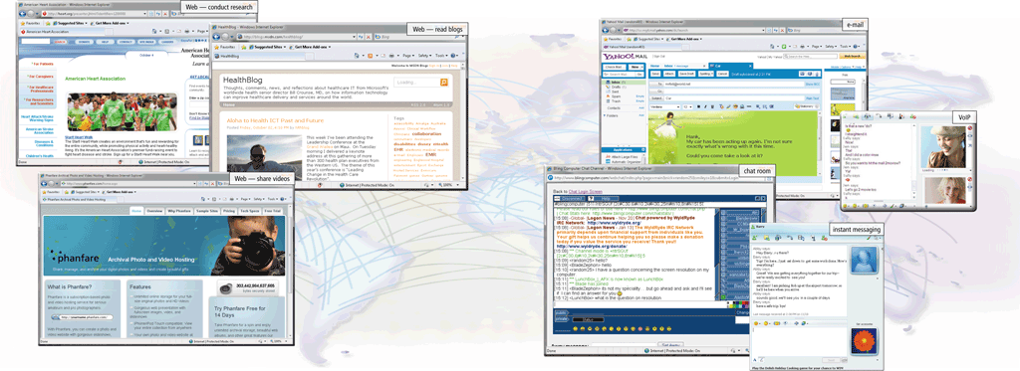
The Internet
The Internet is a worldwide collection of networks that links millions of businesses, government agencies, educational institutions, and individuals
Page 74
Figure 2-1

Slide 3
Evolution of the Internet
The Internet originated as ARPANET in September 1969 and had two main goals:
Allow scientists at different physical locations to share information and work together
Function even if part of the network were disabled or destroyed by a disaster
Page 75

Slide 4
Evolution of the Internet
Many home and small business users connect to the Internet via high-speed broadband Internet service
Cable Internet service
DSL
Fiber to the Premises (FTTP)
Fixed wireless
Cellular Radio Network
Wi-Fi
Satellite Internet Service
Page 76

Slide 5
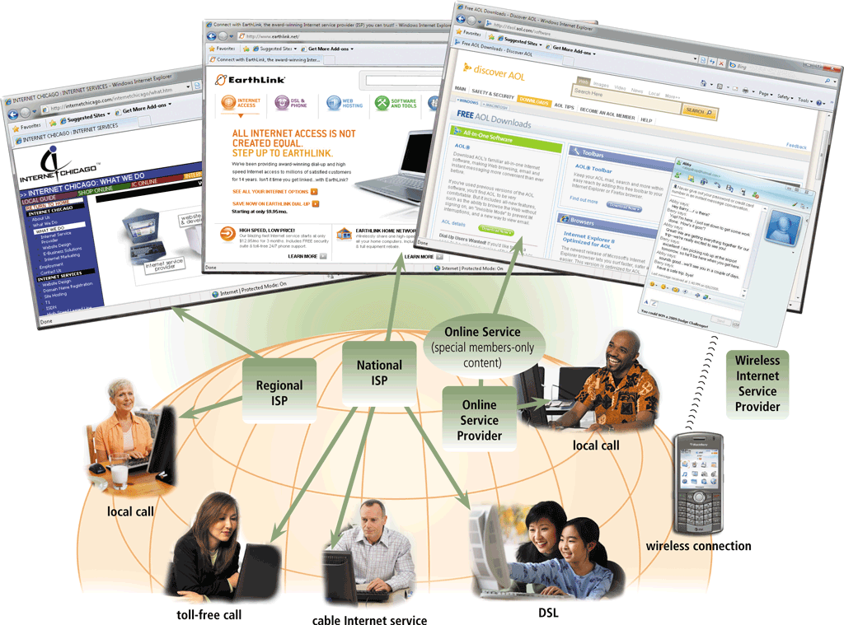
Evolution of the Internet
An access provider is a business that provides individuals and organizations access to the Internet free or for a fee
Page 77
Figure 2-2

Slide 6
Evolution of the Internet
ISP (Internet service provider)
Online service provider (OSP)
Wireless Internet service provider
Regional ISPs provide Internet access to a specific geographical area
National ISPs provide Internet access in cities and towns nationwide
Has many members-only features
Popular OSPs include AOL (America Online) and MSN (Microsoft Network)
Provides wireless Internet access to computers and mobile devices
May require a wireless modem
Page 78

Slide 7
Evolution of the Internet
Page 79
Figure 2-3

Slide 8
Evolution of the Internet
An IP address is a number that uniquely identifies each computer or device connected to the Internet
A domain name is the text version of an IP address
Top-level domain (TLD)
A DNS server translates the domain name into its associated IP address
Pages 79 – 80
Figure 2-4

Slide 9
Evolution of the Internet
Page 80
Figure 2-5
Notes:
mcq

Slide 10
The World Wide Web
The World Wide Web, or Web, consists of a worldwide collection of electronic documents (Web pages)
A Web site is a collection of related Web pages and associated items
A Web server is a computer that delivers requested Web pages to your computer
Pages 80 - 81

Slide 11
The World Wide Web
A Web browser, or browser, allows users to access Web pages and Web 2.0 programs
Internet Explorer
Firefox
Opera
Safari
Google Chrome
Page 81

Slide 12
The World Wide Web
Page 81
Figure 2-6

Slide 13
The World Wide Web
A home page is the first page that a Web site displays
Web pages provide links to other related Web pages
Surfing the Web
Downloading is the process of receiving information
Some Web pages are designed specifically for microbrowsers
Pages 82 - 83
Figure 2-7

Slide 14
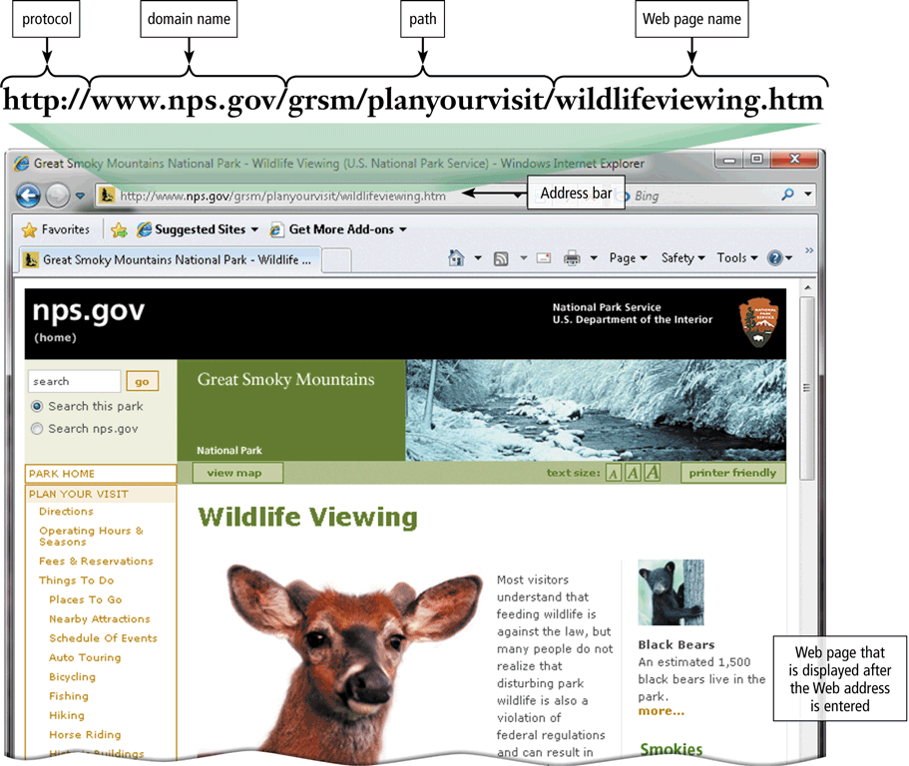
The World Wide Web
A Web page has a unique address called a URL or Web address
Pages 82 – 83
Figure 2-8

Slide 15
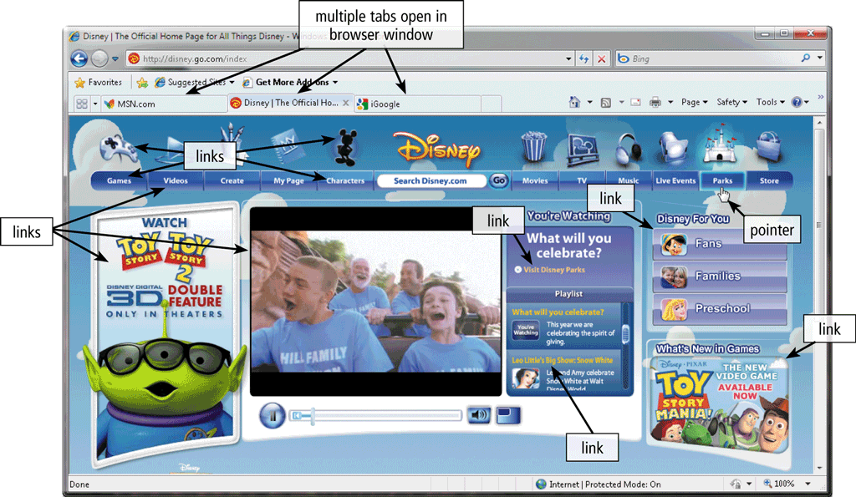
The World Wide Web
Tabbed browsing allows you to open and view multiple Web pages in a single Web browser window
Page 84
Figure 2-9

Slide 16
The World Wide Web
Two types of search tools are search engines and subject directories
Search engine
Finds information related to a specific topic
Subject directory
Classifies Web pages in an organized set of categories
Page 85

Slide 17
The World Wide Web
A search engine is helpful in locating items such as:
Images
Videos
Audio
Publications
Maps
People or Businesses
Blogs
Page 85

Slide 18
The World Wide Web
Page 86
Figure 2-11

Slide 19
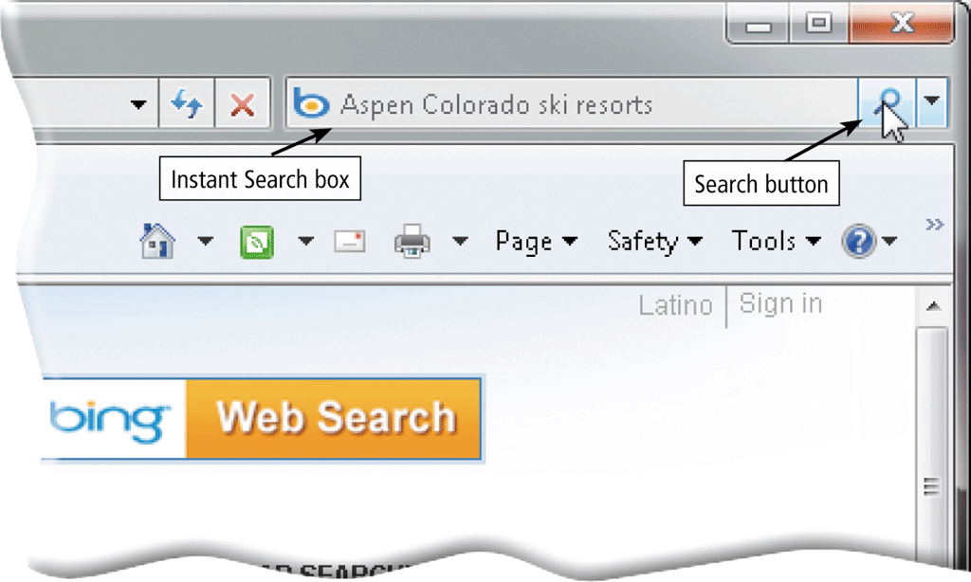
The World Wide Web
Some Web browsers contain an Instant Search box to eliminate the steps of displaying the search engine’s Web page prior to entering the search text
Page 87
Figure 2-12

Slide 20
The World Wide Web
There are thirteen types of Web sites
Portal
News
Informational
Business/Marketing
Blog
Online Social Network
Educational
Wiki
Pages 88 – 91
Figure 2-15

Slide 21
The World Wide Web
Entertainment
Advocacy
Web Application
Content Aggregator
Personal
Pages 91 – 92
Figure 2-15

Slide 22
The World Wide Web
Multimedia refers to any application that combines text with:
Graphics
Animation
Audio
Video
Virtual Reality
Page 92

Slide 23
The World Wide Web
A graphic is a digital representation of nontext information
Graphic formats include BMP, GIF, JPEG, PNG, and TIFF
Page 93
Figure 2-17

Slide 24
The World Wide Web
A thumbnail is a small version of a larger graphic
Page 94
Figure 2-19

Slide 25
The World Wide Web
Animation is the appearance of motion created by displaying a series of still images in sequence
Page 94

Slide 26
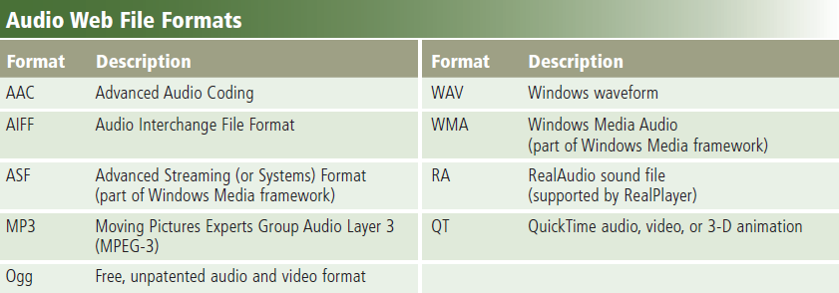
The World Wide Web
Audio includes music, speech, or any other sound
Compressed to reduce file size
You listen to audio on your computer using a player
Streaming is the process of transferring data in a continuous and even flow
Pages 94 – 95
Figure 2-20

Slide 27
The World Wide Web
Page 95
Figure 2-21

Slide 28
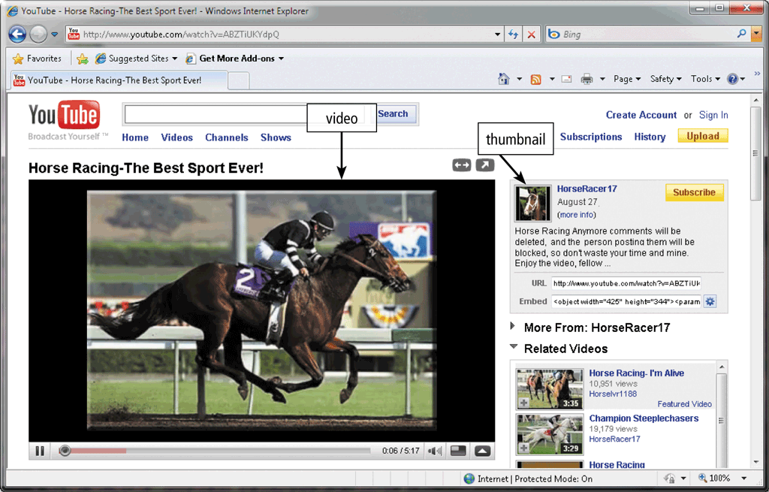
The World Wide Web
Video consists of images displayed in motion
Page 96
Figure 2-22

Slide 29
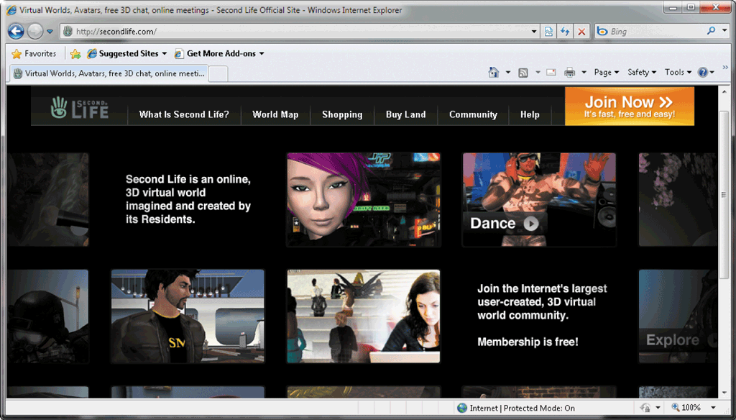
The World Wide Web
Virtual reality (VR) is the use of computers to simulate a real or imagined environment that appears as a three-dimensional space
Pages 96 – 97
Figure 2-23

Slide 30
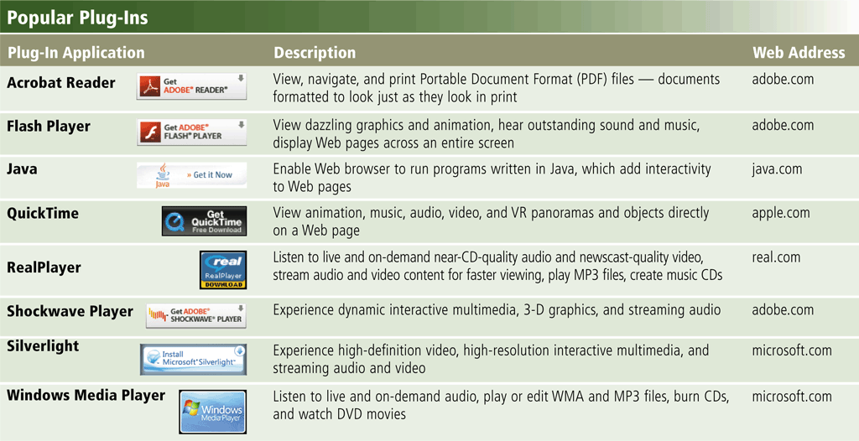
The World Wide Web
A plug-in is a program that extends the capability of a Web browser
Page 97
Figure 2-24

Slide 31
The World Wide Web
Web publishing is the development and maintenance of Web pages
Plan a Web site
Analyze and design a Web site
Create a Web site
Deploy a Web site
Maintain a Web site
Page 98

Slide 32
E-Commerce
E-commerce is a business transaction that occurs over an electronic network
M-commerce identifies e-commerce that takes place using mobile devices
Page 98

Slide 33
E-Commerce
Consumer-to-consumer (C2C)
Business-to-business (B2B)
Business-to-consumer (B2C)
E-commerce
Pages 98 - 99

Slide 34
Other Internet Services
E-mail is the transmission of messages and files via a computer network
An e-mail program allows you to create, send, receive, forward, store, print, and delete e-mail messages
Page 101
Figure 2-26

Slide 35
Other Internet Services
Page 102
Figure 2-27

Slide 36
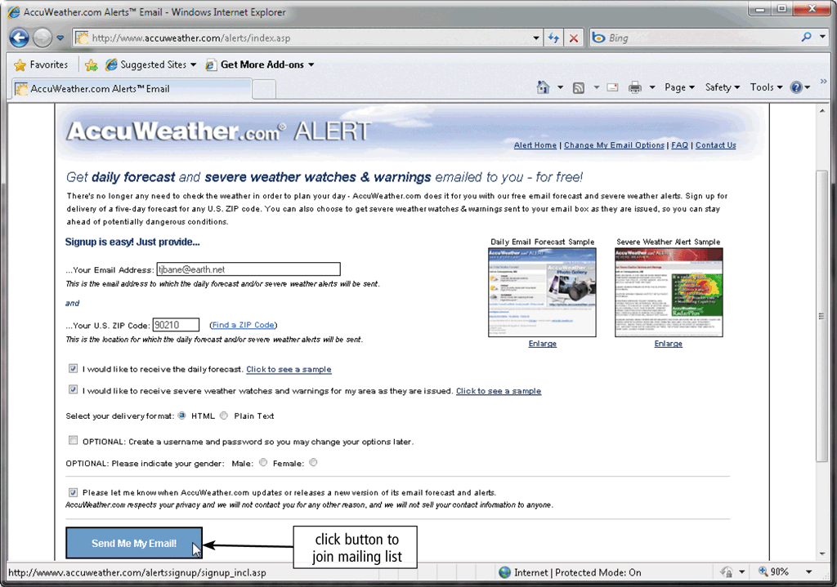
Other Internet Services
A mailing list is a group of e-mail names and addresses given a single name
Subscribing adds your e-mail name and address
Unsubscribing removes your name
Page 103
Figure 2-28

Slide 37
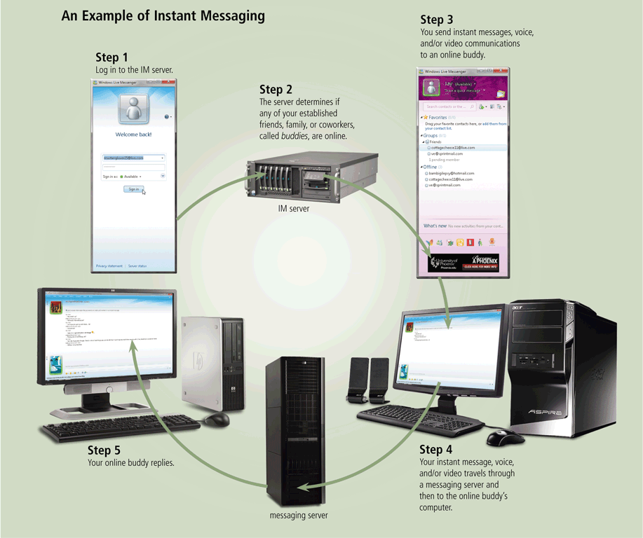
Other Internet Services
Instant messaging (IM) is a real-time Internet communications service
Page 104
Figure 2-29

Slide 38
Other Internet Services
A chat is a real-time typed conversation that takes place on a computer
A chat room is a location on an Internet server that permits users to chat with each other
Page 105
Figure 2-30

Slide 39
Other Internet Services
VoIP (Voice over IP) enables users to speak to other users over the Internet
Also called Internet telephony
Page 106
Figure 2-31
Notes:
question

Slide 40
Other Internet Services
A newsgroup is an online area in which users have written discussions about a particular subject
Typically requires a newsreader
A message board is a Web-based type of discussion group
Page 107
Figure 2-32

Slide 41
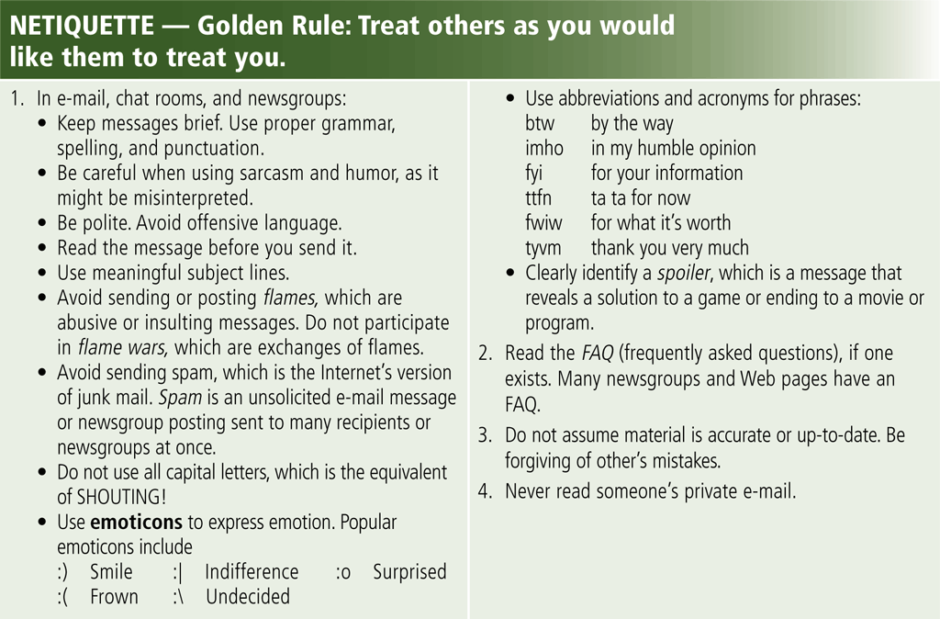
Netiquette
Netiquette is the code of acceptable Internet behavior
Page 108
Figure 2-33
Notes:
question

