Slide 1
AN INTRODUCTION TO THE HUMAN RIGHTS
Miss; naseem kousar
Dept of education uos

Slide 3
INTRODUCTION
HR are inherent in human beings.
Every one has a right to get HRs protected.
Main features of HRs:
Basic and inherent from birth
Equal, Universal and inalienable
Contempt or disregard of HRs lead to barbarous acts
Recognising and respecting every human being in political, social, cultural and economic spheres
Indivisible, inter-related and inter-dependent
HRs demand treating others as we expect others treat us.

Slide 4
Definition of Human Rights
Sect. 2(d) of the Protection of Human Rights Act, 1993:
“2(d) – ‘Human rights’ means the rights relating to life, liberty, equality and dignity of the individual guaranteed by the Constitution or embodied in the International Covenants and enforceable by courts in India.”
Universal Declaration of Human Rights, 1948 (UDHR) declares:
All human beings are born free and equal in rights and dignity.”

Slide 5
Classification of HRs
Rights Essential for the dignified human existence:
Eg., right to basic human need like – food, clothing, shelter and medical care; and
Rights Essential for the adequate development of human personality:
Eg., right to education,
right to freedom of culture,
Right to freedom of speech and expression and
Right to free movement

Slide 6
EVOLUTION OF HUMAN RIGHTS
HRs have long process of evolution.
Possession of HRs distinguishes human beings from other species.
Times in the past – oppression and suppression of human beings by human beings leading to struggles and revolutions – for restoration and protection of HRs.

Slide 7
HRs in Holy Documents
Rigveda – oldest document of human civilisation declares-
All human beings are equal and they are all brothers.
Atharveda – All human beings have equal right over food and water.
Vedas – were the primordial source of “Dharma”
Dharma is regarded as essential securing peace and happiness to the society.
“Sarve Jana Sukhino Bhavanthee” – was the ethos of our motherland.

Slide 8
Modern International History of HRs
Historians give credit to MAGNA CARTA A.D. 1521.
Term HRs was introduced in the United States’ Declaration of Independence in 1776 – thereafter it became part of Bill of Rights in US Constitution.
French Revolution - gave birth to Declaration of Rights of Man and Citizen emerged in 1789.
In 1929, the Institute of International Law, New York, USA prepared a declaration of Human Rights and Duties.
The Inter-American Conference passed a resolution in 1945 seeking the establishment of an International Forum for the furtherance of Human Rights of Mankind.

Slide 9
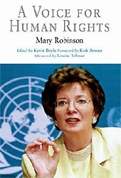
“Human Rights are inscribed in the hearts of people; they were long before they drafted their first proclamation”
- Mary Robinson

Slide 10
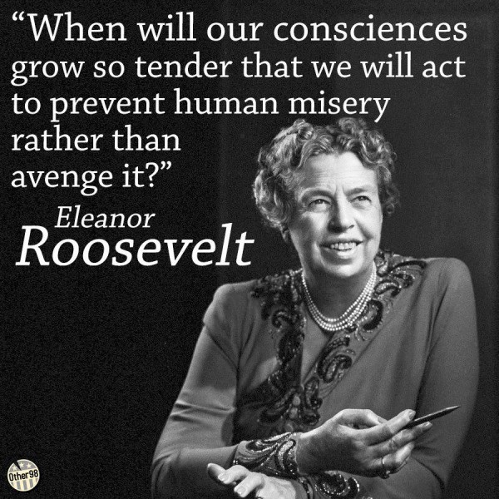
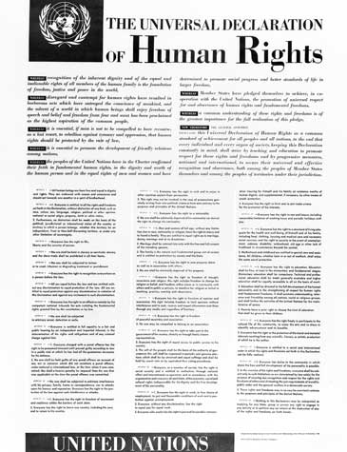
DRAFTING OF UDHR
Wife of thr 32nd President of US (1933-45) Franklin D. Roosevelt

Slide 11
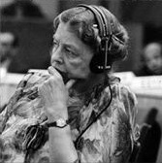
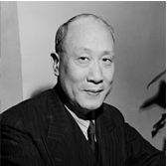
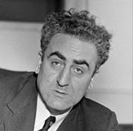
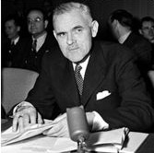
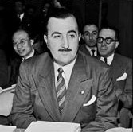
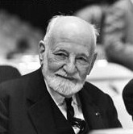
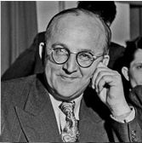
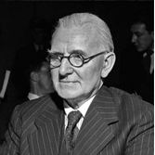
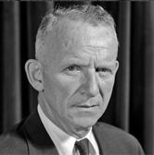
Drafting UDHR
The Drafting Committee included:
Eleanor Roosevelt, USA (Chair)
Peng Chun Chang, of China
Charles Habib Malik, Lebanon
William Roy Hodgson, Australia
Hernán Santa Cruz, Chile
René Cassin, France
A. E. Bogomolov, USSR
Charles Dukes/Lord Dukeston, United Kingdom
John Peters Humphrey, Canada
Eleanor Roosevelt
Pen-Chun Chang
William Roy Hodgson
Charles Malik
Hernán Santa Cruz
René Cassin
A. E. Bogomolov
Charles Dukes
J. P. Humphrey

Slide 12
Declaration of UDHR
In Paris on December 10^{th,} 1948, the UN adopted the Universal Declaration of Human Rights (UDHR).
It came at the time when the World was recovering from a long period of bloody and horrific conflict.
UDHR proclaims that all human beings are born free and equal in dignity and rights.
In history and in ancient scriptures references to the basic human rights can easily be noticed.

Slide 13
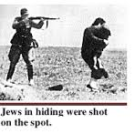
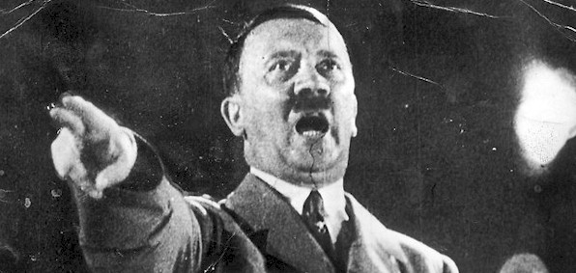
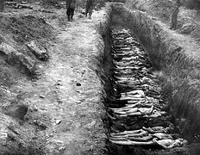
Evolution of Universal HRs.
The International HRs Movement was born in and around the WW II.
It is due to the barbaric terror and violence by Adolf Hitler-which world needed to oppose the repetition of the same.

Slide 14
Contemporary Concept of Human Rights
Three Generations of Human Rights:
First Generation of Human Rights:
Mainly concerned with the Civil and Political Rights of the individual.
In other words, the ‘liberty-oriented’ rights.
They meant to impose ‘negative obligations on the Govt’.
Govt. must desist from interfering with the exercise of individual liberty.
Second Generation of Human Rights:
Mainly ‘security oriented’ and provide for ‘social, economic and cultural security’.
They are positive in nature making it a duty of the State to ensure for the realisation these rights.

Slide 15
Contd…
Third Generation of Human Rights:
These rights are of recent origin.
They have emerged due to various new concerns such as, ‘environmental, cultural and developmental rights’.
They relate to the rights of groups of people rather than individual.
The developing countries have played a significant role in bringing about international consensus on these rights.
Example of these rights: is the declaration on the right to develop, adopted by the United Nations General Assembly in 1986.

Slide 16
BIRTH OF UN AND UDHR
20TH Century – saw an unprecedented human losses, devastations and destruction due to the Two World Wars.
At the end of the WW II the United Nations was established in 1945 in order to establish and accomplish the long awaited-
world peace,
prosperity and
happiness
of all human kinds all over the world irrespective of race, religion, caste, creed, colour and community.

Slide 17
UNIVERSAL DECLARATION OF HUMAN RIGHTS (UDHR) AT A GLANCE
UDHR also called as the United Nations Charter.
UDHR proclaims that the people of United Nations-
“re-affirm faith in the fundamental human rights, in the dignity and worth of the human person, in the equal rights of men and women” and
in “universal respect for, and observance of human rights and fundamental freedoms for all without distinction as to race, sex, language or religion.”

Slide 18
UDHR
United Nations declared the UDHR on 10th December, 1948.
This declaration was not a sudden or miraculous event.
It was the effect of a cumulative and continuing movement of human conscience and changes in thinking that went on over a long period.
It was not mere a declaration, but represents the collective wisdom of the World community to work together towards a World without injustice, indignity and ignorance, without cruelty and hunger.

Slide 19
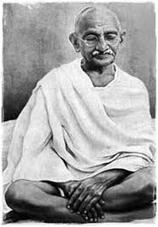
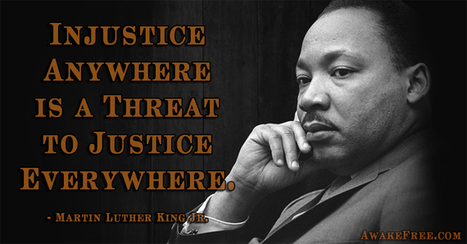
Mahatma Gandhiji said, “peace all over the world can be established not on gun powder but on pure justice” .

Slide 20
Importance of HRs
The gap and disparity between the fortunate, less fortunate and unfortunate inevitably lead to disturbance, tensions, conflicts violence and commissions of offences.
This will impair peace, stability and progress of the country activating forces opposed to the preservation of human rights.
It is a matter of belief that wars produce hunger, but people fail to see the fact that it is the hunger that can lead to wars – as hunger and peace cannot co-exist.
Therefore, all democratic institutions are duty bound to respond to the challenges of their subjects.

Slide 21
UDHR at a glance
Article(1) and the preamble of the UDHR state that, “All human beings are born free and equal in dignity, they endowed with reason and conscience should act towards one another in a spirit of brotherhood.”
UDHR was a statement of intent or principle, and not a treaty or a legal agreement between the countries or the binding legal document, yet it was a document of great influence.

Slide 23
All Articles of UDHR
Article 1 Right to Equality
Article 2 Freedom from Discrimination
Article 3 Right to Life, Liberty, Personal Security
Article 4 Freedom from Slavery
Article 5 Freedom from Torture and Degrading Treatment
Article 6 Right to Recognition as a Person before the Law
Article 7 Right to Equality before the Law
Article 8 Right to Remedy by Competent Tribunal
Article 9 Freedom from Arbitrary Arrest and Exile
Article 10 Right to Fair Public Hearing
Article 11 Right to be Considered Innocent until Proven Guilty
Article 12 Freedom from Interference with Privacy, Family, Home and Correspondence
Article 13 Right to Free Movement in and out of the Country
Article 14 Right to Asylum in other Countries from Persecution
Article 15 Right to a Nationality and the Freedom to Change It

Slide 24
All Articles of UDHR
Article 16 Right to Marriage and Family
Article 17 Right to Own Property
Article 18 Freedom of Belief and Religion
Article 19 Freedom of Opinion and Information
Article 20 Right of Peaceful Assembly and Association
Article 21 Right to Participate in Government and in Free Elections
Article 22 Right to Social Security
Article 23 Right to Desirable Work and to Join Trade Unions
Article 24 Right to Rest and Leisure
Article 25 Right to Adequate Living Standard
Article 26 Right to Education
Article 27 Right to Participate in the Cultural Life of Community
Article 28 Right to a Social Order that Articulates this Document
Article 29 Community Duties Essential to Free and Full Development
Article 30 Freedom from State or Personal Interference in the above Rights

Slide 25
Human Rights Perspective in Indian Constitution
Declaration of HRs by UN in 1948 gave global focus and thrust to the Human Rights.
The rights mentioned in its 30 Articles have been accepted by most of the countries and are reflected in the Constitution of many countries.
Similarly, when the Constituent Assembly drafted the Constitution of India, they already adopted the recommendations of the UDHR, 1948.
This indicates the serious concern of our country to Human Rights.

Slide 26
HRs Principles in Preable
“We the people of India constitute India into a sovereign, socialist, secular, democratic republic and to secure to its citizens justice, liberty, equality and fraternity….”
The resolution assures the dignity of the individual which is one of the basic principles underlying UDHR.
To give effect to this assurance, provisions are made in PART-III and PART-IV of our Constitution as FRs and DPSPs.
FRs are fundamental and enforceable in Courts.
DPSPs are not enforceable but they are fundamental in the governance of the country.

Slide 27
Two Sets of Rights as per UDHR
UDHR speaks of two sets of rights-
Civil and Political Rights and
Economic and Social Rights
Hence the traditional Civil and Political Rights were enshrined as Fundamental Rights under the Indian Constitution, while
The Economic and Social Rights were set forth as DPSPs.
Thus PART-III and PART-IV sets out Declaration of Human Rights.
There are many similarities in content and form of UDHR and PART-III and IV of the Constitution.

Slide 28
SUPREME COURT ON HUMAN RIGHTS
By enacting Laws such as the Protection of Human Rights Act, 1993 and the affirmative executive actions, Government of India have attempted promotion of Human Rights regime giving due respect to human dignity and recognition to Human Rights.
Similarly, Supreme Court has by numerous landmark judgments contributed a lot by interpreting enactments, constitutional provisions and explaining and expanding the position of Human Rights for heir protection and promotion.

Slide 29
SUPREME COURT ON HUMAN RIGHTS
The two Articles 14 and 21 of Constitution of India came to be considered by the Supreme Court to ensure human dignity translating the declaration of human rights into reality.
These two articles have received a much deeper and meaningful considerations at the hands of the Supreme Court.

Slide 30
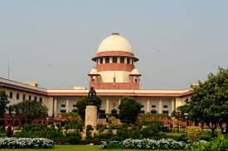
Landmark Judgments of SC on Human Rights

Slide 31
Ahmedabad Municipal Corporation vs. Nawab Khan Gulam Khan & Ors. [1997]
In, the SC having regards to Art. 19(1)(e) read with Article 21 of the Constitution of India and Article 25(1) of the UDHR declared that everyone has a rights to standard of living adequate for the health and well-being. Court also referred Article 11(1) of the International Covenants on Economic, Social and Cultural Rights.

Slide 32
Chameli Singh vs. State of UP and Ors [1996]
SC expressed that right to shelter is a Fundamental Right available to every citizen and that Article 21 encompasses within its limit the right to shelter.
It observed that, “…In any organised society, right to live as a human being is not ensured by meeting only the animal needs of man. It is secured only when he is assured of all facilities to develop himself and is freed from restrictions which inhibit his growth. All human rights are designed to achieve this object…”

Slide 33
Prabhakar Nair vs. State if Tamil Nadu & Ors. [1987]
SC held that shelter is a fundamental right. New national housing policy must attract new buildings, make available new spares, rationalise the rent structure and the rent provisions.

Slide 34
M/s. Shantistar Builders vs. Narayan Khimalal Totame & Ors. [1990]
SC emphasised on right to shelter.
It says -the basic needs of man accepted to be three – food, clothing and shelter.
The Constitution aims at ensuring fuller development of every child.
Therefore, the child should be in a proper home.
SC after interpreting the provisions of Articles 39(e), (f), 41 and 47 of the Constitution gave directions to the State Govt. regarding fulfillment of legislative intentment of Section 3 of the Child Labour (Prohibition and Regulation) Act, 1986.
The SC observed that tender age of the children should not be abused and they should have enough opportunities and facilities to develop in a healthy manner.

Slide 35
Ramamurthy vs. State of Karnataka [1997]
SC expressed serious concern for delaying trial and confining of under trial prisoners in jail for long period and issue direction for jail reforms, production of under trial children before on remand date properly.
Further directions were issued for jail reforms prohibiting the torture and ill-treatment of the prisoners.

Slide 36
SC on Rights of the prisoners
In Charles Shobraj vs. Superintendent, Central Jail, Tihar [1978], Sunil Batra vs. Delhi Adm. [1978] and Sunil Batra vs. Delhi Adm. [1980], State of Maharashtra vs. Prabhakar Pandurang Sanzgiri & Anr. [1966),
SC has recognised rights of the prisoners to ask for observation of Human Rights.
While dealing with the question of right to reading and writing books by prisoners in jails, SC gave advantage of Article 21 to them.
In Suresh Chandra vs. State of Gujarat [1976] and Krishna Lal vs. State of Delhi [1976],
SC provided for penological innovation in the form of parole and recommended for its liberal use.

Slide 37
SC on Rights of the prisoners
In D. Bhuvan Mohan Patnai & Ors. Vs. State of Andhra Pradesh [1974],
SC stated that resort to oppressive measure to curb political people should not be permitted.
In Prem Shanlar Shukla vs. Delhi Adm. [1980] and Kadra Pehadiya vs. State of Bihar [1981],
SC issued direction prohibiting the putting of under-trial prisoners in leg-irons.
In Madhav Hayawadanrao Moskot vs. State of Maharashtra [1978],
SC held that jail manual must be updated to include the mandate of the constitution for the reason that all the obligations are necessarily implied as Article 21 guarantees.

Slide 38
SC on Himan Rights
In Mohini Jain vs. State of Karnataka [1992], the SC held that the right to education is concomitant to Fundamental Rights enshrined in Part-III of the Constitution.
In J.P. Unni Krishnan vs. State of Andhra Pradesh [1993] and in Bandhu Mukti Morca vs. Union of India & Ors [1997], interpreting Article 21 of the Constitution, SC held that every child under the age of 14 years has a right of basic education.
In Suk Das vs. Union Territory of Arunachal Pradesh [1986], SC has pointed out that the obligation on the part of the State to provide free legal aid to those who cannot afford to engage counsel and bear the expensive litigations.

Slide 39
SC on Himan Rights
In Pt. Parmanand Katara vs. Union of India & Ors [1989], SC held that the doctor should not insist for Medic-legal Report and he must provide the medical aid.
It further directed that immediate medical aid to injured persons be provided and held that it was professional obligation of all the doctors, whether Govt. or private to provide medical aid to the injured without insisting on the statutory procedural requirement of observance of police formalities.

Slide 40
SC on Himan Rights
In Vishakha & Ors. Vs State of Rajasthan & Ors. [1997], sexual harassment of working women in the place of employment was found to be against human dignity and violence of Article 21 of the Constitution and guidelines were provided for preventing this menace.
In Bodhisattwa Gautam vs. Miss Subhra Chakraborthy [1996], SC held that rape is a crime against the basic human right and violated the right to life enshrined in article 21 of the Constitution and provided certain guidelines for awarding comensation to the prosecutrix in such a case.

Slide 41
SC on Himan Rights
In Nilabati Behera vs. State of Orissa [1993], SC held that for concentration of Human and Fundamental Rights by the State and its agencies, the Court must award compulsory compensation and rejected the defence of sovereign immunity.
The Court held that custodial death amounts to violation of the Fundamental right to life.

Slide 42
Conclusion
Respect Human Rights is the greatest inspiration for integration of human kind, both internally and internationally.
We are living in the era of modernisation, liberlisation, privatisation and globalisation.
All these must have an element of humanisation.
Humanisation of the globe may lead to reduction in human rights violations.
All Human Rights for all should not merely remain, as declaration on paper but it must be the spirit of living in day-to-day life.
We must treat others as we expect others to treat us, will really serve the purpose of Human Rights.

Slide 43
Conclusion
Recognition of the inherent right of all human beings as well as equal entitlement of each individual to all human rights forms the core of human rights doctrine.
The Legislative has played a crucial role in promoting Human Rights.
The problem of Human Rights besides being a legal problem, also impacts upon society economy and even culture.
However, the battle for prevention of violation of Human Rights if to be fought with sincerity and commitment.

Slide 44
Conclusion
All the institutions and individuals concerned should have unshaken faith in the observance of Human Rights.
They all must strive for better protection and promotion of Human Rights to make the lives of human beings worthy of living with dignity and grace.

Slide 45
Thank you Class!

