Slide 1
Cellular Metabolism

Slide 2
Cellular Metabolism
Cellular metabolism is the set of chemical
reactions that occur in living organism in order
to maintain life
These processes allow organism to grow and
and reproduce , maintain their structure and
respond to environmental changes

Slide 3
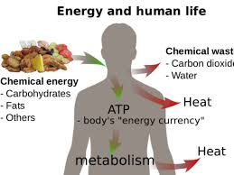

Slide 4
All cells in the body require energy for many of
of their processes
Energy comes into the body in the form of food
stuffs
Carbohydrates, protein and fats that we consume have chemical energy that we can utilize to make ATP

Slide 5
ENERGY
Energy is stored in the chemical bonds of
nutrient molecules
When a bond is broken , energy is released
When a bond is formed , energy is stored in that bond
Energy
AB A + B AB
Energy

Slide 6
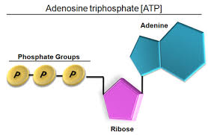

Slide 7
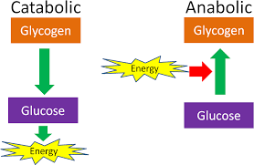
CLASSIFICATION
Cellular metabolism has two distinct divisions:
Anabolism
Catabolism

Slide 8
ANABOLISM
A Constructive process during which larger molecules are built from smaller ones
It is a metabolic process in which a cell uses energy to construct molecules such as enzymes and nucleic acid to perform other essential life
functions
Usually involves Condensation

Slide 9
CARBOHYDRATES, LIPIDS AND PROTEINS
There are three major classes of molecules
Carbohydrates
Monosaccharides = simple sugars
Glucose , fructose
Disaccharides = combination of monosaccharides, removal of water
Sucrose, lactose, maltose
Polysaccharides = Polymers of glucose, e.g starch

Slide 10
LIPIDS
Heterogeneous group of compound which are soluble in organic solvent like ether and insoluble in water or polar carbohydrates
These are triglycerides
Further modification produce :
Phospholipids
Glycolipids
Lipoprotein

Slide 11
PROTEIN
Protein is made up of amino acids
Covalent bond formed is a peptide bond
Polypeptides : 2-100 amino acids
Protein: > 100 amino acids
Required additional modification to become
functional

Slide 12
MODIFICATION
Modification occurs on four levels
Primary: string of amino acid
Secondary: helix or pleat structure
Tertiary : 3D folding
Quaternary: two or more 3-D proteins that act as
as a functional unit
i.e ., Hemoglobin

Slide 13
Shape determines function
Loss of shape leads to loss of function
Protein may be structural or functional
If structural play a role in cellular architecture
Collagen , actin, myosin
If functional play a role in cell metabolism
Enzymes, antibodies

Slide 14
PATHWAY
Anabolism is building up aspect of metabolism
Polymerization, an anabolic pathway used to build macromolecules such as nucleic acid ,Protein and
polysaccharides uses condensation reaction to join
monomers
Larger molecules are form from smaller molecules
using enzymes and cofactor

Slide 15
ENERGY SOURCE
Anabolism is powered by
catabolism where large molecules are broken down into
Smaller parts
Anabolic process is also
powered by cleavage of of ATP
Anabolism usually involves
reduction and decreases
entropy making it unfavorable
without energy input

Slide 16
ENERGY SOURCE
The starting material called precursor , is joined to
to gather using chemical energy made available
from hydrolyzing ATP
Reduced co factor FAD , NAD and performing
favorable side reactions
Cofactors
The reducing agents NADH, FADH2 acts as cofactor
in anabolic pathway

Slide 17
SUBSTRATES
NADH, NADPH and FADH2 act as electron carrier ,
while charged metal ions within enzymes stabilize
charged functional groups on substrates
Substrate for anabolism is mostly intermediate taken
from catabolic pathway during period of high energy
charge in the cell

Slide 18
Functions
Anabolic process build organ and tissues
Increases body size and produce growth and
differentiation of cells
Example:
Growth and mineralization of bone and increases
muscle mass
Anabolic hormones
classic anabolic hormone is steroids which stimulate
protein synthesis and muscle growth and insulin

Slide 19
PHOTOSYNTHETIC CARBOHYDRATE SYNTHESIS
Photosynthetic carbohydrate synthesis in plants and certain bacteria is an anabolic process that produces
glucose, cellulose, starch, lipid and protein from co2
It uses energy produced from light –driven reaction
of photosynthesis and creates precursors to large
molecule via , calvin cycle

Slide 20
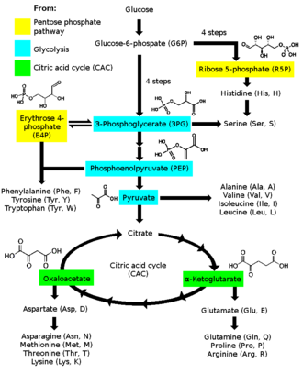

Slide 21
GLYCOGEN STORAGE
During periods of high blood sugar, glucose 6-
phosphate from glycolysis is diverted to
glycogen – storing pathway
It is changed to glucose-1-phosphate by
phosphoglucomutase and UDP-glucose by UTP-
glucose -1-phosphate
Glycogen synthase adds this UDP – glucose to
glycogen chain

Slide 22
GLUCONEOGENESIS
Glucagon is a catabolic hormone , but also
stimulates the anabolic process of
gluconeogenesis by the liver
Lesser extent the kidney cortex and intestines
during starvation to prevent low blood sugar
Gluconeogenesis pathway has many reversible
enzymatic process similar to glycolysis

Slide 23
But it is not the process of glycolysis in reverse
Regulation
Anabolism operates with separate enzymes from
catalyst
They undergo irreversible steps at some point in
their pathway
This allow the cell to regulate the rate of production and prevent infinite loop

Slide 24
Balance between anabolism and catabolism
is sensitive to ADP and ATP and known as
energy charge of the cell
High amount of ATP favors anabolic pathway and slow catabolic pathway
Excess ADP slows anabolism and favors
catabolism

Slide 25
CATABOLISM
A set of metabolic pathway that breaks down molecules into smaller units
Either oxidized to release energy or used in other
anabolic reaction
Catabolism is the breaking down aspects of metabolism

Slide 26
CATABOLIC HORMONES
Many signals that control catabolism
Catabolic hormone that are known since 20th
century:
Cortisol
Glucagon
Adrenaline

Slide 27
Large molecules broken down into smaller molecules
Usually by hydrolysis
Splitting with water
Adds water back into molecule
Breaks covalent bond
Energy is released when bonds break
Reverse of condensation

Slide 28
Hydrolysis= chemical digestion
Occur simultaneously with anabolism
Process controlled by enzymes
Catabolic reaction in animals separated into three stages
Large molecules such as protein or lipid are digested into
smaller components
Smaller molecules are taken up by cells and converted to smaller molecule such as CoA which releases energy

Slide 29
Acetyl group on CoA is oxidized to water and carbon dioxide
in citric acid cycle and electron transport chain releasing
energy that is stored by reducing the coenzyme NAD+
into NADH
Digestion
Macromolecules such as protein cannot be rapidly taken
up by cells and broken into smaller units before they
can be used in cell metabolism

Slide 30
Digestive enzyme include protease that digest protein into amino
acid as well as glycoside hydrolase that digest polysaccharides
into simple sugar
Microbes simply secrete digestive enzymes into their surrounding
Animals secrete these enzymes from specialized cells in their guts
including stomach and pancreas
Amino acids or sugar released by these extracellular enzymes
and then pumped into cell for active transport

Slide 31
Catabolism

Slide 32
Metabolic Disorder
Calcium metabolism disorder
Acid base imbalance
Metabolic brain disorder
Sign and Symptoms
Weight loss
Jaundice and seizures
CAUSES
Inherited metabolic disorder are cause of metabolic disorder

Slide 33
And occurs when defective gene causes enzyme deficiency
Metabolic disorder can also occur when liver or pancreas do not function properly
DIAGNOSIS
Metabolic disorder can be present at birth and may can be
identified by routine screening
Specific blood and DNA test can be done to diagnose genetic
metabolic disorder

