Slide 1
Vertebrate pests of Agricultural crops
ENTO-306
Agricultural Pests & Their Management
By: Dr. Muhammad Zeeshan Majeed

Slide 2
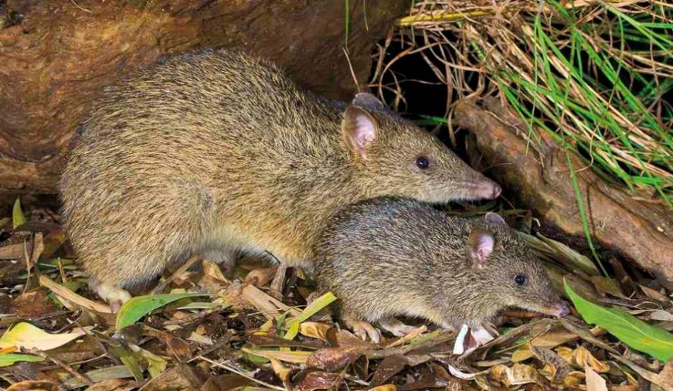
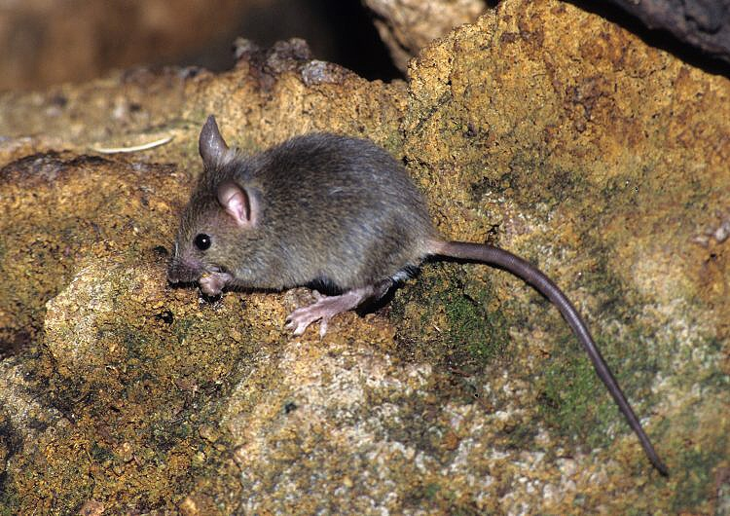
The lesser bandicoot rat, Sindh rice rat or Indian mole-rat is a giant rat of Southern Asia. They can be up to 40 cm long, and are considered a pest in the cereal crops and gardens of Asian countries, and emit grunts when attacking.
The rat's damage estimate in mature wheat was 12.1% of grain destroyed before harvest. Wheat damage was attributable primarily to the lesser bandicoot rat.
Mus musculus
Eastern house mouse
Bandicota bengalensis
bandicoot rat

Slide 3
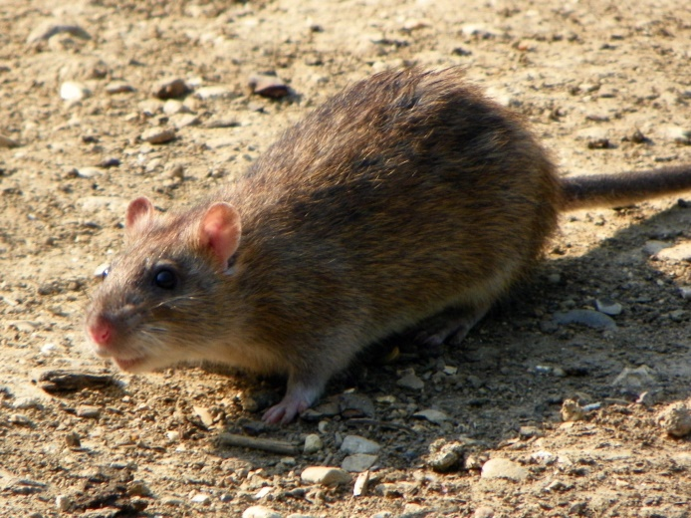
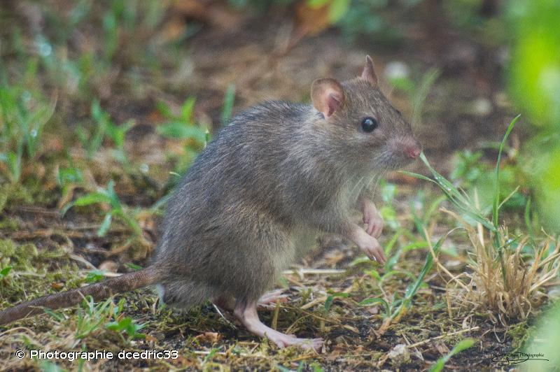
Most of the crop damage and economic loss were caused by rodent pests. Vertebrate rodent pests include Mus musculus (house mouse) and Bandicota bengalensis (lesser bandicoot rat), Rattus norvegicus and Rattus rattus caused damage to crops like sugarcane, maize, household stored food items and grains.
Rattus norvegicus
Norway rat
Rattus rattus
Black rat, ship rat, roof rat, or house rat

Slide 4
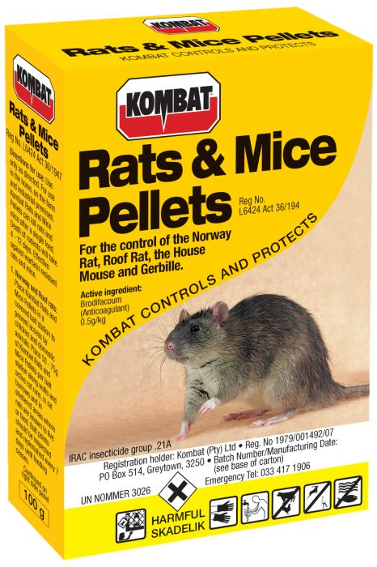
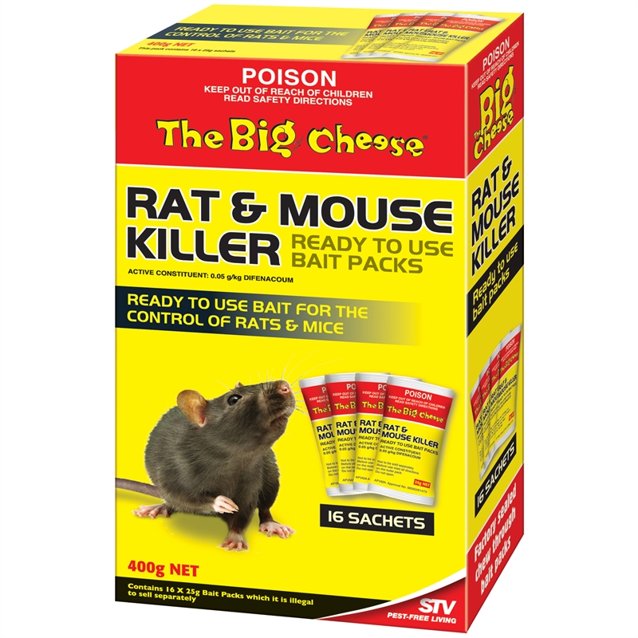
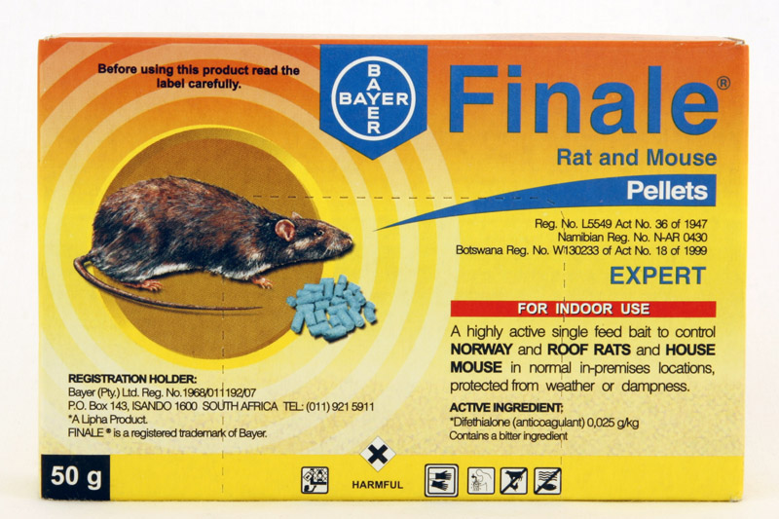
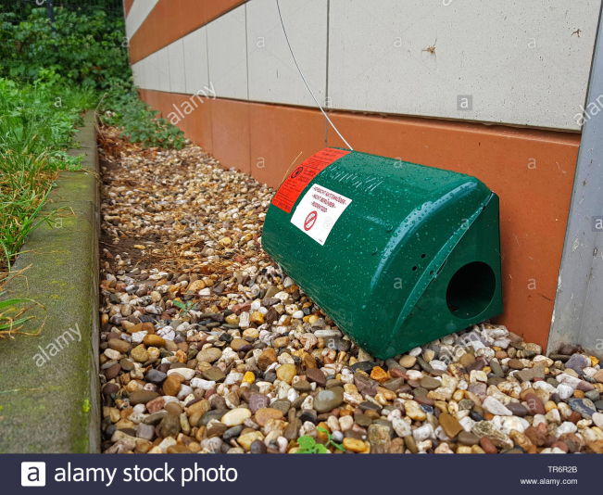
Notes:
Many rodenticides stop normal blood clotting; these are called anticoagulants. Bromadiolone, chlorophacinone, difethialone, brodifacoum, and warfarin are all anticoagulants.

Slide 5
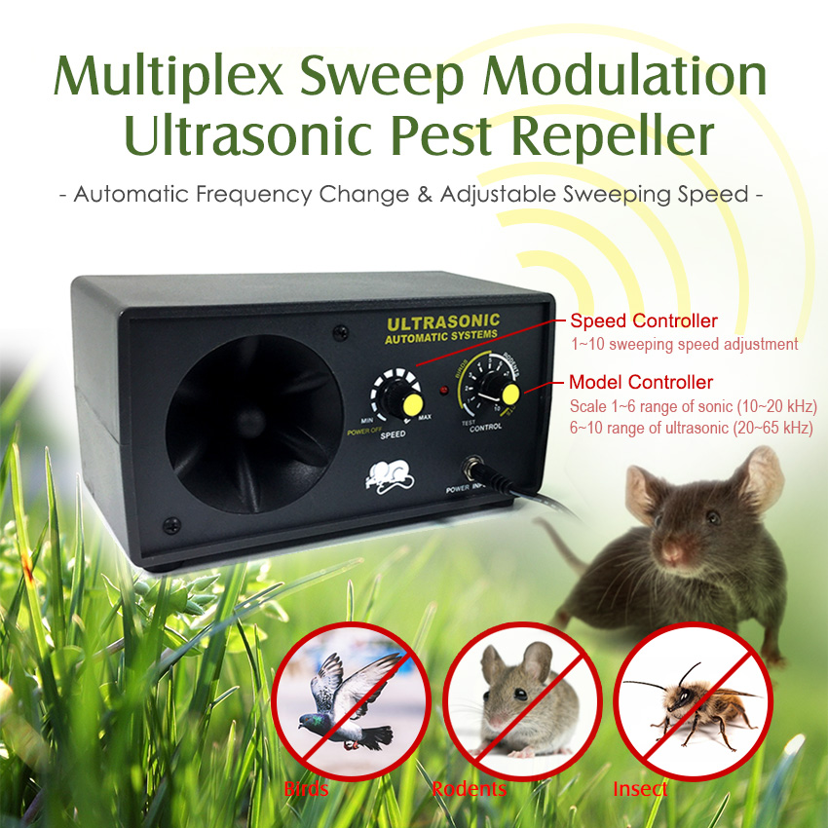

Slide 6
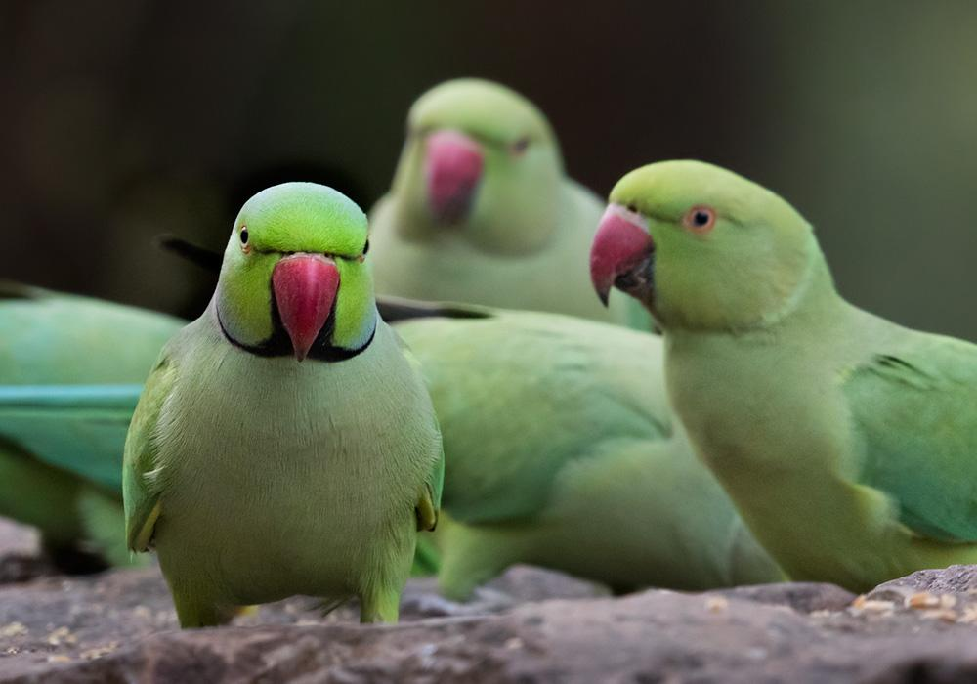
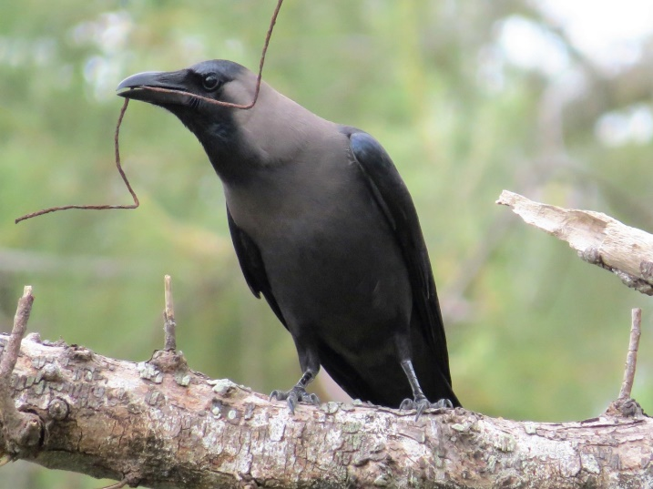
Major bird pest is Psittacula krameri (Rose Ringed Parakeet) that cause damage to fruit gardens of Common Fig (Anjeer), Guava, Stone fruits etc.
House crows (Corvus splendens)
Psittacula krameri
(Rose Ringed or ring-necked parakeet Parakeet)
Usually rodents damage the seeds, standing crop and food items stored in households. While birds always prefer fresh fruits from the tree.

Slide 7
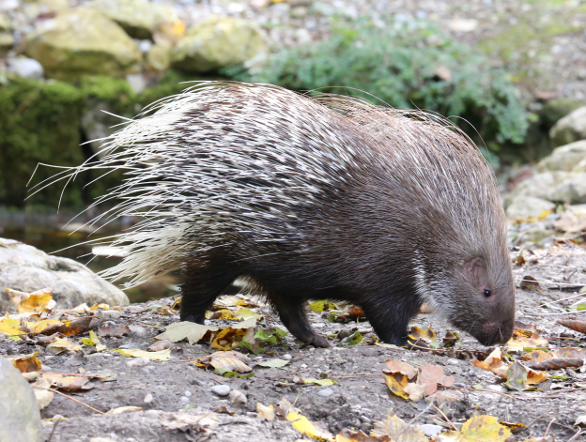
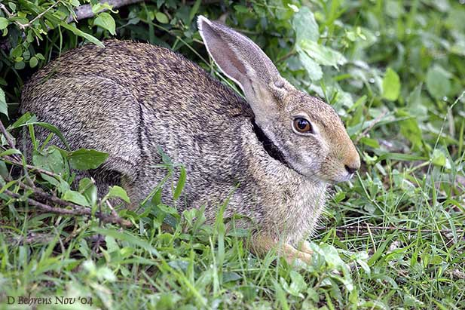
Hystrix indica
porcupines
Lepus nigricollis
Desert hares
Notes:
Rabbits and hares are different from the moment they are born. ... Hares tend to be larger than rabbits, with longer hind legs and longer ears with black markings. While rabbits' fur stays the same color year-round,hares change color from brown or gray in the summer to white in the winter.

Slide 8
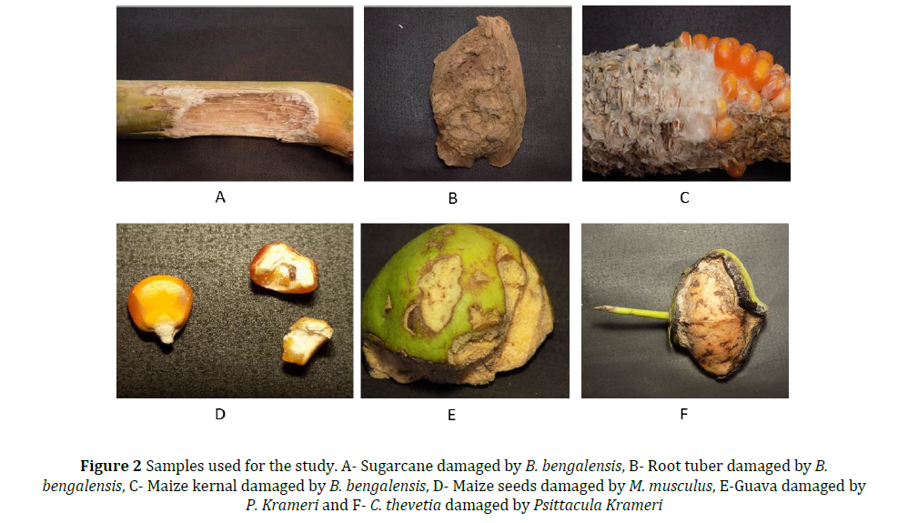
Rehman et al. 2019

Slide 9
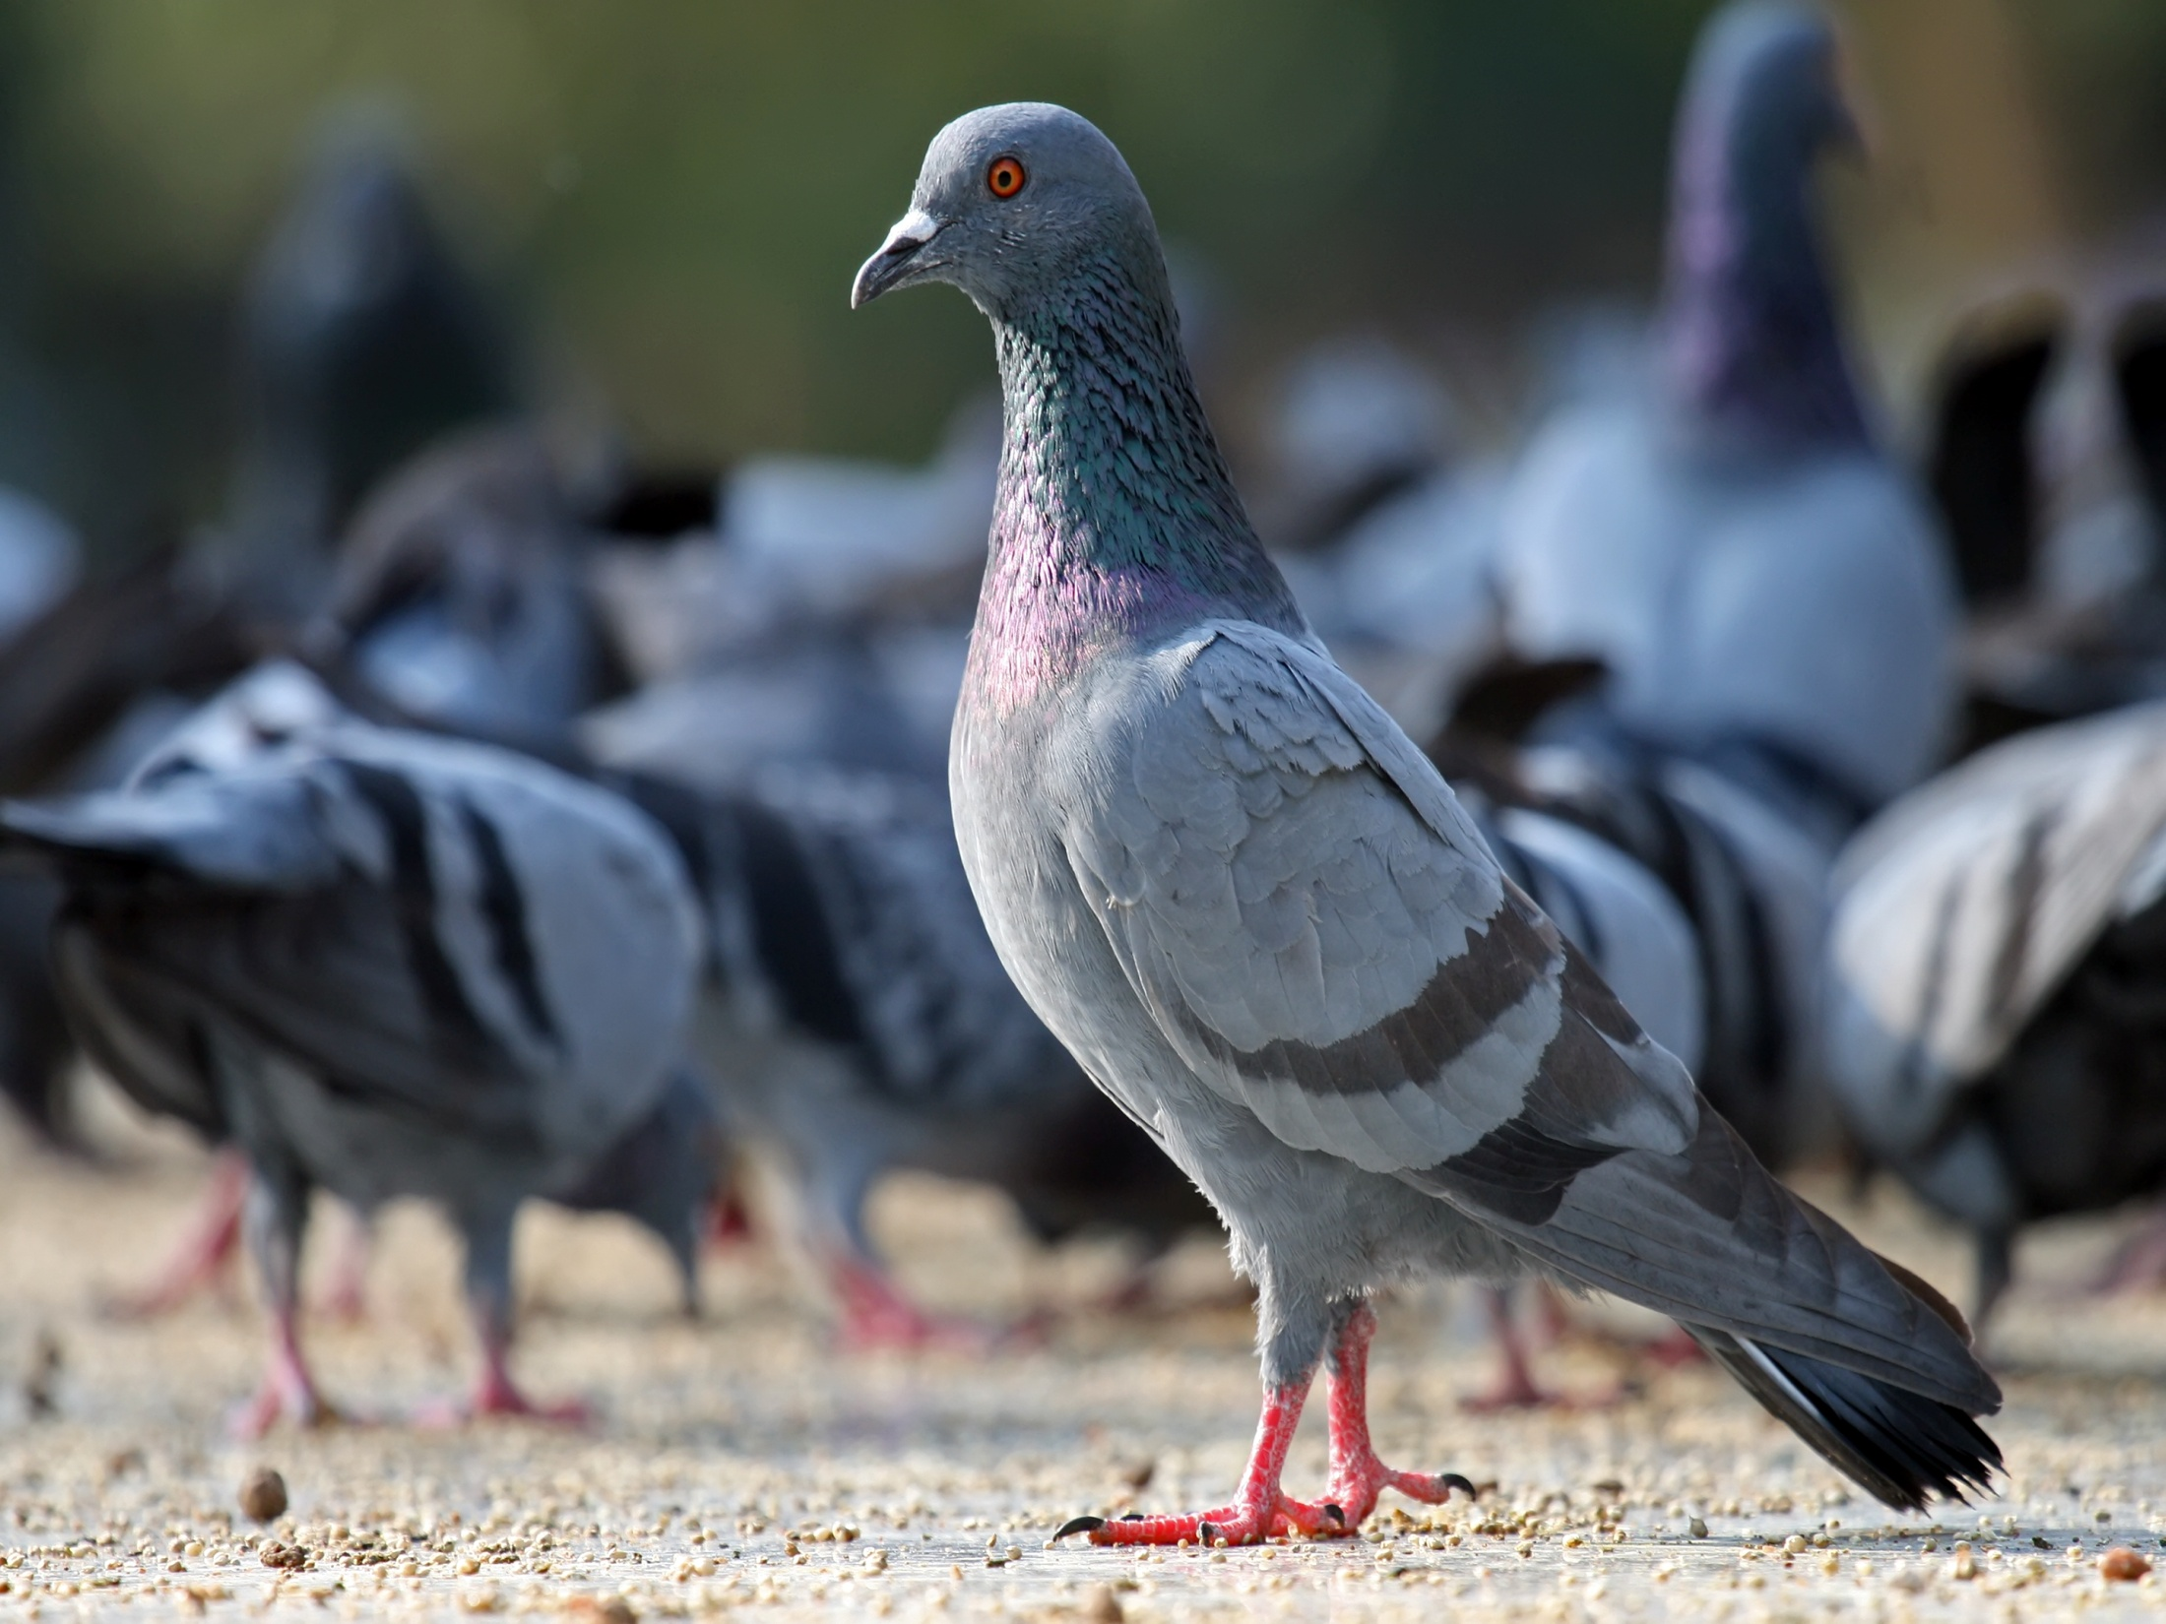
Common Name: Pigeon Family: Columbidae Order: Columbiformes

Slide 10
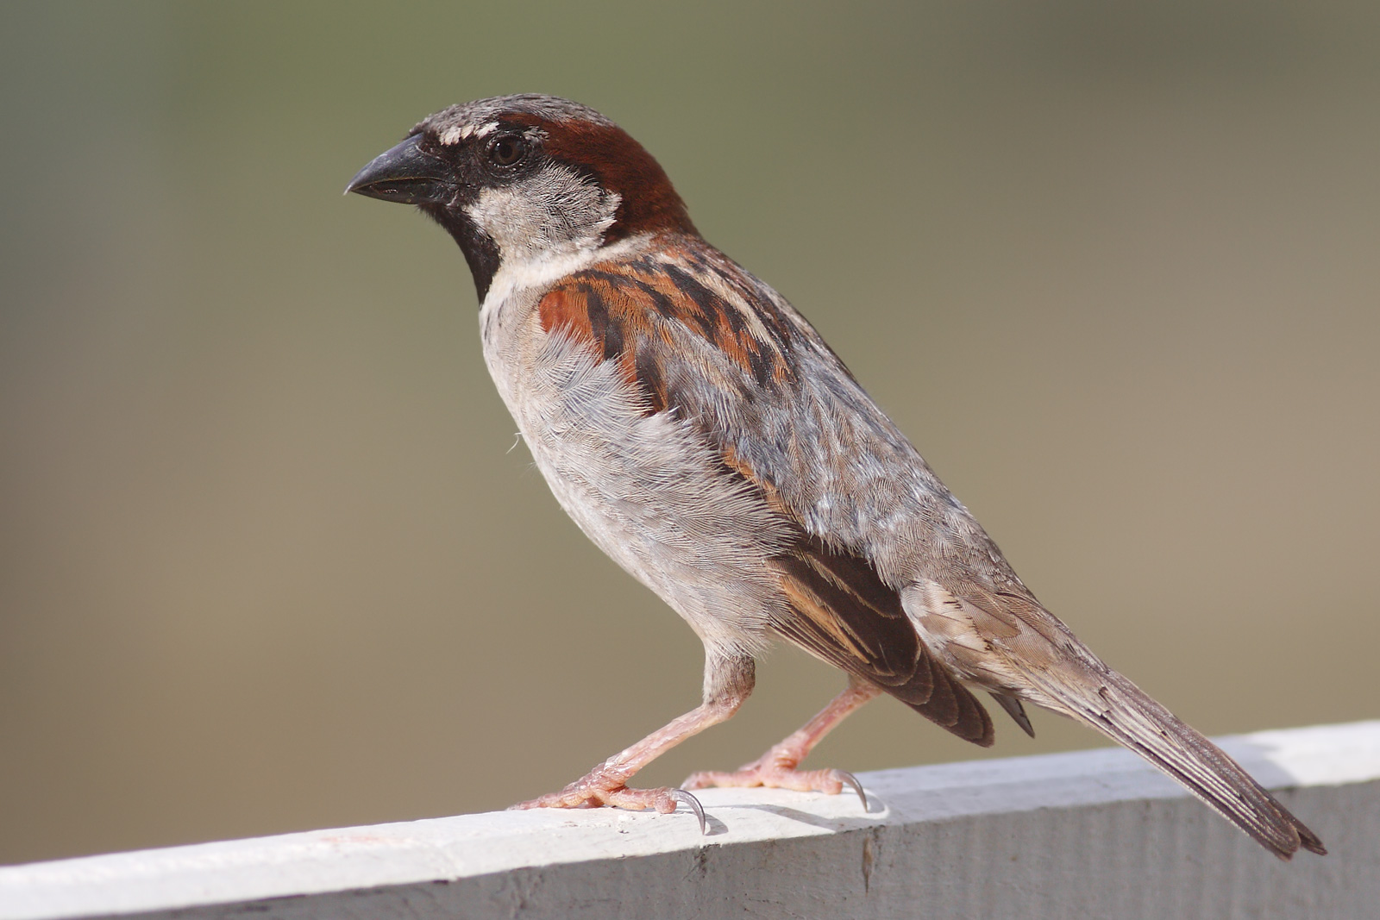
Common Name:
House Sparrow Family: Passeridae Order: Passeriformes

Slide 11
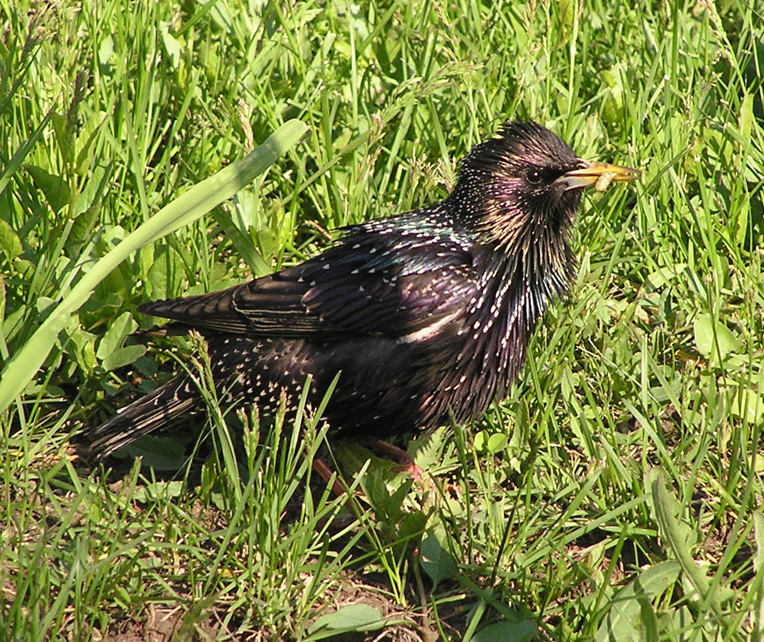
Common Name:
Europia Starling Family: Sturnidae Order: Passeriformes

Slide 12
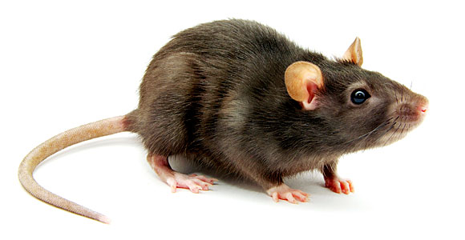
Common Name:
Norway Rat Family: Muridae Order: Rodentia

Slide 13
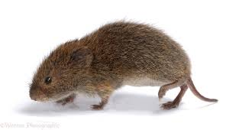
Common Name: Vole Family: Cricetidae Order: Rodentia

Slide 14
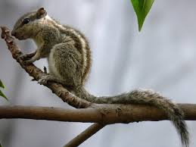
Common Name:
Tree Squirrel Family: Sciuridae Order: Rodentia

Slide 15
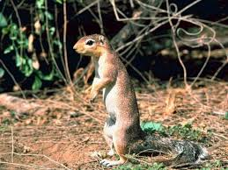
Common Name:
Ground Squirrel Family: Sciuridae Order: Rodentia

Slide 16
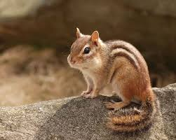
Common Name: Chipmunk Family: Sciuridae Order: Rodentia

Slide 17
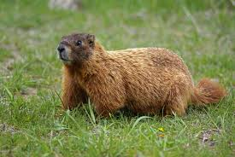
Common Name: Wood Chuck Family: Sciuridae Order: Rodentia

Slide 18
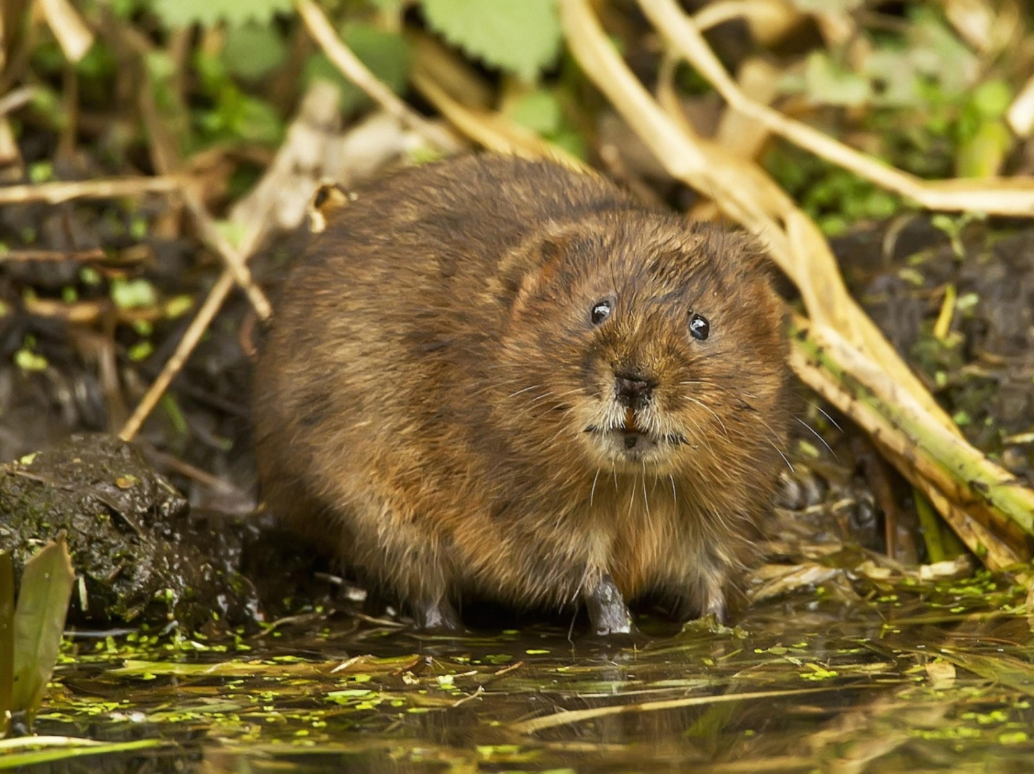
Common Name: Muskrat Family: Cricetidae Order: Rodentia

Slide 19
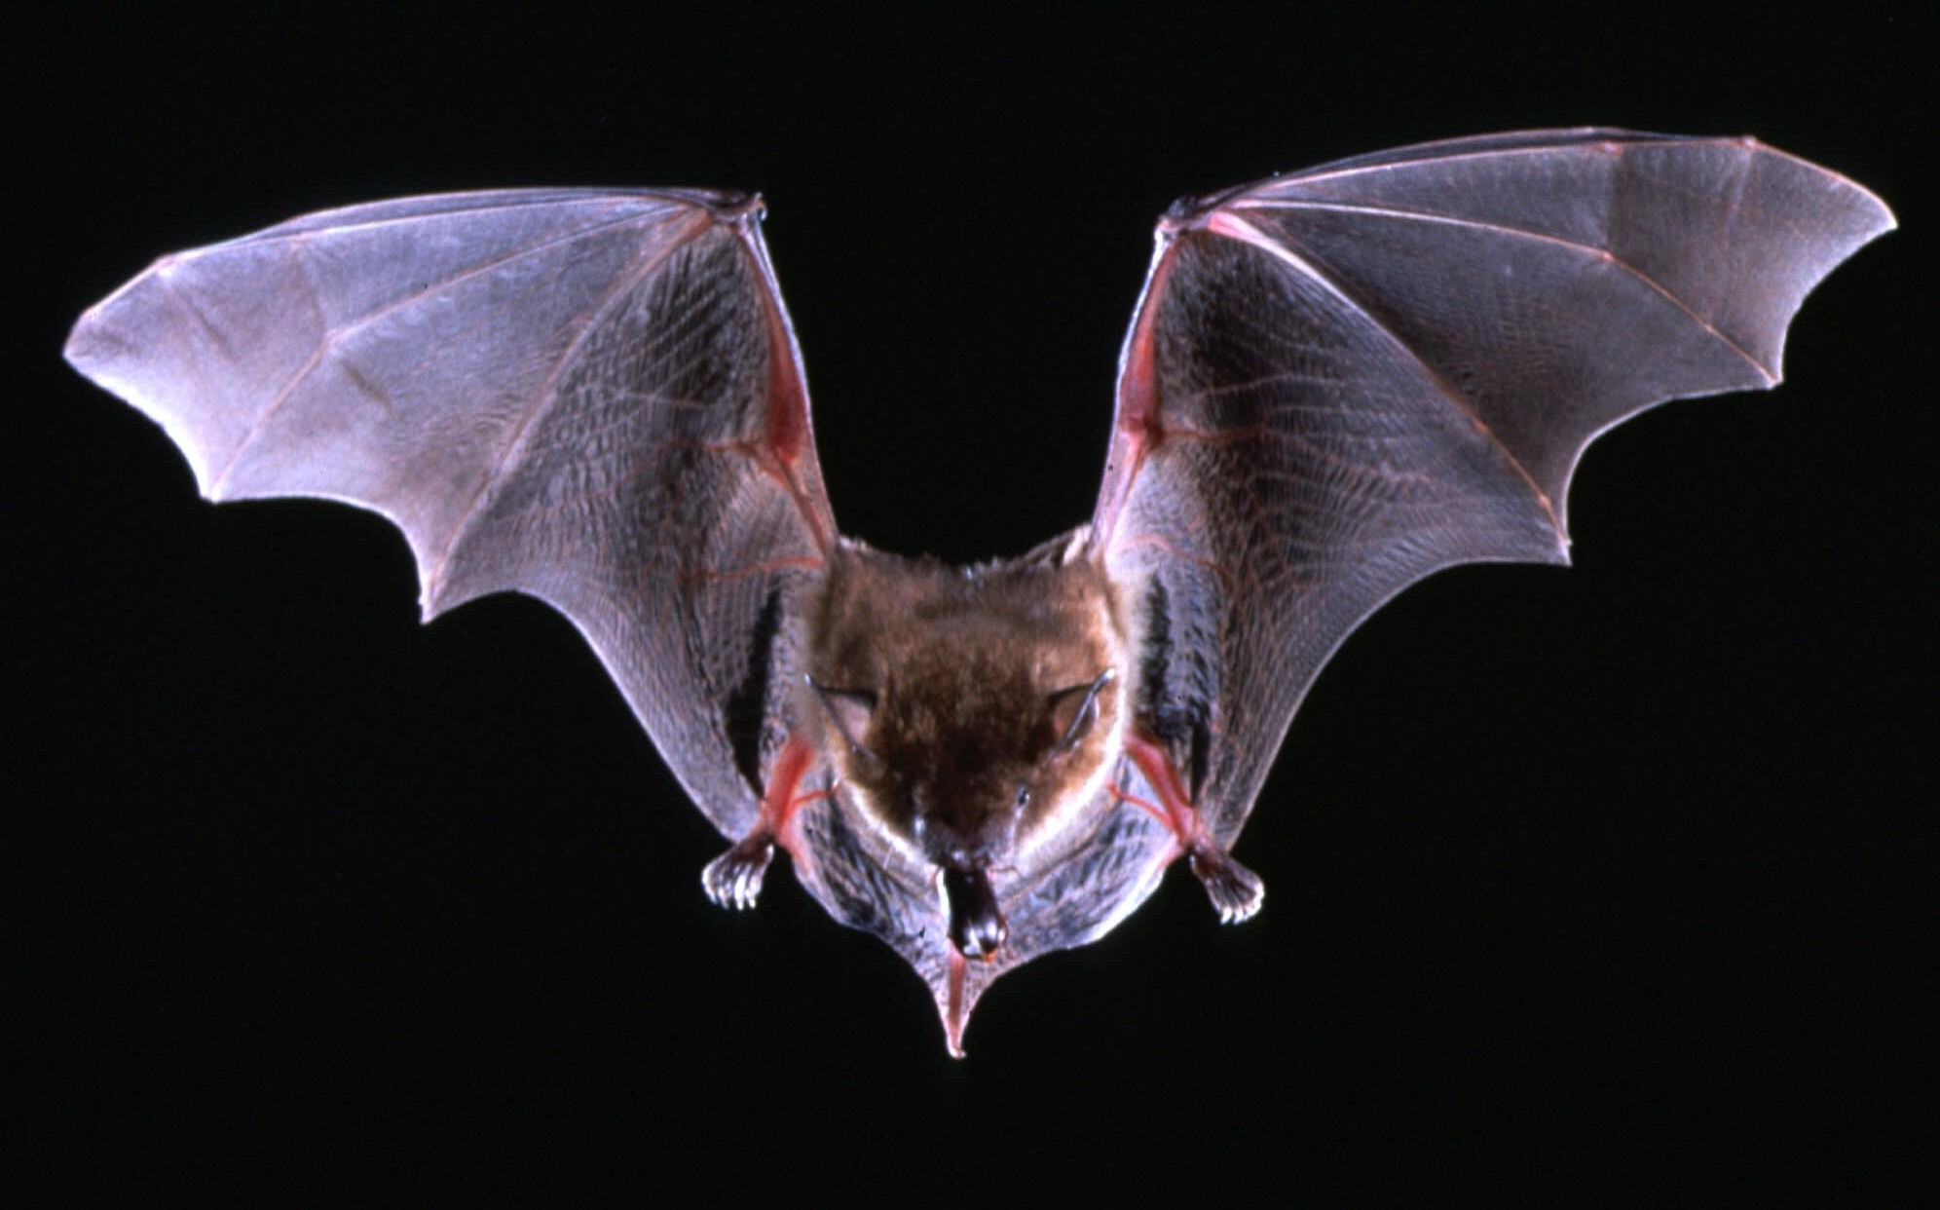
Common Name: Bats Family: Phyllostomidae Order: Chiroptera

Slide 20
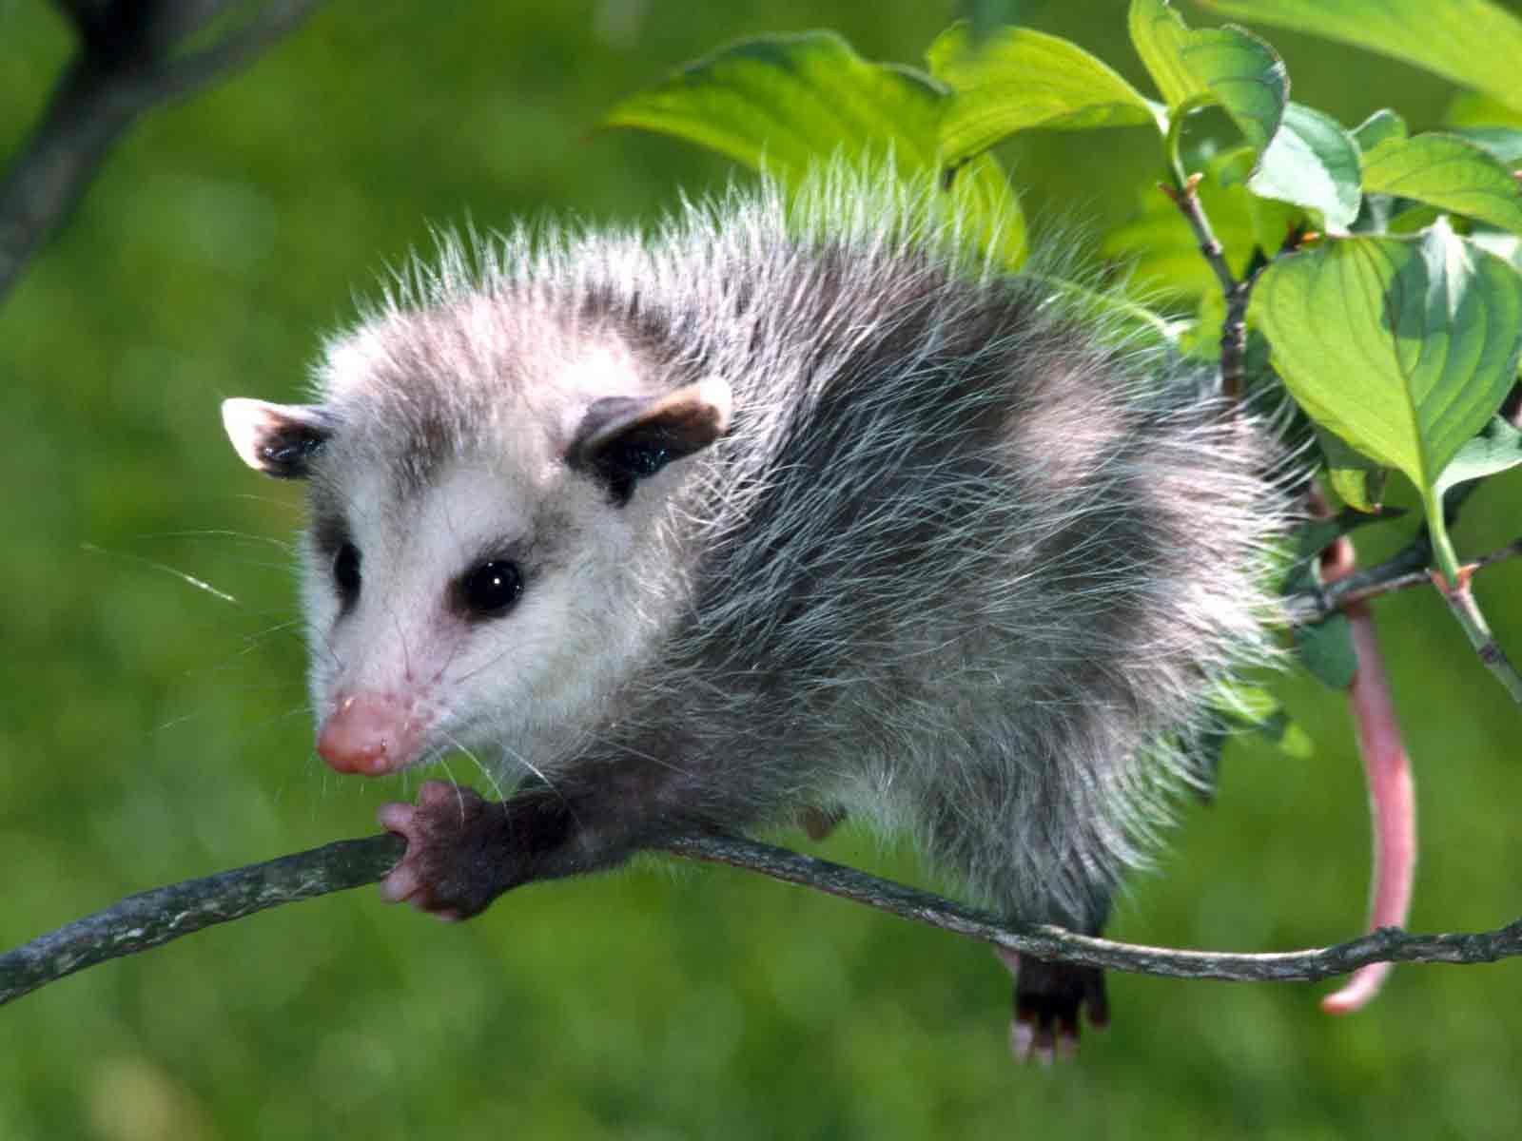
Common Name: Mole Family: Talpidae Order: ‎ Fulipotyphla

Slide 21
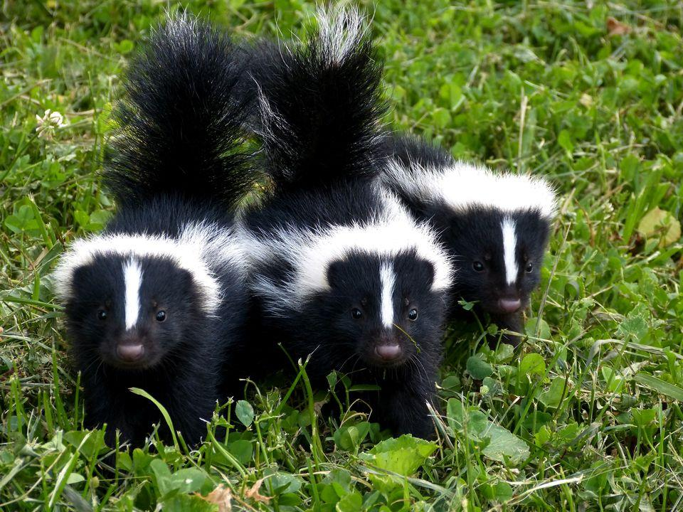
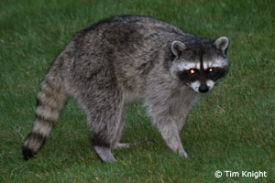
Common Name: Skunk Family: Mephitidae Order: Carnivora

Slide 22
Common Name: Raccoon Family: Procyonidae Order: Carnivora

Slide 23
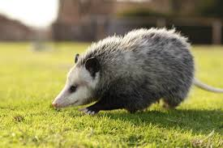
Common Name: Opossum Family: Didelphidae Order: Paucituberculata

Slide 24
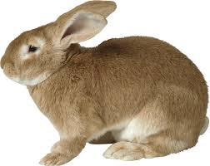
Common Name: Rabbit Family: Leporidae Order: Lagomorpha

Slide 25
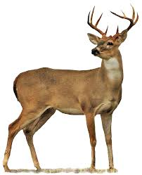
Common Name: Deer Family: Ruminant Order: Cetartiodactyla

Slide 26
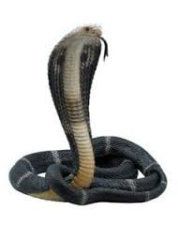
Common Name: Snakes Family: Elapidae Order: Squamata

Slide 27
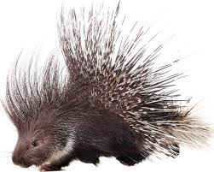
Common Name: Porcupine Family: Hystricidae Order: Rodentia

