Slide 1
Mango

Slide 2
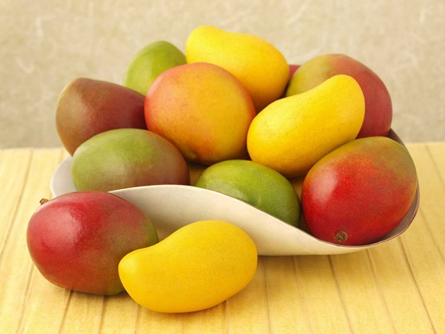
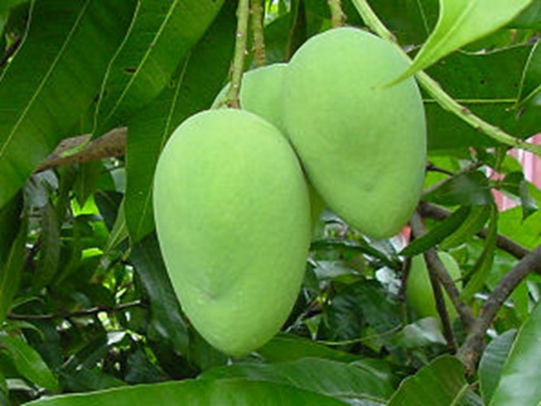
Mango
Mango, Mangifera indica, is one of the oldest and most important of tropical fruits.
It was cultivated since before 4,000 B.C.
Indigenous to Southern Asia, it is now widely grown in all tropical and some subtropical areas.
The fruit is a fleshy drupe with a thick yellowish-red skin and a large seed.
The pulp is orange, yellow or red and when ripe has a rich, aromatic flavor with a perfect blending of sweetness and acidity. They are also used in preserves, sauces, and salads and as chutney.
They are also cooked, dried and canned.

Slide 3
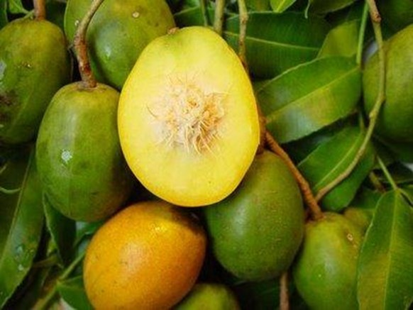
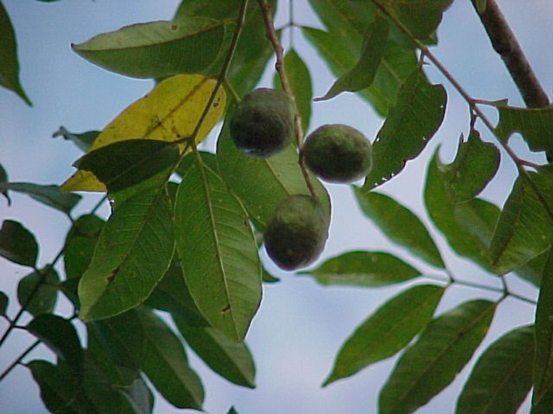
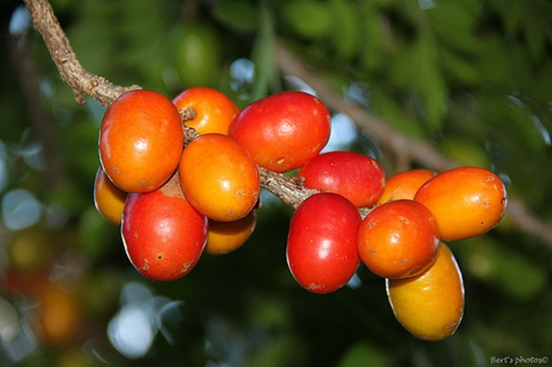
The related genus Spondias includes three species that furnish fruits often found in tropical markets.
The Golden Apple, Otaheite Apple or Ambarella, Spondias cytherea, is native to the Society Islands and is cultivated in both hemispheres.
The Yellow Mombin or Hog Plum, Spondias mombin, and the Red Mombin or Spanish Plum, S. purpurea, are natives of tropical America where they are widely distributed as both wild and cultivated trees.

Slide 4
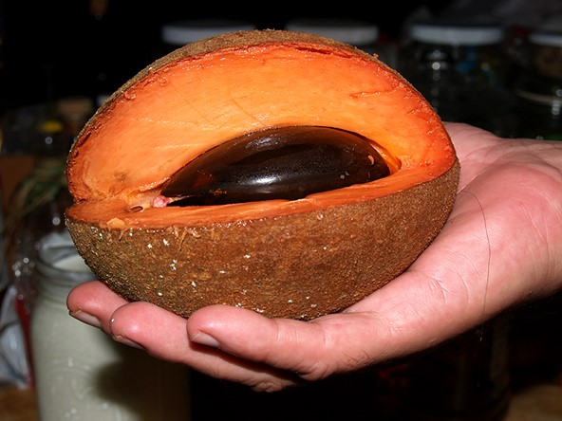
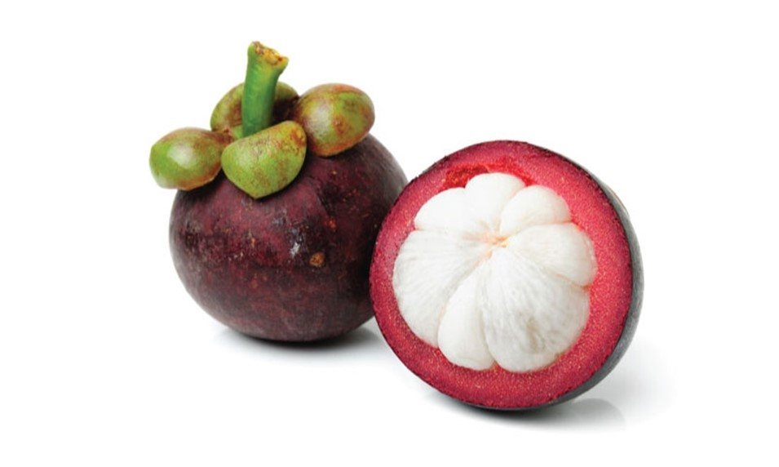
Mangosteen, Garcinia mangostana, has been called The World’s Best Flavored Fruit.
Native to Malaya it is common in the East Indies, Cochin China and Ceylon.
The pulp is white or yellowish, with crimson veins and exudes a yellow juice of exquisite flavor
The Mamey or Mammee Apple, Mammea americana, is a close Neotropical relative that is an important fruit in the West Indies and tropical America.
The aromatic flesh is magenta colored with the consistency of an avocado.

Slide 5
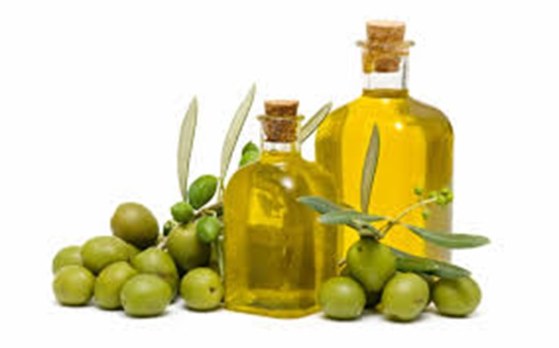
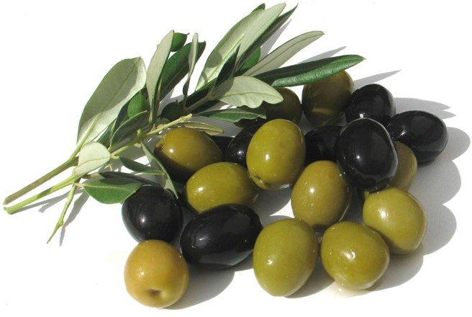
Olive, Olea europaea, is one of the oldest of fruits and had been grown from prehistoric time.
It is actually used more like a vegetable and an edible oil, however.
It was known in Egypt in the 17th Century B.C.
The fruit is shiny purplish black when ripe.
They are cultivated for eating, but more especially as a source of olive oil.
The fruit contains a bitter glucoside and have to be processed before they are palatable.
The processing is done by pickling and heating with sodium hydroxide.

Slide 6
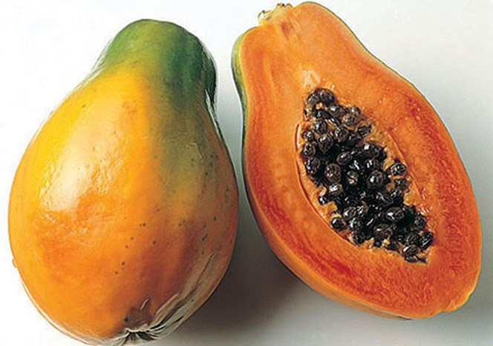
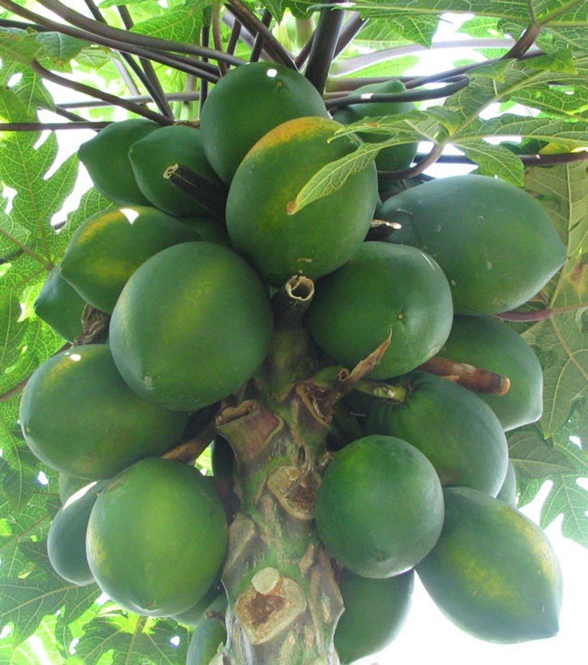
Papaya
Papaya, Carica papaya, is indigenous to the West Indies and Mexico.
Varieties may be either dioecious or monocious.
The fruits are fleshy berries that resemble melons, yellow-orange in color.
Papaya is an excellent breakfast fruit especially when served with the juice of limes. It is also used for salads, pies, sherbets and confections. Unripe fruits are cooked like squash or preserved.
The fruit and other parts of the plant contain a latex that is used in chewing-gum manufacture.
One of the constituents of the latex is a digestive ferment, Papain that acts on proteins in a manner similar to pepsin.
This ferment is important in medicine and is also used for tenderizing meat.

Slide 7
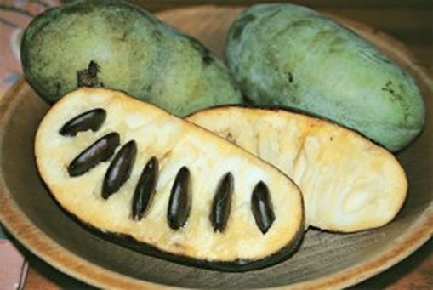
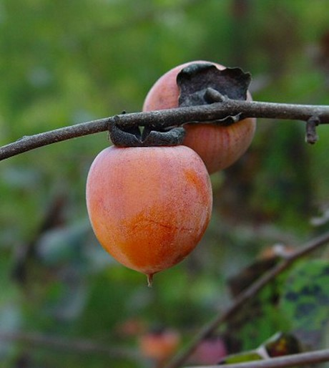
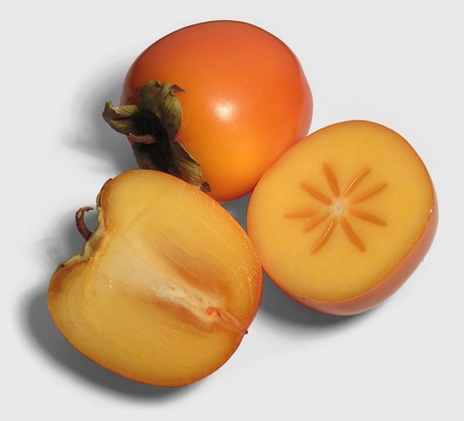
Papaw, Asimina triloba, is native to temperate North America.
Japanese Persimmon, Diospyros kaki, is indigenous to China but has spread from there worldwide.
Intestinal allergic reactions may occur in some who eat this fruit.
American Persimmon, Diospyros virginiana, is a hardy small tree of the Eastern United States.
The fruits ripen after a frost and are of high quality and delicious flavor.

Slide 8
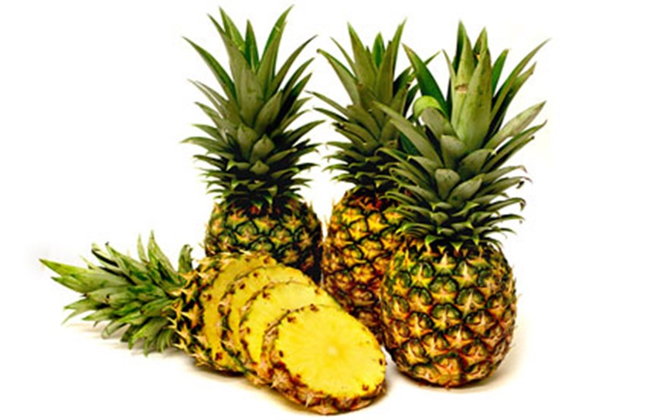
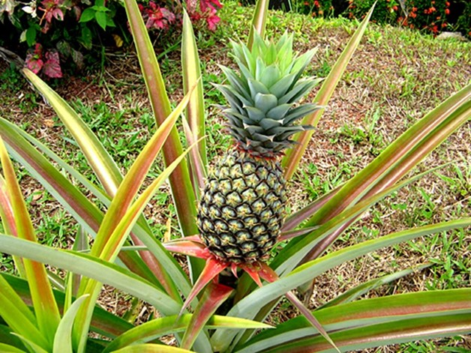
Pineapple, Ananas comosus, is one of the first tropical fruits to be grown commercially.
Pineapples are indigenous to Northern South America.
Wild varieties still exist in Brazil.
These are multiple accessory fruits formed from the whole inflorescence.
The cultivated varieties are mostly seedless.
Besides the content of sugar and fruit acids, a valuable digestive ferment, Bromelin, is present.

Slide 9
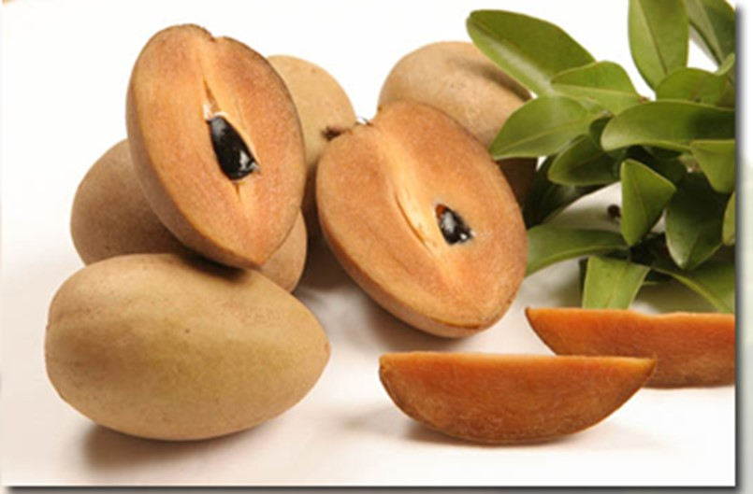
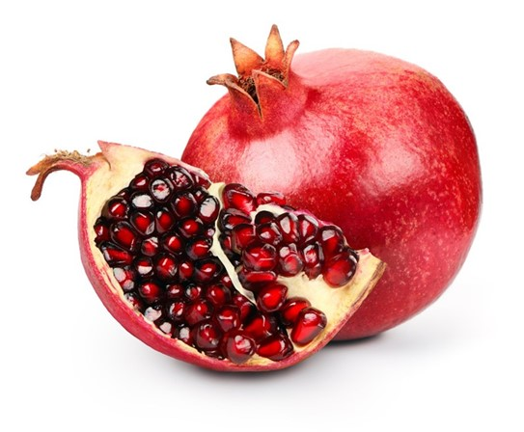
Pomegranate, Punica granatum, is native to Iran.
A leathery rind encloses the pulp with amethyst colored juice surrounding many seeds.
Pomegranates are very refreshing and are used as a table or salad fruit and in beverages.
The roots, rind and seeds are medicinal.
Sapodilla, Achras zapota, is a delicious dessert fruit of tropical America.
Young fruits contain tannin and are unpalatable.
The principal commercial product from this tree is not the fruit but the milky latex that is the chief source of chicle for making chewing gum.

Slide 10
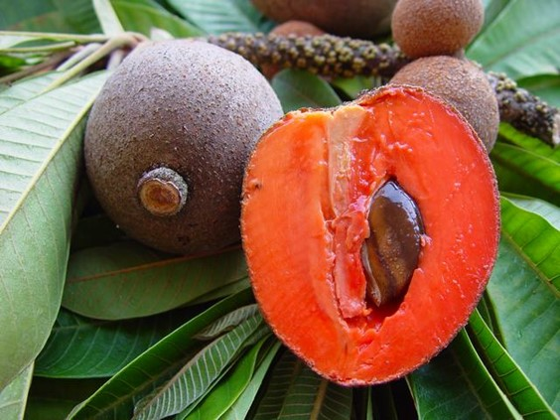
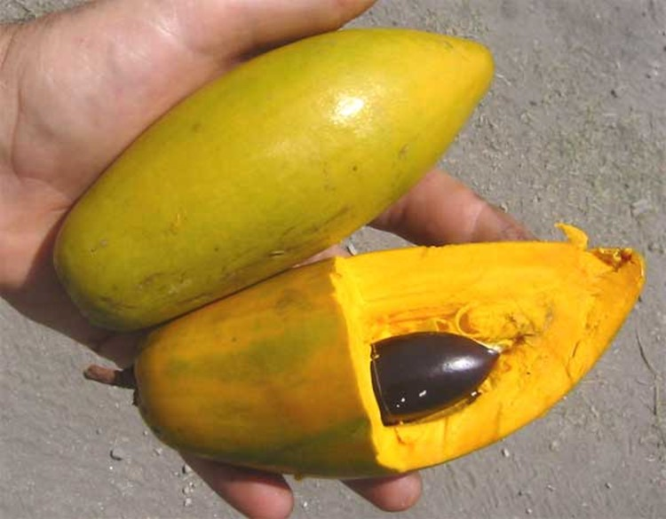
Sapote, Calocarpum sapota, and other species, are common in Central America and the West Indies. The russet-brown fruit has a sweet spicy flesh and is important in the local diet.
Canistel or Egg Fruit, Lucuma nervosa and other species, is a beautiful tree with orange-yellow fruit and a sweet and aromatic pulp. native to Northern South America. The fruit is consumed fresh, in salads, or for pies, puddings and jam.

Slide 11
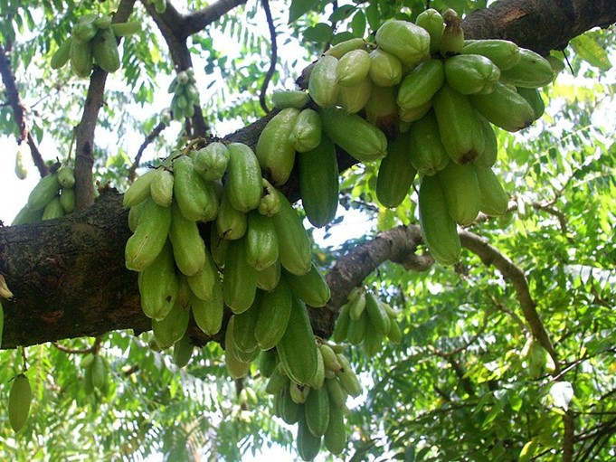
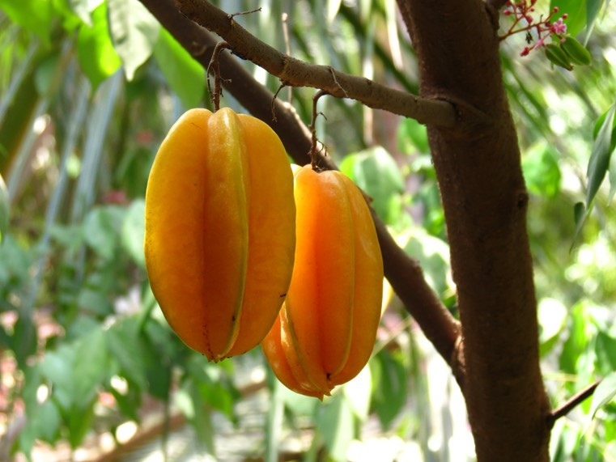
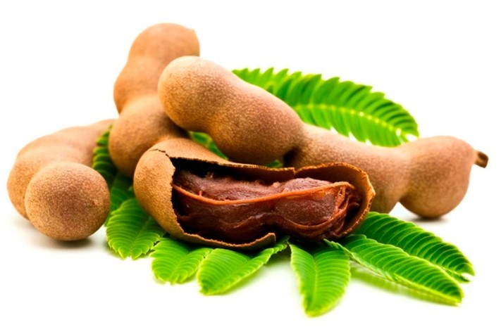
Tamarind, Tamarindus indica, is believed to have originated in tropical Africa or Southern Asia.
Tamarinds are extensively used in India and the Orient as fresh fruit, in beverages, for preserving and in medicine.
Bilimbi, Averrhoa bilimbi, and Carambola, Averrhoa carambola, are indigenous in Southeastern Asia but are grown in the tropics worldwide. The small fruits are acid so they are cooked with sugar before eating.

Slide 12
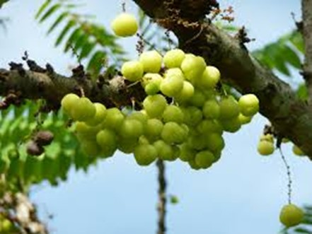
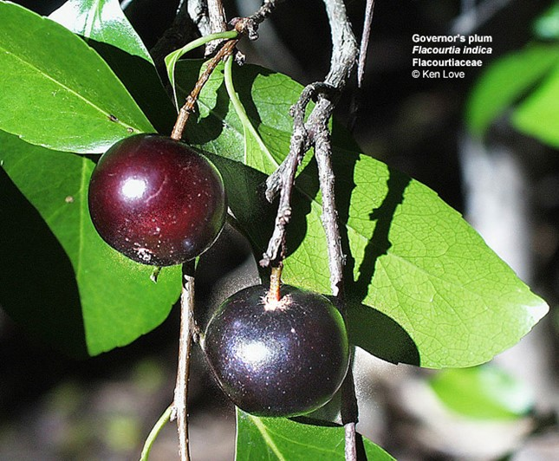
Otaheite or Star Gooseberry (Phyllanthus acidus), has yellow cherrylike fruits that are excellent when eaten with sugar. The small tree is ornamental but has developed wild in Florida and the West Indies.
Governor’s or Madagascar Plum (Flacourtia indica) is an Asiatic species with excellent fruits.

Slide 13
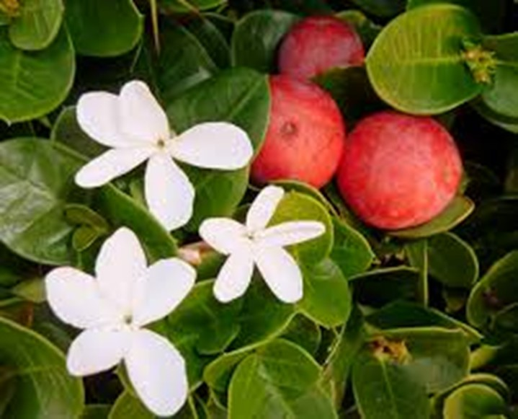
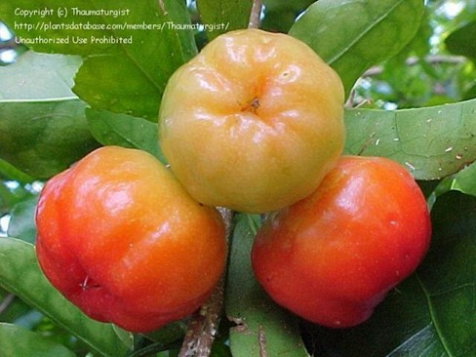
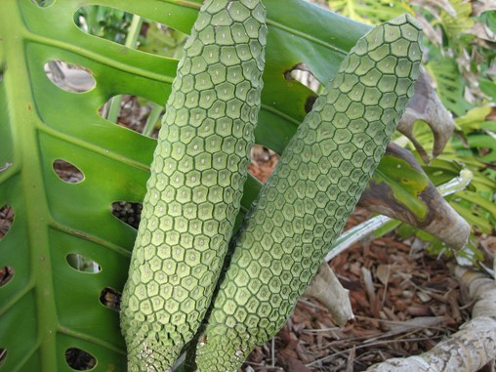
Natal Plum (Carissa grandiflora) and other species of South Africa is a spiny ornamental that is often used as a hedge plant in subtropical areas.
Barbados Cherry (Malpighia glabra) of the West Indies is commonly grown from Texas to Northern South America.
Ceriman or Pine Tree Fruit (Monstera deliciosa) is an ornamental aroid often planted in greenhouses. It has long conelike fruits with a pleasant pineapple-like flavor when ripe.

Slide 14
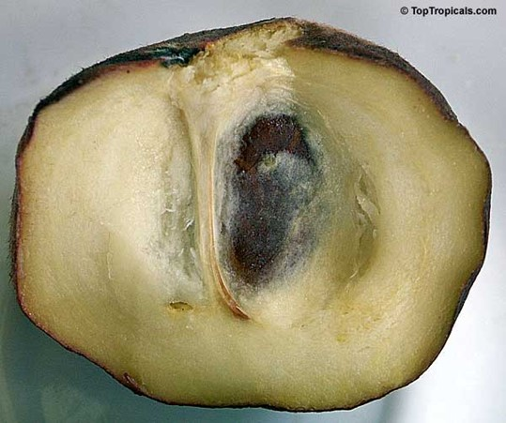
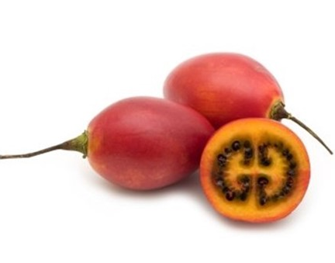
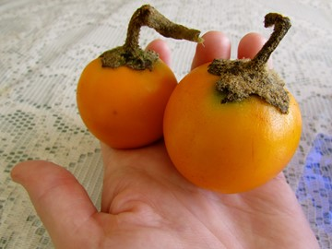
White Sapote (Casimioa edulis) is indigenous to the highlands of Mexico and Central America. The apple like fruits have a soft, yellow, sweet, custard like pulp.
Tree Tomato (Cyphomandra betacea) is native to Peru but it is extensively cultivated throughout the Andean region. The oval, reddish-orange fruits are consumed raw or cooked.
Naranjilla (Solanum quitoense) is a robust herb with very large leaves and orange fruits that are produced in abundance throughout the year.
It is common in the high Andes from Peru to Colombia. The fruit has a very delicious and refreshing juice that is rich in protein and minerals.

