Slide 1
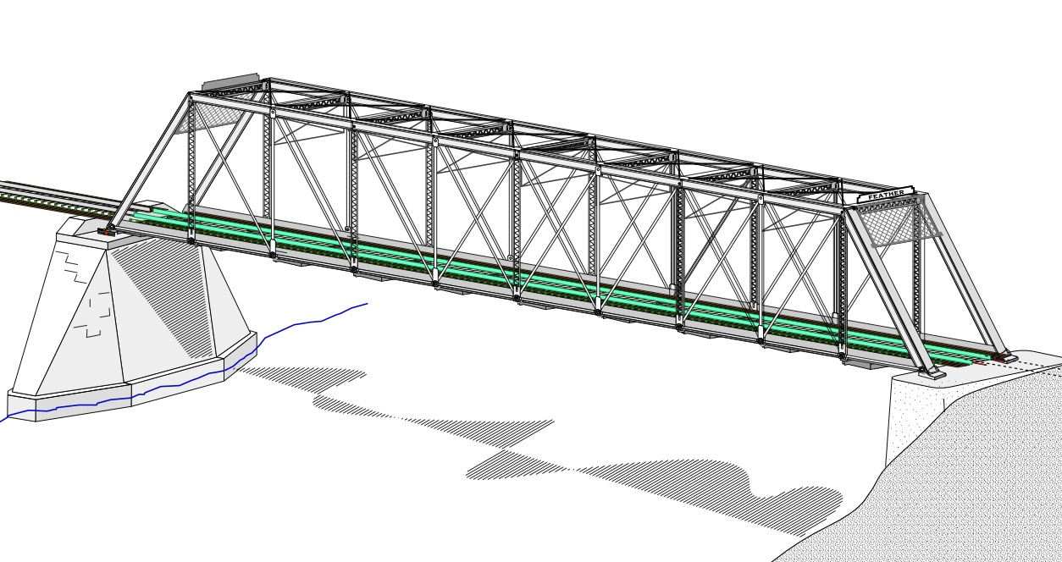
COLLEGE OF ENGINEERING AND TECHNOLOGY UNIVERSITY OF SARGODHA STEEL STRUCTURES (CT-313) (B.S TECHNOLOGY)
LECTURE-31,32 & 33
DESIGN OF COMPRESSION MEMBERS
Engineer Aqeel Ahmed
Lecturer, Civil Engineering Department
CET, UOS, Sargodha
22-01-2020

Slide 3
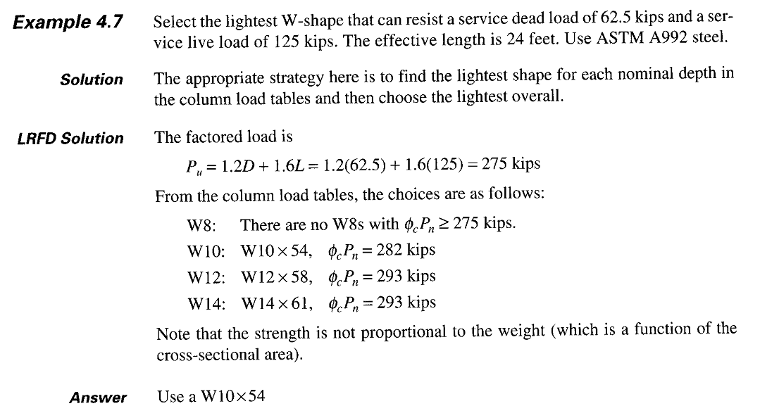

Slide 4
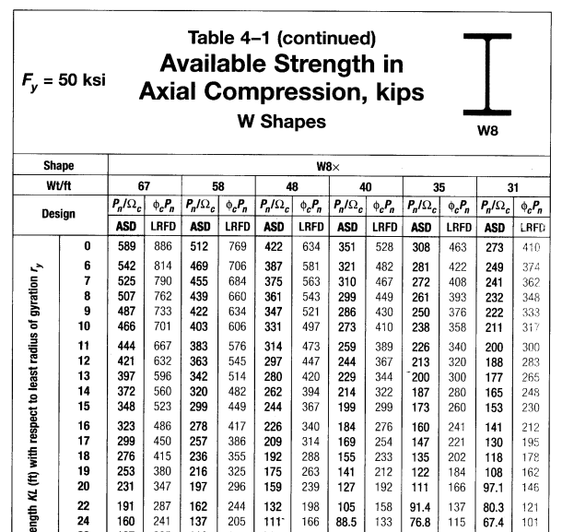

Slide 5
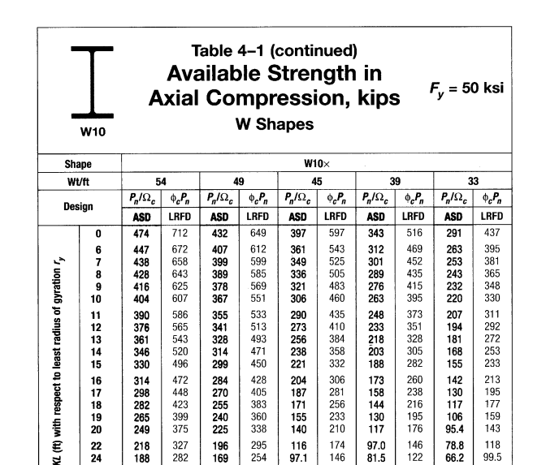

Slide 6
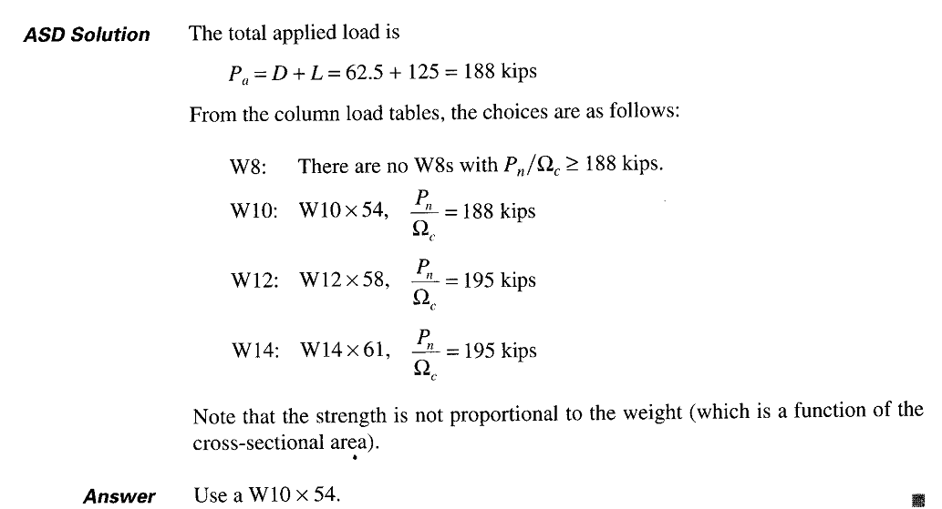

Slide 7
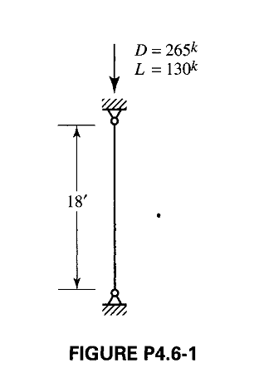

Slide 8
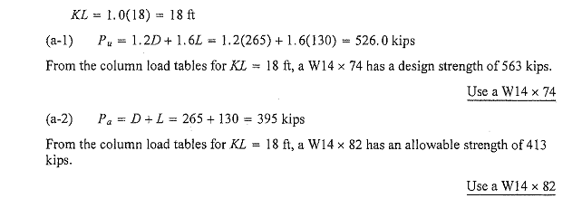

Slide 12
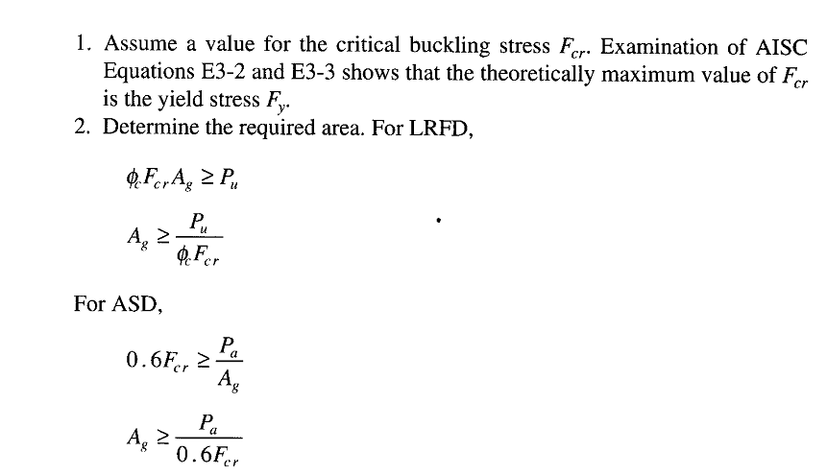

Slide 13
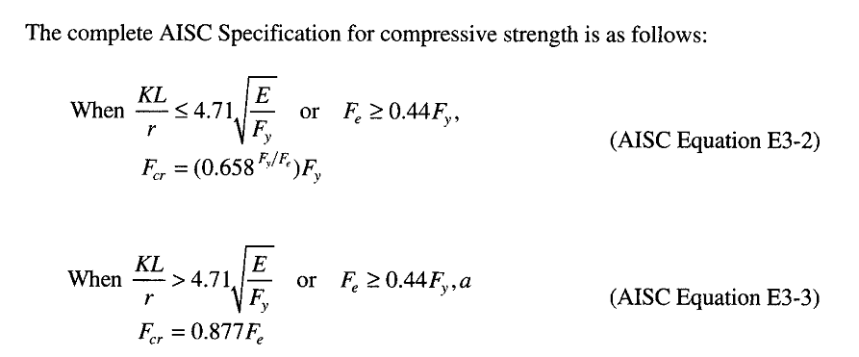
AISC Requirements……..

Slide 15
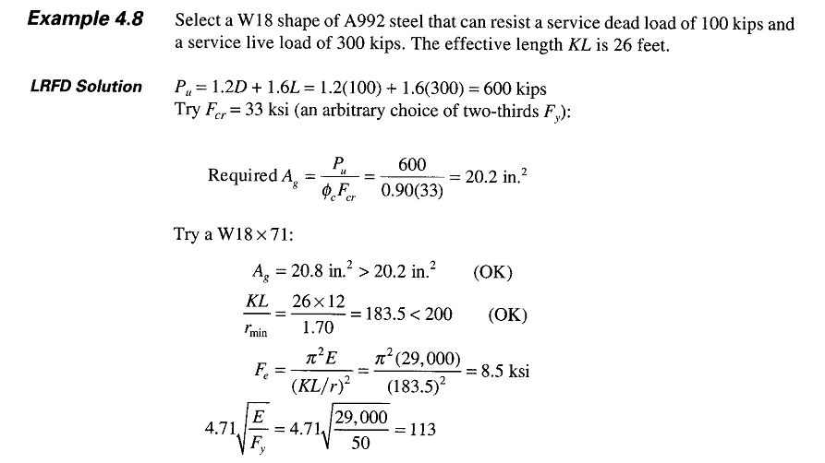
Fy=50 Ksi for A992 Steel

Slide 17
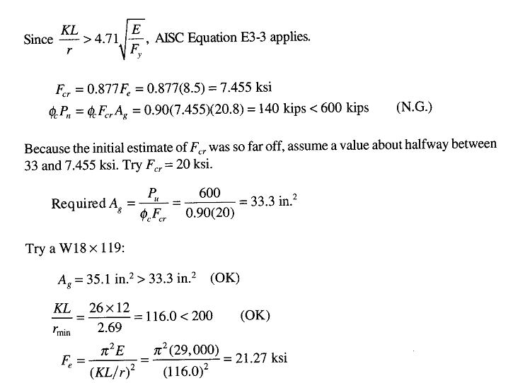

Slide 18
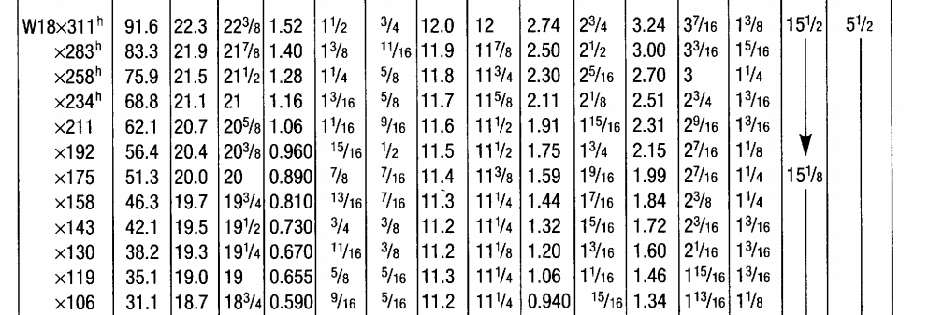

Slide 20
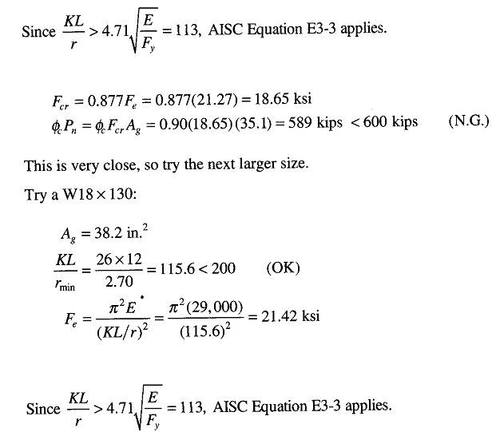

Slide 24
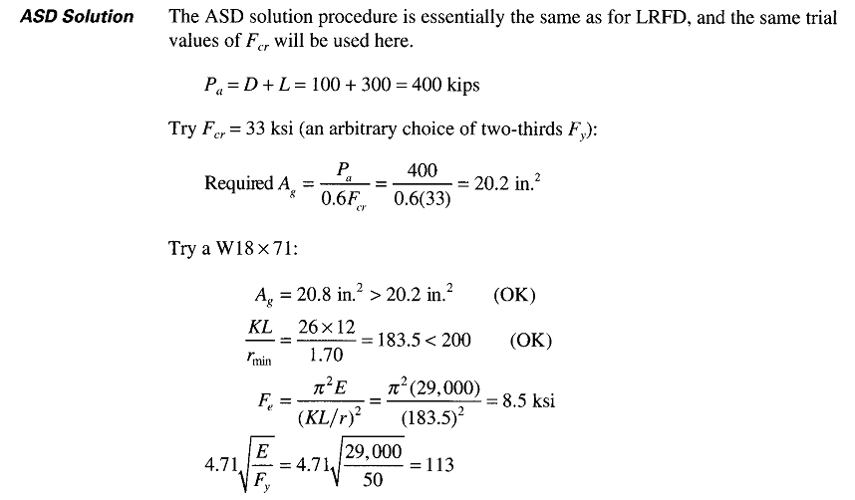

Slide 26
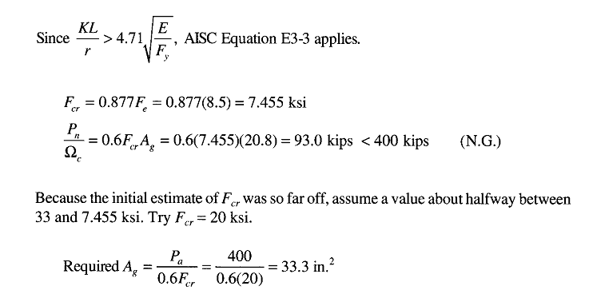

Slide 27
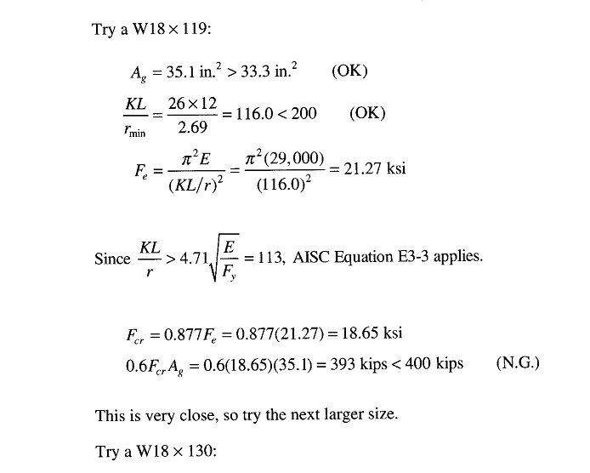

Slide 30
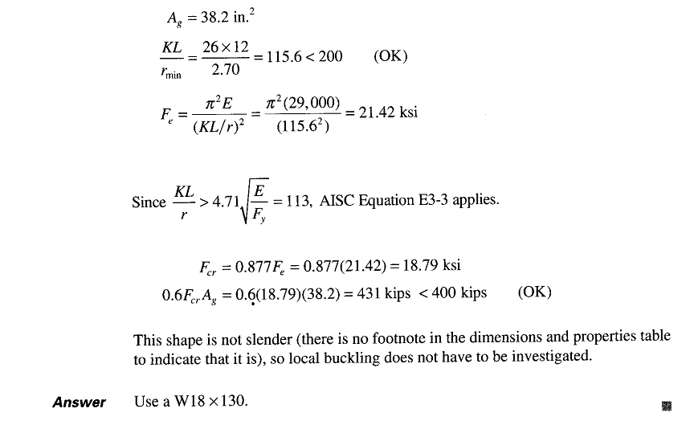

Slide 32
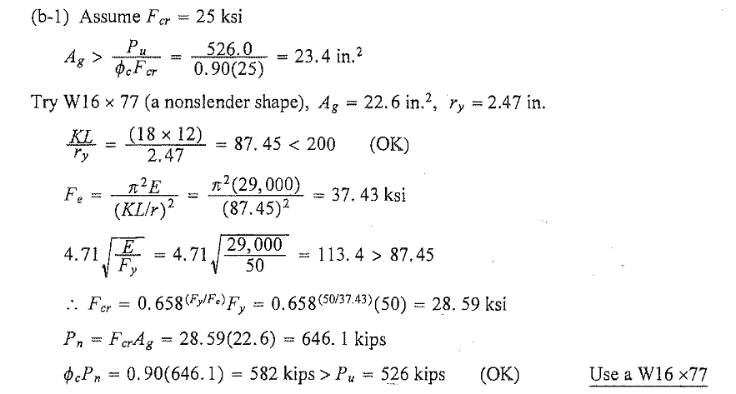

Slide 33
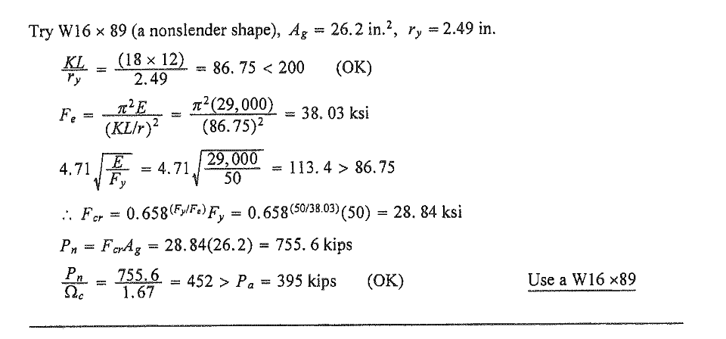

Slide 35
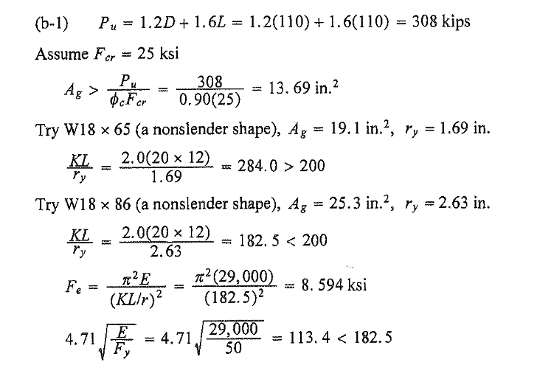

Slide 36
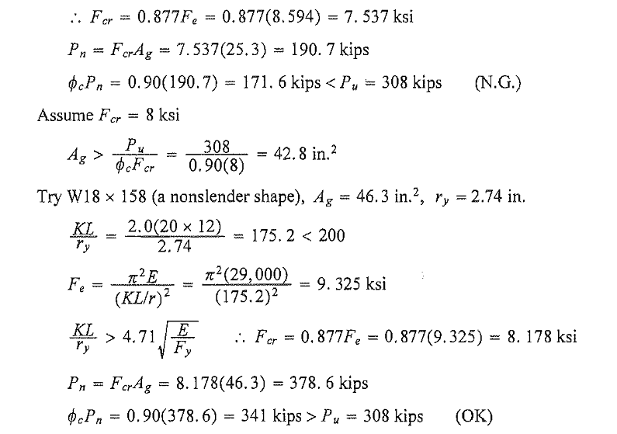

Slide 37
