Slide 1
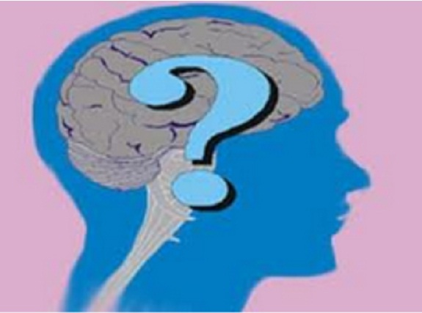
Somatic Symptom Disorders (previously Somatoform Disorders) and Dissociative Disorders

Slide 2
Somatic Symptom disorders
occur when a person manifests a psychological problem through a physiological symptom
Illness Anxiety Disorder (formerly called hypochondriasis) - frequent physical complaints for which medical doctors are unable to locate the cause
Actually believe they are ill, not seeking attention
Conversion disorder (also referred to as functional neurological symptom disorder)- existence of a severe physical problem such as paralysis or blindness or uncontrollable physical movements
be unable to move their arms or see or cannot control actions.
no biological reason for this problem can be identified.
https://www.youtube.com/watch?v=_jOuqAcgMrA

Slide 3
Dissociative Disorders
Disorders in which a person appears to experience sudden loss of memory or change in identity, often in response to an overwhelmingly stressful situation.
Conscious awareness becomes separated (dissociated) from previous memories, thoughts, and feelings.
Many people may have the sense of being unreal, of being separated from their body, of watching themselves as if in a movie.
Notes:
Preview Question 8: What are dissociative disorders, and why are they controversial?

Slide 4
Dissociative Disorders
Psychogenic amnesia - when a person cannot remember specific events caused by extensive psychological distress
no physiological basis for the disruption in memory can be identified.
Psychogenic fugue - experience long period of amnesia
find themselves in an unfamiliar environment, sometimes with a new life.
https://www.youtube.com/watch?v=2e-nC0xnVqA
Notes:
Fast Forward YouTube Video to 6:15

Slide 5
Dissociative Disorders
Most dramatic, least common, and most controversial dissociative disorder is Dissociative Identity Disorder (DID), which is previously known as Multiple Personality Disorder (MPD).
When a person exhibits two or more distinct and alternating personalities-- each with its own memories, behaviors, and relationship-- rather than one integrated personality.
Research suggests severe sexual or physical abuse during childhood seems to be related to the condition.
Some suggest DID is a social construction—that it represents a category people adopt to make sense out of their experiences, while others believe the therapists may help “create” these personalities inadvertently (as we have many roles in our lives)
Majority of DID diagnoses are women
https://www.youtube.com/watch?v=zhM0xp5vXqY

