Slide 1
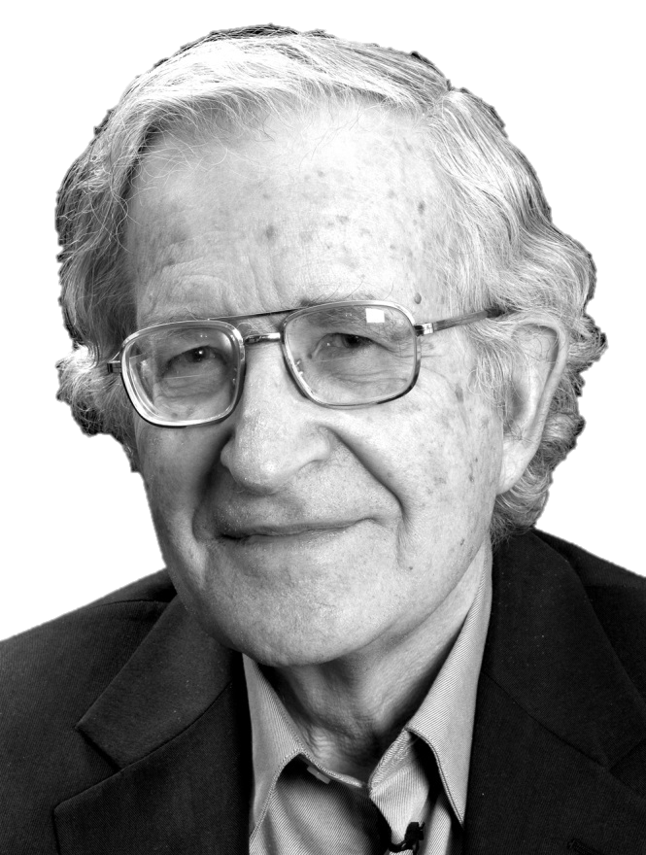
Chomsky’s Universal Grammar
HAMED LOTFI
(BA in Translation Studies)
hamed.lotfilco@gmail.com Feb 23, 2015 Tabriz-Iran
In the First Annual Student Conference of Linguistics and Language Studies
Organized By: Scientific Association of English Students
(Islamic Azad University – Tabriz Branch)

Slide 2
Definition:
Universal Grammar (UG) or Mental Grammar
Is a theory in Linguistics proposing that the ability to learn grammar is hard-wired into the brain.
and as opposed to other 'grammars‘ e.g.
Prescriptive
Descriptive
Pedagogical

Slide 3
Definition:
The theory suggests that linguistic ability manifests itself without being taught and that there are properties that all natural human languages share.
It is a matter of observation and experimentation to determine precisely what abilities are innate and what properties are shared by all languages.

Slide 4
Argument:
The theory of Universal Grammar proposes that if human beings are brought up under normal condition then they will always develop language with a certain property X e.g.:
distinguishing nouns from verbs, or distinguishing function words from lexical words.

Slide 5
Argument:
As a result, property X is considered to be a property of universal grammar in the most general sense.
Using the above examples, Universal Grammar would be the innate property of the human brain that causes it to posit a difference between nouns and verbs whenever presented with linguistic data.

Slide 6
Argument:
Chomsky: "Evidently, development of language in the individual must involve three factors:
Genetic endowment, which sets limits on the attainable languages, thereby making language acquisition possible;
External data, converted to the experience that selects one or another language within a narrow range;
Principles not specific to FL.“

Slide 7
Argument:
[FL is the faculty of language, whatever properties of the brain cause it to learn language.]
So
Factor 1 is Universal Grammar in the first theoretical sense, and
Factor 2 is the linguistic data to which the child is exposed.

Slide 8
Different Hypotheses:
In an article titled,
"The Faculty of Language: What Is It, Who Has It, and How Did It Evolve?“
Hauser, Chomsky, and Fitch present the three leading hypotheses for how language evolved and brought humans to the point where we have a Universal Grammar.

Slide 9
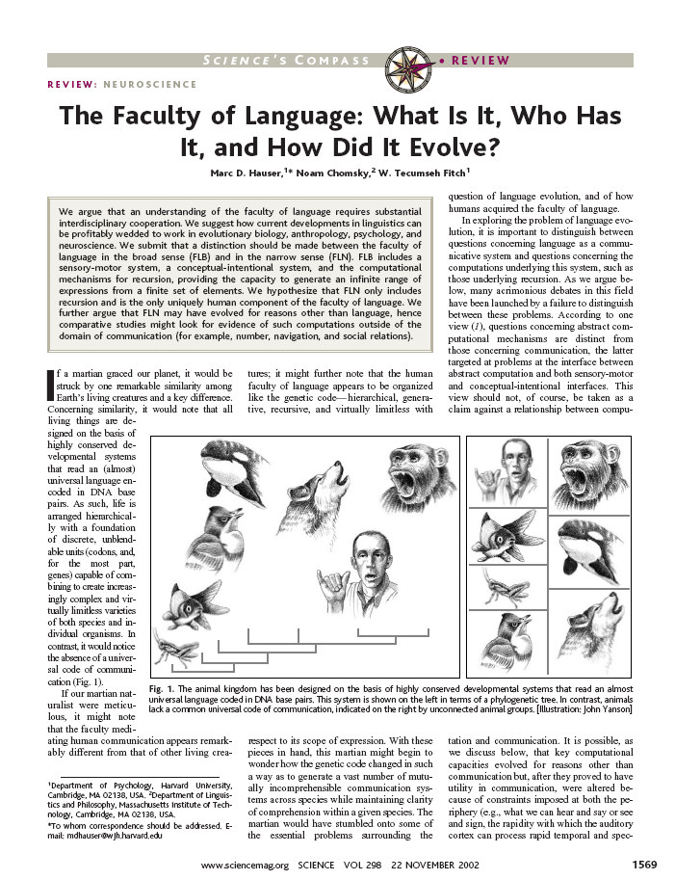

Slide 10
Different Hypotheses:
Three Hypotheses :
It states that FLB (the Faculty of Language in the broad sense) is strictly homologous to animal communication.
This means that homologous aspects of the Faculty of Language exist in non-human animals.

Slide 11
Different Hypotheses:
Three Hypotheses :
It states that FLB "is a derived, uniquely human adaptation for language".
This hypothesis believes that individual traits were subject to natural selection and came to be very specialized for humans.

Slide 12
Different Hypotheses :
Three Hypotheses :
It states that only FLN (the Faculty of Language in the narrow sense) is unique to humans.
It believes that while mechanisms of FLB are present in both humans and non-human animals, that the computational mechanism of recursion is recently evolved solely in humans.
This is the hypothesis which most closely aligns to the typical theory of Universal Grammar championed by Chomsky.

Slide 13
Chomsky's Theory:
Chomsky argued that the human brain contains a limited set of rules for organizing language. This implies in turn that all languages have a common structural basis; the set of rules is what is known as Universal Grammar.

Slide 14
Chomsky's Theory:
Chomsky has stated "I think, yet the world thinks in me",
exemplifying his belief that since humans are natural beings and have undergone evolution,
that Universal Grammar is a biological evolutionary trait, common to all humans.

Slide 15
Chomsky's Theory:
Speakers proficient in a language know which expressions are acceptable in their language and which are unacceptable.
The key puzzle is how speakers come to know these restrictions of their language, since expressions that violate those restrictions are not present in the input, indicated as such.

Slide 16
Criticisms:
Hinzen summarizes the most common criticisms of Universal Grammar:
Universal Grammar has no coherent formulation and is indeed unnecessary.
Universal Grammar is in conflict with biology: it cannot have evolved by standardly accepted Neo-Darwinian evolutionary principles.
There are no linguistic universals: Universal Grammar is refuted by abundant variation at all levels of linguistic organization, which lies at the heart of human faculty of language.

Slide 17
The End

