Slide 2
Benign Prostate Hyperplasia
Presented to:-
Dr. Taseer Ahmed
Presented by:-
Tahira Yasmeen (DPRF18E028)
Arooba Javed (DPRF18E060)
Amna Saleem (DPRF18E046)

Slide 3
Contents:
Definition
Location of gland
Normal functioning
Pathophysiology
Etiology & Risk factors
Diagnostic Assessments
Pharmacological Management
Surgical Management

Slide 4
Definition:
It is defined as:
“Non-cancerous increase in size of prostate gland which involves hyperplasia of prostatic stromal and epithelial cell.
It results in formation of large, fairly discrete nodules in transitional zone of prostate, which push on and narrow the urethra resulting in an increased resistance to flow of urine from bladder”

Slide 5
Location & Normal functioning: The prostate is a gland located below the bladder and in front of the last portion of the gut (rectum). The Urethra runs through the centre of the prostate from the bladder to the penis let the urine flow out of the body. Structure:

Slide 6
It is male reproductive gland, its main function is to secrete the prostate fluid, one of the components of semen.
Its muscles help to propel the seminal fluid into the urethra during ejaculation.
One component of prostate fluid is an enzyme called prostate specific antigen(PSA) that aids in the success of sperms.
Testosterone has great effect on the prostate gland, Testosterone diffuses into the prostate epithelial and stromal cell.T can interact with the androgens receptors in the stromal cell T is converted into dihydrotestosterone(a much more potent androgen that act in the stromal cells)

Slide 7
Etiology and risk factors:
Age: BPH rarely causes signs and symptoms in men younger than age 40, about one-third of men experience moderate to severe symptoms by age 60 and about half do so by age 80.
Family History: Having a blood relative , such as father or brother with prostate problems means more likely to have problems.
Heart Disease: Studies show that in heart diseases and use of Beta blockers might increase the risk of the BPH.
DHT: Dihydrotestosterone may play a role in BPH.

Slide 8
Symptoms:
Feeling of incomplete bladder emptying
Frequency(urinating too often)
Intermittency(stopping & starting while urinating)
Urinary urgency
Weak Stream
Nocturia
Sexual Dysfunction

Slide 9
Diagnostic Assessments:
Prostate specific antigen blood test: This test measures the blood level of PSA which is a protein that is produced by prostate gland, in BPH plasma level of PSA is greatly increased.
Urinalysis : Urine is tested to look for the signs of infection or blood which could indicate the presence of stones.
Creatinine Blood Test: To check the kidney function.
Sexual function questionnaire.
Urodynamics: This test involves small pressure-recording catheters in the bladder and rectum, this is test for bladder function.
Digital Rectal Exam(DRE): Your doctor will insert a gloved, lubricated finger into your rectum. This test can show if your prostate is enlarged or abnormally shaped. You’ll need more tests to find out if you have BPH or prostate cancer.

Slide 10
Pharmacological Management:
In 1925,it was suggested that hormones regulate the growth of prostate.
In 1937.the first medicine stilboestrol was synthesized for prostate and remained in use for 40 years,despite its several side effects.
Stilboestrol works by fooling the signal pathwaybetween the brain and the testes by increasing the blood levels of a chemical that looks like the female hormone oestrogen.
In turn the brain thinks the testis are producing too many sex hormones including testosterone and as a consequence switches off the driving signal by itself-this results in a marked reduction in the blood level of testosterone.

Slide 11
Alpha Blockers: Medications normally Tamsulosin (Flow Max) , Doxazosin(Cardura), Terazosin(Hytrin).
How they work: by relaxing the muscle fibers in the prostate so that urine can flow more smoothly through the prostate.They show their effects within 48 to 72 hours.
They make urination faster and improve symptoms. Do not decrease the risk of worsening BPH
Side Effects: Low Blood Pressure, runny nose, abnormal ejaculation
Contraindications: Low Blood Pressure
Designed to be taken for life.

Slide 12
5-alpha-reductase:
5-alpha-reductase inhibitors: Medications including Finasteride , Dutasteride .
How they work: By shrinking the prostate, may take 3 to 6 months.
Improved symptoms: Decreased risk of complications such as bleeding and retention
Side Effects: Decreased libido, erectile dysfuction
Contraindications:These medicines should not be used in patients having small prostate.

Slide 13
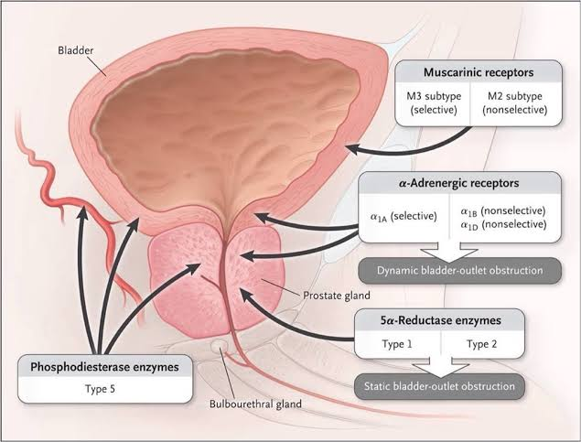

Slide 14
Surgical Management:
If medications are not so useful in treating BPH then prostate gland is often removed surgically ,in general surgery for BPH is done “Transurethrally”
Transurethrally: this means it is done through the urethra with no need for an incision.
The goal of surgery is to remove any obstructing tissues from the inside similar to corting out an apple .
The hospital stay is usually about one day.
Possible risk of surgery:
Bleeding
Infection
Incontinence

Slide 15
Laser prostatectomy:
Different types of lasers have been used to treat BPH.
Laser prostatectomies usually have less bleeding and have fewer complications. If you are taking blood thinners you can have a laser prostatectomy
Open prostatectomy:
In this procedure the inside of the prostate is removed through an incision in the abdomen, this surgery has high risk of complications, but maybe good if you have a very large prostate.

Slide 16
Novel Medication:
NX-1207 is an investigational drug for the treatment of BPH that is currently in phase III double-blinded, placebo-controlled,multicenter clinical trials in the USA .It is a new therapeutic protein of proprietary composition with selective pro-apoptopic properties.
NX-1207 is administered as an office based procedure by transrectal intraprostatic injection under ultrasound guidance.
NX-1207 has selective pro-apoptopic properties, which induce focal cell loss in prostate tissue,leading to prostate vo;ume reduction with both short and long-term symptomatic improvement.

Slide 17
Herbal treatment for BPH Saw palmetto

Slide 18
References
Luo G.C., Foo K.T., Kuo T., Tan G. Diagnosis of prostate adenoma and the relationship between the site of prostate adenoma and bladder outlet obstruction. Singap Med J. 2013;54:482–486. [PubMed] [Google Scholar
S. Salvioli, D. Monti, C. Lanzarini et al., “Immune system, cell senescence, aging and longevity—inflamm-aging reappraised,” Current Pharmaceutical Design, vol. 19, no. 9, pp. 1675–1679, 2013. View at: Google Scholar
Auffenberg GB, Helfand BT, McVary KT. Established medical therapy for benign prostatic hyperplasia. Urol Clin North Am. 2009;36:443–59. [PubMed] [Google Scholar
Dreikorn K. Other medical therapies. In: Denis L, Griffiths K, Murphy G, editors. Proceedings of the Fourth International Consultation on Benign Prostatic Hyperplasia (BPH), Paris, July 2–5, 1997. Plymouth, UK: Health Publication, Ltd.;; 1998. pp. 635–659
Diethylstilbestrol USP package insert (Lilly—US), Rev 8/31/88, Rec 4

