Slide 1
Nitrogen Fixation
Nitrogen fixation is a process by which molecular
nitrogen in the air is converted into ammonia (NH3) or
related nitrogenous compounds in soil.
Nitrogen is essential constituents of all biomolecules
both in plants and animals
Only some plants can take nitrogen from soil in the
form of nitrate or ammonium ion other need to fix it.

Slide 2
Role Of Nitrogen In Plants
Major substance in plants next to water
Building blocks
Constituent element of
Chlorophyll
Cytochromes
Alkaloids
Many vitamins
Plays important role in metabolism, growth, reproduction and heredity

Slide 3
Sources Of Nitrogen
Atmospheric nitrogen:
78% atmosphere contain nitrogen
Plant cannot utilize this form
Some bacteria, blue green algae and leguminous plants can fix it.
Organic nitrogenous compounds in insects
Insectivorous plants
Nitrates, nitrites, ammonia.
Amino acids in soil

Slide 4
Types Of Nitrogen Fixation

Slide 5
Non-biological Fixation
Non-biological fixation can occur in two ways
Through lightning
Industrial fixation
Microorganisms donot take part in it.
Nitrogen can be fixed by lightning that converts
nitrogen gas (N2) and oxygen gas (O2) present in the
atmosphere into NOx (nitrogen oxides).
NOx may react with water to make nitrous acid or nitric acid, which seeps into the soil, where it makes nitrate,
which is of use to plants.
1-Through lightening

Slide 6
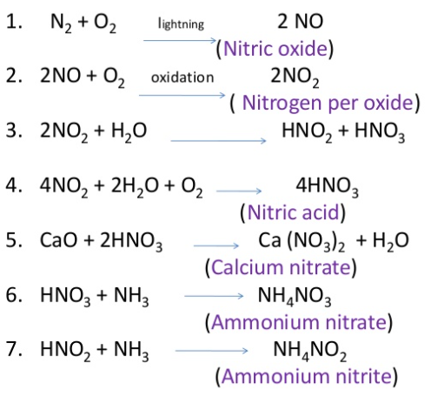
Process of fixation through lightning

Slide 7
2-Industrial nitrogen fixation
Industrial nitrogen fixation through the Haber (or Haber-Bosch) process is a deliberate attempt of humans to produce ammonia.
This process was invented in the early 1900s by German scientist Fritz Haber.
It recquires high pressure (200 atmospheres) and temperature (400 °C), and the resulting ammonia is used as a synthetic nitrogen fertilizer to enrich land for crop growth.

Slide 8
Biological Fixation
Biological nitrogen fixation was discovered by the German agronomist Hermann Hellriegel and Dutch
microbiologist Martinus Beijerinck.
N2 gas are found 78.084% in the atmosphere of our
planet called Earth.
N2 gas are found in molecular N2 form in soil.
Biological nitrogen fixation is a specific process in which the atmospheric nitrogen is converted to ammonia by
an enzyme called nitrogenase.

Slide 9
BNF is mostly accomplished by microorganisms called
diazotrophs or N2 fixers.
Diazotrophs includes some species of bacteria, fungi,
blue greenalgae(Cyanobacteria), lichens etc.
There are two types of biological nitrogen
fixation
Symbiotic
Non-symbiotic

Slide 10
Symbiotic nitrogen fixation
Fixation of free nitrogen by micro-organisms living symbiotically inside the plants.
The term ‘symbiosis’ was first introduced by a biologist named DeBary.
These can be discussed under the following three headings
1. Nodule formation in leguminous plants.
2. Nodule formation in non-leguminous plants.
3. Non nodulation

Slide 11
1-Nodule formation in leguminous plants
More than 2500 species of the family Leguminosae produce root nodules with Rhizobium spp.
Some examples of plants that belongs to botanical family Leguminosae includes Cicer arientium , Pisum, Cajanus, Arachis ,etc.
They fix nitrogen only inside the root nodules.
The association provides food and shelter to the bacteria. The
bacteria supply fixed nitrogen to the plant.
Nodule may buried in soil, even after harvesting - continue nitrogen
fixation.

Slide 12
2-Nodule formation in non-leguminous plants
Besides leguminous plants, some other plants aslo
found to form root nodules.
Some examples include, Causuarina equisetifolia,
Myrica gale etc.
Leaf nodules are also noted in some species of
Gymnosperms e.g., Pavetta zinumermanniana.

Slide 13
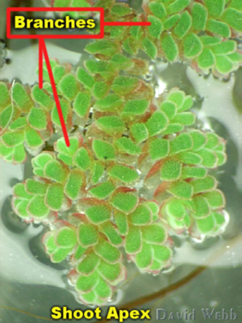
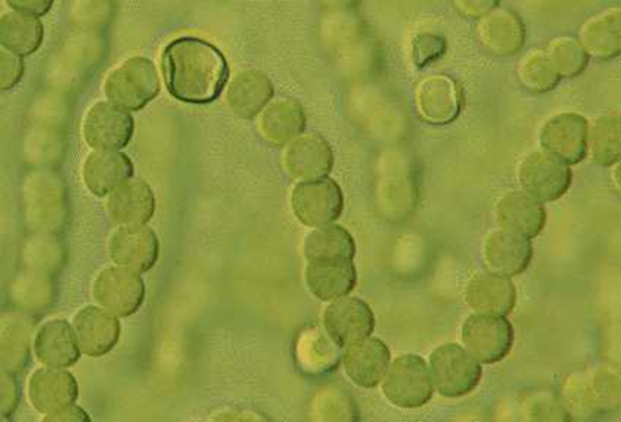
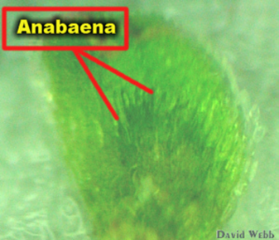
3-Non-nodulation
Lichens- Cyanobacteria
Anthoceros- Nostoc
Azolla- Anabaena azollae
Cycas- Nostoc and Anabaena
Nostoc

Slide 14
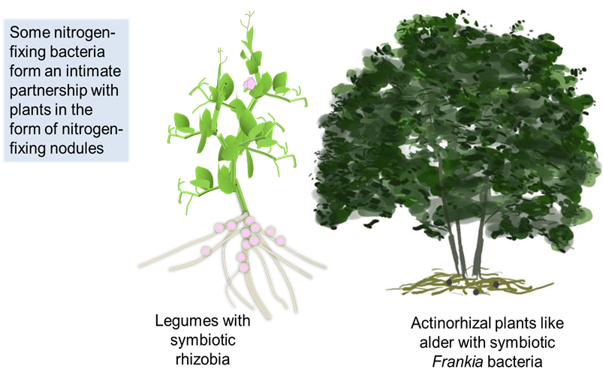
Symbiotic nitrogen fixation

Slide 15
Process of root nodule formation
Root nodules formed due to infection of Rhizobium.
Free living bacteria growing near the root of legumes
unable the fix nitrogen in free condition.
Roots of the plants belonging to the family Leguminosae secrete some growth factors helps in fast multiplication of bacteria.
For instant, Pisum sativum secretes homo serine and
carbohydrate containing protein called Lectins over their surface

Slide 16
Rhizobia are chemotactically attracted to the root hairs.
Medited by lectins, some attach to root hair cell wall.
Tryptophan is a component of the root hair exudate.
Tryptophan is transformed by rhizobia to indole acetic acid(IAA).
This plant hormone causes the root hair to curl or branch around the attached rhizobia.
Polygalacturonase, sectered by rhizobia or possibly by the plant, depolymerizes and softens cell wall of root hair, as a result rhizobia get entry to the root hair cell.

Slide 17
The root hair cell nucleus directs the development of infection thread.
Infection thread is a tube consisting of cell membrane and surrounding cellulosic wall. The infection thread with time results into formation of nodule tissue.
Infected root cells swell and cause dividing.
Bacteria within the swellen cells change their form to become endosymbiotic bacteriods, which begin to fix nitrogen.

Slide 18
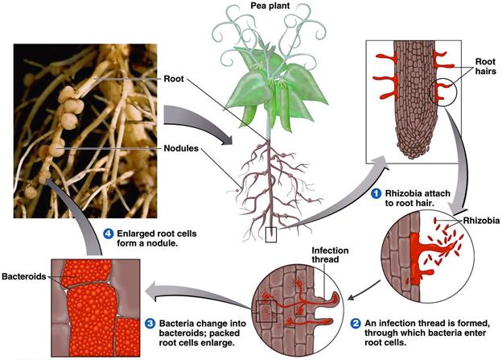

Slide 19
Non-symbiotic nitrogen fixation
Non-symbiotic (NS) N2 fixation includes N2 fixation by free-living soil bacteria (autotrophic and heterotrophic) that are not in a direct symbiosis with plants, and
associative N2-fixation (e.g. associated with the
rhizospheres of grasses and cereals).
Non-symbiotic N2 fixers are also known as free living
nitrogen fixers.
They inhabit both in terrestrial and aquatic conditions.

Slide 20
Fixation carried out by free living micro-organisms which are categorized into three different groups such as Aerobic, Anaerobic and blue green algae.
1. Free living aerobic : Azotobacter, Beijerenckia
2. Free living anaerobic : Clostridium.
3. Free living photosynthetic : Chlorobium, Rhodopseudomonas
4. Free living chemosynthetic :Desulfovibro,Thiobacillus
5. Free living fungi: yeasts and Pillularia
6. Blue green algae :
a. Unicellular – e.g., Synechoccus
b. Filamentous ( non heterocystous) : Oscillatoria
c. Filamentous ( heterocystous) : Nostoc, Anabaena

Slide 21
Ability to fix N2 by Microorganisms was confirmed by technique – acetylene reduction to ethylene . It is seen in diazotropic microorganisms.
The conversion is controlled by an enzymatic complex known as nitrogenous enzyme. It reduces the gaseous nitrogen into ammonia.
Nitrogenase sensitive to O2 .
Several groups of microorganisms fix nitrogen in presence of minute quantities of O2.
Oxygen not only inhabits the activity of nitrogenase but also regulate biosynthesis.

Slide 22
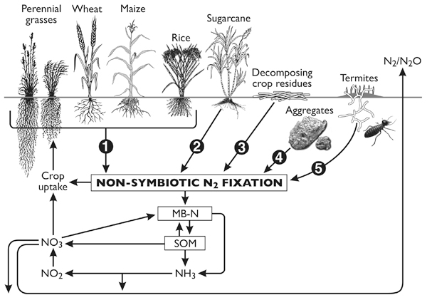

Slide 23
Biochemistry of nitrogen fixation
Nitrogen fixers utilize atmospheric N2 to synthesize
NH3.
In this process, N2 is first split up into free N2 atoms by breaking the triple bond, with the help of nitrogenase
enzyme.
This reaction is endergonic (energy consuming), it requires an input of nearly 160kcal energy.
Free energy combines with hydrogen forming NH3.

Slide 24
This reaction is exergonic (energy releasing).
Mediated by enzyme hydrogenase and it releases nearly 13 kcal energy.
Biological nitrogen fixation requires a net input of 147kcal energy and expenditure of nearly 16 moles of ATP per molecule of nitrogen.

