Slide 1
MASS CONTACT METHODS

Slide 2
Advantages of Mass Contact Methods
Target large group of audience in short time
Timely & quickly delivery of message
Develop reputation of extension department
Suitable for general awareness
Less expensive due to more coverage

Slide 3
disadvantages of Mass Contact Methods
Lack of feedback due to one way communication
Use of generalized recommendations
High competition with entertainment programs
Very expensive if use private TV channels
Requires extensive production time

Slide 4
MASS CONTACT METHODS
EXTENSION METHODS BY NATURE OF CONTACT
Electronic Media
TV, Radio, Internet, social media, Interactive and computer aided instructions, Telephone Message services
Web sites
Internet
Print Media
Bulletins, Newsletter, publications, Circular Letter, Magazines, posters
Exhibitions
Fairs
Campaigns at mass level

Slide 5
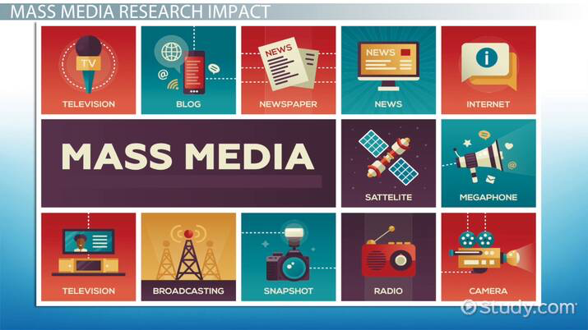
EXTENSION METHODS BY NATURE OF FUNCTION
Information Delivery
Bulletins
Newsletter
Circular Letter
Meetings
Skill Building
Workshop
Conference
Symposium
Demonstration
Role Playing

Slide 6
EXTENSION METHODS BY FORM OF COMMUNICATION
Written: Bulletins , Fact sheets, , News letters , News Articles and Personal Letters, News Paper, Folder, Journal, Magazine, Booklet, Brochures, Press Release, Flyers
Spoken: Meetings, Farm and Home Visits, office visits, Office calls, Telephone calls, Radio.
Visual: Demonstration, Exhibits, Slides, Videos, Television, Web Pages, Visual Aids.
Spoken and Visuals: Method Demonstration Motion, Meeting and Result Demonstrations, Meeting Involving motion pictures, charts and other audio visual Aids and Telivision.

Slide 7
