Slide 1
Communication Skills
.

Slide 2
WHAT IS COMMUNICATION?
Communication is sending or receiving ideas, thoughts or feelings from one person to one or more persons in such a way that, the person receiving it understands it in the same way the sender wants him/her to understand.
The term ‘communication’, derived from a Latin term ‘communicare’.
Also known as “people skills” or “soft skills”.
Ranked in a survey as the most important requirement for successful job performance.

Slide 4
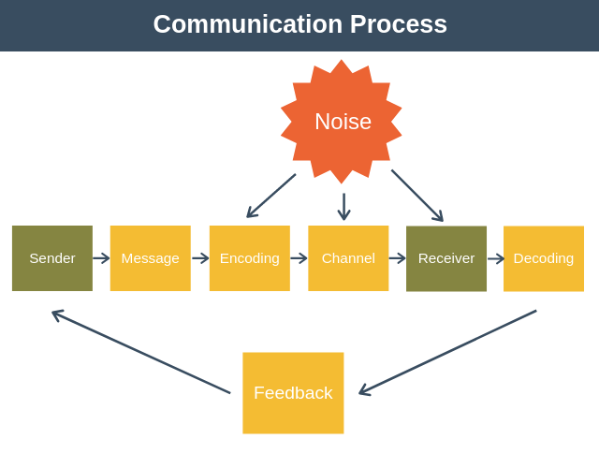

Slide 5
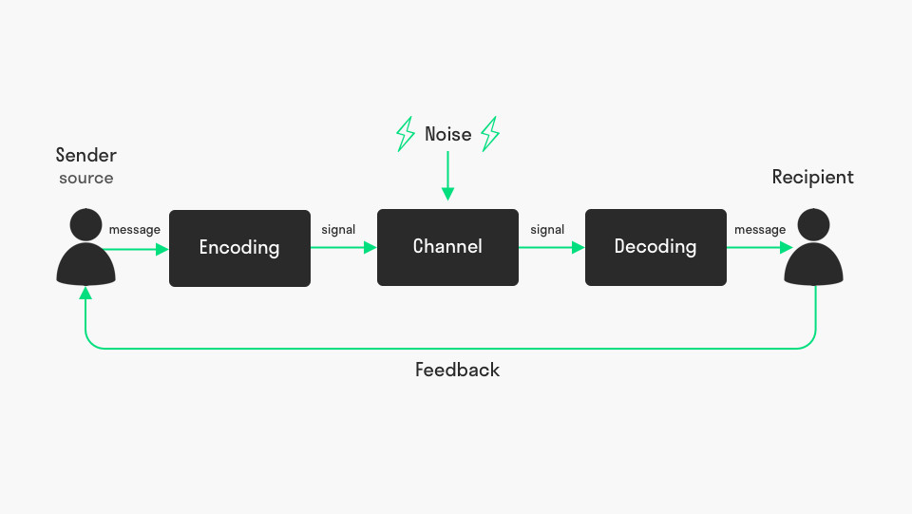
Communication Cycle

Slide 6
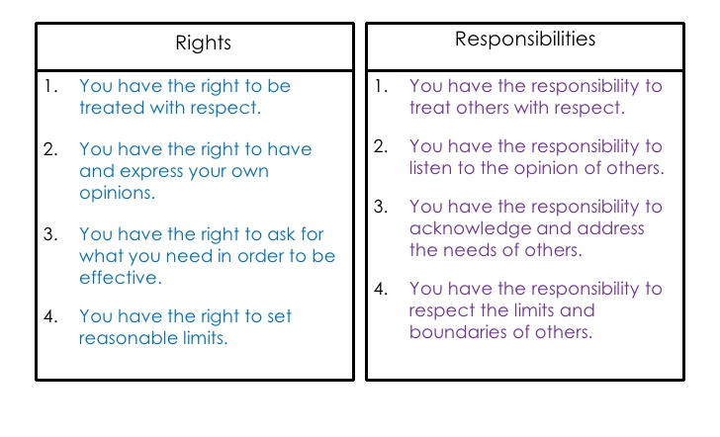
Communication Rights and responsibility

Slide 8
Major types of Communication
Verbal
Nonverbal
Written

Slide 9
Verbal Communication
• Communicating using language, a structured system of sounds that is used and understood to express ideas among people.
– Verbal communication includes… volume level, tone, etc.
Organize Your Thoughts
Paint Word Pictures
Watch Your Grammar
Be clear

Slide 10
Listening Skills
Listening is not a “passive” skill but a “receptive” skill. It requires as much attention and mental activity as speaking.
That of the time an individual is engaged in communication, approximately 9 % is devoted to writing, 16 % to reading, 30 % to speaking, and 45 % to listening.

Slide 11
Nonverbal Communication
• What percent of how we communicate with others is through nonverbal communication (facial expressions, body

Slide 12
Why is nonverbal communication so important?
Nonverbal is the first thing our mind reads before a word is even spoken.
Non-verbal communication can Reinforces, Complements, Contradicts, Regulates, or Replaces a verbal message.

Slide 13
CATEGORIES OF NONVERBAL COMMUNICATION
Body movement; way of walking.
Posture; way of sitting, standing.
Gesture; movements of hands, legs, arms and feet.
Facial expressions & eye contact.
Space; place of sitting, distance.
Touch; shake hands, patting on the back.
Time.
Personal appearance; clothes, hair, jeweler.
Paralanguage; vocal characteristics (pitch, volume, rate and quality), vocal interferences (umm, uhh).

Slide 14
Written Communication

Slide 15
Purposes of Communication
To support decision
to achieve coordinated action
To share information
To develop friendships
To build your personality in others mind.
To change behavior
To ensure understanding
To persuade

Slide 16
ELEMENTS OF COMMUNICATION
Source
Message
Channel
Receiver
Effect
Feedback These are the 6 elements of communication.

Slide 17
SOURCE
The source is the origin of the idea. Source is also famously known as sender. He may be an individual or group though ultimately, it is an individual who will act on behalf of the group. The sender conceives the idea, prepares the message, selects the channel of distribution and decides who the receiver will be.

Slide 18
MESSAGE
It refers to the content that the sender passes on to the receiver. It is the core of communication. Messages can consist of symbols or words. Transformation of an idea into a message by the sender is known an encoding and converting this message into some meaning by the receiver is known as decoding. The message should be clear so that the receiver understands it.

Slide 19
CHANNEL
The channel is the medium through which a message travels from sender to receiver. The channel may be mass media or interpersonal. Selection of channel depends on the message to be conveyed, availability of channel, cost and effectiveness of channel of distribution.

Slide 20
RECEIVER
The receiver is the person for whom the message is intended. He is the most important aspect of the communication process which is a two way process and incomplete without the receiver. Any change or neglect on the part of the receiver will hamper the entire process.

Slide 21
EFFECT
Effect is the change in behaviour of the receiver on receiving the message from the sender. He may ignore the message or store it or dispose it or even send a feedback to the source depending on how the message has an effect on the receiver.

Slide 22
FEEDBACK
Feedback is the response the receiver gives to the sender after the element of effect. Feedback can be negative or positive depending on how the message is encoded and decoded by the sender and receiver respectively. Feedback in most cases does not take place. It is an optional element of communication that may or may not happen.

