Slide 1
Design rendering

Slide 9
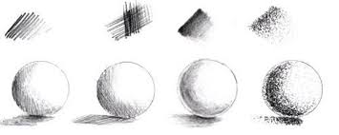

Slide 11
