Slide 1
Extracellular Matrix;various types of extracellular matrix proteins

Slide 3
EXTRACELLULAR MATRIX
DEFINITION:
The extracellular matrix (ECM) is a three-dimensional network of extracellular macromolecules, such as collagen, enzymes, and glycoproteins, that provide structural and biochemical support to surrounding cells.

Slide 4
ECM Function
Support for cells
Pattern of ECM regulates
polarity
cell division
adhesion
motility

Slide 5
FUNCTIONS…….
Development
Migration
Differentiation
Growth factors

Slide 6
ECM Features
stable and able to be reorganised?
different for different tissues

Slide 7
ECM Structure
Glycoproteins
Fibers
Collagen- main fibers
Elastin
Hydrated Matrix
Proteoglycans
High carbohydrate
Adhesive
Laminin
Fibronectin

Slide 8
TYPES OF EXTRACELLULAR MATRIX
The extracellular matrix is made of three main types of extracellular macromolecules:
(i) Polysaccharide glycosaminoglycan’s (com­monly known as mucopolysaccharides)

Slide 9
Continue…..
(ii) Fibrous protein contain two types
(a) Mainly structural (e.g., collagen and elastin)
(b) Mainly adhesive (e.g., fibronectin and laminin)
(iii) Specialised extracellular matrix or basal lamina

Slide 10
(i) Glycosaminoglycan:
It is a long, un-branched linear polysaccharide chains and consists of repeating disaccharide units in which one of two sugars is always either N-acetyl glucosamine or N-acetylgalactosamine. Hence it is named glycosaminoglycan.

Slide 11
(ii) Fibrous Protein:
A. Structural Fibrous Protein
(a) Collagen:
The major fibre-forming structural proteins of the extracellular matrix are collagens. The fibrillar collagens are generally rope-like
It is a hyderpphobic protein.

Slide 12
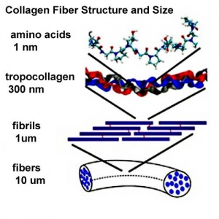
Collagen structure
Composed of 3 polypeptide alpha chains coiled around each other to form triple helix configuration.
Depending upon the type of collagen the molecule may be made up of either identical alpha chains or 2 or 3 different alpha chains.
Each helix is around 1.4nm in length

Slide 13
Components of collagen
Cartilage
Ligament
Tendon
Bone
Skin

Slide 14
Function of Collagen
It play an important role in cell differentiation ,polarity,movement.
It play an important role in tissue and organ development.

Slide 15
Types of Collagen
Collagen can be organized into three groups based on their location and function in body.
Network forming collagen
Fibril forming collagen
Fibril associated collagen

Slide 16
Fibril forming collagen
These have rope like structure.
Types and Distribution
Type 1: skin, bone, tendon, blood vessels ,cornea
Type 2: cartilage,invertebratebral disk
Type 3: blood vessels,fetal skin

Slide 17
Network forming collagen
These are three dimensional mwsh rather than distinct fibrils.
Type 4:basement membrane
Type5:beneath stratified squamous epithelia

Slide 18
Fibril associated collagen
These types bindes to the surface of collagen fibrils linking these fibrils to one otherand other components in extracellular matrix.
Type6:cartilage
Type7:tendon ,ligament ,some other tissues

Slide 19
(b) Elastin:
Elastin is a fibrillar cross-linked, random-coil, hydrophobic, non-glycosylated protein that gives the elasticity of the tissues—such as skin, blood vessels and lungs—in order to function.

Slide 20
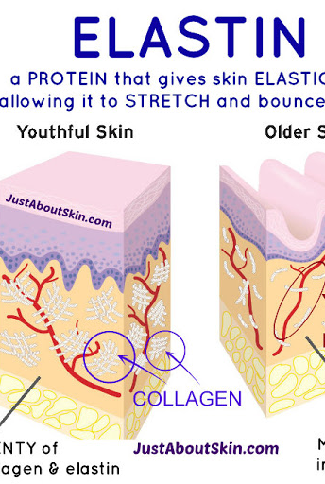
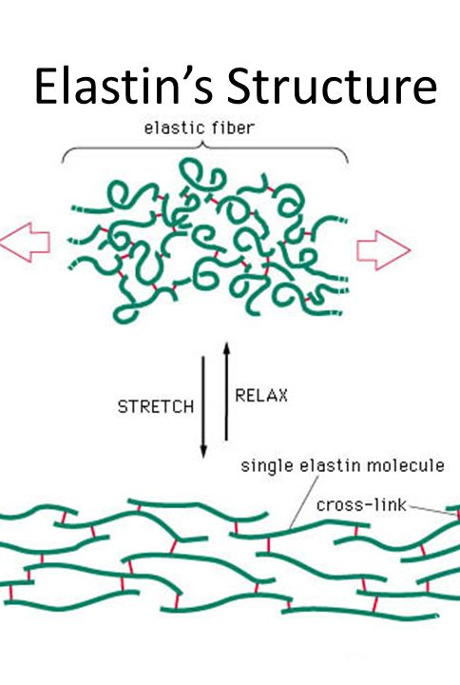
Diagram:

Slide 21
Adhesive Fibrous Protein:
The extracellular matrix contains several ad­hesive fibrous glycoproteins that bind to both cells and other matrix macromolecules.

Slide 22
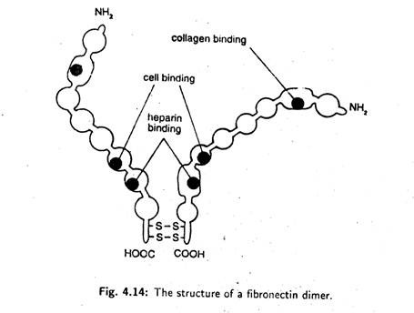
(a) Fibronectin:
Fibronectin is a glycoprotein. It is made of two polypeptide chains which are similar but not identical.

Slide 23
(b) Laminan:
Laminin is an adhesive glycoprotein. It is secreted specially by epithelial cells. This protein is a major part of all basal laminae. It binds the epithelial cells to type IV collagen of basal Lamina.

Slide 24
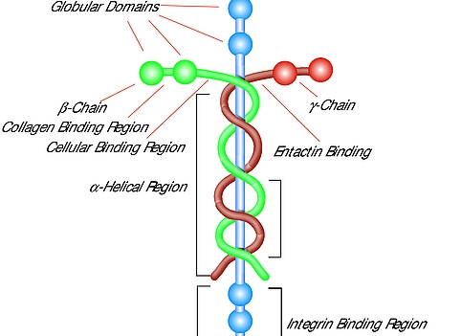
Diagram:

Slide 25
(iii) Specialised Extracellular Matrix Basal Laminae:
Basal lamina is a continuous thin mat or sheet like specialised extracellular structure that un­derlies all epithelial cells. Individual muscle cells, fat cells, Schwann cells are wrapped by basal lamina. It is actually linked to the plasma membranes of different types of cell by specific receptors.

Slide 26
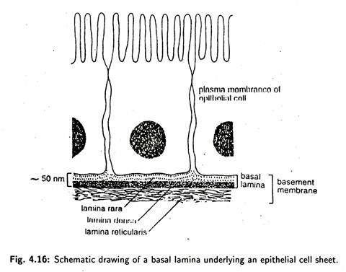
Diagram:

