Slide 1
Economic Principles of Livestock Production (FACTOR-PRODUCT RELATIONSHIP)
By Hanzala Zulfiqar

Slide 2
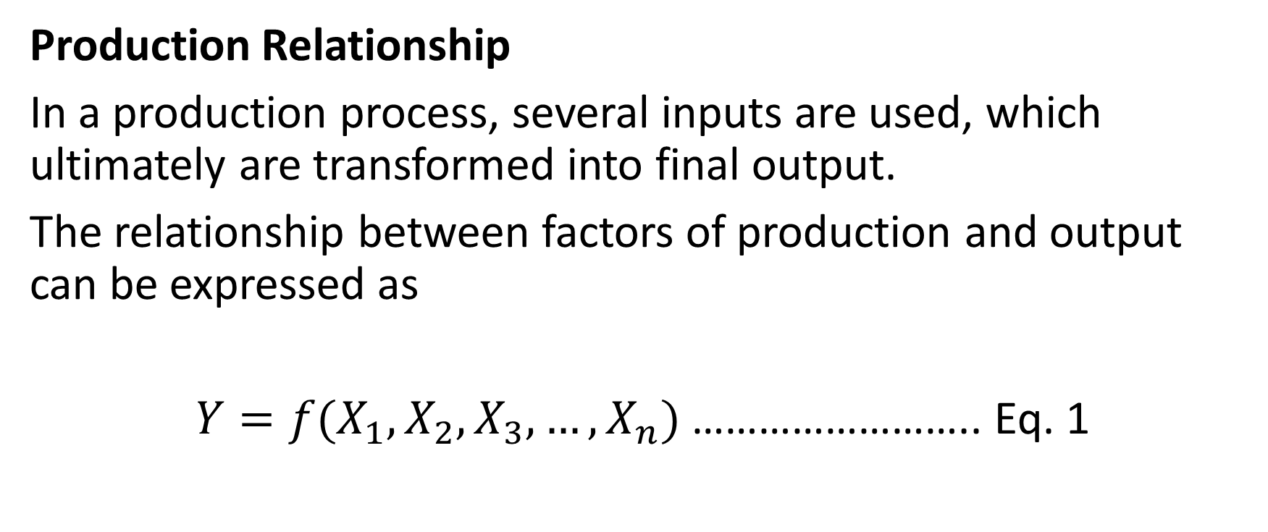
There are physical and mathematical relationship between the levels of inputs and output realized in a production process.
Production Relationship
In a production process, several inputs are used, which ultimately are transformed into final output.
The relationship between factors of production and output can be expressed as
$Y=f(X_{1},X_{2},X_{3}, …,X_{n})$ …………………….. Eq. 1

Slide 3
There are three relationships in a production economics.
Factor-Product Relationship
Factor-Factor Relationship
Product-Product Relationship

Slide 4
FACTOR-PRODUCT RELATIONSHIP
The production of any final product depends on the use of various inputs or factors of production. Example
Production may be affected by the use of one or all of these factors.
The quantity of products vary in a production due to the variation in quantity of inputs.

Slide 5
Production Function
The physical relationship between inputs (factors) and the output (product) is called the production function.
Let we consider a production relation where only one variable input of production combined with the fixed inputs is used to produce only one product.
Suppose Ration Intake (total digestible nutrients (TDN)) is an input which we can vary to get milk production by feeding animals. All other inputs are fixed.
$Y=f(X_{1}/X_{2},X_{3}, …,X_{n})$ …………………………. Eq. 2

Slide 6
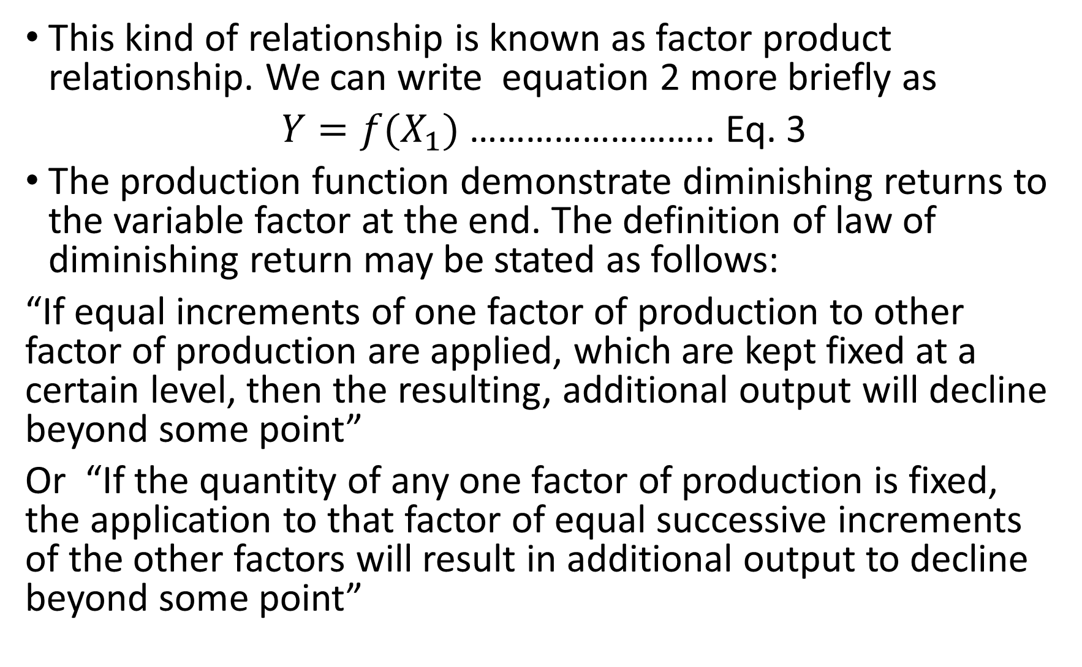
This kind of relationship is known as factor product relationship. We can write equation 2 more briefly as
$Y=f(X_{1})$ …………………….. Eq. 3
The production function demonstrate diminishing returns to the variable factor at the end. The definition of law of diminishing return may be stated as follows:
“If equal increments of one factor of production to other factor of production are applied, which are kept fixed at a certain level, then the resulting, additional output will decline beyond some point”
Or “If the quantity of any one factor of production is fixed, the application to that factor of equal successive increments of the other factors will result in additional output to decline beyond some point”

Slide 8
Representation of
Single Factor Product
Function

Slide 9
Relationship Between Marginal Product (MP) and Total Product (TP)
There are different relationships exist between MP and TP.
When the TP is increasing, MP is positive
When the TP is maximum, MP is zero
When the TP is decreasing, MP is negative
When the TP is increasing at increasing rate, the MP is increasing
When the TP is increasing at decreasing rate, the MP is decreasing but positive

Slide 10
Relationship Between Marginal Product (MP) and Average Product (AP)
There are different relationships exist between MP and AP.
When the marginal product is greater than the average product, AP is increasing.
When the marginal product is less than the average product, AP is decreasing.
When the marginal product is equal to the average product, AP is maximum.

Slide 12
Profit Maximization Condition
There are different ways to find out profit maximization condition in Factor Product relationship.
Added Revenue is equal to Added Cost $Added Revenue= {∆Y.P}_{Y} \& Added Cost= {∆X_{1}.P}_{X_{1}}$
VMP (Value of Marginal Product) is equal to price of the input. where $VMP= \frac{∆Y}{∆X}.P_{Y}$
MR=MC $P_{Y}=\frac{{∆X}_{1}P_{X_{1}}}{∆Y}$ or $P_{Y}=\frac{P_{X_{1}}}{MP}$
MP is equal to inverse price ratio. $MP=\frac{P_{X_{1}}}{P_{Y}} where MP= \frac{∆Y}{{∆X}_{1}}$
Maximum difference between Total Revenue and Total Cost. ${Profit=Y.P}_{Y}− X_{1}{.P}_{X_{1}}$

