Slide 1
WHAT IS A LEADER?
Need for leadership – today, managers are expected to do more than just give orders. They must involve employees and find ways to meet employee needs as well as business needs.
Leadership characteristics – it takes skill to get people with different backgrounds and personalities to work well together.

Slide 2
Characteristics of Effective Leaders
Understanding
Initiative
Dependability
Judgment
Objectivity
Confidence
Stability
Cooperation
Honesty
Courage
Communication
Intelligence

Slide 3
Preparing to Be a Leader
Study leadership
Participate in organizations and activities
Practice leadership at work
Observe leaders
Work with a mentor
Do a self-analysis and ask for feedback

Slide 4
IMPORTANCE OF HUMAN RELATIONS
Human relations skills
Self understanding
Understanding others
Communication
Team building
Developing job satisfaction

Slide 5
Leadership

Slide 6
What is Leadership
Leadership is a process by which an executive can direct, guide and influence the behaviour and work of others towards accomplishment of specific goals in a given situation. Leadership is the ability of a manager to induce the subordinates to work with confidence and zeal.

Slide 7
Leadership is the potential to influence behaviour of others. It is also defined as the capacity to influence a group towards the realization of a goal.
Leaders are required to develop future visions, and to motivate the organizational members to want to achieve the visions.

Slide 8
According to Keith Davis, “Leadership is the ability to persuade others to seek defined objectives enthusiastically. It is the human factor which binds a group together and motivates it towards goals.”

Slide 9
Characteristics of Leadership
• It is a inter-personal process in which a manager is into influencing and guiding workers towards attainment of goals.
• It denotes a few qualities to be present in a person which includes intelligence, maturity and personality.

Slide 10
It is a group process. It involves two or more people interacting with each other.
A leader is involved in shaping and moulding the behaviour of the group towards accomplishment of organizational goals.
Leadership is situation bound. There is no best style of leadership. It all depends upon tackling with the situations.

Slide 11
Importance of Leadership
Leadership is an important function of management which helps to maximize efficiency and to achieve organizational goals. The following points justify the importance of leadership in a concern.

Slide 12
Initiates action
Leader is a person who starts the work by communicating the policies and plans to the subordinates from where the work actually starts.

Slide 13
Motivation
A leader proves to be playing an incentive role in the concern’s working. He motivates the employees with economic and non-economic rewards and thereby gets the work from the subordinates.

Slide 14
Providing guidance
A leader has to not only supervise but also play a guiding role for the subordinates. Guidance here means instructing the subordinates the way they have to perform their work effectively and efficiently.

Slide 15
Creating confidence
Confidence is an important factor which can be achieved through expressing the work efforts to the subordinates, explaining them clearly their role and giving them guidelines to achieve the goals effectively. It is also important to hear the employees with regards to their complaints and problems.

Slide 16
Building morale
Morale denotes willing co-operation of the employees towards their work and getting them into confidence and winning their trust. A leader can be a morale booster by achieving full co-operation so that they perform with best of their abilities as they work to achieve goals.

Slide 17
Builds work environment
Management is getting things done from people. An efficient work environment helps in sound and stable growth. Therefore, human relations should be kept into mind by a leader. He should have personal contacts with employees and should listen to their problems and solve them. He should treat employees on humanitarian terms.

Slide 18
Co-ordination
Co-ordination can be achieved through reconciling personal interests with organizational goals. This synchronization can be achieved through proper and effective co-ordination which should be primary motive of a leader.

Slide 19
A COMPARISON OF MANAGEMENT AND LEADERSHIP
Management
Planning and budgeting
Keeping eye on bottom line
Organizing and staffing
Directing and controlling
Create boundaries
Leadership
Creating vision and strategy
Keeping eye on the horizon
Creating shared culture and values
Helping others grow
Minimize boundaries

Slide 20
A COMPARISON OF MANAGEMENT AND LEADERSHIP
Management
Focuses on objects – producing/selling
goods and services
Based on position power
Acting as boss
Leadership
Focuses on people – inspiring and motivating followers
• Based on personal power
Acting as coach, facilitator, servant

Slide 21
A COMPARISON OF MANAGEMENT AND LEADERSHIP
Management
Emotional distance
• Expert mind
• Talking
• Conformity
• Insight into organization
Leadership
Emotional connections (heart)
• Open mind (mindfulness)
• Listening (communication)
• Non-conformity (courage)
• Insight into self (integrity)

Slide 22
A COMPARISON OF MANAGEMENT AND LEADERSHIP
Management
Implementation of the leader’s vision and changes introduced by leaders, and the maintenance and administration of organizational infrastructures.
Leadership
Articulation of an organizational vision and
the introduction of major organizational
change; provides inspiration and deals with
highly stressful and troublesome aspects of
the external environments of organizations.

Slide 23
A COMPARISON OF MANAGEMENT AND LEADERSHIP
Management
Focuses on the tasks (things) when performing the management functions of planning, organization, and controlling.
Leadership
Focuses on the interpersonal relationships
(people).

Slide 24
A COMPARISON OF MANAGEMENT AND LEADERSHIP
Management
Planning. Establishes detailed objectives and plans for achieving them.
Organizing and staffing. Sets up structure for employees to do the job the way the manager expects it to be done.
Leadership
Establishes direction; develops a vision and the strategies needed for its achievement.
• Innovates and allows employees to do the
job any way they want, as long as they get
results that relate to the vision.

Slide 25
A COMPARISON OF MANAGEMENT AND LEADERSHIP
Management
Controlling. Monitors results against plans and takes corrective action.
Predictable. Plans, organizes, and controls with consistent behaviour. Prefers stability.
Leadership
Motivates and inspires employees to accomplish the vision in creative ways.
Makes innovative, quick changes that are not very predictable. Prefers change.

Slide 26
A COMPARISON OF MANAGEMENT AND LEADERSHIP
Management
Managers do things right.
Focus is on a short-term view, avoiding
risks, maintaining and imitating.
Maintains stability
Leadership
Leaders do the right things.
The focus is on a long-term view, taking risks, innovating, and originating.
Creates change

Slide 27
Leadership Skills

Slide 28
"Leadership is a function of knowing yourself, having a vision that is well communicated, building trust among colleagues, and taking effective action to realize your own leadership potential."
Prof. Warren Bennis

Slide 29
Exercise In pairs
Discuss examples you have come across of strong and weak leadership
You can use examples from employment, academic studies or participation in sports clubs and societies (keep anonymous)

Slide 30
Leadership Theory
Early Theories:
Great Man Theories
Leaders are exceptional people, born with innate qualities, destined to lead
Term 'man' was intentional - concept was primarily male, military and Western
Trait Theories
Research on traits or qualities associated with leadership are numerous
Traits are hard to measure. For example, how do we measure honesty or integrity?

Slide 31
Leadership Traits
Leadership Skills
Group Exercise:
Choose leaders YOU admire
What personality traits and skills do they have?

Slide 32
Leadership Traits and Skills
Skills
Clever (intelligent)
Conceptually skilled
Creative
Diplomatic and tactful
Fluent in speaking
Knowledgeable about group task
Organised (administrative ability)
Persuasive
Socially skilled
Stogdill, 1974
Traits
Adaptable to situations
Alert to social environment
Ambitious and achievement orientated
Assertive
Cooperative
Decisive
Dependable
Dominant (desire to influence others)
Energetic (high activity level)
Persistent
Self-confident
Tolerant of stress
Willing to assume responsibility
Leaders will also use:
Integrity, Honesty, Compassion, Humility

Slide 33
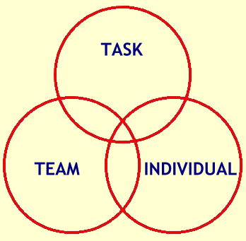
Leadership Theory
Functional Theories (John Adair, Action Centred Leadership, 1970)
Leader is concerned with the interaction of 3 areas:
Task – goal setting, methods and process
Team – effective interaction/communication, clarify roles, team morale
Individual – attention to behaviour, feelings, coaching, CPD

Slide 34
Behaviourist Theories (Blake and Mouton, Managerial grid, 1964)
Leaders behaviour and actions, rather than their traits and skills e.g. production orientated or people orientated
Different leadership behaviours categorised as ‘leadership styles’ e.g. autocratic, persuasive, consultative, democratic
Doesn’t provide guide to effective leadership in different situations

Slide 35
Leadership Theory
Situational/contingency Leadership (Hersey-Blanchard, 1970/80) Leadership style changes according to the 'situation‘ and in response to the individuals being managed – their competency and motivation

Slide 36
Competency | Low competence | Some competence | High competence | High competence
Motivation | Low commitment/ Unable and unwilling or insecure | Variable commitment/ Unable but willing or motivated | Variable commitment/ Able but unwilling or insecure | High commitment/ Able and willing or motivated
Leadership style | DIRECTIVE (Telling) | COACHING (Selling) | SUPPORTIVE (Participating) | DELEGATORY (Observing)

Slide 37
New Leadership Theory
Transformational Theory (Bass and Avolio, 1994)
Leaders inspire individuals, develop trust, and encourage creativity and personal growth
Individuals develop a sense of purpose to benefit the group, organisation or society. This goes beyond their own self-interests and an exchange of rewards or recognition for effort or loyalty.

Slide 38
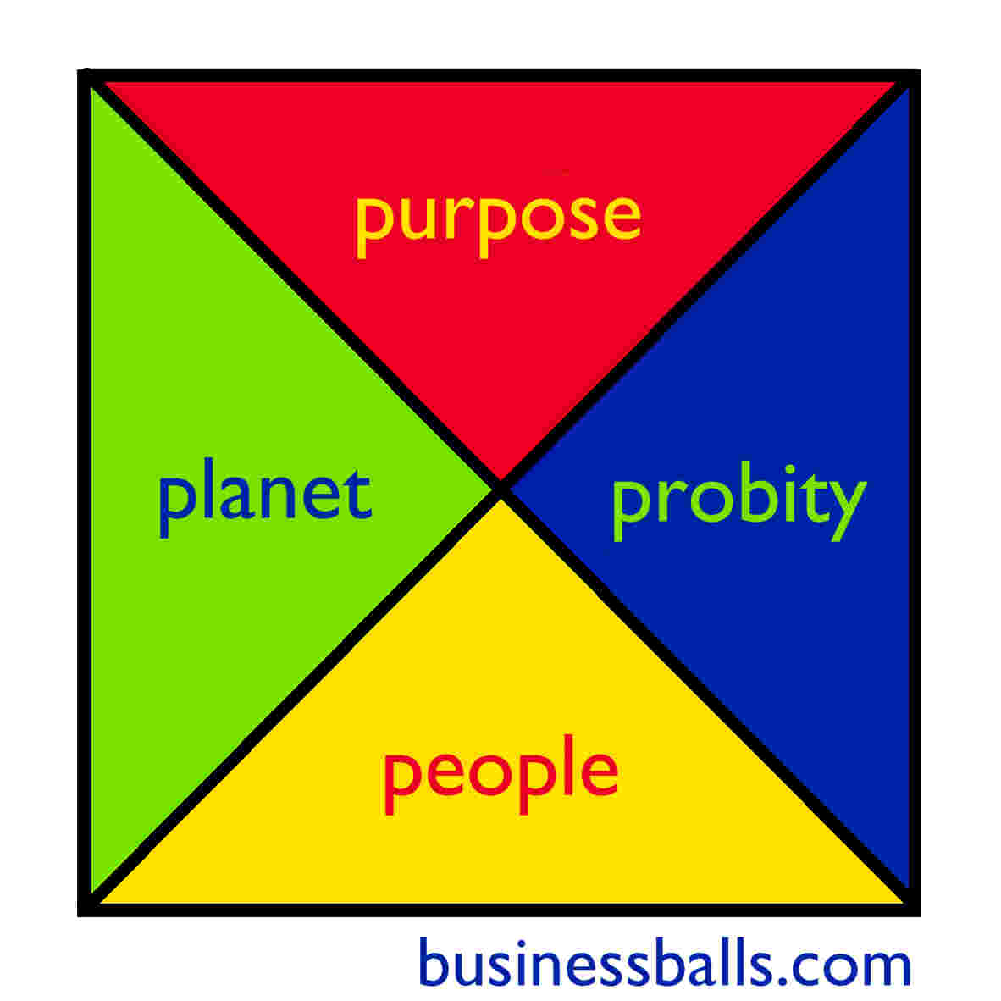
Leadership Philosophies
Ethical Leadership
CSR, sustainability, equality, humanitarianism
Four P’s - Purpose, People, Planet, Probity
Alan Chapman, 2006

Slide 39
Key Team Leader Responsibilities
Guide/coordinate team members – encourage teamwork and motivate individuals
Provide structure for team – set mission and purpose, clarify roles and responsibilities, allocate tasks and set objectives
Clarify working methods, practises and protocol
Focus on performance – anticipate challenges, monitor performance, delegate and provide CPD support

Slide 40
Leadership Skills
Responsibility Vs Accountability?
What does having authority mean?

Slide 41
Accountability, Responsibility, and Authority
Accountability the state of being accountable, liable, or answerable
Responsibility (for objects, tasks or people) can be delegated but accountability can not – buck stops with you!
A good leader accepts ultimate responsibility:
will give credit to others when delegated responsibilities succeed
will accept blame when delegated responsibilities fail
Accountability can not operate fairly without the leader being given full authority for the responsibilities concerned
Authority is the power to influence or command thought, opinion or behaviour
Cross-functional team – less authority - more difficult to manage

Slide 42
Group Exercise
When have you experienced an issue as a leader that you did not have the authority to resolve?
How did you know you did not have the authority?
Who did you refer to for help?
Use examples from your own current experience – work, volunteer, club /society

Slide 43
Team Leader Authority
Team Leader authority will vary from role to role dependent on the scope of duties and organisational structure
A Team Leader may refer to line management or other
authorities for the following:
HR (staff recruitment and training, performance and discipline, racism or bullying)
Policy and procedures (Health and Safety, changes to working practises)
Budget & resources (allocation and management)
Organisational objectives (strategy, targets)
Managing change (department restructure, office move)
Line management (support and advice, own CPD)

Slide 44
How to improve your leadership skills
Reflect and identify the skills YOU need to lead effectively and create your action plan to develop them
Ask for feedback from work colleagues, line managers, tutors, your ‘followers’
Practise! Take on responsibility (work, volunteering, clubs & Societies) and reflect on your performance SIFE - www.youtube.com/watch?v=KB2fOF_gYBg
Find a mentor – learn from positive leadership role-models
Attend further leadership and management training
Use the resources on Exeter Leaders Award ELE pages

Slide 45
Review your performance as a Leader
Individual Exercise:
Assess yourself as a Leader
Conduct a SWOT analysis - Strengths, Weaknesses, Opportunities, Threats
(Use the Results of Leadership Questionnaire you have been completed prior to attending the session)
Develop an Action Plan to improve as a leader
list 2 actions you will undertake to address Weaknesses or capitalise on Opportunities identified
Apply SMART targets to your actions – Specific,
Measurable, Achievable, Realistic, Time-bound

Slide 46
Leadership Styles

Slide 47
3 Main Types of Leadership Styles
The Autocratic or Authoritarian Leader
The Democratic or Participative Leader
The Laissez-faire or Delegative Leader

Slide 48
2 Other Styles
The Charismatic Leader
The Servant Leader

Slide 49
The Autocratic or Authoritarian Leader
Given the power to make decisions alone, having total authority.
Closely supervises and controls people when they perform certain tasks.

Slide 50
The Democratic or Participative Leader
Includes one or more people in the decision making process of determining what to do and how to do it.
Maintains the final decision making authority.

Slide 51
The Laissez-faire or Delegative Leader
Laissez-faire is a French phrase meaning “let do”
Allows people to make their own decisions.
Leader is still responsible for the decisions that are made.
This style allows greater freedom and responsibility for people.
However, you need competent people around you or nothing will get done.

Slide 52
The Charismatic Leader
Leads by creating energy and eagerness in people.
Leader is well liked and inspires people.
Appeals to people’s emotional side.

Slide 53
The Servant Leader
The highest priority of this leader is to encourage, support and enable people to fulfill their full potential and abilities.
Helps people achieve their goals.
Works for the people.

Slide 54
Combinations of Styles
A leader can also be a combination of styles…
What leadership styles do you think Adolf Hitler used?

Slide 55
Review
The Autocratic or Authoritarian Leader
The Democratic or Participative Leader
The Laissez-faire or Delegative Leader
The Charismatic Leader
The Servant Leader

Slide 56
Questions
Which leadership style do you think is the most effective? Why?
Which leadership style do you think is the least effective? Why?
Which style do you like leaders to use when they are in charge of you? Why?
What leadership style best describes you?

Slide 57
Credits
Some material used in this presentation was taken from a PowerPoint found at http://www.slideshare.net/DanHrstich/leadership-style-presentation by Daniel Hrstich

