Slide 1
Establishment of vegetable Farms

Slide 2
Types
Home gardening
Market gardening
Truck gardening
Vegetable forcing
Organic vegetable production

Slide 3
Home Gardening: production of vegetables for home use
Market gardening: production of perishable vegetables for local markets. This type is developed to meet the requirement of people with no land, time or interest to grow their own vegetables.
Truck gardening: it is the production of vegetables in relatively large quantities for distant markets.
Vegetable forcing: production of vegetables out of their normal season is known as vegetable forcing.
Organic vegetable production: vegetable production which is not exposed to any chemical right from the stage of seed treatment to the final post harvest handling and processing

Slide 4
Site selection
Climate should be favorable for vegetable production
Soil should be well drained, fertile and levelled
Water quality and its availability should be optimum
Vegetable farm area should be cleared from heavy shade casting trees
Site should be accessible by road and near to market.
Labor availability must be considered
Transportation facilities should be available on site

Slide 5
Sowing Methods
Direct sowing: sowing of vegetable seeds in the actual field e.g Spinach, corriander, fenugreek
Indirect sowing: it is consist of two steps:
Nursery raising
Transplantation
e.g Tomato, chilies, onion

Slide 6
Direct Sowing
Advantages
Less time consuming
Less labor requirement
Easy and cheap
Easy to manage
Disadvantages
More quantity of seeds is used
Competition between seedlings
Weed problem
Not uniform crop stand in case of broadcasting

Slide 7
Indirect sowing
Advantages:
Early crop can be grown
Less amount of seed is used per acre
Easy management of weeds in field
Easy in harvesting
Plant to plant and row to row distance can be efficiently maintained
Healthy seedlings are used for transplantation
Uniform crop stand
Economical land use as more number of plants are raised on a piece of land for transplanting in large area.
Disadvantages:
More labor requirement
Time consuming

Slide 8
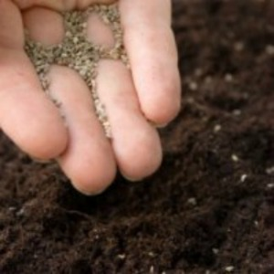
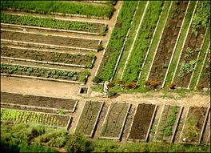
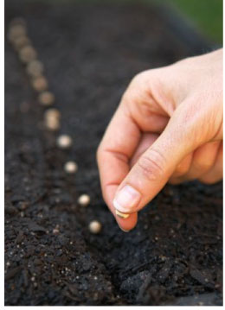
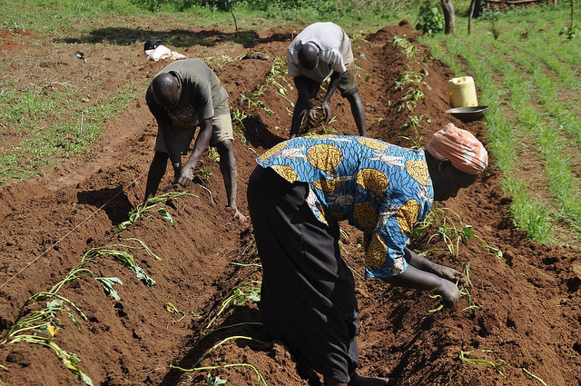
Seed sowing techniques
Bed sowing
Broadcast
Ridge sowing
Line

Slide 9
Vegetable nursery raising
Nursery is a place where young seedlings are raised and nourished before planting in the main field.
For raising good crop, it is important that seedling should be healthy, vigorous and disease free.
It is good approach to handle the costly hybrid seeds.
Nursery can be raised under protected conditions as well as in open fields.

Slide 10
Requirements for nursery raising
Site selection: nursery bed should be raised in open place.
It is not advisable to select the site near tree or building, as these are shady places.
Site, which is known for diseases and insect pests should be avoided
Raised areas should be selected with good drainage.

Slide 11
2. Selection of soil
Soil should be sandy loam or loamy
Well drained, rich in organic matter and free from insect pests and diseases.
pH should be in the range of 6-7
Acidic or saline soils should be avoided

Slide 12
3. Soil treatment:
Before seed sowing, soil should be solarized, for this purpose, soil mulching is done with transparent polyethylene, during the period of high temperature and solar radiation.
Formalin can also be used for soil treatment. 1 part formalin in 100 parts of water can be used efficiently. 5 liter of this solution is sprayed uniformly on soil surface for 1 square meter area. After application, area is covered with polythene for 7-8 days. After removing cover, soil is kept open for 7-8 days for emission of formalin through volatilization.
Seven dust powder is also used (20-25 g/m² area).

Slide 13
4. Nursery bed preparation
Digging, ploughing and harrowing should be done to make the soil open, well pulverized, porous, well aerated and less compact.
On small areas, it can be done with small implements like spade, kudali etc.
on levelled plot, raised or flat beds can be prepared depending on situation.
Raised Nursery Beds:
On well cultivated field, area is demarked having 1 to 1.5 m width and length as per need. However, it should not exceed 5-6 m.
In marked area, soil is drawn from the sides, so that the level of bed is raised to 15-20 cm from natural level of the plot.
All big clods, stones, plant stumps, weed plants are removed.
Well rotten FYM is added

Slide 14
Surface of nursery bed is made smooth and should be slightly raised in the middle to facilitate drainage.
50-60 cm space is left between beds to facilitate cultural practices like watering, weeding, spraying of insecticides, uprooting of seedling for transplanting and for draining extra water.
Furrow should be 2-3 cm deep, 5-7 cm apart and across the width of the bed are made.
Seeds are sown and covered with compost+soil to avoid soil crusting, thus facilitating seed emergence.
Sowing depth should be 2.5 times the diameter of seed.

Slide 15
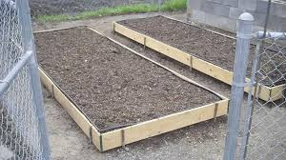
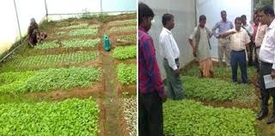
Raised Nursery Beds

Slide 16
Flat Nursery Beds:
Developed in those areas where rainfall is not so heavy and field is well levelled and drained
Ridges are made around each bed.
Inside each bed, surface is levelled and stones, stumps are picked up.
Finally soil is prepared and seeds are sown in lines across the width of bed in lines.
Advantages are:
Easy to prepare
Cost of operation is less
Disadvantages are:
More chances of getting extra irrigation water.
Soil become compact and result in root pruning when seedlings are uprooted

Slide 17
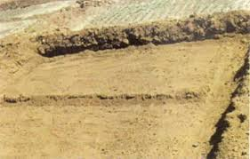
Flat Nursery Bed

Slide 18
5. Manures and Fertilizers
Generally, seedlings are quick growing and therefore, need readily available nutrients.
Nitrogen helps in the proper development of seedlings and also protects them from certain diseases or physiological disorders. Nitrogen through urea spray @ 1 % is most beneficial.

Slide 19
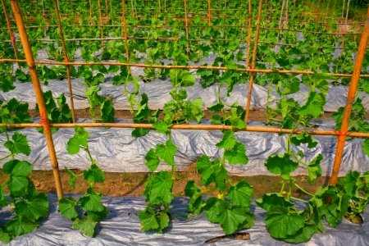
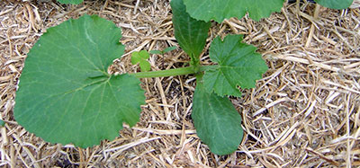
6. Mulching
To conserve soil moisture
a thin layer of manure or leaves or straws or dry grasses and polyethylene is used to cover the soil.
It suppresses weed growth
Protect seed from birds.
It is removed carefully with the emergence of plumule.

Slide 20
7. Irrigation
Watering is done at frequent intervals.
Uniform supply of water is desirable
Excessive watering should be avoided
8. Thinning
This is an essential operation in which weak and diseased seedlings are removed.
It avoids crowding, so allowing better growth to seedlings.
9. Weeding
Removal of weeds
It should be done very carefully to avoid damage to actual seedlings

Slide 21
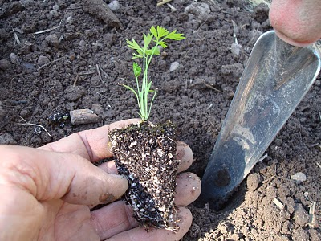
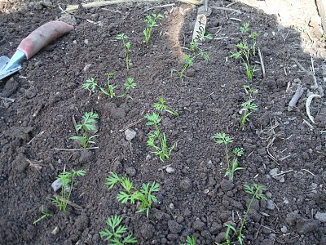
Transplanting
A process in which seedlings or rooted cuttings of vegetable crops are planted from one place to another, usually on permanent site where they grow, produce flowers and fruits.

Slide 22
Advantages:
There is an economic use of land and seed.
It is easy to raise seedlings on small area.
Transplanting materials like seedlings, rooted cuttings can be grown under controlled conditions even during off season.
Effective supervision can be provided.
Uniform plant stand can be achieved due to availability of healthy transplants.
Higher yield of vegetables is obtained.

Slide 23
Categories of vegetables according to their transplanting ability
Easy to transplant: Cabbage, cauliflower, tomato, lettuce, Brinjal
Transplanted with care: onion, leek, chilies, celery
Not transplanted: okra, beans, peas, turnips, fenugreek, spinach

Slide 24
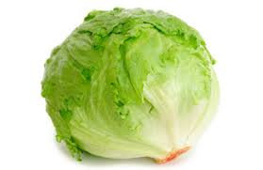
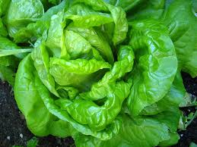
lettuce

Slide 25
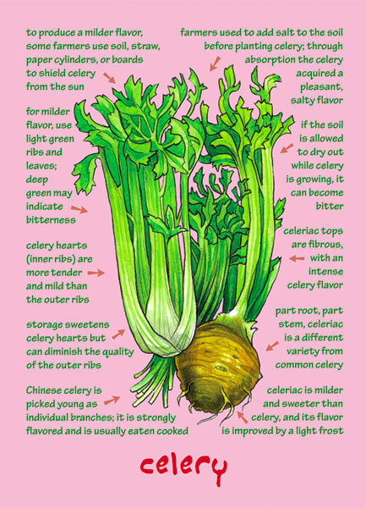
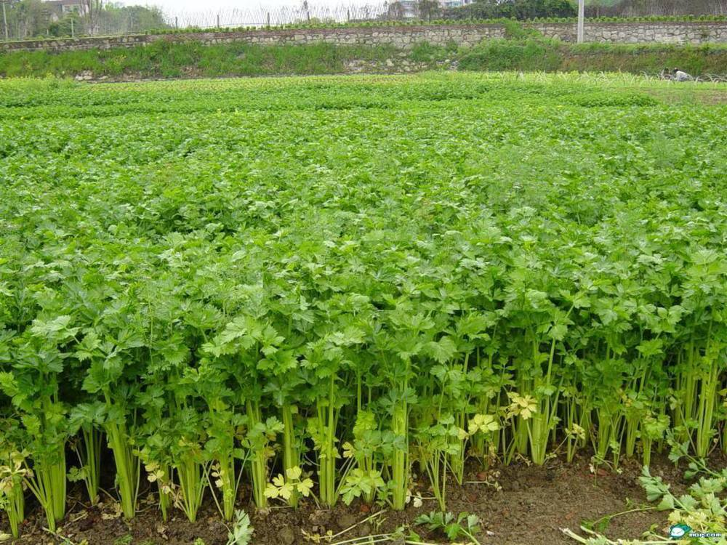
celery

Slide 26
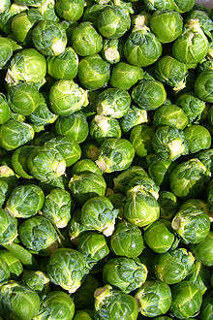
Brussels sprout

Slide 27
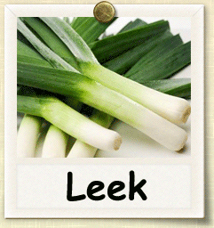
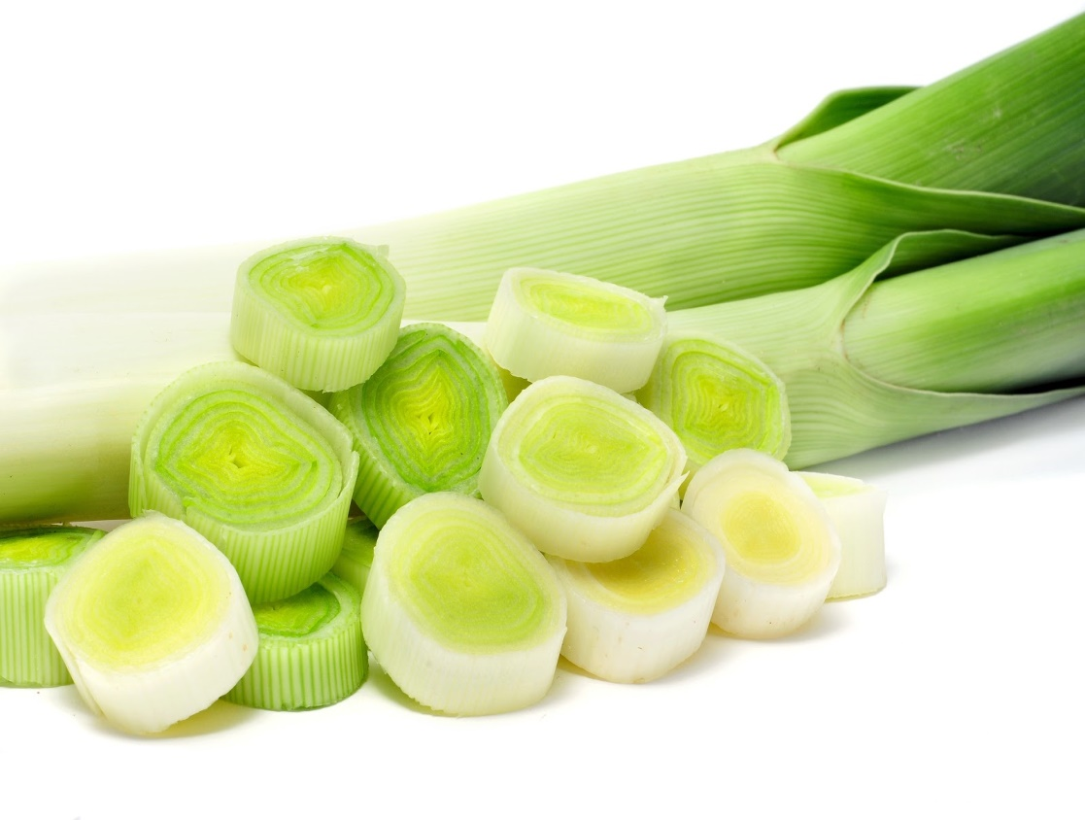
Leek

Slide 28
Selection of seedlings for transplanting
Seedlings should be stocky (thick) and sturdy (strong)
Seedlings should have attained proper age at the time of transplanting
They should have good root system
They should be free from any insect pests and diseases.
Seedlings should not be over-aged, as they show more rate of mortality.

Slide 29
Suitable age for seedlings transplanting
Crops | Age in Week
Brinjal | 3-4
Brussels sprout | 6-8
Cabbage | 4-6
Cauliflower | 3-4
Celery | 6-8
Chilies | 3-4
Onion | 6-8
Tomato | 3-4

Slide 30
Precautions in transplanting
The nursery bed should be lightly irrigated 24 hours before uprooting of seedlings to avoid root injury.
Transplanting should be performed in the afternoon, avoiding period of high temperature.
Sufficient soil moisture is essential at the time of transplanting
Depth of transplanting should be enough to accommodate root system.
Seedlings should be planted in position and pressed gently around the base so that air pockets are removed from root zone.
Stalking should be done, where needed.

Slide 31
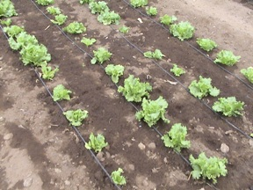
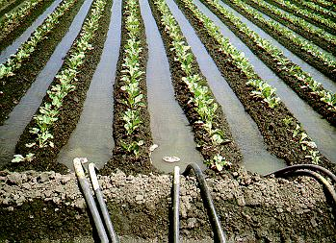
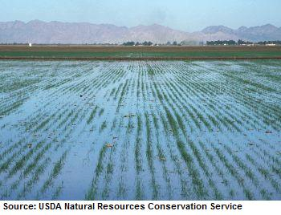
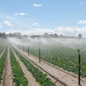
Irrigation Methods
Drip irrigation
Furrow irrigation
Sprinkler irrigation
Flood irrigation

Slide 32
Fertilizer Application
Broadcast method: fertilizer is spread uniformly on the soil surface and later ploughed in. this method raises the general fertility of the soil.
Banding: fertilizers are banded with the seed to provide immediate contact with the emerging roots. Banding besides the seed is generally done at a distance of 5cm from the seed.
Fertigation: fertilizers are applied through irrigation water.
Foliar spray: fertilizers are applied through foliar sprays. The sprayed elements are readily absorbed through stomata.

Slide 33
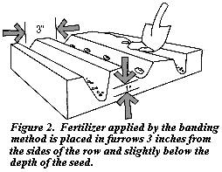
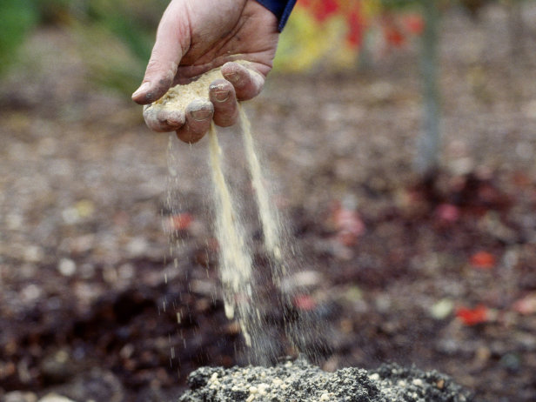
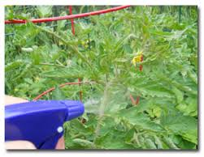
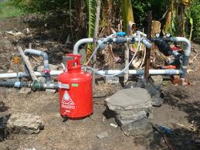
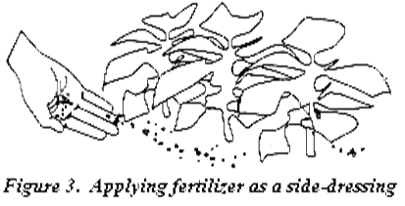
Banding
Broadcast method
Foliar application
Fertigation

Slide 34
Harvesting
Collection of produce from the plant at their proper maturity stage is termed as harvesting.
Mostly it is done by manually.
Produce must be harvested at optimum maturity as quality cannot be improved after harvest.
Harvest at the cooler times of the day.
Do not harvest during or just after rain as wet conditions favor disease development.
Carefully harvest the produce to minimize injury.
Harvesting should be done keeping in view the market locality and demand, transportation facilities.

