Slide 1
Chapter-3
Supervision and Inspection
By: Dr Nadeem Anwar
Department of Education, SU

Slide 2
Definitions
Supervision is a Latin Word. Super means ‘from the above’ and vision means ‘to see’. In ordinary sense of the term, supervision means overseeing the activities of others.
It is the process through which overseeing the subordinates at work with authority and with an aim to guide the employees, if he is doing wrong.”
Supervision is a way of ensuring and improving staff competence and effectiveness through observation, discussion, guidance & support and on-the-job training.
Notes:
An inspection is a task or assessment of fault-finding and fact-finding in many job settings.

Slide 3
A process by which one worker is given responsibility by the organisation to work with another worker(s) in order to meet certain organisational, professional and personal objectives which together promote the best outcomes for service users.’

Slide 4
Educational Supervision
Educational supervision is a process which aims to support, assure and develop the knowledge, skills and values of the teachers and learners.
Educational supervision is the positive, democratic action taken by school administrators in providing leadership of all educational workers in the development of a better learning situation for the individuals involved.

Slide 5
Educational Supervision
According to Adams and Dickey, “Supervision is a planned programme for the improvement.” It exists in their opinion for one reason only to improve teaching and learning. So it is mainly concerned with “development of teachers and pupils.”
The dictionary of education defines supervision as “all efforts of designed schools towards providing leadership to teachers and other educational workers in the improvement of instruction ; involves the stimulation of professional growth and development of teachers, the selection and revision of educational objectives, materials on instruction and methods of teaching and the evaluation of instruction.” Here the word “supervision” means to guide and stimulate the activities of teachers with a view to improve them, i.e., teaching as well as instruction and promoting professional growth.

Slide 6
Educational Supervision
Supervision is a creative and dynamic process giving friendly guidance and direction to teachers and pupils for improving themselves and the teaching-learning situation for the accomplishment of the desired goals of education.
Educational Supervision means an all out effort of the school officials directed towards providing leadership to teachers and other educational workers for the improvement of institution. It involves both human and material elements.
The human elements are the pupils, parents, teachers and other employees, the community and other educational.
On the material side money, building, equipment, playgrounds etc. are included. Besides these, the curriculum, methods and techniques of teaching also come under the scope of supervision.

Slide 7
Activities: Educational Supervision
Judgment concerning the competence of teachers:
1. The subject matter taught.
2. The methods of teaching utilized.
3. The evaluation of student achievement.
4. Student relationships.
5. Relationships with fellow teachers.
6. Professional development.
7. Community living.

Slide 8
Features of Supervision
Supervision is a creative and dynamic expert technical service.
It provides leadership with expert knowledge and superior skills.
It gives coordination, direction and guidance to teacher’s activities.
It stimulates the continuous growth of teachers and development of pupils.
It improves instruction and the teaching-learning process.

Slide 9
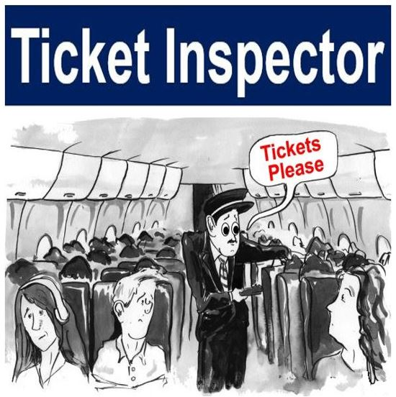
It came from Old French Inspeccion, meaning ‘examination, which became Inspection in Modern French.
The French word came from Latin Inspectionem which meas ‘ to observe, to look at, to view, to examine, to look into.’

Slide 10
An inspection involves checking something, i.e., examining and assessing something. We may inspect a building or organization to make sure that it meets specific standards. The inspectors need to ensure that nothing is faulty and that nobody is breaking any laws. They also have to make sure that whatever they are inspecting is safe.
It is the critical appraisal of materials, items, or systems involving examination, testing, and gauging. Inspectors take measurements and make comparisons. Inspections are formal evaluations or organized examination exercises.
The inspectors determine whether the item or material is in proper condition and of the right quantity.

Slide 11
Educational Inspection
Education inspectors evaluate schools to ensure that specific standards in teaching, learning, financial management and organisation are being achieved and maintained.
The dictionary of education defines supervision as “all efforts of designed schools towards providing leadership to teachers and other educational workers in the improvement of instruction ; involves the stimulation of professional growth and development of teachers, the selection and revision of educational objectives, materials on instruction and methods of teaching and the evaluation of instruction.” Here the word “supervision” means to guide and stimulate the activities of teachers with a view to improve them, i.e., teaching as well as instruction and promoting professional growth.

Slide 12
Activities: Educational Inspection
In education settings it deals with the
Observing lessons.
Talking with teachers and pupils.
Assessing school organisation.
Checking pupils’ work.
Looking school record.
Teaching & Learning Environment.
Examine the use and maintain of Learning material

Slide 13
Thank you

