Slide 1
LIS-636 & 411 Knowledge Management
Taught by: Dr. Haroon Idrees
To: MLIS 4th & BS LIS 8th Semester
DLIS, UOS
Presentation 3

Slide 2
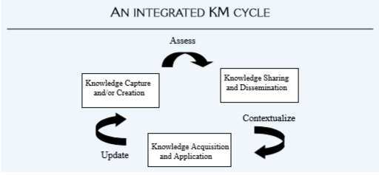
KM Cycle….. Cont.

Slide 3
KM System Life Cycle
Evaluate existing infrastructure.
Form the KM team.
Knowledge capture.
Design KM blueprint.
Verify and validate the KM system.
Implement the KM system.
Manage change and reward structures.
Postsystem evaluation.

Slide 4
Challenges in Building KM Systems
Culture
Knowledge evaluation
Knowledge processing
Knowledge implementing

Slide 5
KM Team
Champion
Knowledge Developer
Knowledge Worker
Knower

Slide 6
Knowledge Team Role of the champion
A champion is someone in an organization who, because of position, power, influence or control, secures the organization’s support for new system from inception to deployment.

Slide 7
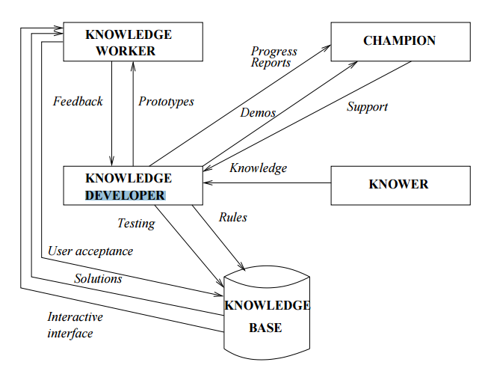
Knowledge Developer

Slide 8
Knowledge Team Knowledge Worker
A knowledge worker is someone who uses IT in conducting day-to-day business and one that has direct impact on the efficiency and productivity of the job and the work process(Awad 1996).
Knowledge workers are people who use their heads more than their hand to produce value(horbie 1999).

Slide 9
Knowledge Team Knowledge Worker’s Attributes
Adopt the culture of the organization.
Align personal and professional growth.
Attitude of collaboration and sharing.
Creative minded.
Innovative capacity.

Slide 10
Knowledge Team Knowledge Worker’s Attributes
Willing to adopt new ways.
Clear understanding of the business.
Self-control.
Self-learning.
Willing to tolerate the uncertainties.

Slide 11
Knowledge Management Models
Nonaka’s Four Modes of Knowledge Conversion
Nonaka and Takeuchi (1995)
Emphasis on:
Tacit knowledge.
Explicit knowledge
SECI

Slide 12
KM Models… Nonaka and Takeuchi (1995)… K. Spiral

Slide 13
KM Models… Nonaka and Takeuchi (1995)… K. Spiral…

Slide 14
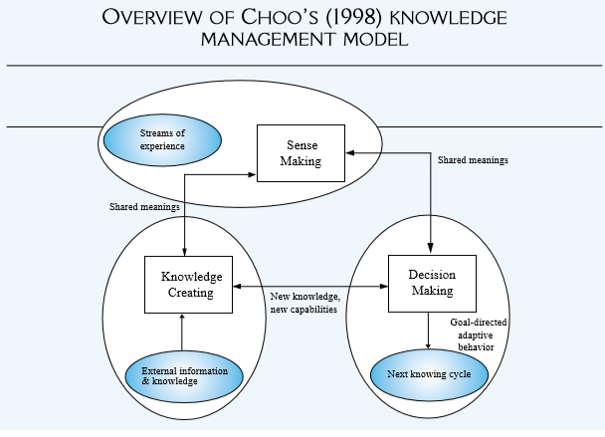
KM Models…Choo (1998)… Sense Making External environment / information stimulus / trigger
Notes:
Choo, C. [Chun Wei Choo] (1998). The knowing organization. New York: Oxford University Press.

Slide 15
KM Models…Choo (1998)… Sense Making….Cont.
Sense Making in organizations consists of four integrated processes:
(1) ecological change
(2) enactment
(3) selection and
(4) retention.
Ecological change is a change in the environment that is external to the organization—one that disturbs the ﬂow of information to participants— and triggers an ecological (environmental) change in the organization. Organizational actors enact their environment . People try to construct, rearrange, single out, or demolish speciﬁc elements of content. Many of the objective features of their environment are made less random and more orderly through the creation of their own constraints or rules.

Slide 16
KM Models…Choo (1998)… Sense Making….Cont.
Enactment clariﬁes the content and issues to be used for the subsequent selection process.
Selection and retention are the phases in which individuals attempt to interpret the rationale for the observed and enacted changes by making selections. The retention process in turn furnishes the organization with an organizational memory of successful sense-making experiences. This memory can be reused in the future to interpret new changes and to stabilize individual interpretations into a coherent organizational view of events and actions. These phases also serve to reduce any uncertainty and ambiguity associated with unclear, poorly defined information

Slide 17
Role of KM in Library and Information Centers
Storing, indexing, and dissemination of the knowledge using people, process, and technology in such a way that library could fulfill the mission of the parent organization in term of user’s satisfaction.

Slide 18
Role of KM in Library and Information Centers
Involves organizing and providing access to tangible and intangible resources that help librarians carry out their tasks more effectively and efficiently.
KM in libraries is the combination of different processes such as acquisition of knowledge from different sources and classification.

Slide 19
KNOWLEDGE CAPTURE & CODIFICATION

Slide 21
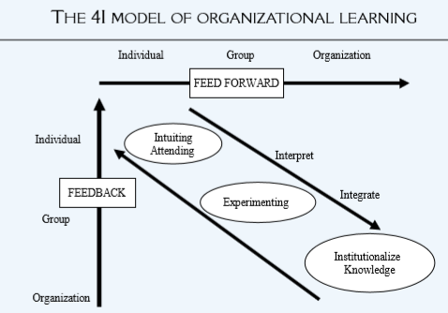
KNOWLEDGE ACQUISITION/CAPTURE & LEARNING
Learning of individuals & organizations: a debate
Crossan’s 4-I model OF ORGANIZATIONAL LEARNING
Zietsma et al.’s attending & experimenting

Slide 22
Knowledge Capture (KC) at Individual and Group Level
Analyzing information and knowledge ﬂow.
Working with experts to obtain information.
Designing and implementing an expert system.
Parsaye (1988)
Interviewing experts.
Learning by being told.
Learning by observation.

Slide 23
KC at Individual and Group Level…. Tacit Knowledge Capture
Interviewing Experts
Structured Interviewing
Semi-Structured Interviewing
Unstructured Interviewing
Techniques
Starting Questions
Core Questions
Clarifying
Summarizing
Reﬂecting feelings

Slide 24
KC at Individual and Group Level…. Tacit Knowledge Capture
Stories: Important Principles
The explicit story should be relatively brief and detailed just enough that the audience can understand it.
The story must be intelligible to the speciﬁc audience so that they are “hooked.”
The story should be inherently interesting.
The story should spring the listener to a new level of understanding.
The story should have a happy ending.
The story should embody the change message.
The change message should be implicit.
The listeners should be encouraged to identify with the protagonist (hero)
The story should deal with a speciﬁc individual or organization.
The protagonist should be prototypical of the organization’s main business.
Other things being equal, true is better than invented.
One should test, test, and test again.
Notes:
Protagonist: central character

Slide 25
KC at Individual and Group Level…. Some Other Methods of Tacit Knowledge Capture
Ad hoc sessions.
Road maps.
Learning histories.
Action learning.
E-learning.
Learning from others through business guest speakers and benchmarking against best practices.

Slide 26
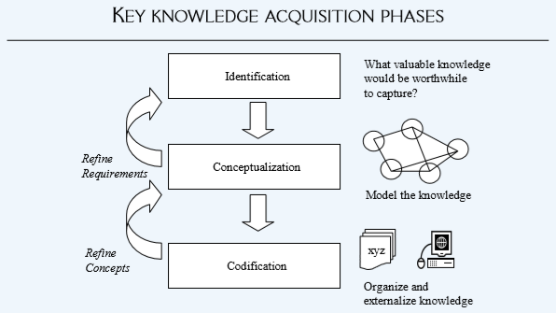
Knowledge Acquisition Phases

Slide 27
Tacit Knowledge Capture at the Organizational Level
More macro level
Grafting: migration of knowledge between ﬁrms
Vicarious learning: one ﬁrm observing other ﬁrms’ demonstrations of techniques or procedures
Experiential learning: learning curve to establish routines and procedures (tacit, but convertible through codification and documentation)
Inferential processes. interpretation of events, states, changes, and outcomes relative to the activities undertaken and decisions made.
(Malhotra, 2000)
Notes:
Grafting: Attaching
Vicarious : Secondhand

Slide 28
Knowledge Codification Quality: Important Considerations
Accuracy
Readability/Understandability
Accessibility
Currency
Authority/ Credibility

Slide 29
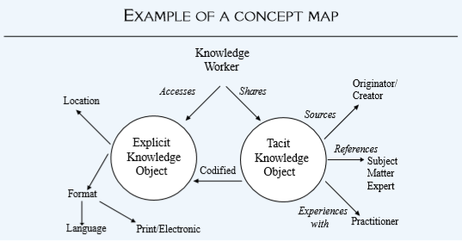
Knowledge Codification
Cognitive Maps: Mental Maps based on concept mapping

Slide 30
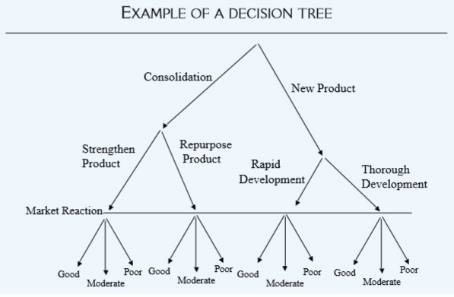
Knowledge Codification
Decision Trees: The decision tree is typically in the form of a ﬂowchart, with alternate paths indicating the impact of different decisions being made.

Slide 31
Knowledge Codification
Knowledge Taxonomies:
concepts that have been identiﬁed and captured and arranged in a hierarchy
Taxonomies are basic classiﬁcation systems that enable us to describe concepts and their dependencies
An important concept that underlies taxonomies is the notion of inheritance. Each node is a subgroup of the node above it
Example of Taxonomies: DDC Hierarchy of Knowledge

