Slide 1
HANDLING VIDEOS
Multimedia system & design

Slide 2
Video Concept
Video is an excellent tool for delivering multimedia.
Video places the highest performance demand on computer and its memory and storage.
Digital video has replaced analog video as the method of choice for making and delivering video for multimedia.
motion
a sequence of pictures
frames

Slide 3
Analogue Video
Video information that is stored using television video signals, film, videotape or other non-computer media
Each frame is represented by a fluctuating voltage signal known as an analogue wave form or composite video
Composite analogue video has all the video components:
brightness, color and synchronization
Then combined into one signal for delivery Example : traditional television signal

Slide 4
Video Display
Progressive scan: is a way of displaying, storing, or transmitting moving images in which all the lines of each frame are drawn in sequence.
used in computer monitors and digital televisions.
displays all the horizontal lines of a picture at one time as a single frame.
Interlaced scan: (used in standard television formats) - displays only half of the horizontal lines at a time (the first field, containing the odd-numbered lines, is displayed, followed by the second field, containing the even-numbered lines)
So in this scan only half the number of actual image frames are used to produce video. The system was originally known as "sequential scanning" when it was used in the Baird 240 line television transmissions from Alexandra Palace, United Kingdom in 1936.

Slide 5
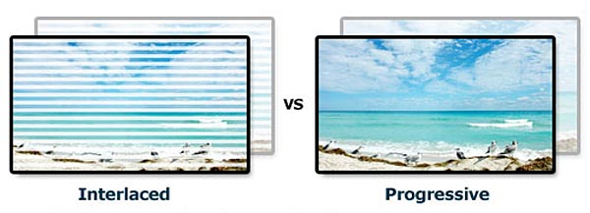
Advantage/Drawbacks
Main advantage with progressive scan is that motion appears smoother and more realistic
There is an absence of visual artifacts associated with interlaced video of the same line rate

Slide 6
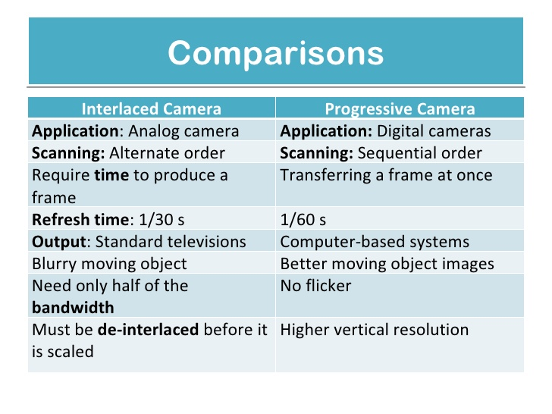

Slide 7
Broadcast Video signal/Standards

Slide 8
Ntsc - National Television Standards Committee
Standards for coding information into an electronic signal, to make a TV picture
US, Japan has developed in 1941 and had no provision for color
It has screen resolution of 525 horizontal scan lines and a scan rate of 30 frames per second.
In 1953 a second NTSC standard was adopted, which allowed for color television broadcasting which was compatible with the existing stock of black-and-white receivers.

Slide 9
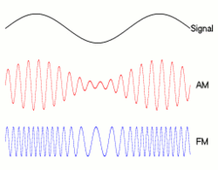
Amplitude modulation: Amplitude modulation is a modulation technique used in electronic communication, most commonly for transmitting information via a radio carrier wave.
In amplitude modulation, the amplitude (signal strength) of the carrier wave is varied in proportion to that of the message signal being transmitted.
Frame of video: 525 vertical scan lines 30 frames per second
Two passes drawing (Interlacing)
Odd-numbered lines
followed by even-numbered
Fig 1: An audio signal (top) may be carried
by a carrier signal using AM or FM methods

Slide 10
PAL, SECAM
Phase Alternate Line (PAL) and Sequential Color and Memory (SECAM):
Phase Alternate Line - is a color encoding system for analogue television
Europe, Australia, South Africa
625 scan lines
25 frames per second
Odd/even line interlacing
Amplitude modulation
SECAM: Sequential Color and Memory
France, Russia
Also 625-line, 25 frames per sec, interlaced
Frequency modulation

Slide 11
HDTV
High Definition Television
Advanced Television Systems Committee
Six video formats (resolution & frame rate combinations)
16:9 aspect ratio (width : height ratio) – widescreen format, 720p
1080 x 1920-pixels or 720 x 1280-pixels – 1080p
1080i (1920×1080i: 1,036,800 pixels)
24, 30, 60 frames/sec

Slide 12
Frame Rates of Different Broadcast Standards
Video Type | Frame Rate (frames per second)
NTSC (black-and-white) | 30
NTSC (color) | 29.97
PAL | 25
SECAM | 25
Motion-picture film | 24

Slide 13
Comparison – broadcast standards

Slide 14
Digitizing Video
Digital video combines features of graphics and audio to create dynamic content for multimedia products.
Video is simply moving pictures.
Digitized video can be edited more easily and are extremely large
A video source (video camera, VCR, TV or videodisc) is connected to a video capture card in a computer.
As the video source is played, the analog signal is sent to the video card and converted into a digital file (including sound from the video).

Slide 15
Sampling and Quantization of Motion
Temporal:
sampling rate:
how frequent you take a snapshot of the motion
frame rate
higher sampling rate: higher frame rate
higher frame rate ⇒ more frames for the same duration ⇒ larger file size

Slide 16
Sampling and Quantization of Motion
Each snapshot: a frame
an image
digitized based on the same concepts of sampling and quantization of images
Frame Size
Resolution of the frame image
Measured in pixel dimensions
No ppi setting: Unlike digital images, there is no pixel per inch (ppi) setting for video because video is not intended for print but for on screen display.

Slide 17
Frame Size - Examples
 |  | Frame size
NTSC | standard definition | 720 x 480 pixels
HDTV | high definition HDV format | 1280 x 720 pixels 1440 x 1080 pixels
PAL | standard definition | 720 x 576 pixels

Slide 18
Frame Aspect Ratio
the ratio of a frame's viewing width to height
NOT equivalent to ratio of the frame’s pixel width to height.
16:9
4:3
Examples:
Standard definition NTSC wide-screen format
High definition digital video
High definition TV
Example:
Standard definition NTSC standard format

Slide 19
Frame Size (Resolution) Comparison between Standard Definition and High Definition
By viewing frame size

Slide 20
File Size and Formats
Color depth
Frame rate
Image size

Slide 21
File Size and Formats
Frame Rate
animation is an illusion caused by the rapid display of still images
Frame rate (expressed in frames per second or fps) is the frequency (rate) at which consecutive images called frames appear on a display. The term applies equally to film and video cameras, computer graphics, and motion capture systems.
television and movies play at 30 fps but acceptable
playback can be achieved with 15 fps.

Slide 22
File Size and Formats
Image Size
A standard full screen resolution is 640x480 pixels but to safe storing space a video with 320x240 for a computer display is still acceptable.
New high-definition televisions (HDTV) are capable of resolutions up to 1920×1080p, 60
1920 pixels per scan line by 1080 scan lines, progressive, at 60 frames per second.

Slide 23
File Size and Formats
Color Depth
The quality of video is dependent on the color quality (related to the number of colors) for each bitmap in the frame sequence.

Slide 24
File Size and Formats
Color Depth
The color depth below 256 colors is poorer-quality image. The frame rate to below 15 fps causes a noticeable and distracting jerkiness that unacceptable.
Changing the image size and compressing the file therefore become primary ways of reducing file size.
24 bit
16 bit
8 bit (256 colors)

Slide 25
Common Video File Types
File Type | Acronym For | Originally Created By | File Info & Compression | Platforms
.mov | QuickTime movie | Apple | Also audio-only Can be streamed "Fast start" Common compression methods: H.264, Sorenson Video, Animation | Apple QuickTime player, which is available for Mac and Windows
.avi | Audio Video Interleave | Intel | Common compression methods: Microsoft RLE, Intel Indeo Video | Primarily used on Windows but Apple QuickTime player can play AVI files
.mpg .mpeg | MPEG | Motion Picture Experts Group | For DVD-video High definition HDV | Cross-platform
.divx |  | DivX, Inc | Uses DivX codec, which is based on MPEG-4 Popular format for movies because of the high image quality and small file size AVI is a common container file format | May require downloading DivX codec Windows Media Player v11.0 comes with DivX codec

Slide 26
Common Video File Types
File Type | Acronym For | Originally Created By | File Info & Compression | Platforms
.mp4 | MPEG-4 | Moving Pictures Experts Group | Video codec: H.264 Audio codec: AAC One of the HTML5 video formats | Plays in Web browsers that support the MP4 format of HTML5 video (Safari and IE)
.ogg or .ogv | Audio Video Interleave | Xiph.Org Foundation | Video codec: Theora Audio codec: Vorbis One of the HTML5 video formats Compared to the other two HTML5 video formats, it has lower quality for the same file size | Plays in Web browsers that support the OGG format of HTML5 video (Firefox, Chrome, Opera)
.webm |  | An open source video format from Google | Video codec: VP8 Audio codec: Vorbis One of the HTML5 video formats | Plays in Web browsers that support the WebM format of HTML5 video (Firefox, Chrome, Opera)

Slide 27
Common Video File Types
File Type | Acronym For | Originally Created By | File Info & Compression | Platforms
.flv | Flash Video | Adobe | Progressive download Can be streamed Common compression methods: H.264, Sorenson Spark, On2 VP6 | Cross-platform Requires Adobe Media Player to play
.f4v | Flash Video | Adobe | Builds on MPEG-4 Part 12 Supports H.264/ACC-based content | A newer Flash Video format than flv Cross-platform Requires Adobe Media Player to play Can be embedded in Flash SWF files
.wmv | Windows Media | Microsoft |  | Requires Windows Media Player to play

Slide 28
Video Editing Terminology
Linear
Linear video editing is a video editing post-production process of selecting, arranging and modifying images and sound in a predetermined, ordered sequence.
It plays end to end in one direction, usually relates to videotape editing specifically the editing of linear tape segments into one final master tape.

Slide 29
Video Editing Terminology
Non-linear
Refers to the editing of disk-based digital video.
The software provides an on screen map of what the final video sequences should look like incorporating the edits, splices, special effects, transitions and sound tracks.
With a computer, you can shift the order of clips around, change durations, etc, all out of order.

Slide 30
Special Effects
Transitions
– Such as fading, wiping, splatters, scrolling, stipple and many more are available by simply dragging and dropping that transition between the two video clips.

Slide 31
Special Effects
CHROMA KEY
The ability to superimpose one clip over another is a valuable technique.
The technique of green screening is identical except that the color green is used for the screen and later digitally removed.
The blue screen and green screen superimposing are just two of the superimposing technique available.

Slide 32
Green/blue screen

Slide 33
Video Editing Software
Incorporating transitions such as dissolves, wipes and spin.
Superimposing titles and animating them, such as fly-in logo.
Applying special effects to various images, such as twisting, zooming, rotating and distorting.
Synchronizing sound with the video.
Apply filters that control color balance, brightness & contrast, blurring, distortions and morphing.
Adobe Premiere Pro
Corel Video Studio
Pinnacle Studio
Macromedia Flash

